Slide 1

Computer Vision & Convolutional Neural Networks
with

Slide 2

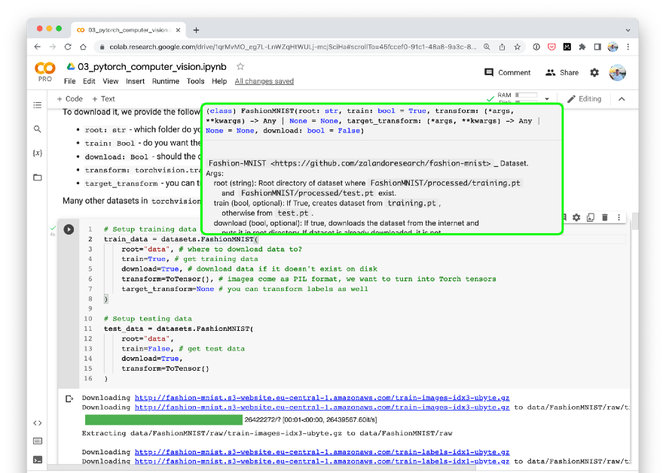



Where can you get help?
“If in doubt, run the code”
Follow along with the code
Try it for yourself
Press SHIFT + CMD + SPACE to read the docstring
Search for it
Try again
Ask
https://www.github.com/mrdbourke/pytorch-deep-learning/discussions

Slide 3
“What is a computer vision problem?”

Slide 4
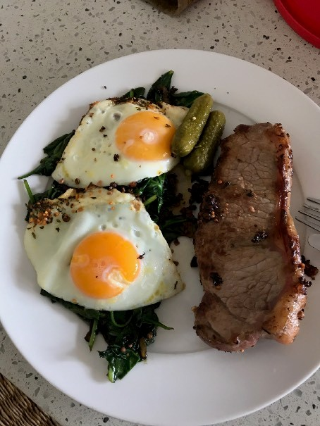
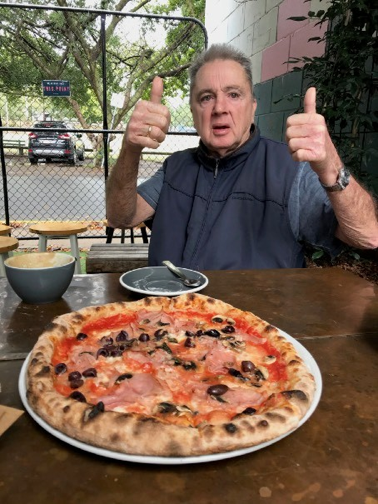
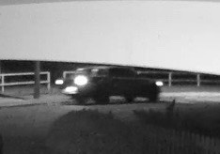
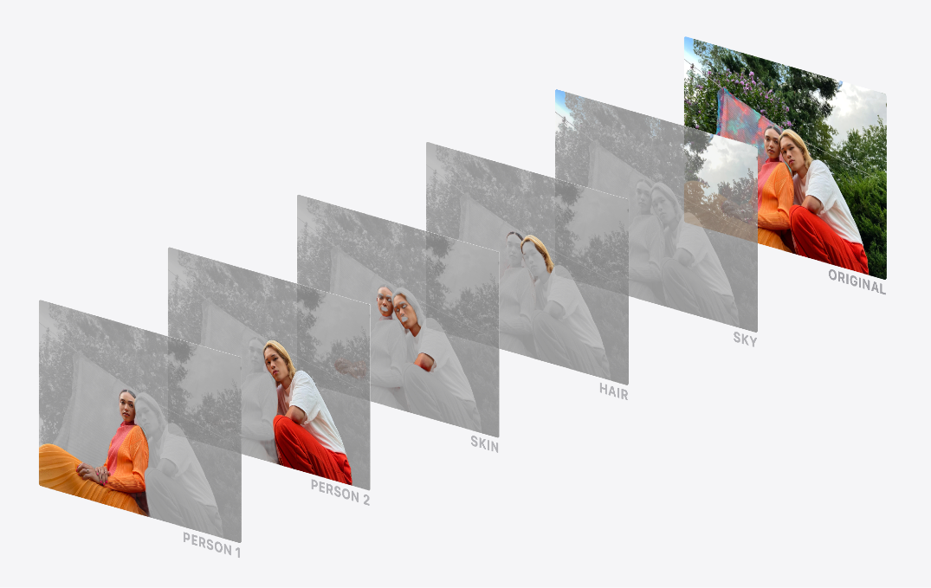
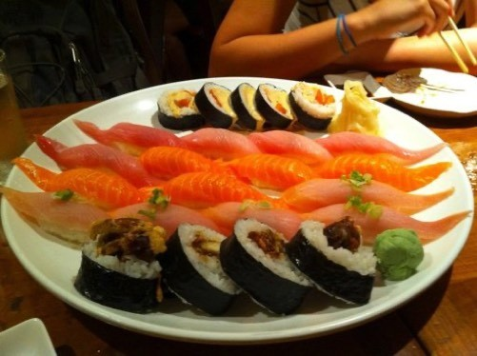
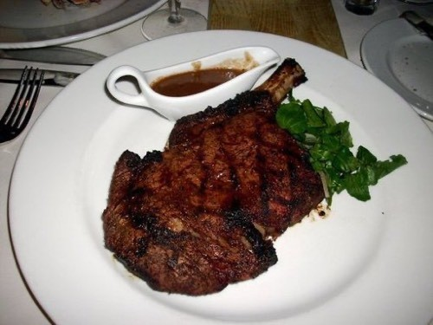
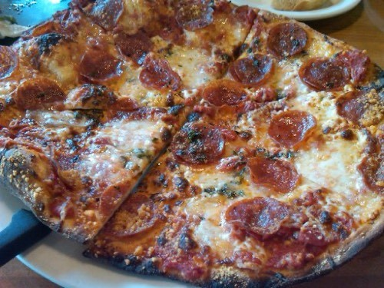
Example computer vision problems
“Is this a photo of steak or pizza?” “Where’s the thing we’re looking for?”
Binary classification
Object detection
“What are the different sections in this image?”
(one thing or another)
“Is this a photo of sushi, steak or pizza?”
Multiclass classification
(more than one thing or
Segmentation
Source: On-device Panoptic Segmentation for Camera Using Transformers.
another)

Slide 5
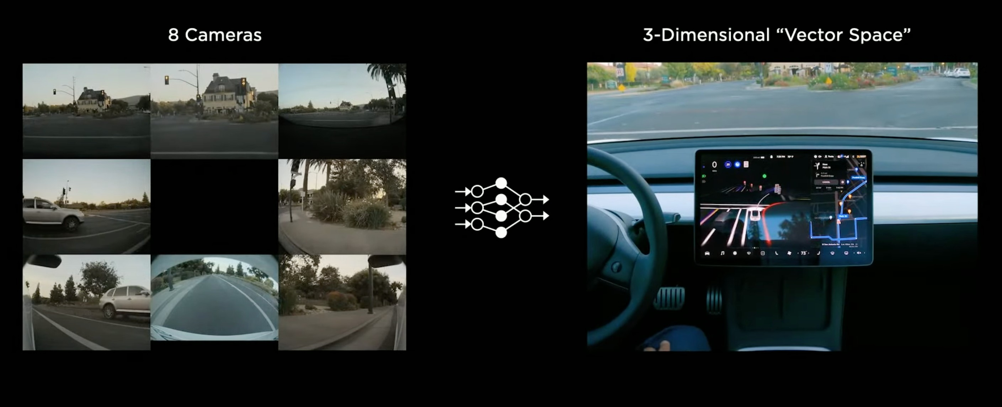
Tesla Computer Vision
Source: Tesla AI Day Video (49:49). PS see 2:01:31 of the same video for surprise ;)

Slide 6

Tesla Computer Vision
Source: AI Drivr YouTube channel.

Slide 7


What we’re going to cover
(broadly)
Getting a vision dataset to work with using torchvision.datasets
Architecture of a convolutional neural network (CNN) with PyTorch
An end-to-end multi-class image classification problem
Steps in modelling with CNNs in PyTorch
Creating a CNN model with PyTorch
Picking a loss and optimizer
Training a PyTorch computer vision model
Evaluating a model
How:
(we’ll be cooking up lots of code!)

Slide 8

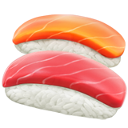
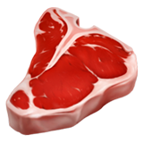

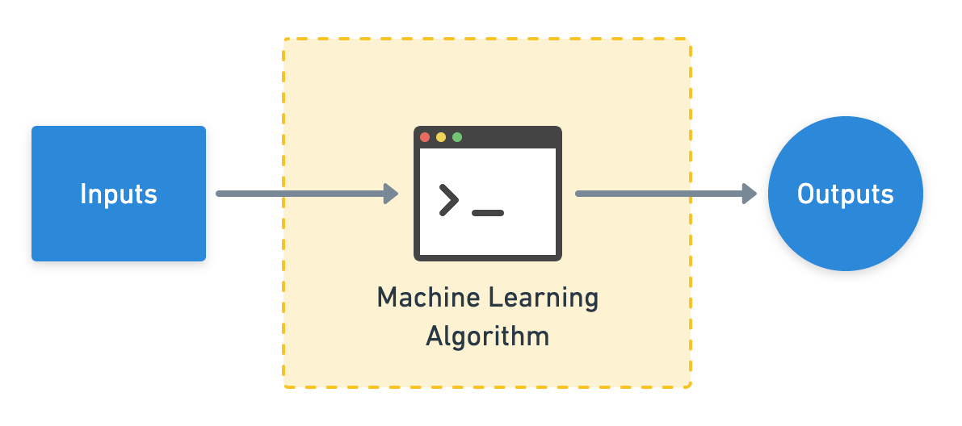


Computer vision inputs and outputs
224
W = 224
H = 224
C = 3
224
Sushi
Steak
Pizza
Actual output
(c = colour channels, R, G, B)
This is often a convolutional neural network (CNN)!
[[0.31, 0.62, 0.44…],
[[0.97, 0.00, 0.03],
[0.92, | 0.03, | 0.27…], | [0.81, | 0.14, | 0.05],
[0.25, | 0.78, | 0.07…], | [0.03, | 0.07, | 0.90],
…, |  |  | …,
(normalized pixel values)
Numerical encoding
Predicted output
(often already exists, if not,
(comes from looking at lots
you can build one)
of these)

Slide 9
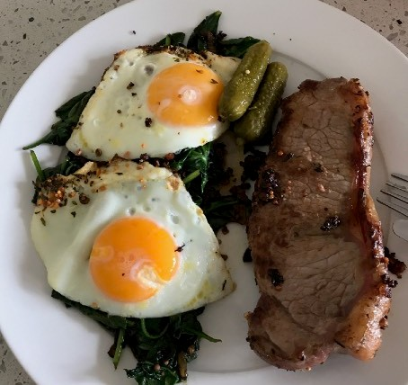
Input and output shapes
We’re going to be building CNNs to do this part!
(for an image classification example)
224
[[0.31, 0.62, 0.44…],
224
[0.92, 0.03, 0.27…],
[0.25, 0.78, 0.07…],
…,
[0.00, 0.97, 0.03]
(prediction probabilities)
(gets represented as a tensor)
[batch_size, width, height, colour_channels]
Shape = [3]
Shape = [None, 224, 224, 3]
or
Shape = [32, 224, 224, 3]
These will vary depending on the problem you’re working on.
(32 is a very common batch
size)

Slide 10
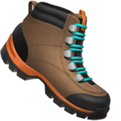

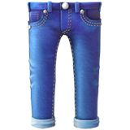
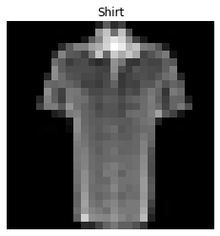
Input and output shapes
28
(gets represented as a tensor)
…
[[0.00, 0.62, 0.44…],
28
[0.00, 0.03, 0.27…],
[0.01, 0.78, 0.07…],
…,
[0.00, 0.97, …]
(prediction probabilities)
[batch_size, height, width, colour_channels] (NHWC)
or
[batch_size, colour_channels, height, width] (NCHW)
(colour channels last)
Shape = [10]
(colour channels first)
Shape = [None, 28, 28, 1] (NHWC)
Shape = [None, 1, 28, 28] (NCHW)
or
Shape = [32, 28, 28, 1]
These will vary depending on the problem you’re working on.
(32 is a very common batch size)

Slide 11
“What is a convolutional neural network (CNN)?”

Slide 12
Let’s code!

Slide 13
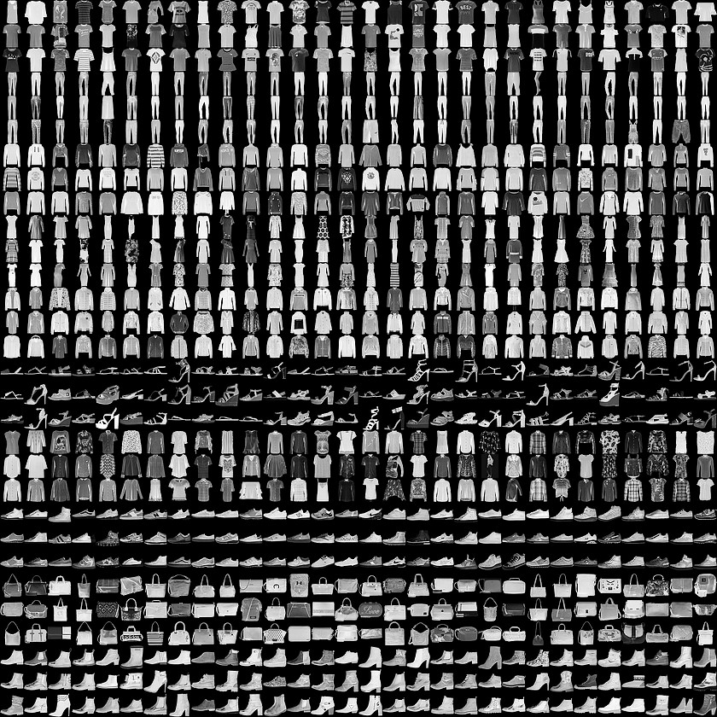
FashionMNIST
“What type of clothing is in this image?”
Multiclass classification
(more than one thing or
another)
torchvision.datasets.FashionMNIST

Slide 14
Input and output shapes
28
(gets represented as a tensor)
…
[[0.00, 0.62, 0.44…],
28
[0.00, 0.03, 0.27…],
[0.01, 0.78, 0.07…],
…,
[0.00, 0.97, …]
(prediction probabilities)
[batch_size, height, width, colour_channels] (NHWC)
or
[batch_size, colour_channels, height, width] (NCHW)
(colour channels last)
Shape = [10]
(colour channels first)
Shape = [None, 28, 28, 1] (NHWC)
Shape = [None, 1, 28, 28] (NCHW)
or
Shape = [32, 28, 28, 1]
These will vary depending on the problem you’re working on.
(32 is a very common batch size)

Slide 15
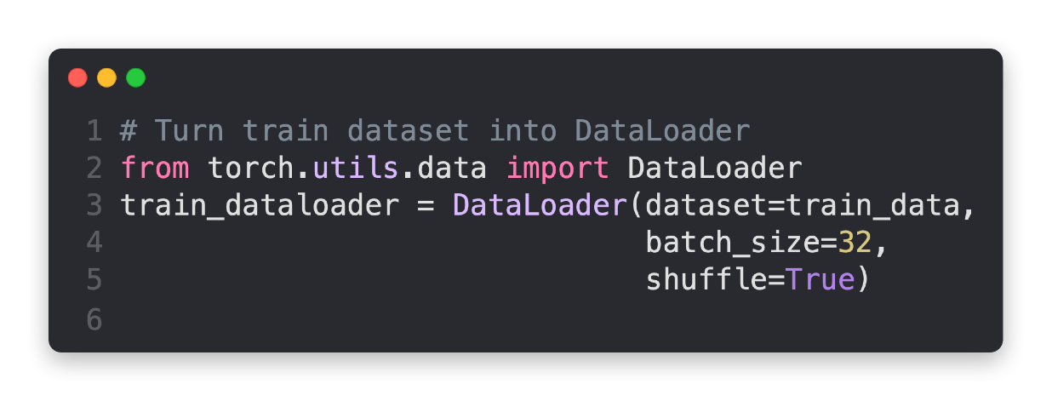
FashionMNIST: Batched
batch_size=32
(32 samples per batch)
Sample 0 1 2
3 4 5 32
Batch
0
…
1
…
2
…
torch.utils.data.DataLoader
…
3
4
…
torchvision.datasets.FashionMNIST
shuffle=True
(samples all mixed up)
Num samples/ batch_size
…

Slide 16
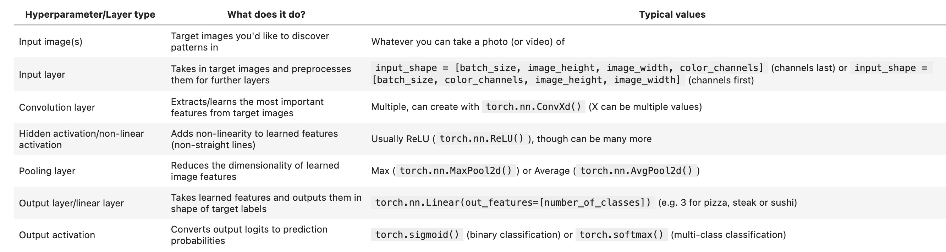
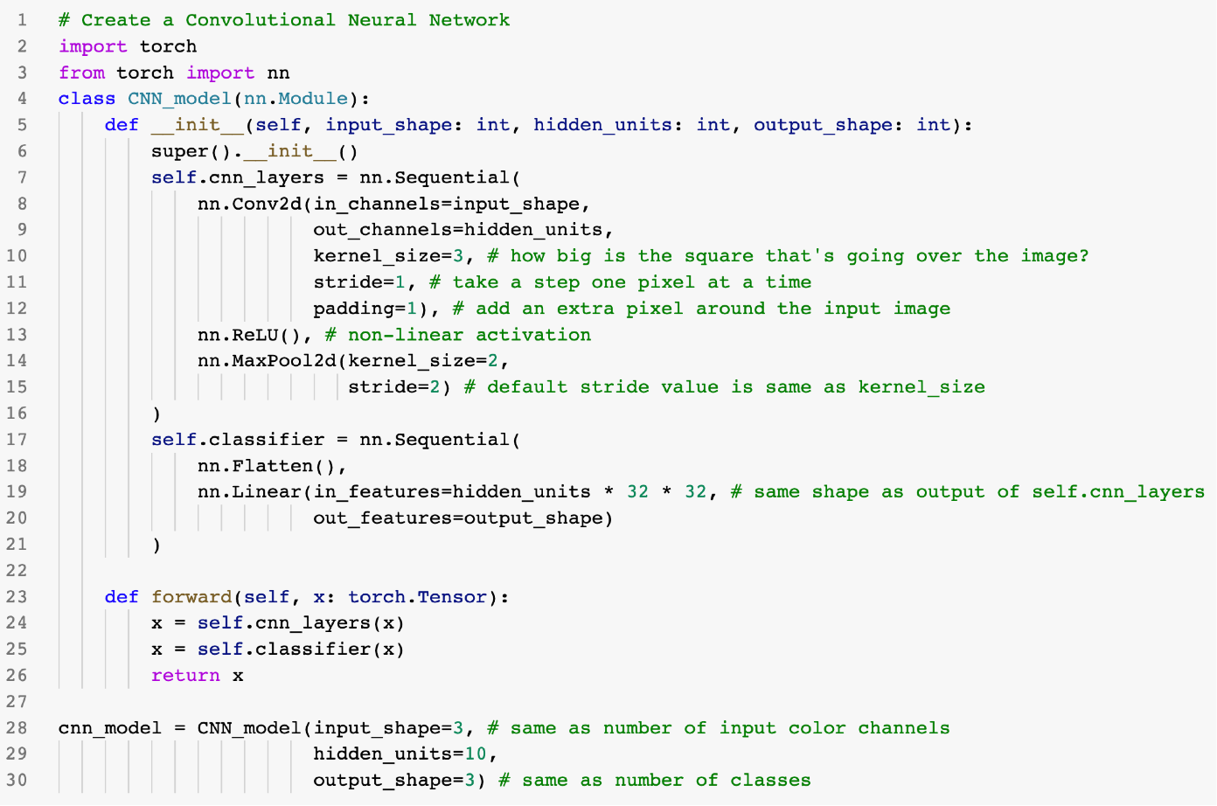
Architecture of a CNN
(typical)*
(what we’re working towards
building)
Steak
Pizza
Sushi
*Note: there are almost an unlimited amount of ways you could stack together a convolutional neural network, this slide demonstrates only one.

Slide 17
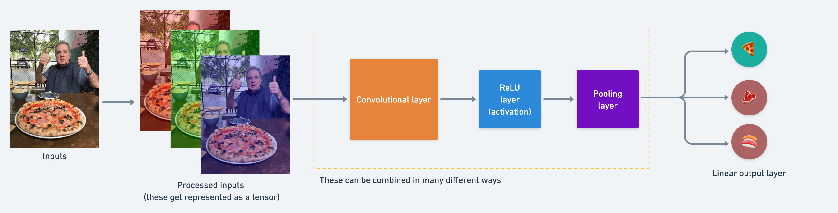
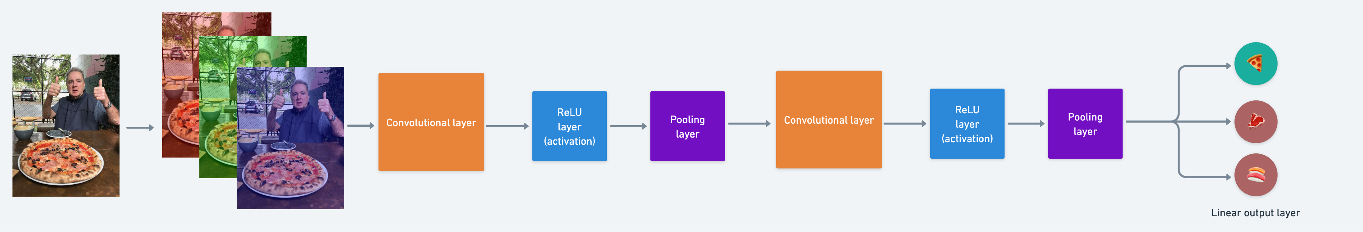
Typical architecture of a CNN
Simple CNN
(coloured block edition)
Deeper CNN

Slide 18
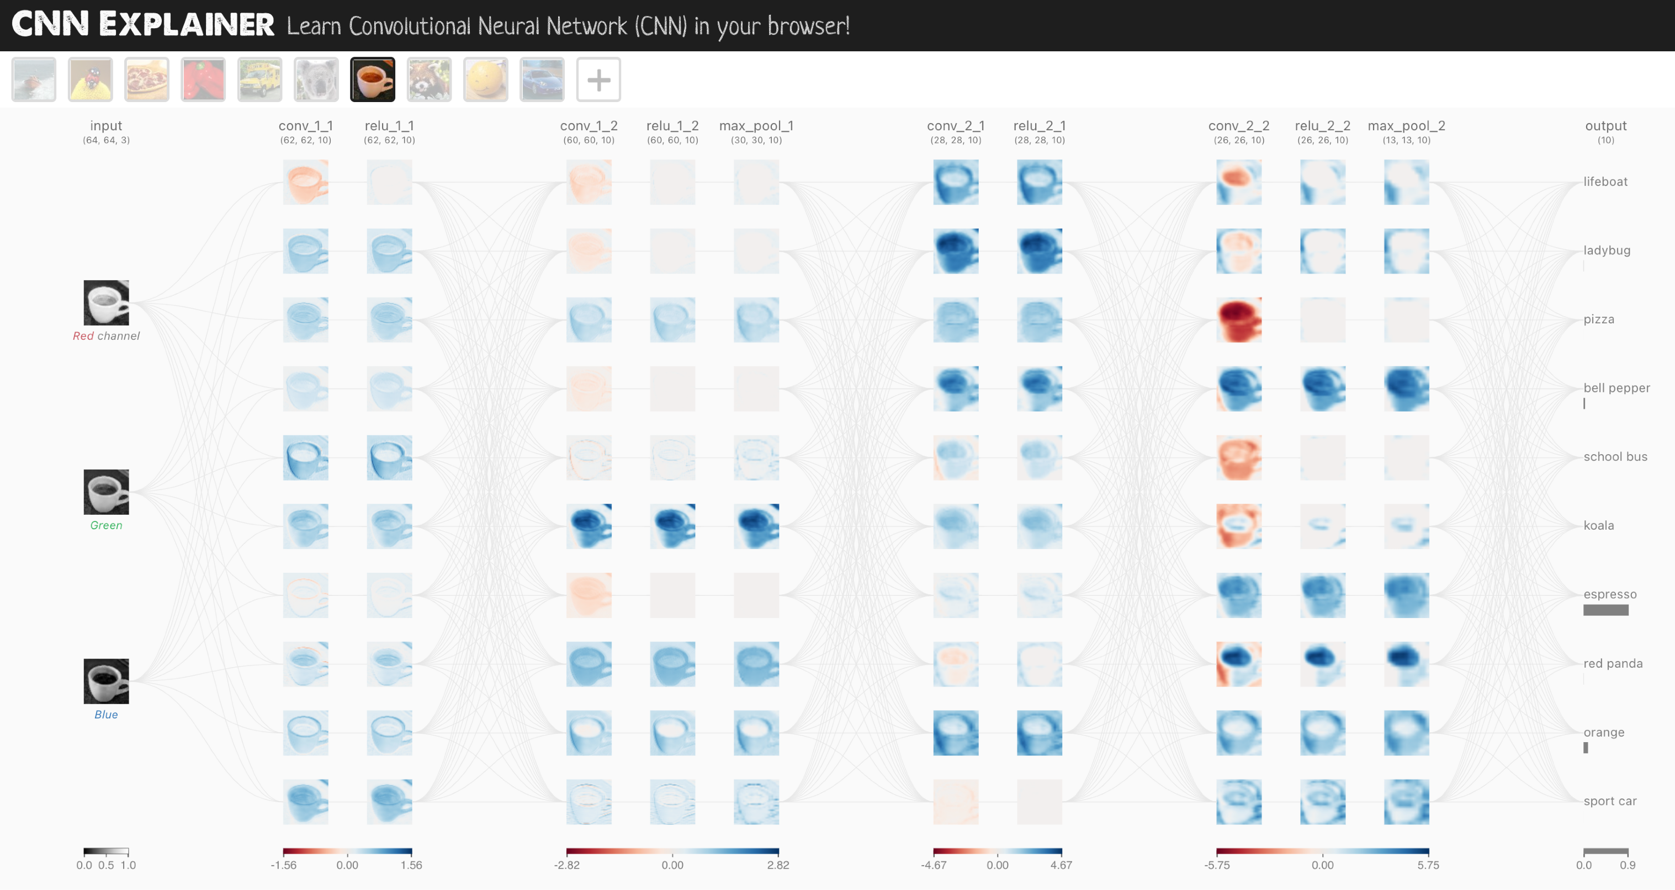
CNN Explainer model
Input layer
Conv2d layers ReLU activation layers Pooling layers
Output layer
Source: CNN Explainer website, architecture is known as TinyVGG.

Slide 19
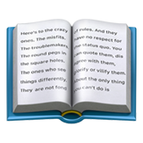
Breakdown of torch.nn.Conv2d layer
Example code: torch.nn.Conv2d(in_channels=3, out_channels=10, kernel_size=(3, 3), stride=(1, 1), padding=0)
Example 2 (same as above): torch.nnConv2d(in_channels=3, out_channels=10, kernel_size=3, stride=1, padding=0)
Hyperparameter name | What does it do? | Typical values
in_channels | Defines the number of input channels of the input data. | 1 (grayscale), 3 (RGB color images)
_{out_channels} Defines the number output channels of the layer (could _{10, 128, 256, 512} also be called hidden units). kernel_size (also referred to as Determines the shape of the kernel (sliding windows) over 3, 5, 7 (lowers values learn smaller _{`lter size) the input.} features, higher values learn larger features) The number of steps a filter takes across an image at a stride time (e.g. if strides=1, a filter moves across an image 1 1 (default), 2 pixel at a time). Pads the target tensor with zeroes (if “same”) to preserve padding input shape. Or leaves in the target tensor as is (if 0, 1, “same”, “valid” “valid”), lowering output shape.
Resource: For an interactive demonstration of the above hyperparameters, see the CNN Explainer website.

Slide 20
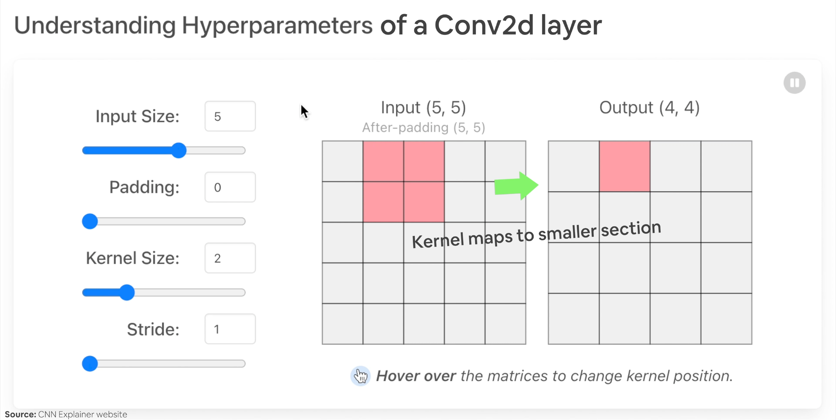
Breakdown of torch.nn.Conv2d layer
(Visually)
Resource: For an interactive demonstration of the above hyperparameters, see the CNN Explainer website.

Slide 21

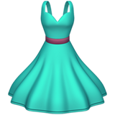
FashionMNIST -> CNN
Output layer outputs predictions
[[0.00, 0.62, 0.44…],
[0.00, | 0.03, | 0.27…],
[0.01, | 0.78, | 0.07…],
[0.21, | 0.34, | 0.00…],
[0.91, | 0.66, | 0.81…],
[0.90, | 0.55, | 0.99…],
[0.00, | 0.22, | 0.57…],
…,
Inputs
Numerical encoding
Layers learn numerical representation
…
Keep going until number of classes is fulfilled

Slide 22
torchvision.transforms torch.utils.data.Dataset
torch.utils.data.DataLoader
torch.save torch.load
torchmetrics
torch.optim
torch.nn torch.nn.Module torchvision.models
torch.utils.tensorboard
See more: https://pytorch.org/tutorials/beginner/ptcheat.html

Slide 23
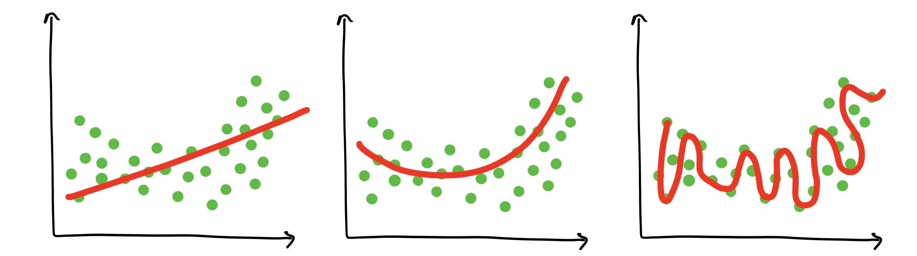
What is overfitting?
Overfitting — when a model over learns patterns in a particular dataset and isn’t able to generalise to unseen data.
For example, a student who studies the course materials too hard and then isn’t able to perform well on the final exam. Or tries to put their knowledge into practice at the workplace and finds what they learned has nothing to do with the real world.
Underfitting
Balanced
(goldilocks zone)
Overfitting

Slide 24
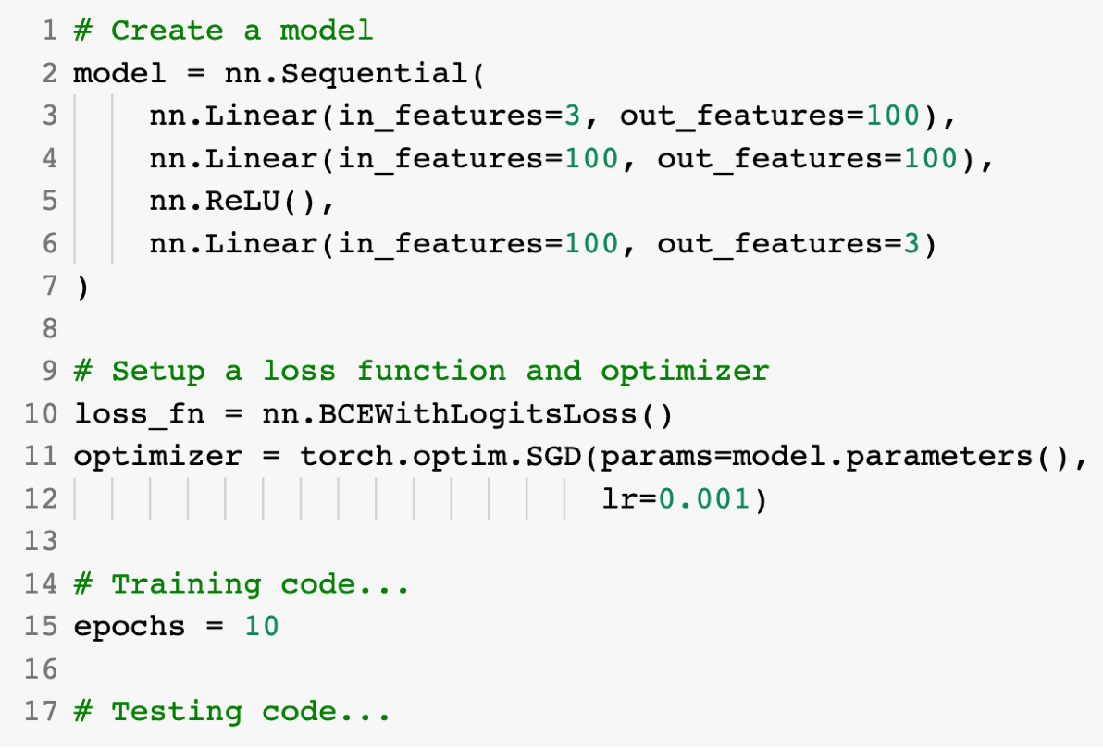
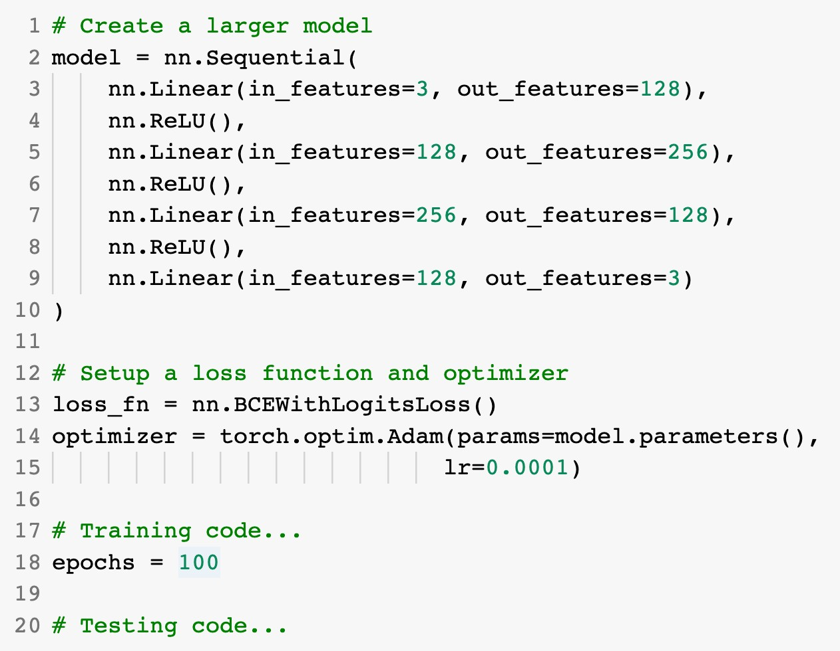
Improving a model
(from a model’s perspective)
Smaller model
Common ways to improve a deep model:
Adding layers
Increase the number of hidden units
Change/add activation functions
Larger model
Change the optimization function
Change the learning rate
(because you can alter each of
Fitting for longer
these, they’re hyperparameters)

Slide 25
Improving a model
(from a data perspective)
Method to improve a model (reduce overfitting)
What does it do?
Gives a model more of a chance to learn patterns between samples (e.g. if a model is performing poorly on images of pizza, show it more images of pizza).
More data
Increase the diversity of your training dataset without collecting more data (e.g. take your photos of pizza and randomly rotate them 30°).
Increased diversity forces a model to learn more generalisation patterns.
Data augmentation
Not all data samples are created equally. Removing poor samples from or adding better samples to your dataset can improve your model’s performance.
Better data
Take a model’s pre-learned patterns from one problem and tweak them to suit your own problem. For example, take a model trained on pictures of cars to recognise pictures of trucks.
Use transfer learning

Slide 26
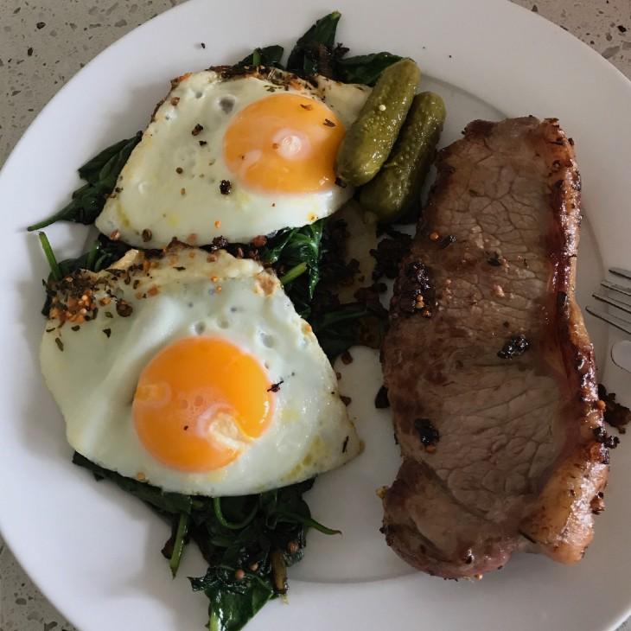
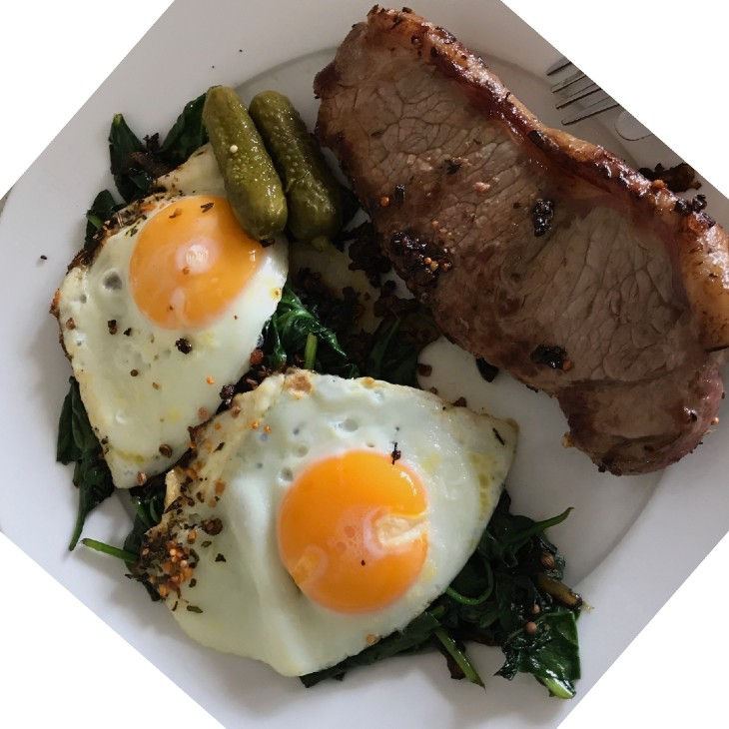
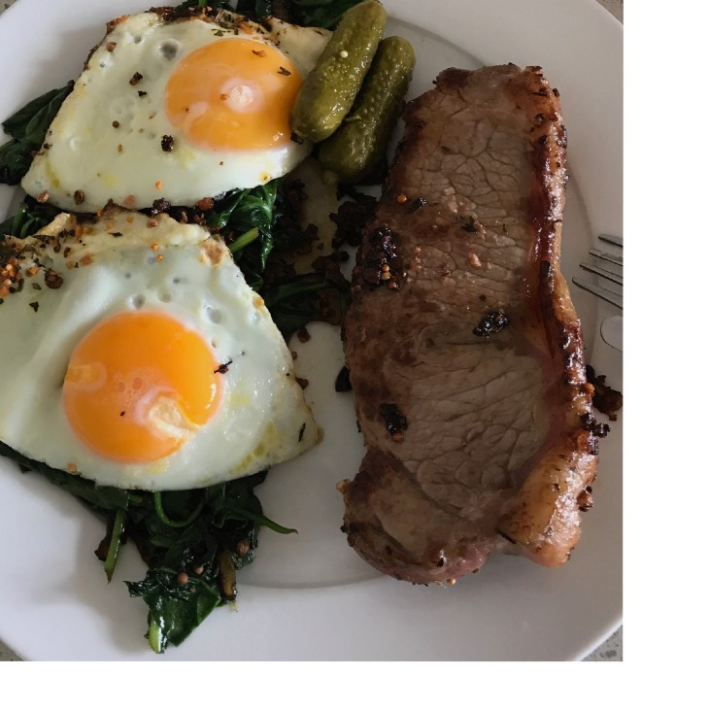
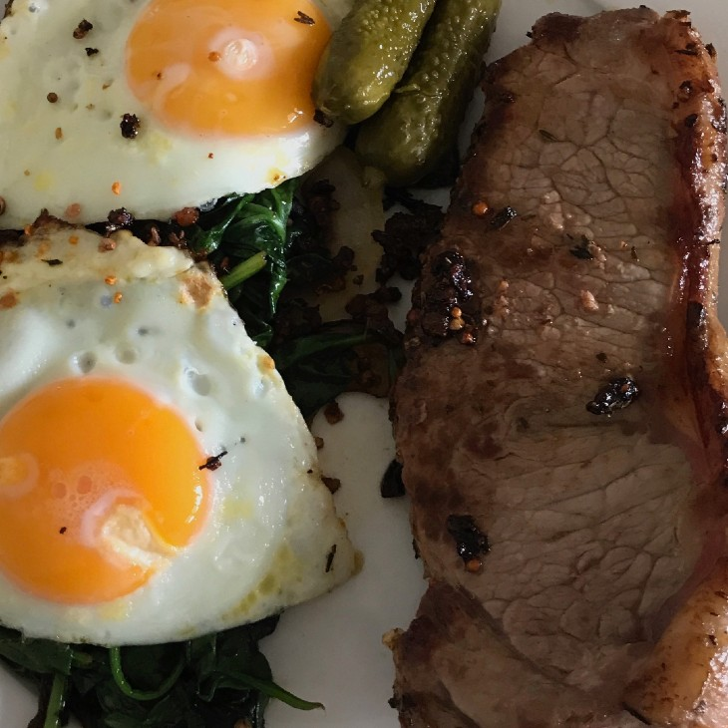
What is data augmentation?
Looking at the same image but from different perspective(s)*.
Original
Rotate
Shift
Zoom
*Note: There are many more different kinds of data augmentation such as, cropping, replacing, shearing. This slide only demonstrates a few.

Slide 27
Popular & useful computer vision architectures: see torchvision.models
Release Date
Architecture
Paper Use in PyTorch When to use
ResNet (residual networks) | 2015
EfficientNet(s) | 2019
Vision Transformer (ViT) | 2020
MobileNet(s) | 2017
https://arxiv.org/abs/ 1512.03385
A good backbone for many computer vision problems
torchvision.models.resnet…
https://arxiv.org/abs/ 1905.11946
Typically now better than ResNets for computer vision
torchvision.models.efficientnet…
https://arxiv.org/abs/ 2010.11929
torchvision.models.vit_…
Transformer architecture applied to vision
https://arxiv.org/abs/ 1704.04861
Lightweight architecture suitable for devices with less computing power
torchvision.models.mobilenet…

Slide 28



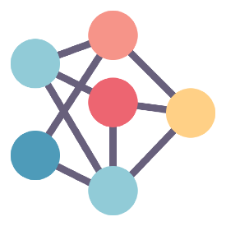
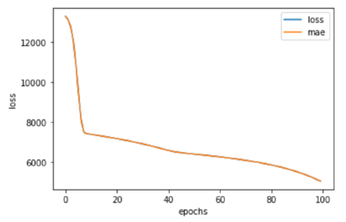
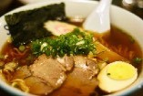
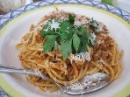
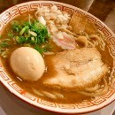
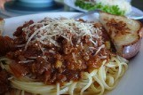
The machine learning explorer’s motto
“Visualize, visualize, visualize”
Data
Model
It’s a good idea to visualize these as often as possible.
Training
Predictions

Slide 29
The machine learning practitioner’s motto
“Experiment, experiment, experiment”
(try lots of things and see what
tastes good)

