Slide 1

Custom datasets with

Slide 2

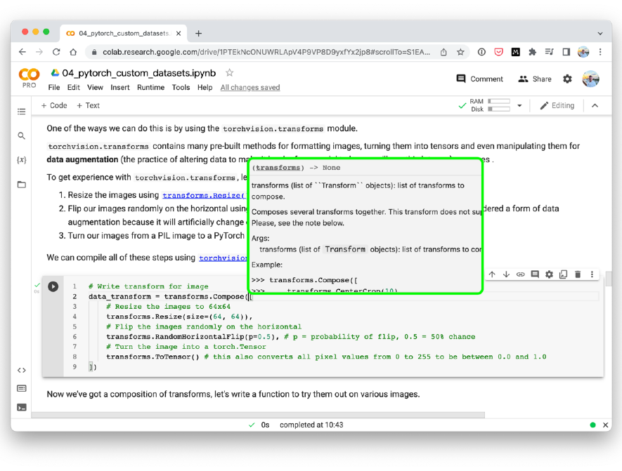



Where can you get help?
“If in doubt, run the code”
Follow along with the code
Try it for yourself
Press SHIFT + CMD + SPACE to read the docstring
Search for it
Try again
Ask
https://www.github.com/mrdbourke/pytorch-deep-learning/discussions

Slide 3
“What is a custom dataset?”
“I’ve got my own dataset, can I build a model with PyTorch to predict on it?”
Yes.

Slide 4
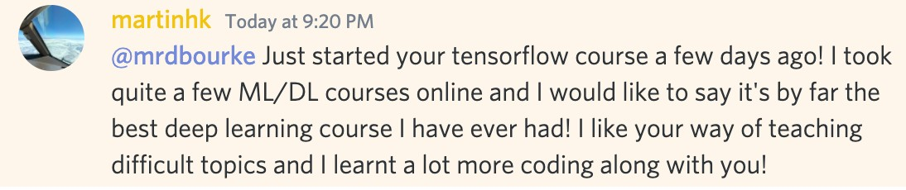



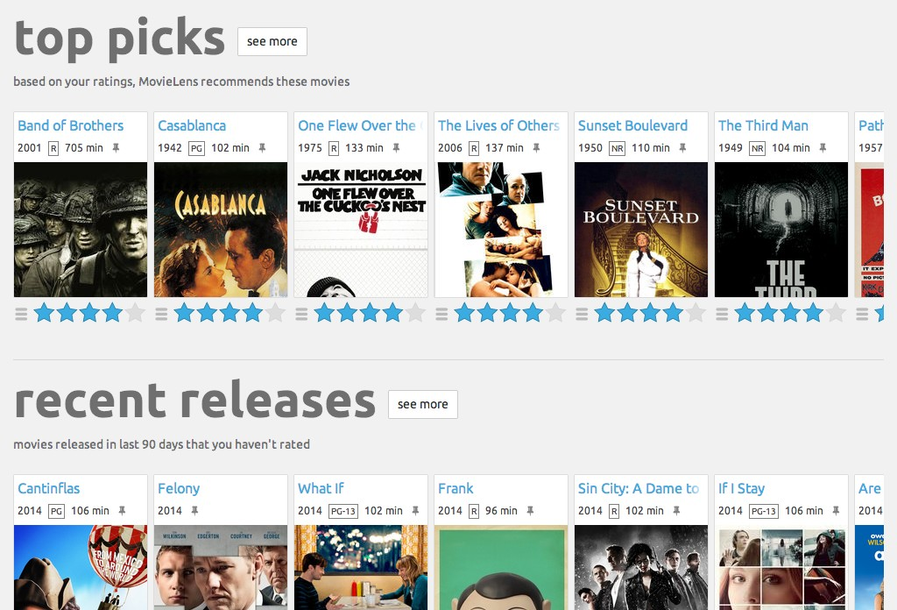
PyTorch Domain Libraries
“Are these reviews positive or negative?”
“Is this a photo of pizza, steak or sushi?”
TorchVision
“What song is playing?”
TorchText
“How do we recommend similar products?”
Different domain
libraries contain data
loading functions for
different data sources
TorchAudio
TorchRec
Source: movielens.org

Slide 5
PyTorch Domain Libraries
Problem Space | Pre-built Datasets and Fuctions
Vision | torchvision.datasets
Text | torchtext.datasets
Audio | torchaudio.datasets
Recommendation system | torchrec.datasets
Bonus | TorchData*
*TorchData contains many different helper functions for loading data and is currently in beta as of April 2022.

Slide 6
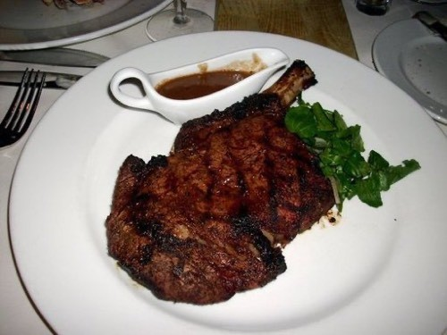


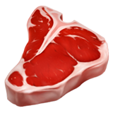

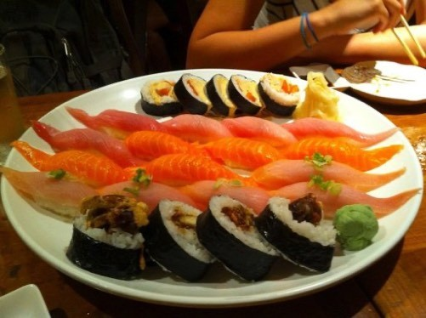
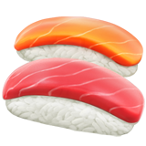
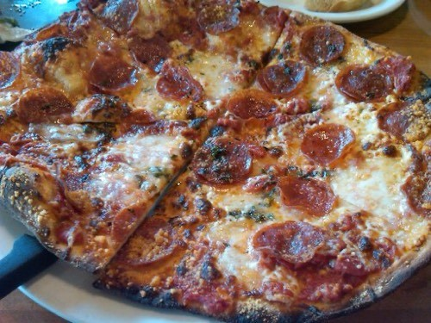

What we’re going to build
FoodVision Mini
Load data
Build a model
Predict with the model
We’re going to write code to
load images of food (our own
custom dataset for
FoodVision Mini)

Slide 7
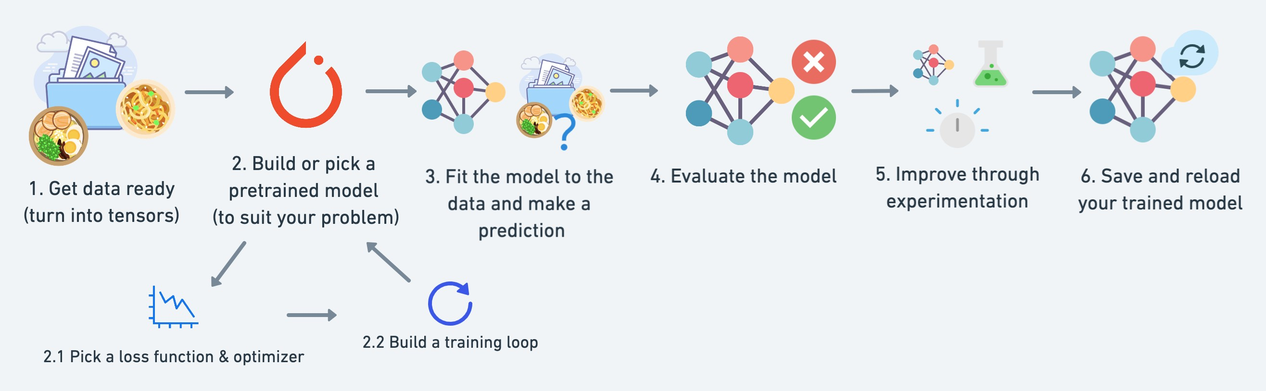
torchvision.transforms torch.utils.data.Dataset
torch.utils.data.DataLoader
torch.save torch.load
torchmetrics
torch.optim
torch.nn torch.nn.Module torchvision.models
torch.utils.tensorboard
See more: https://pytorch.org/tutorials/beginner/ptcheat.html

Slide 8



What we’re going to cover
(broadly)
Getting a custom dataset with PyTorch
Becoming one with the data (preparing and visualising)
Transforming data for use with a model
Loading custom data with pre-built functions and custom functions
Building FoodVision Mini to classify images
Comparing models with and without data augmentation
Making predictions on custom data
How:
(we’ll be cooking up lots of code!)

Slide 9
Let’s code!

Slide 10
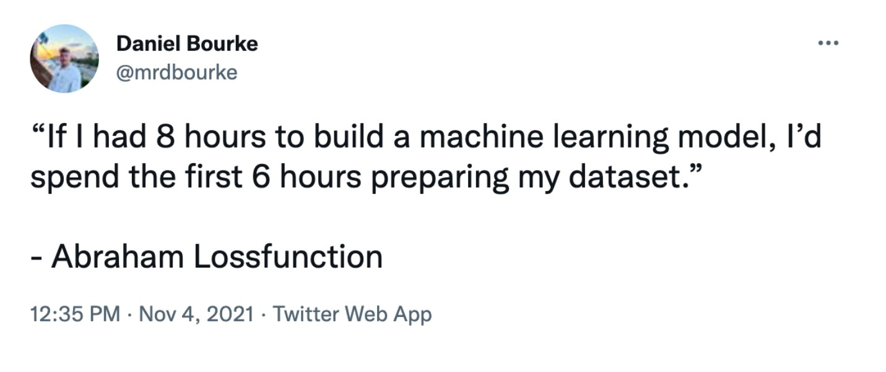
Source: @mrdbourke Twitter

Slide 11
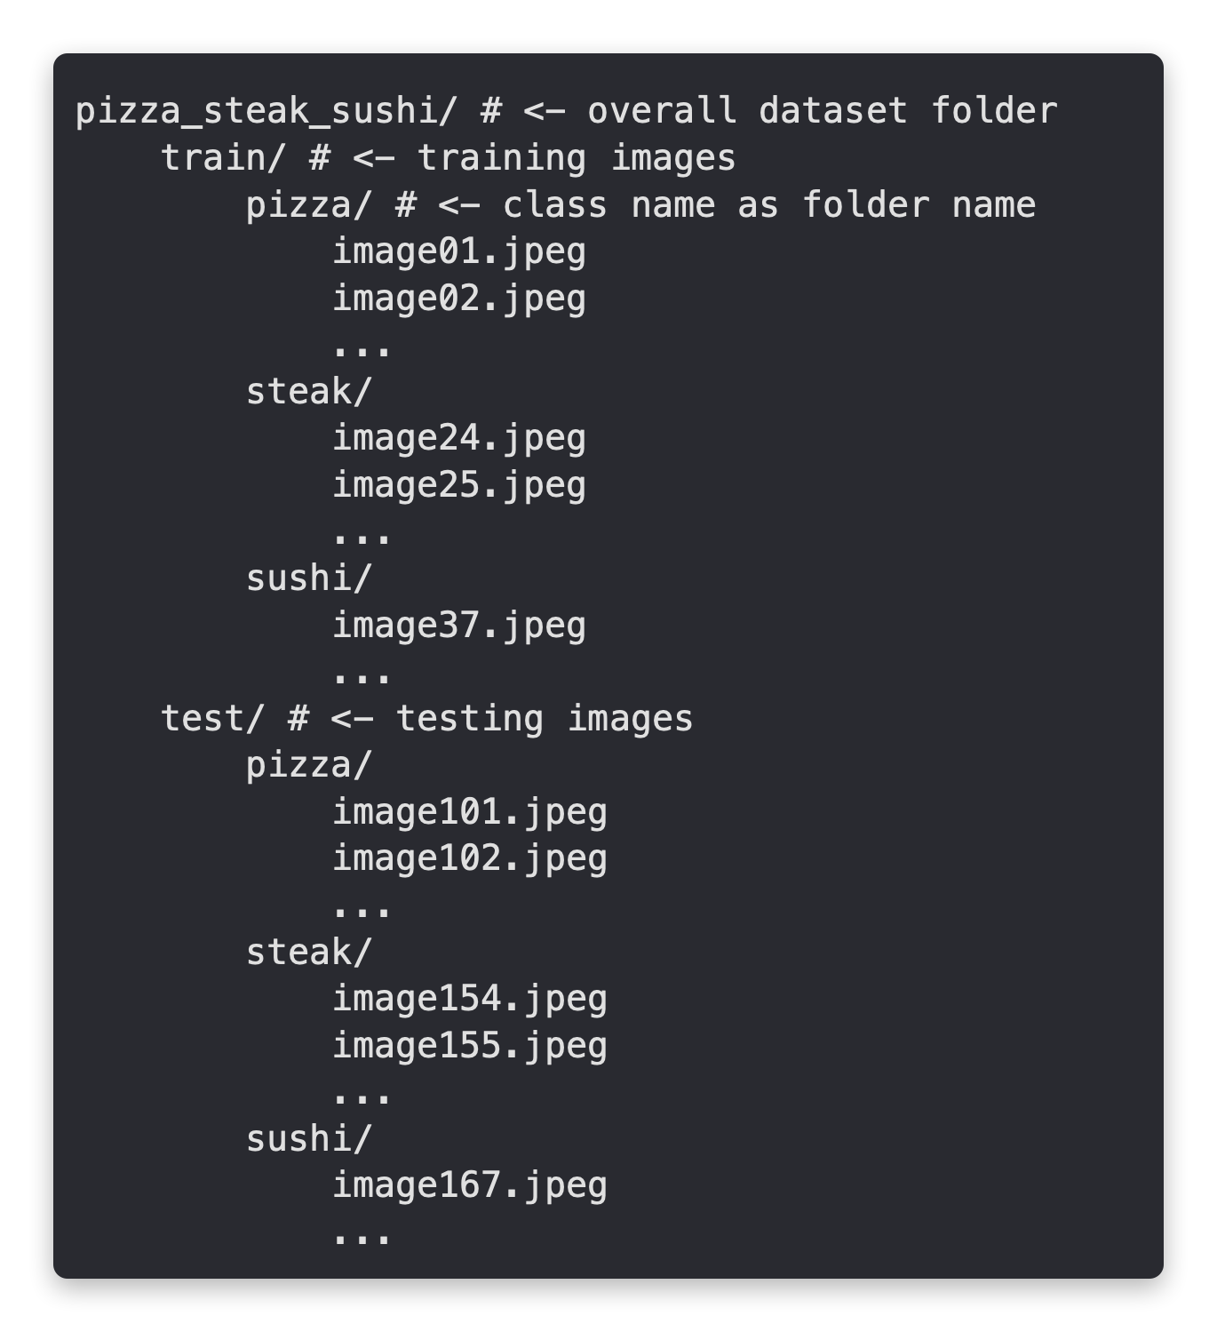
Standard image classification data format
Your own data format
will depend on what
you’re working
The premise remains:
write code to get your
data into tensors for
use with PyTorch

Slide 12
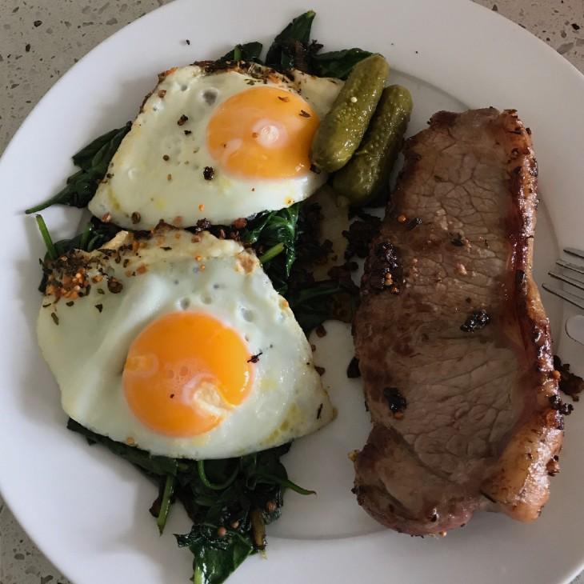
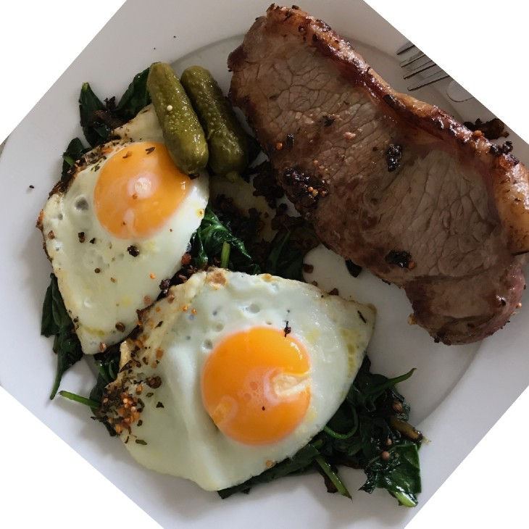
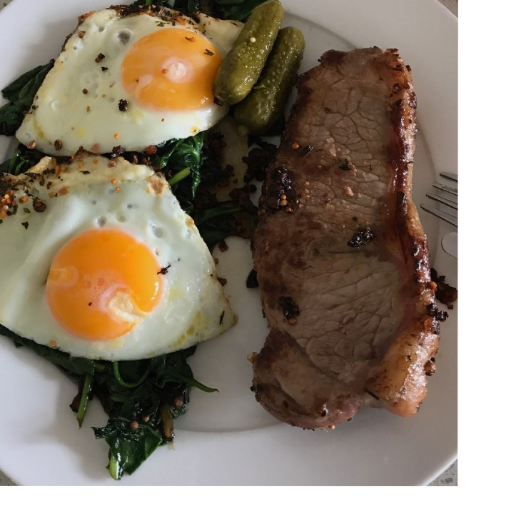
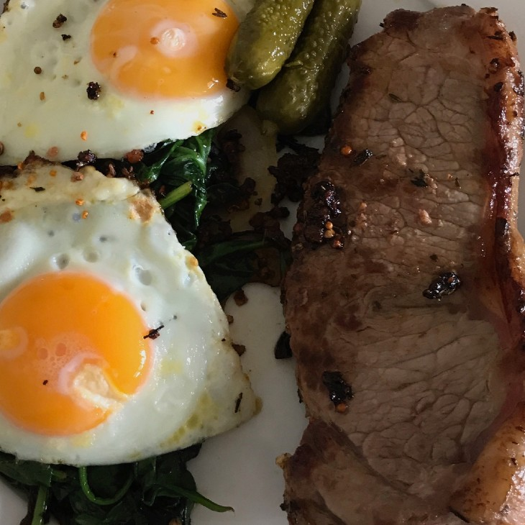
What is data augmentation?
Looking at the same image but from different perspective(s)*. To artificially increase the diversity of a dataset.
Original
Rotate
Shift
Zoom
*Note: There are many more different kinds of data augmentation such as, cropping, replacing, shearing. This slide only demonstrates a few.

Slide 13

PyTorch State of the Art Recipe
Research comes out often on
how best to train models,
state-of-the-art (SOTA)
methods are always
changing).
Source: Training state-of-the-art computer vision models with torchvision
from the PyTorch blog.

Slide 14
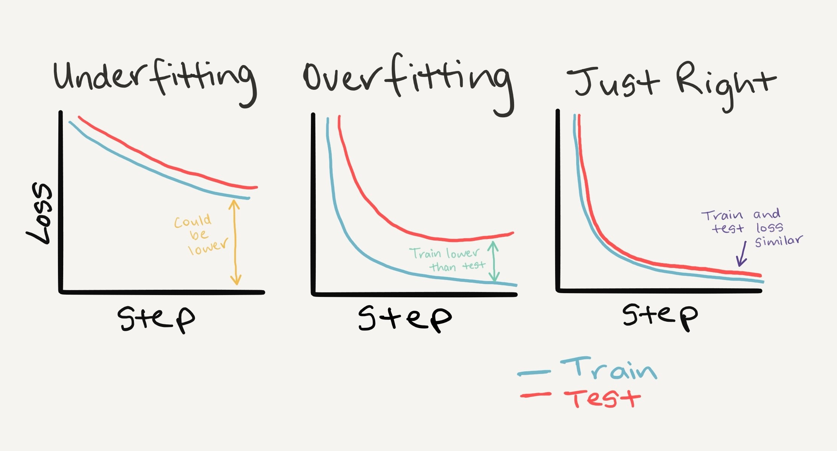
Loss curves
(a way to evaluate your
model’s performance over
time)
*There are more combinations of these, to see them check out Google’s Interpreting Loss Curves guide.

Slide 15
Dealing with overfitting
Method to improve a model (reduce overfitting)
What does it do?
Get more data
Gives a model more of a chance to learn patterns between samples (e.g. if a model is performing poorly on images of pizza, show it more images of pizza).
Data augmentation
Increase the diversity of your training dataset without collecting more data (e.g. take your photos of pizza and randomly rotate them 30°). Increased diversity forces a model to learn more generalisation patterns.
Better data
Not all data samples are created equally. Removing poor samples from or adding better samples to your dataset can improve your model’s performance.
Use transfer learning
Take a model’s pre-learned patterns from one problem and tweak them to suit your own problem. For example, take a model trained on pictures of cars to recognise pictures of trucks.
If the current model is already overfitting the training data, it may be too complicated of a model. This means it's learning the patterns of the data too well and isn't able to generalize well to unseen data. One way to simplify a model is to reduce the number of layers it uses or to reduce the number of hidden units in each layer.
Simplify your model
The idea here is to slowly decrease the learning rate as a model trains. This is akin to reaching for a coin at the back of a couch. The closer you get, the smaller your steps. The same with the learning rate, the closer you get to convergence, the smaller you'll want your weight updates to be.
Use learning rate decay
Early stopping stops model training *before* it begins to overfit. As in, say the model's loss has stopped decreasing for the past 10 epochs (this number is arbitrary), you may want to stop the model training here and go with the model weights that had the lowest loss (10 epochs prior).
Use early stopping

Slide 16
Dealing with underfitting
Method to improve a model (reduce underfitting)
What does it do?
If your model is underfitting, it may not have enough capability to *learn* the required patterns/weights/representations of the data to be predictive. One way to add more predictive power to your model is to increase the number of hidden layers/units within those layers.
Add more layers/units to your model
Perhaps your model's learning rate is too high to begin with. And it's trying to update its weights each epoch too much, in turn not learning anything. In this case, you might lower the learning rate and see what happens.
Tweak the learning rate
Sometimes a model just needs more time to learn representations of data. If you find in your smaller experiments your model isn't learning anything, perhaps leaving it train for a more epochs may result in better performance.
Train for longer
Take a model’s pre-learned patterns from one problem and tweak them to suit your own problem. For example, take a model trained on pictures of cars to recognise pictures of trucks.
Use transfer learning
Use less regularization
Perhaps your model is underfitting because you're trying to prevent overfitting too much.
Holding back on regularization techniques can help your model fit the data better.

Slide 17
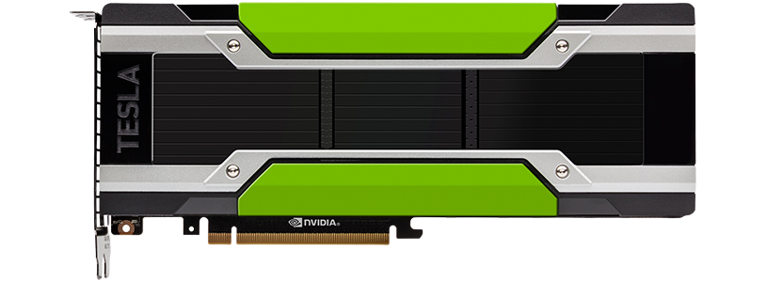

Predicting on custom data
(3 things to make sure of…)
Is the model on the GPU?
Original
Custom image
Shape = [64, 64, 3]
[[0.31, 0.62, 0.44…],
[0.92, 0.03, 0.27…],
[0.25, 0.78, 0.07…],
[[0.31, 0.62, 0.44…],
[0.92, 0.03, 0.27…],
[0.25, 0.78, 0.07…],
…,
…,
Add batch dimension & rearrange if needed
Shape = [None, 64, 64, 3] (NHWC)
Shape = [None, 3, 64, 64] (NCHW)
Same as model input
torch.float32
1. Data in right datatype
2. Data on same device as model
3. Data in correct shape

