Slide 1

Going modular with

Slide 2
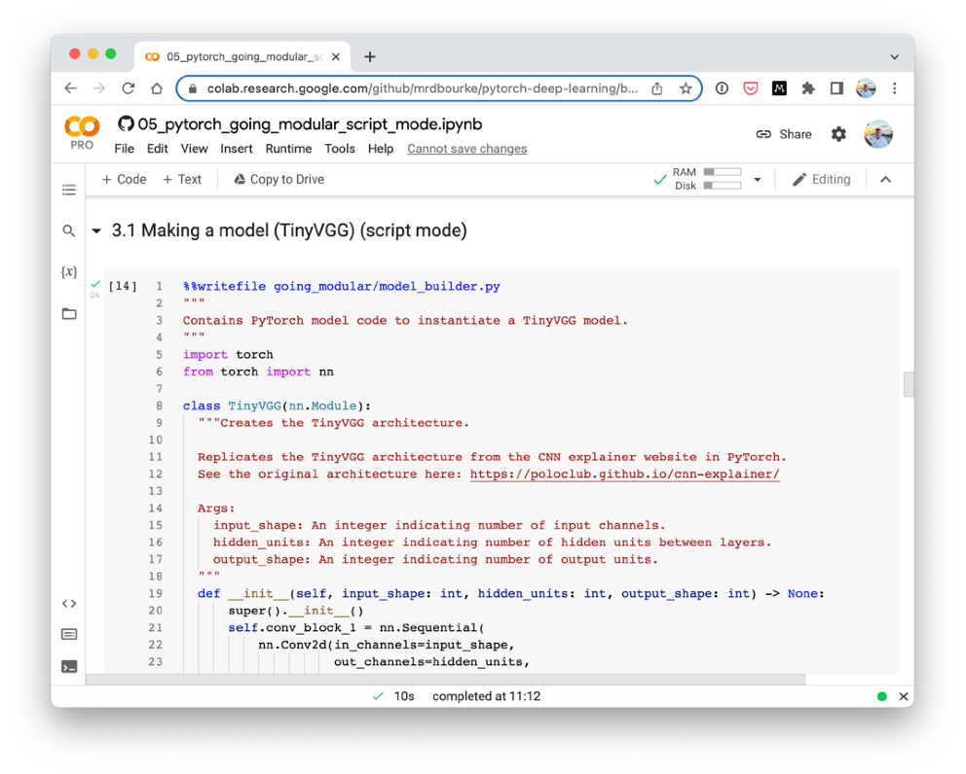
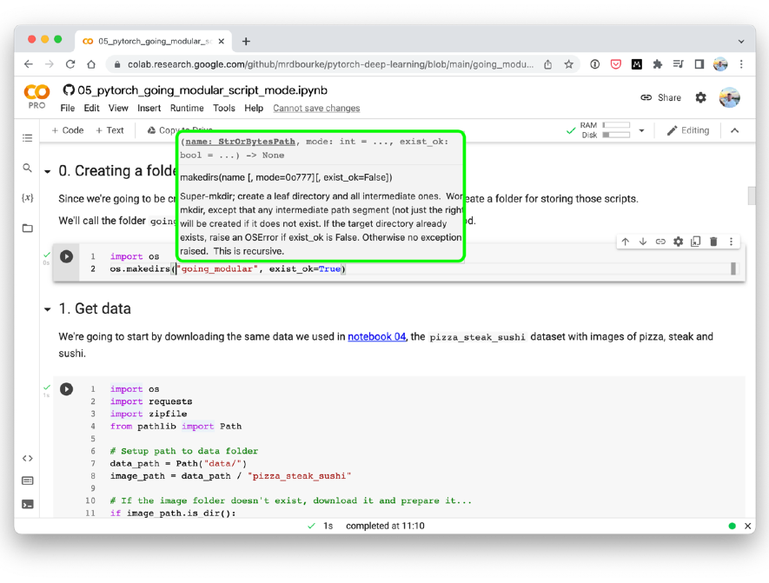

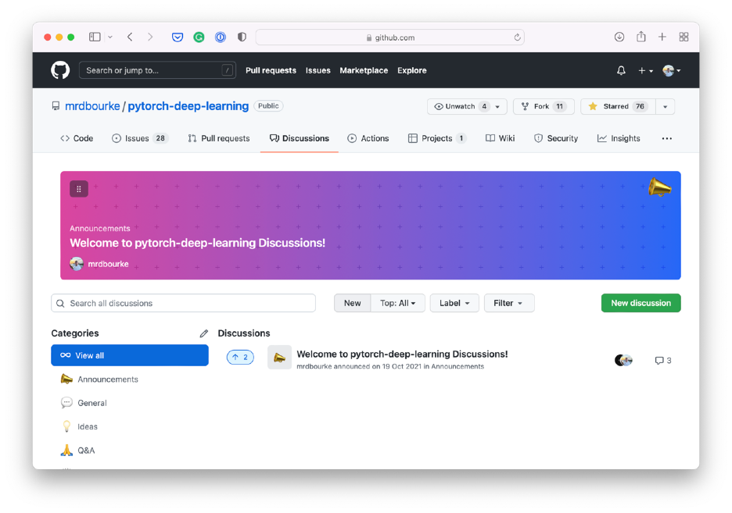
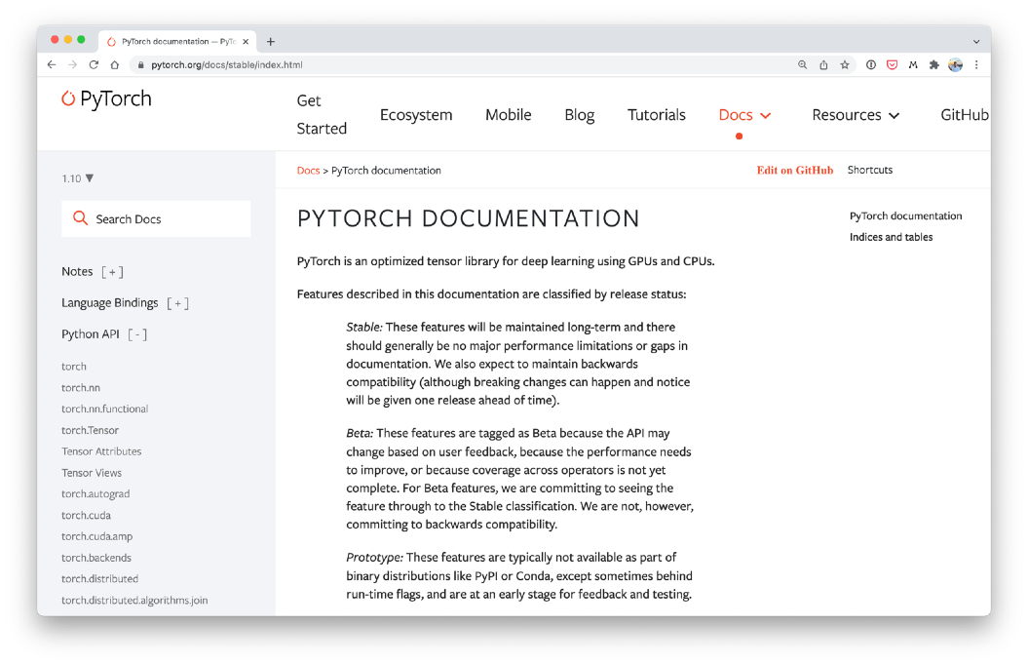
Where can you get help?
“If in doubt, run the code”
Follow along with the code
Try it for yourself
Press SHIFT + CMD + SPACE to read the docstring
Search for it
Try again
Ask
https://www.github.com/mrdbourke/pytorch-deep-learning/discussions

Slide 3
“What is going modular?”
“I’ve written some nice code in a notebook, can I reuse it elsewhere?”
Yes.

Slide 4
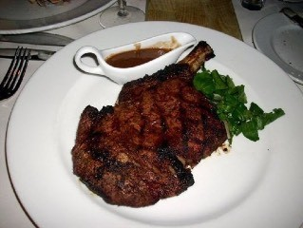


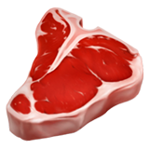

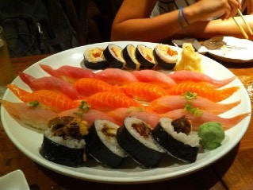
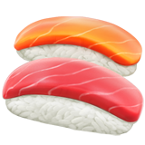
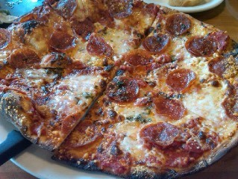


What we’re going to build
FoodVision Mini
Load data
Build/train a model
Predict with the model
We’re going to turn the code to do
this from notebook cell code into a
series of Python scripts

Slide 5
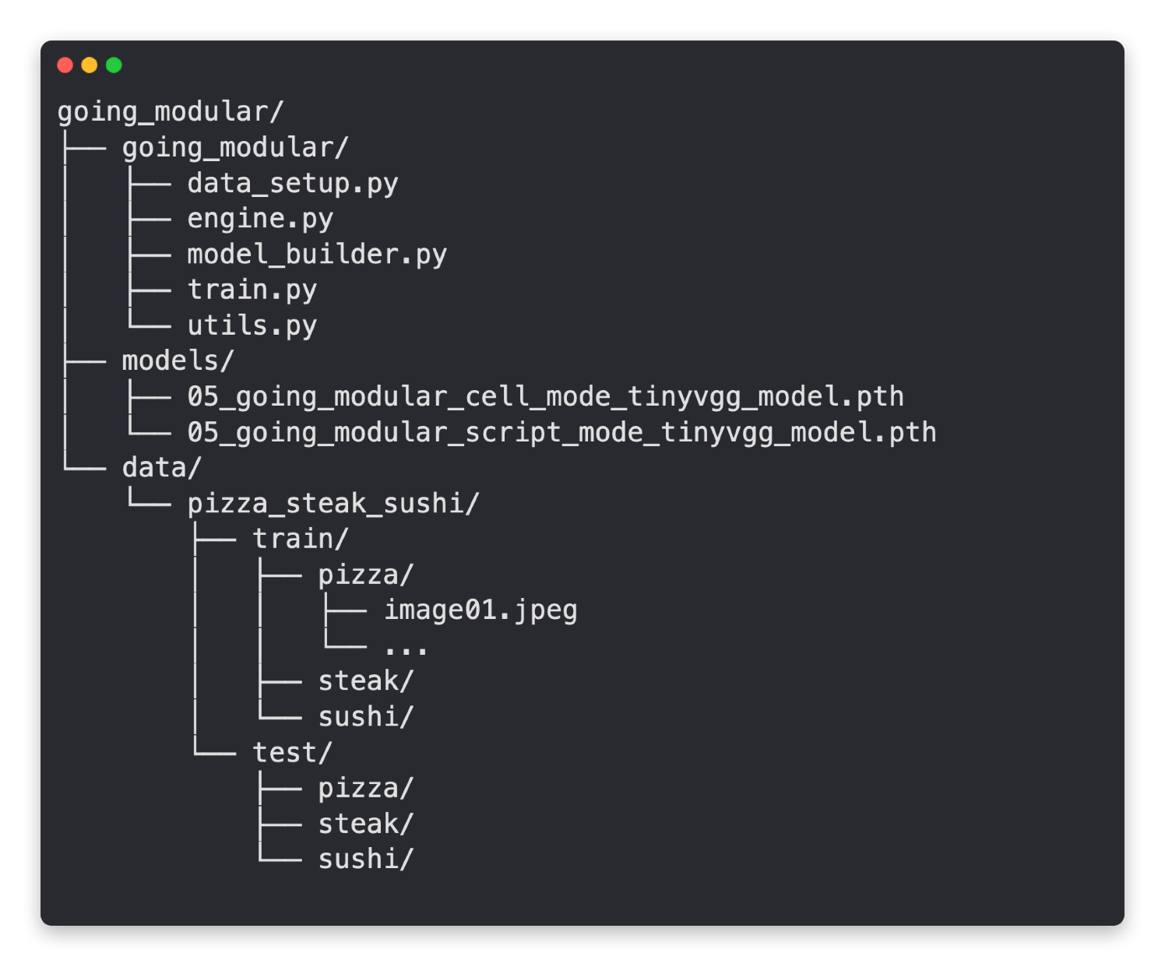
What we’re going to build
FoodVision Mini
Prepares data
Functions to train/test
Builds a PyTorch model
Trains a PyTorch model
Utility functions
Trained models Data in standard
image classification format
Predict with the model
Load data
Build/train a model
We’re going to turn the code to do
this from notebook cell code into a
series of Python scripts

Slide 6
PyTorch from the command line
Target Python script How big should the batch size be? Train for how long?
python train.py —model MODEL_NAME —batch_size BATCH_SIZE —lr LEARNING_RATE —num_epochs NUM_EPOCHS
Model to train
What should the learning rate be?
python train.py —model tinyvgg —batch_size 32 —lr 0.001 —num_epochs 10
“Train the TinyVGG model with a batch size of 32 and a learning rate of 0.001 for 10 epochs.”
Note: there are many more
hyperparameters you could ^{add here}

Slide 7
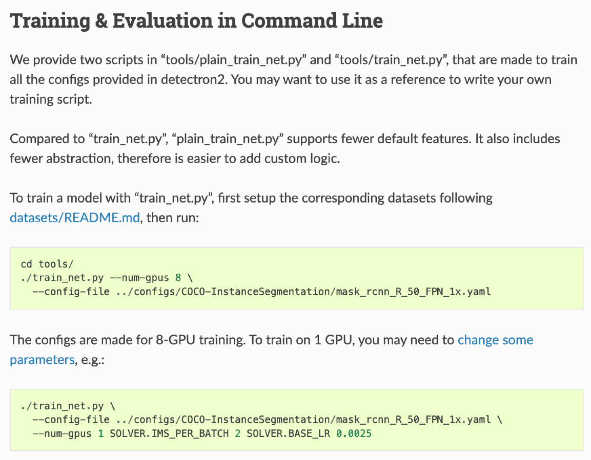
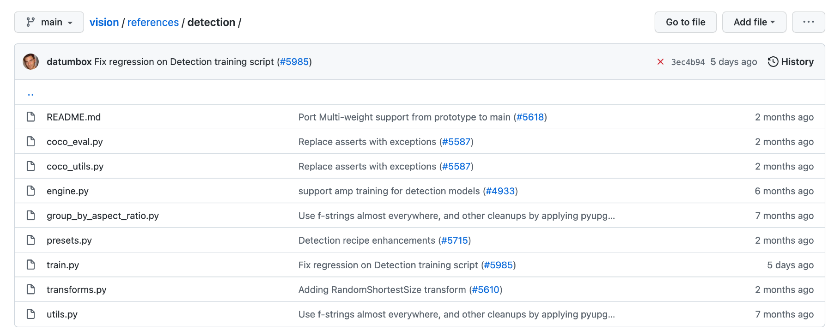
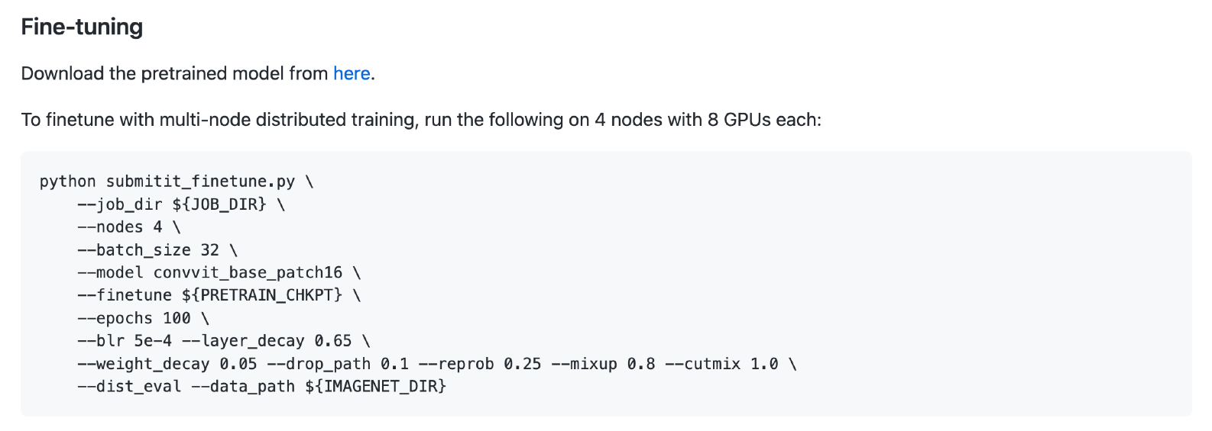
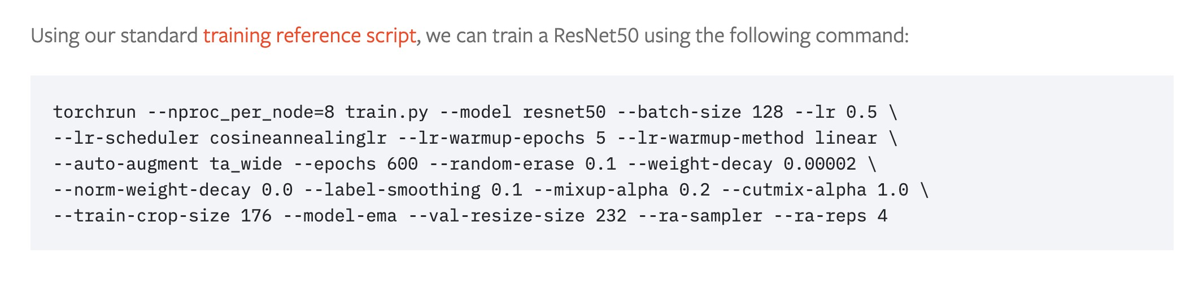
PyTorch in the wild
(examples of Python scripts)
Source: torchvision object detection GitHub.
Source: Detectron2 documentation.
Source: ConvMAE paper GitHub.
Source: Training state-of-the-art computer vision models with torchvision from the PyTorch blog.

Slide 8

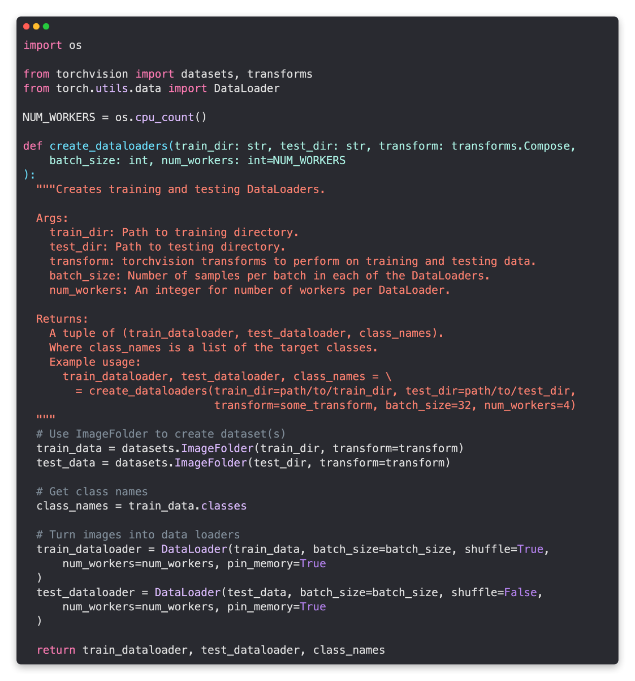
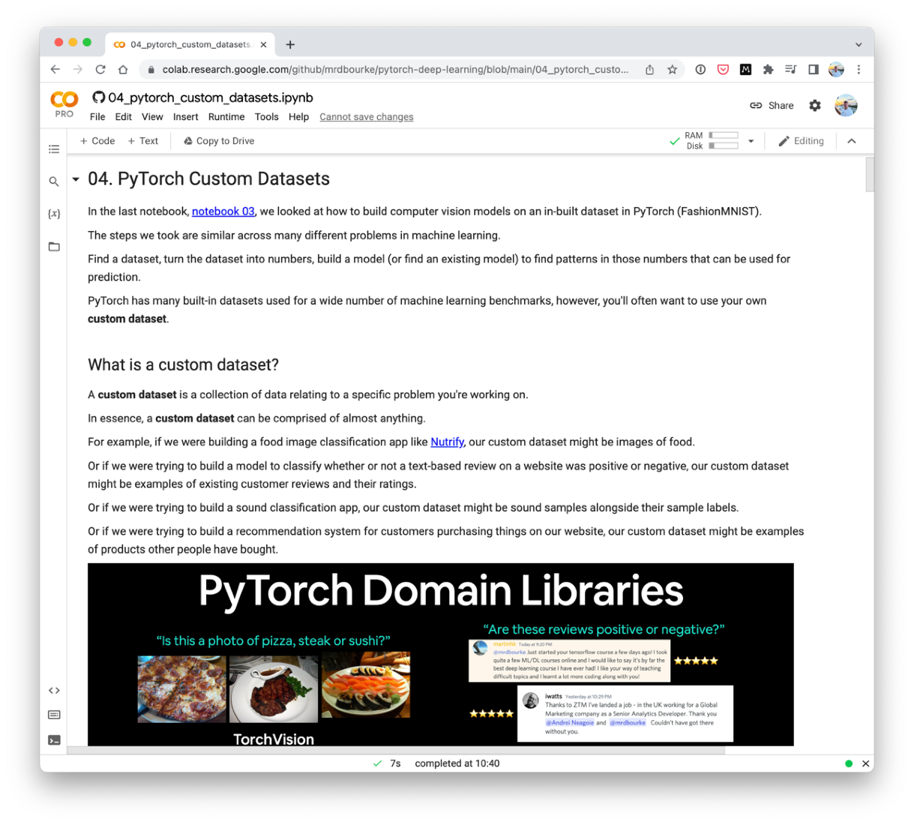
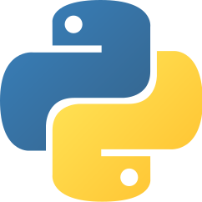


My workflow
(one of many options)
data_setup.py
(experiment, experiment, experiment!)
Start with Jupyter/Google Colab notebooks
Move most useful code to Python scripts

Slide 9
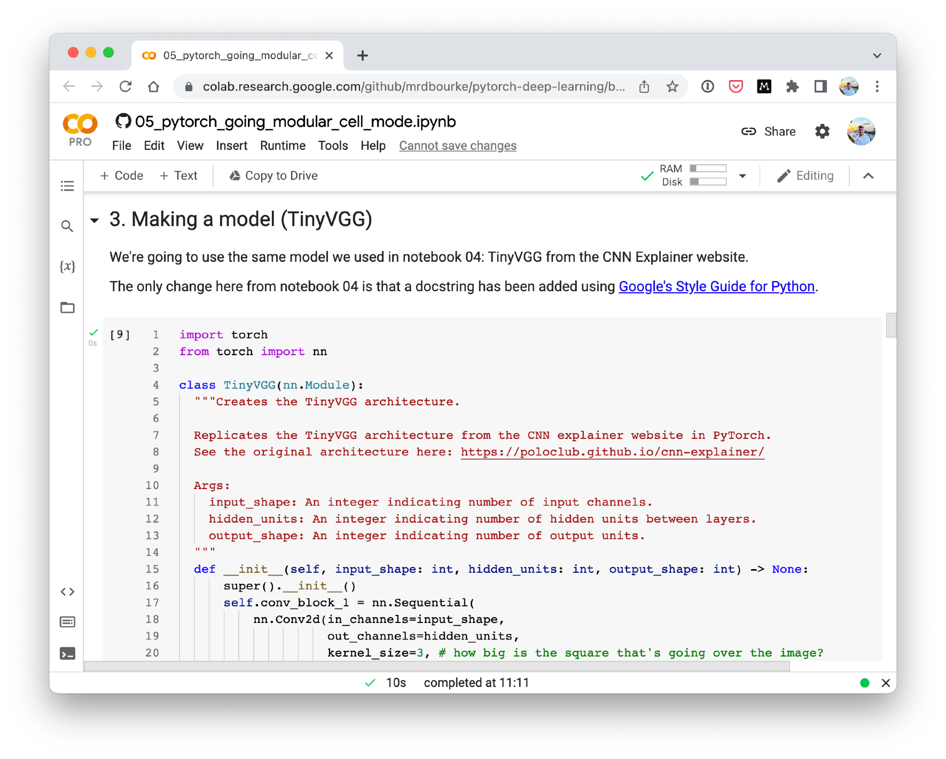
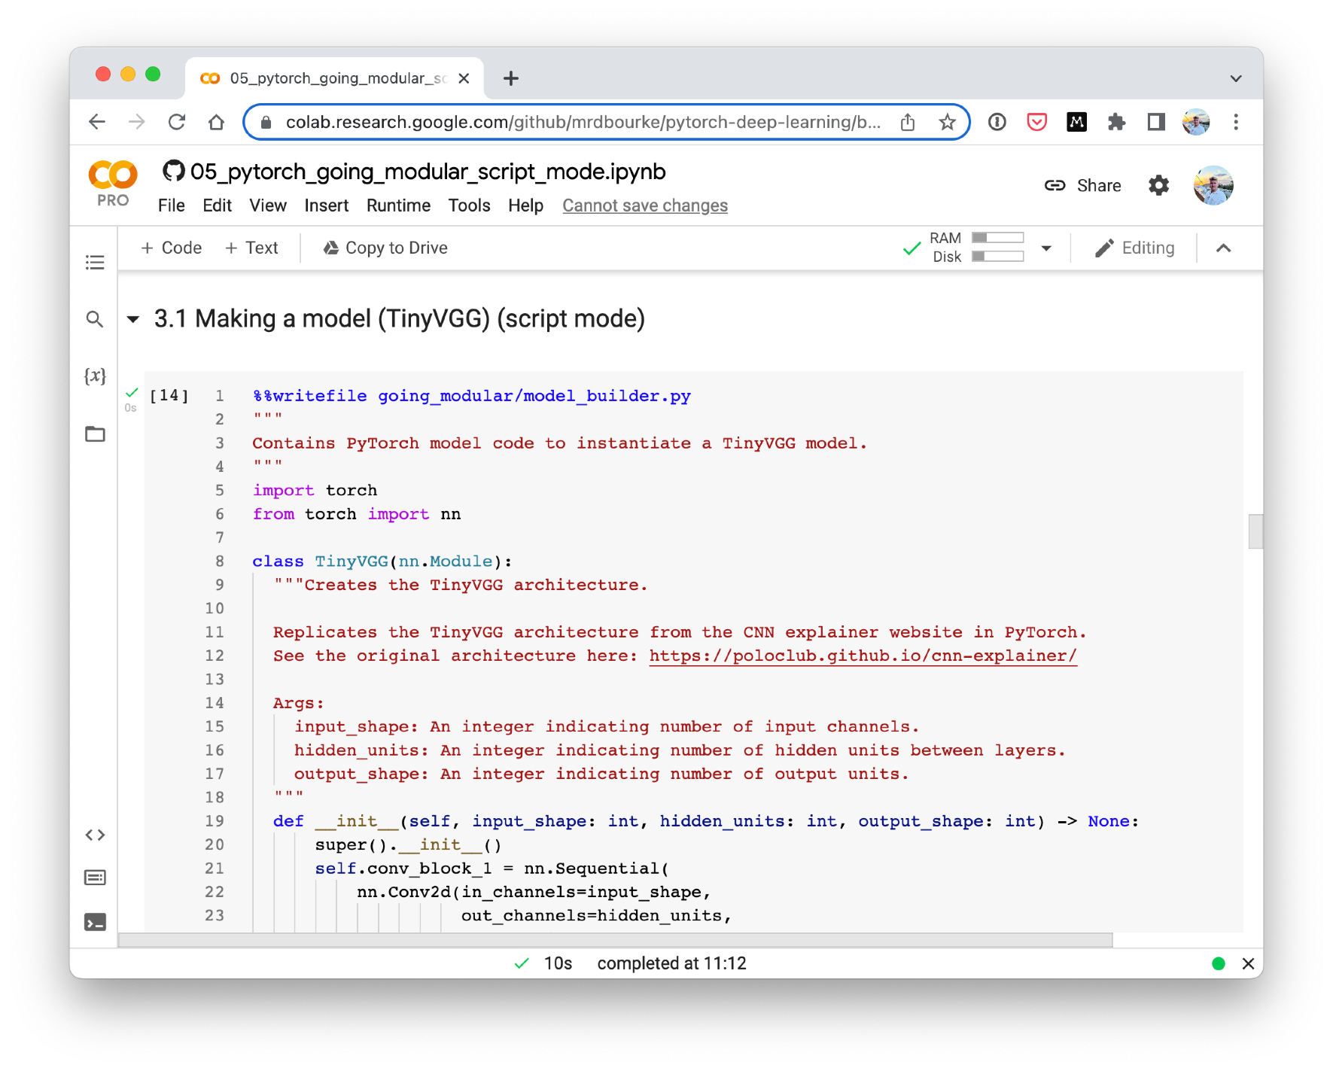
Cell mode vs. Script mode
Notebook 05 Part 1: Cell mode
Notebook 05 Part 2: Script mode
_{(turns} useful code into Python scripts)

Slide 10
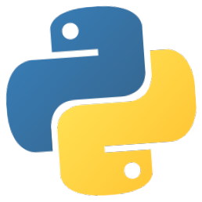
torchvision.transforms torch.utils.data.Dataset
torch.utils.data.DataLoader
torch.save torch.load
torchmetrics
torch.optim
torch.nn torch.nn.Module torchvision.models
torch.utils.tensorboard
Each of these could be turned
into a Python script!
See more: https://pytorch.org/tutorials/beginner/ptcheat.html

Slide 11



What we’re going to cover
(broadly)
Transforming data for use with a model
Loading custom data with pre-built functions
Building FoodVision Mini to classify images
Turning useful notebook code (all of the above) into Python scripts
Training a PyTorch model from the command line
How:
(we’ll be cooking up lots of code!)

Slide 12
Let’s code!

Slide 13
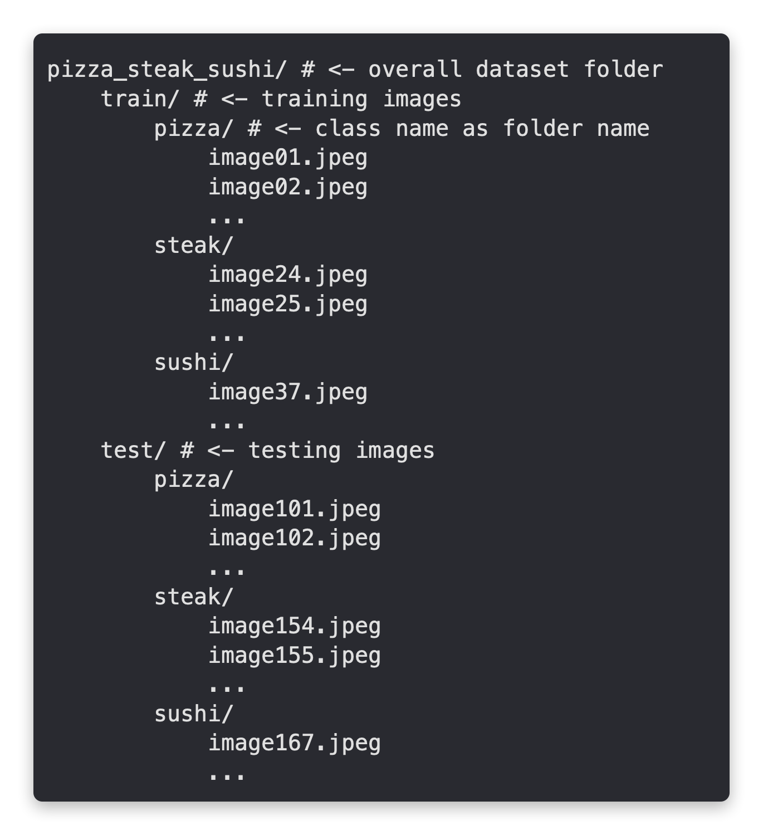
Standard image classification data format
Your own data format
will depend on what
you’re working
The premise remains:
write code to get your
data into tensors for
use with PyTorch

