Slide 1

Transfer Learning with

Slide 2
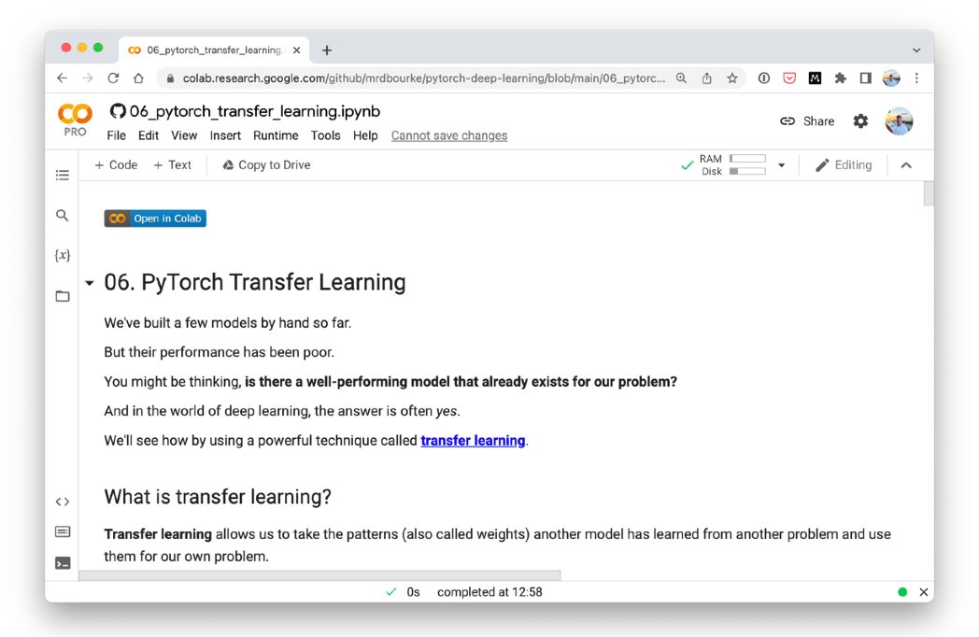
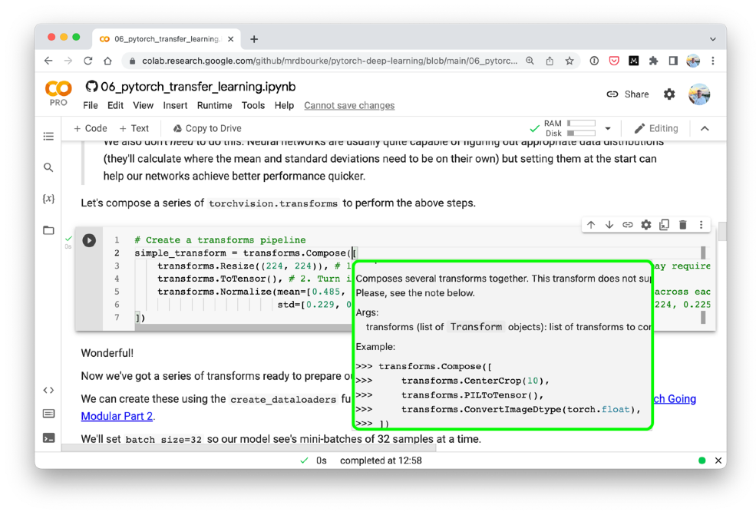



Where can you get help?
“If in doubt, run the code”
Follow along with the code
Try it for yourself
Press SHIFT + CMD + SPACE to read the docstring
Search for it
Try again
Ask
https://www.github.com/mrdbourke/pytorch-deep-learning/discussions

Slide 3
“What is transfer learning?”
Surely someone has spent the time crafting the right model for the job…

Slide 4

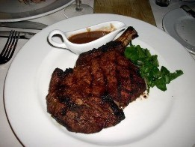
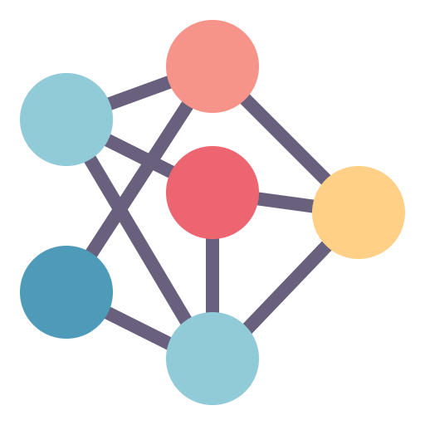

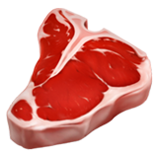

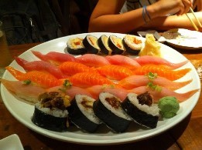
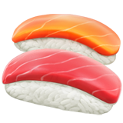
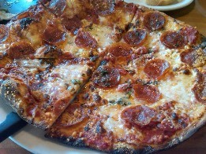

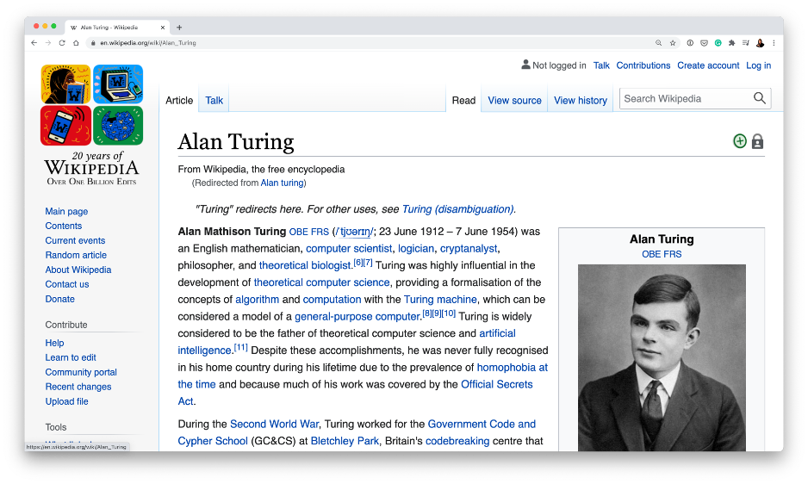
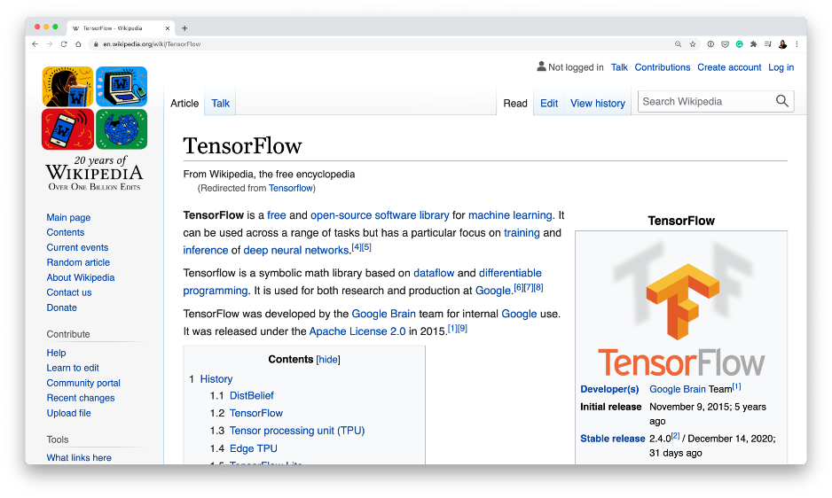
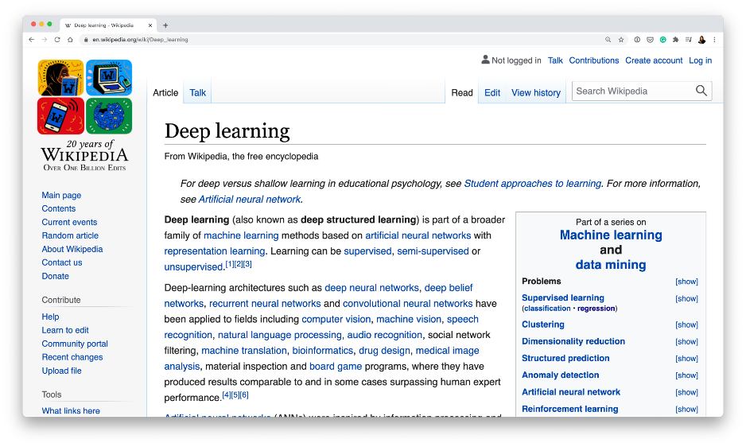
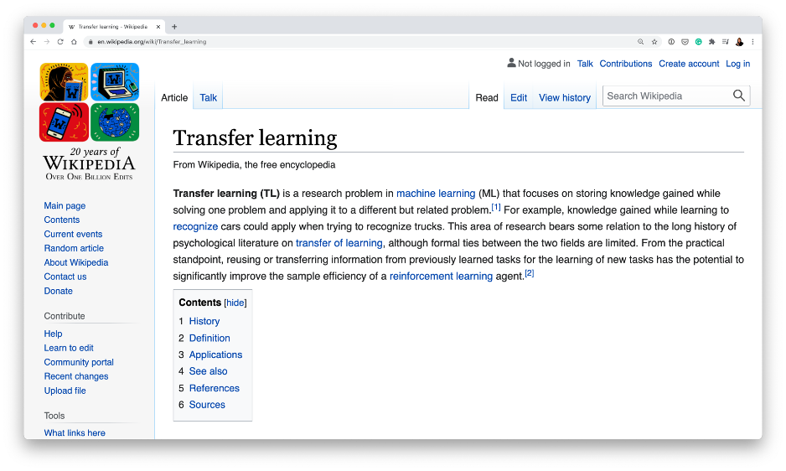
Example transfer learning use cases
Computer vision
Natural language processing
To: daniel@mrdbourke.com Hey Daniel,
To: daniel@mrdbourke.com Hay daniel…
This deep learning course is incredible! I can’t wait to use what I’ve learned!
C0ongratu1ations! U win $1139239230
Not spam
Spam
Model learns patterns/weights from similar problem space
Patterns get used/tuned to specific problem

Slide 5
“Why use transfer learning?”

Slide 6
Why use transfer learning?
Can leverage an existing neural network architecture proven to work on problems similar to our
own
Can leverage a working network architecture which has already learned patterns on similar data to our own (often results in great results with less data)
Learn patterns in a wide variety of images (using ImageNet)
Pretrained EfficientNet architecture (already works really well on computer vision tasks)
Extract/tune patterns/weights to suit our own problem (FoodVision Mini)
Model performs better than from scratch

Slide 7
Improving a model
Method to improve a model (reduce overfitting)
What does it do?
Gives a model more of a chance to learn patterns between samples (e.g. if a model is performing poorly on images of pizza, show it more images of pizza).
More data
Increase the diversity of your training dataset without collecting more data (e.g. take your photos of pizza and randomly rotate them 30°).
Increased diversity forces a model to learn more generalisation patterns.
Data augmentation
Not all data samples are created equally. Removing poor samples from or adding better samples to your dataset can improve your model’s performance.
Better data
Take an existing model’s pre-learned patterns from one problem and tweak them to suit your own problem. For example, take a model trained on pictures of cars to recognise pictures of trucks.
Use transfer learning

Slide 8

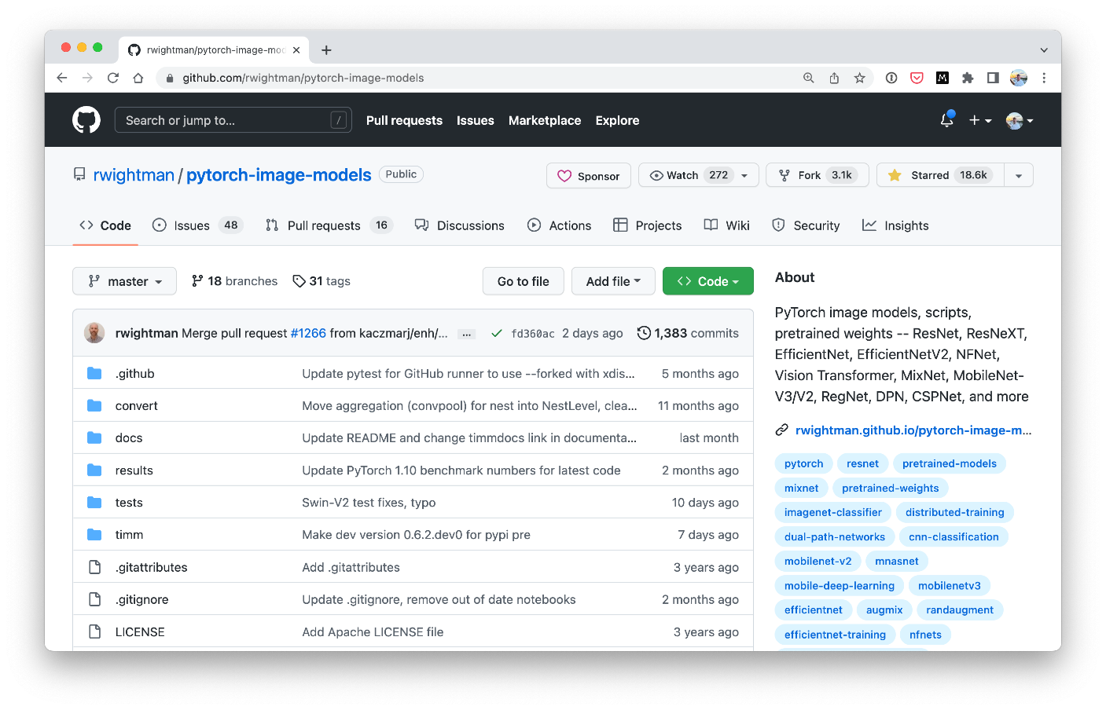
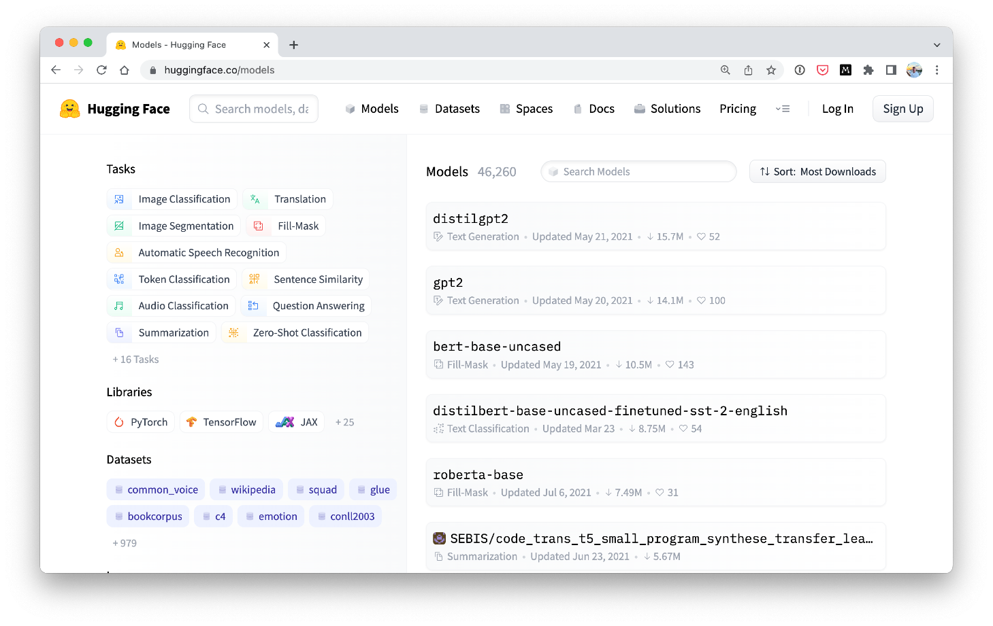


Where to find pretrained models
PyTorch domains libraries (torchvision, torchtext, torchaudio, torchrec). Source: https://pytorch.org/vision/stable/models.html
Torch Image Models (timm library).
Source: https://github.com/rwightman/pytorch-image-models
HuggingFace Hub.
Source: https://huggingface.co/models
Paperswithcode SOTA.
Source: https://paperswithcode.com/sota

Slide 9



What we’re going to cover
(broadly)
Getting setup (importing previously written code)
Introduce transfer learning with PyTorch
Customise a pretrained model for our own use case (FoodVision Mini )
Evaluating a transfer learning model
Making predictions on our own custom data
How:
(we’ll be cooking up lots of code!)

Slide 10
Let’s code!

Slide 11
Original Model vs. Feature Extraction
Changes
Output layer(s) gets trained
ImageNet has 1000 classes
Output Layer (shape = 1000)
3
on new data
…
…
Layer 235
Layer 235
Layer 234
Layer 234
Working architecture
(e.g. EfficientNet)
Stays same (frozen)
…
(original model layers don’t update during training)
…
Layer 2
Layer 2
Input Layer
Input Layer
…
…
Changes
Large dataset (e.g. ImageNet)
Original Model
Different dataset (e.g. 3 classes of food )
Feature Extraction Transfer Learning Model

Slide 12
Kinds of Transfer Learning
Top layers get trained
on new data
Output Layer (shape = 1000)
Changes
3
Stays same
3
…
…
…
Layer 235
Layer 235
Layer 235
Changes (unfrozen)
Layer 234
Layer 234
Layer 234
Stays same (frozen)
…
…
…
Layer 2
Layer 2
Layer 2
Stays same (frozen)
Input Layer
Input Layer
Input Layer
…
…
…
Changes
Might change
Fine-tuning
usually requires
more data than
Large dataset (e.g. ImageNet)
Original Model
Different dataset (e.g. 3 classes of food
Feature Extraction
)
feature
extraction
Fine-tuning

Slide 13
Kinds of Transfer Learning
Type
Description
What happens
When to use
Take a pretrained model as it is and apply it to your task without any changes.
The original model remains unchanged.
Helpful if you have the exact same kind of data
the original model was trained on.
Original model (“As is”)
Take the underlying patterns (also called weights) a pretrained model has learned and adjust its outputs to be more suited to your problem.
Most of the layers in the original
Helpful if you have a small amount of custom
Feature extraction
model remain frozen during training tr data (similar to what the original model was
(only the top 1-3 layers get updated).
ained on) and want to utilise a pretrained model
to get better results on your specific problem.
Take the weights of a pretrained model and adjust (fine-tune) them to your own problem.
Some, many or all of the layers in the pretrained model are updated during training.
Helpful if you have a large amount of custom data and want to utilise a pretrained model and improve its underlying patterns to your specific problem.
Fine-tuning

Slide 14

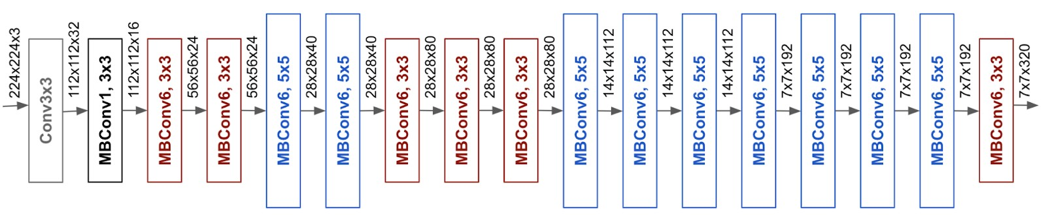


EfficientNet feature extractor
Input data (Pizza, Steak, Sushi)
Changes
(same shape as number of classes)
Stays same
(frozen, pretrained on ImageNet)
3
EfficientNetB0 architecture. Source: https://ai.googleblog.com/2019/05/efficientnet-improving-accuracy-and.html
EfficientNetB0 Backbone (torchvision.models.efficientnet_b0)
Linear classifier layer
(torch.nn.Linear)

Slide 15
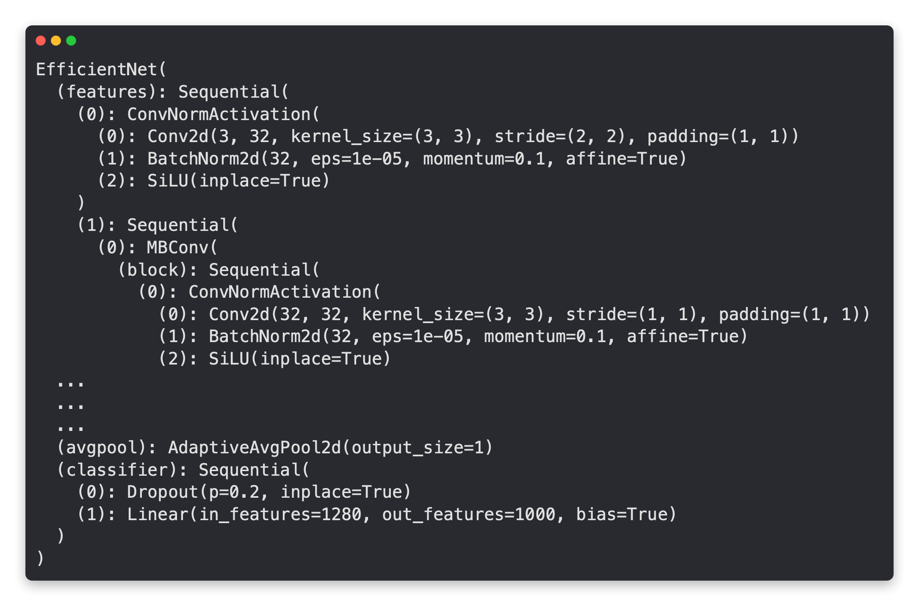
EfficientNet feature extractor
EfficientNetB0 Backbone
(torchvision.models.efficientnet_b0(prertained=True)
Extracts features
from image
Turns features into a feature vector (by taking the average)
Turns feature vector into prediction logits
Can adjust depending on the number of classes you have

Slide 16

EfficientNet feature extractor — changing the classifier head
EfficientNetB0 Backbone
(torchvision.models.efficientnet_b0(prertained=True)
Same
Changed
Original Model
Original Model + Changed Classifier Head
(3 output classes for , , )
(1000 output classes for ImageNet)

Slide 17
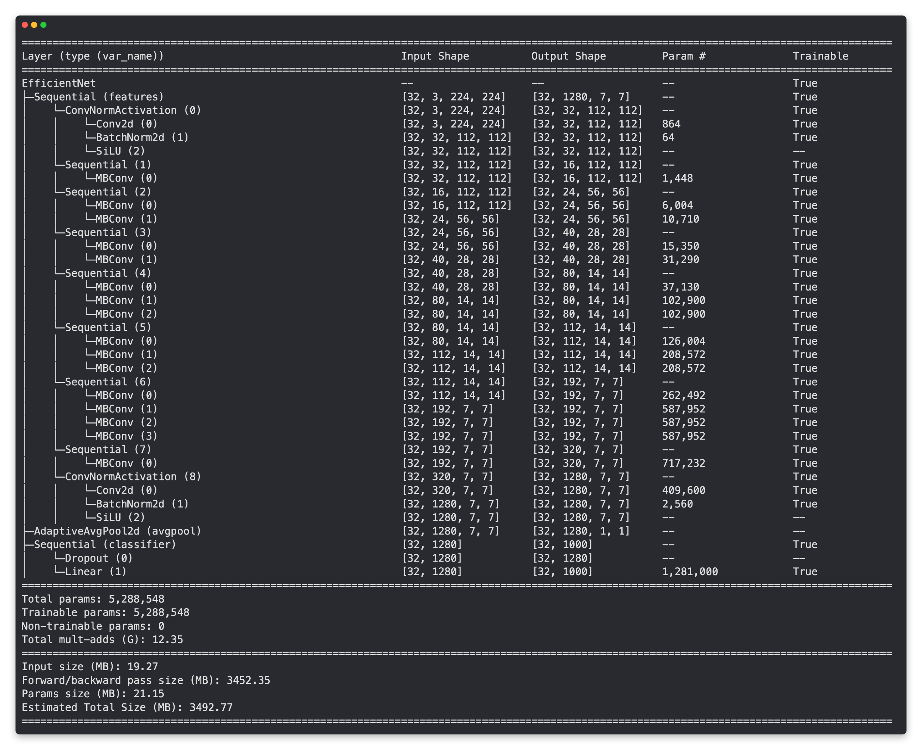
Input shape of data per layer Output shape of data per layer
torchinfo.summary(model, input_size=(32, 3, 224, 224))
Are the layers trainable? (unfrozen)
Total number of parameters and trainable parameters

Slide 18
torchinfo.summary(model, input_size=(32, 3, 224, 224))
Many layers
untrainable (frozen)
Only last layers are trainable
Final layer output (same as number of classes )
Less trainable parameters because many layers are frozen

