Slide 1

Experiment Tracking with
Milestone Project 1

Slide 2
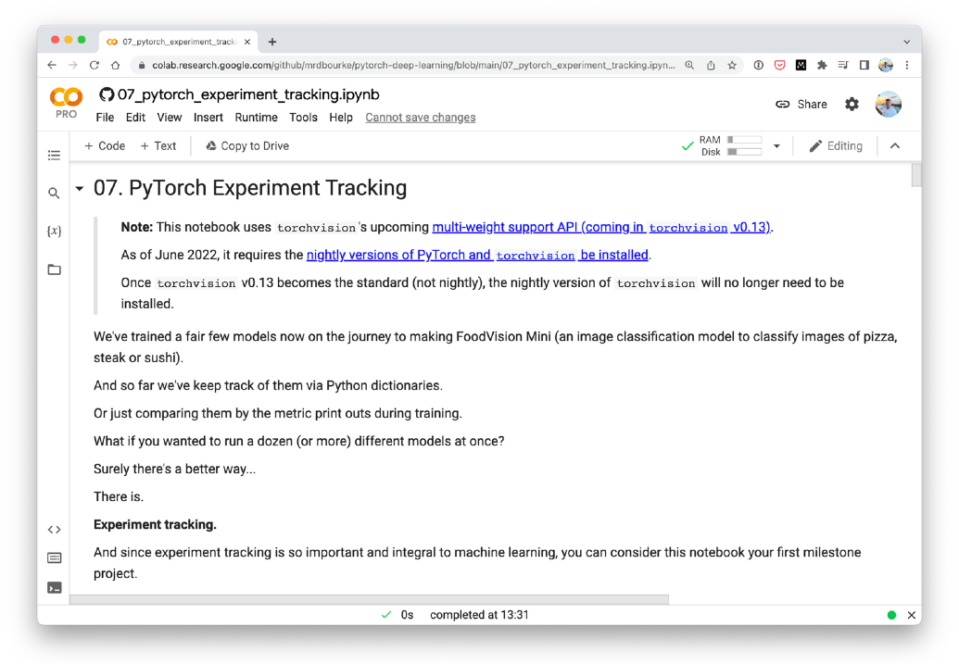
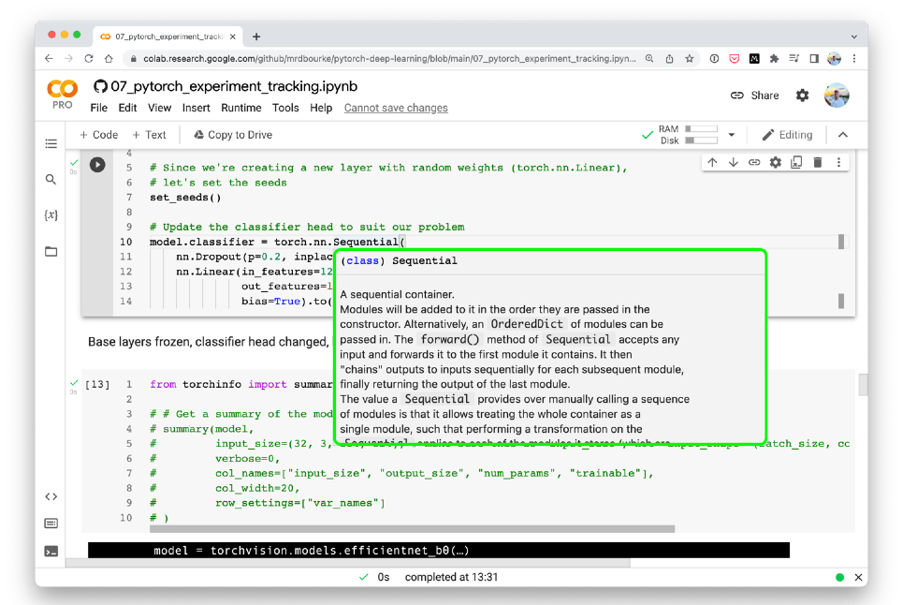

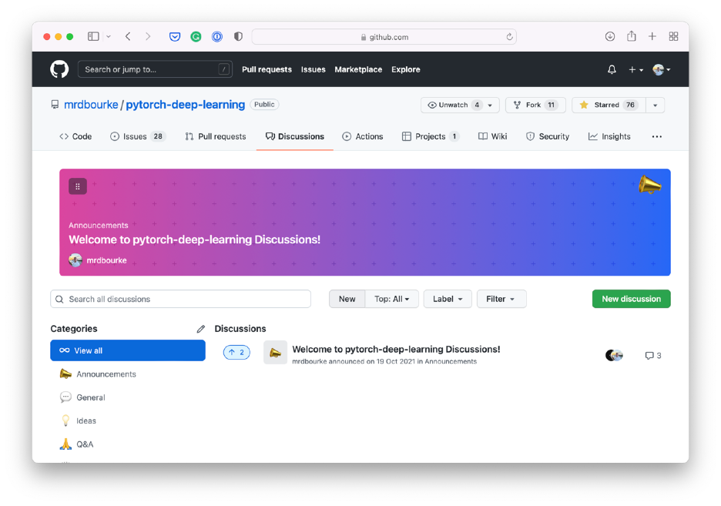

Where can you get help?
“If in doubt, run the code”
Follow along with the code
Try it for yourself
Press SHIFT + CMD + SPACE to read the docstring
Search for it
Try again
Ask
https://www.github.com/mrdbourke/pytorch-deep-learning/discussions

Slide 3
“What is experiment tracking?”
How do I know which of my models has done the best…?

Slide 4
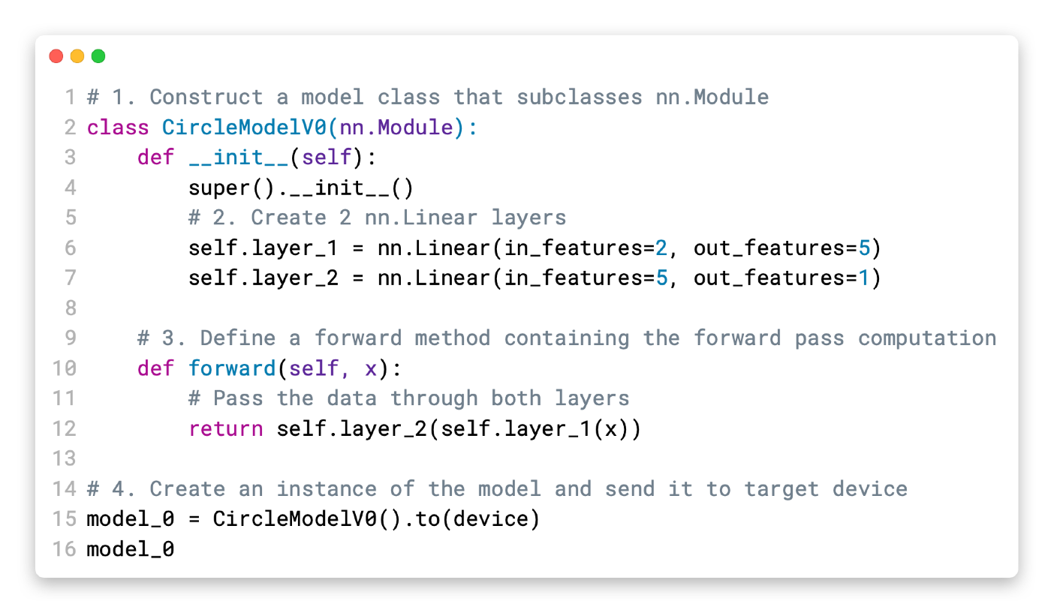









How to approach this course
Motto #2:
Experiment, experiment,
Motto #3: Visualize, visualize, visualize!
experiment!
1. Code along
2. Explore and experiment
3. Visualize what you don’t understand
Motto #1: if in doubt, run the code!
(including the
“dumb” ones)
4. Ask questions
5. Do the exercises
6. Share your work

Slide 5
“Why track experiments?”

Slide 6
Experiment tracking can quickly get out of hand…
results
model_1_results
model_2_results
model_1_results_v2
model_2_results_v2
model_2_results_v3
model_2_results_v3
2022-07-07-model_3_results_v1
2022-07-07-model_3_results_v1_experiment_5
2022-07-07-model_3_results_v2_big_model_25_epochs
2022-07-07-model_4_results_v1_big_model_25_epochs_20_percent_data
2022-07-07-model_4_results_v1_big_model_25_epochs_20_percent_data_new_model
2022-07-07-model_4_results_v2_big_model_feature_extractor_30_epochs_20_percent_data_no_dro
2022-07-07-model_5_results_v1_bigger_model_feature_extractor_50_epochs_50_percent_data_no_

Slide 7
How do I know which one of my models performs the best?
0 results
model_1_results
model_2_results
model_1_results_v2
model_2_results_v2
model_2_results_v3
model_2_results_v3
2022-07-07-model_3_results_v1
What should I try less of?
8 2022-07-07-model_3_results_v1_experiment_5
What should I try more of?
2022-07-07-model_3_results_v2_big_model_25_epochs
2022-07-07-model_4_results_v1_big_model_25_epochs_20_percent_data
2022-07-07-model_4_results_v1_big_model_25_epochs_20_percent_data_new_model
2022-07-07-model_4_results_v2_big_model_feature_extractor_30_epochs_20_percent_data_no_dro
2022-07-07-model_5_results_v1_bigger_model_feature_extractor_50_epochs_50_percent_data_no_

Slide 8


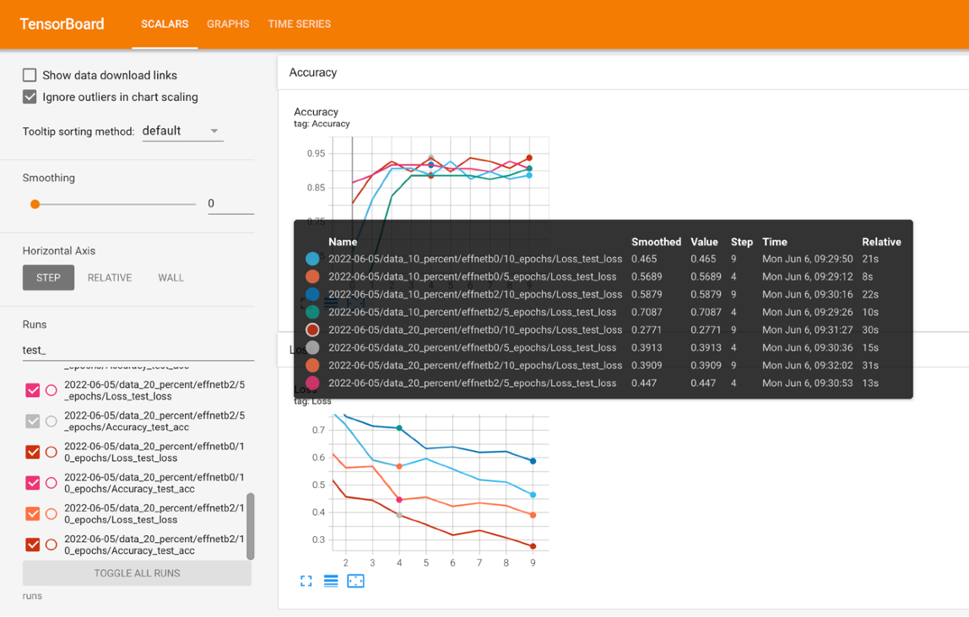
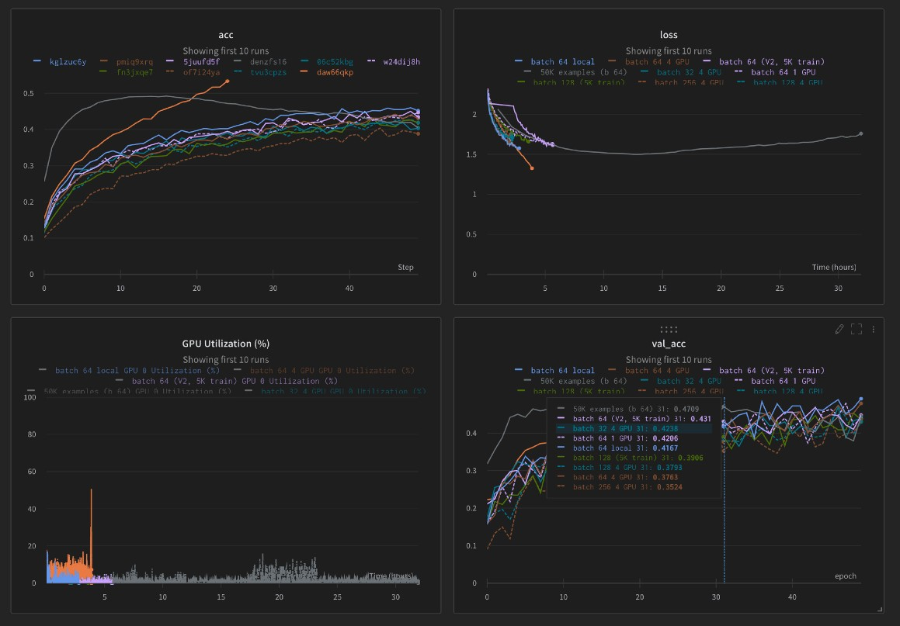

Different ways to track experiments
Python dictionaries, CSV files, print outs.
Search: “track machine learning experiments”
TensorBoard
Source: https://www.tensorflow.org/tensorboard
MLfLow
Source: https://mlflow.org/docs/latest/tracking.html
Weights & Biases
Source: https://wandb.ai/site/experiment-tracking

Slide 9


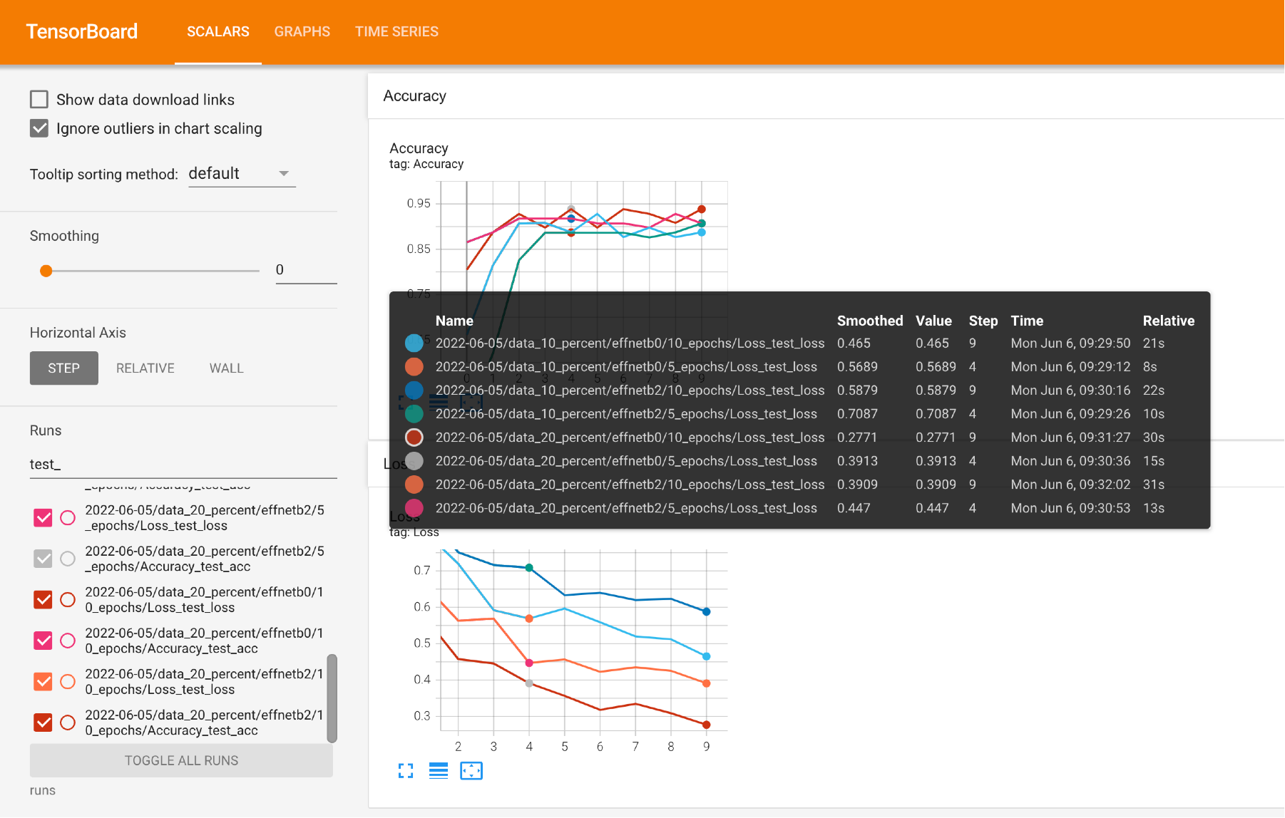




What we’re going to build
FoodVision Mini Experiment Tracking
Experiment Results tracked in TensorBoard
1
2
3
4
. . .

Slide 10



What we’re going to cover
(broadly)
Getting setup (importing previously written code)
Introduce experiment tracking with PyTorch
Building several modelling experiments for FoodVision Mini
Evaluating modelling experiments with TensorBoard
Making predictions with the best performing model on custom data
How:
(we’ll be cooking up lots of code!)

Slide 11
Let’s code!

Slide 12
model = torchvision.models.efficientnet_b0(…) torchinfo.summary(model, input_size=(32, 3, 224, 224))
Many layers
untrainable (frozen)
Only last layers are trainable
Final layer output (same as number of classes )
Less trainable parameters because many layers are frozen

Slide 13

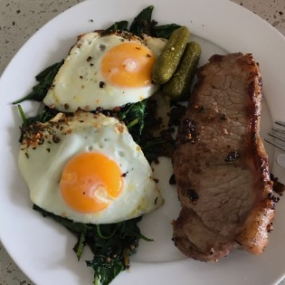
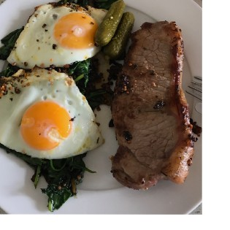
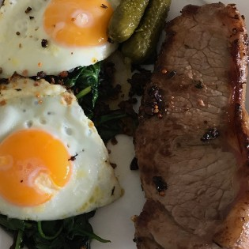
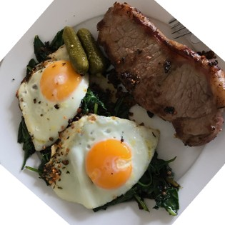
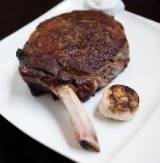
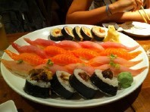
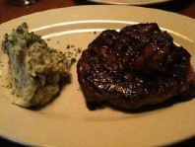
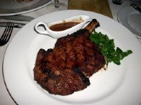
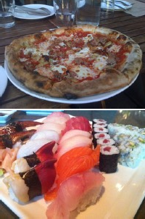
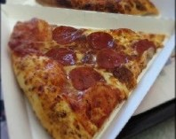
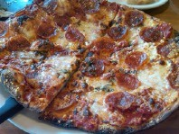
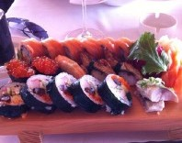
What experiments should you try?
torch.nn.Linear(in_features=256, out_features=512) torch.nn.Linear(in_features=512, out_features=1024)
Number of layers/ hidden units
Model architecture
Data augmentation
Loss
Amount of data
torch.optim.Adam(lr=0.001) torch.optim.Adam(lr=0.0003) torch.optim.lr_schedular()
Learning rate
Epochs
+ any hyperparameter you can think of…

Slide 14
Experiments we’re running
Experiment number | Training data | Testing data | Model architecture | Number of epochs
1 | Pizza, Steak Sushi 10% training data | Pizza, Steak Sushi 10% testing data | EffNetB0 | 5
2 | Pizza, Steak Sushi 10% training data | Same as 1 | EffNetB2 | 5
3 | Pizza, Steak Sushi 10% training data | Same as 1 | EffNetB0 | 10
4 | Pizza, Steak Sushi 10% training data | Same as 1 | EffNetB2 | 10
5 | Pizza, Steak Sushi 20% training data | Same as 1 | EffNetB0 | 5
6 | Pizza, Steak Sushi 20% training data | Same as 1 | EffNetB2 | 5
7 | Pizza, Steak Sushi 20% training data | Same as 1 | EffNetB0 | 10
8 | Pizza, Steak Sushi 20% training data | Same as 1 | EffNetB2 | 10
Note: All experiments use the same testing data (to keep evaluation consistent). Also notice how the first experiment is the smallest, and each consecutive experiment increases data, training time and model size.

Slide 15
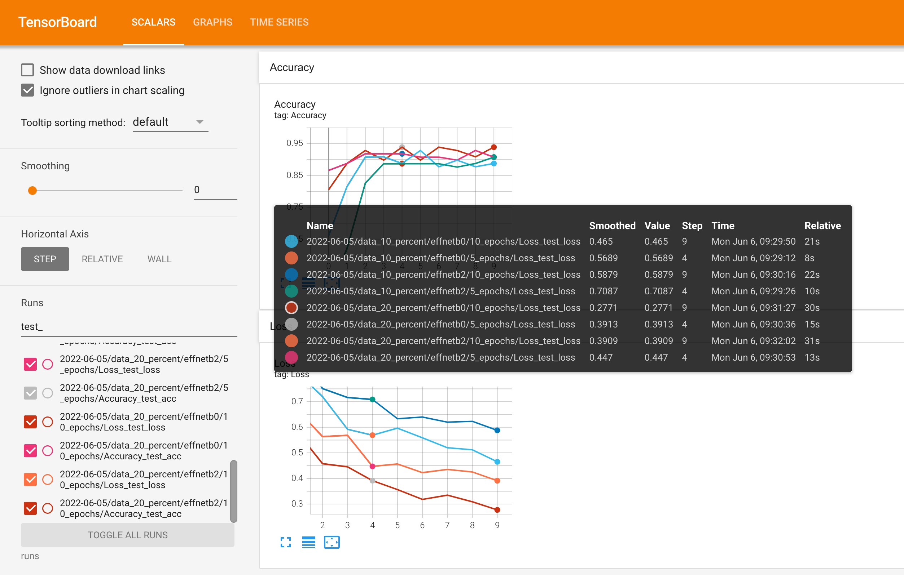
Inspecting test loss

Slide 16
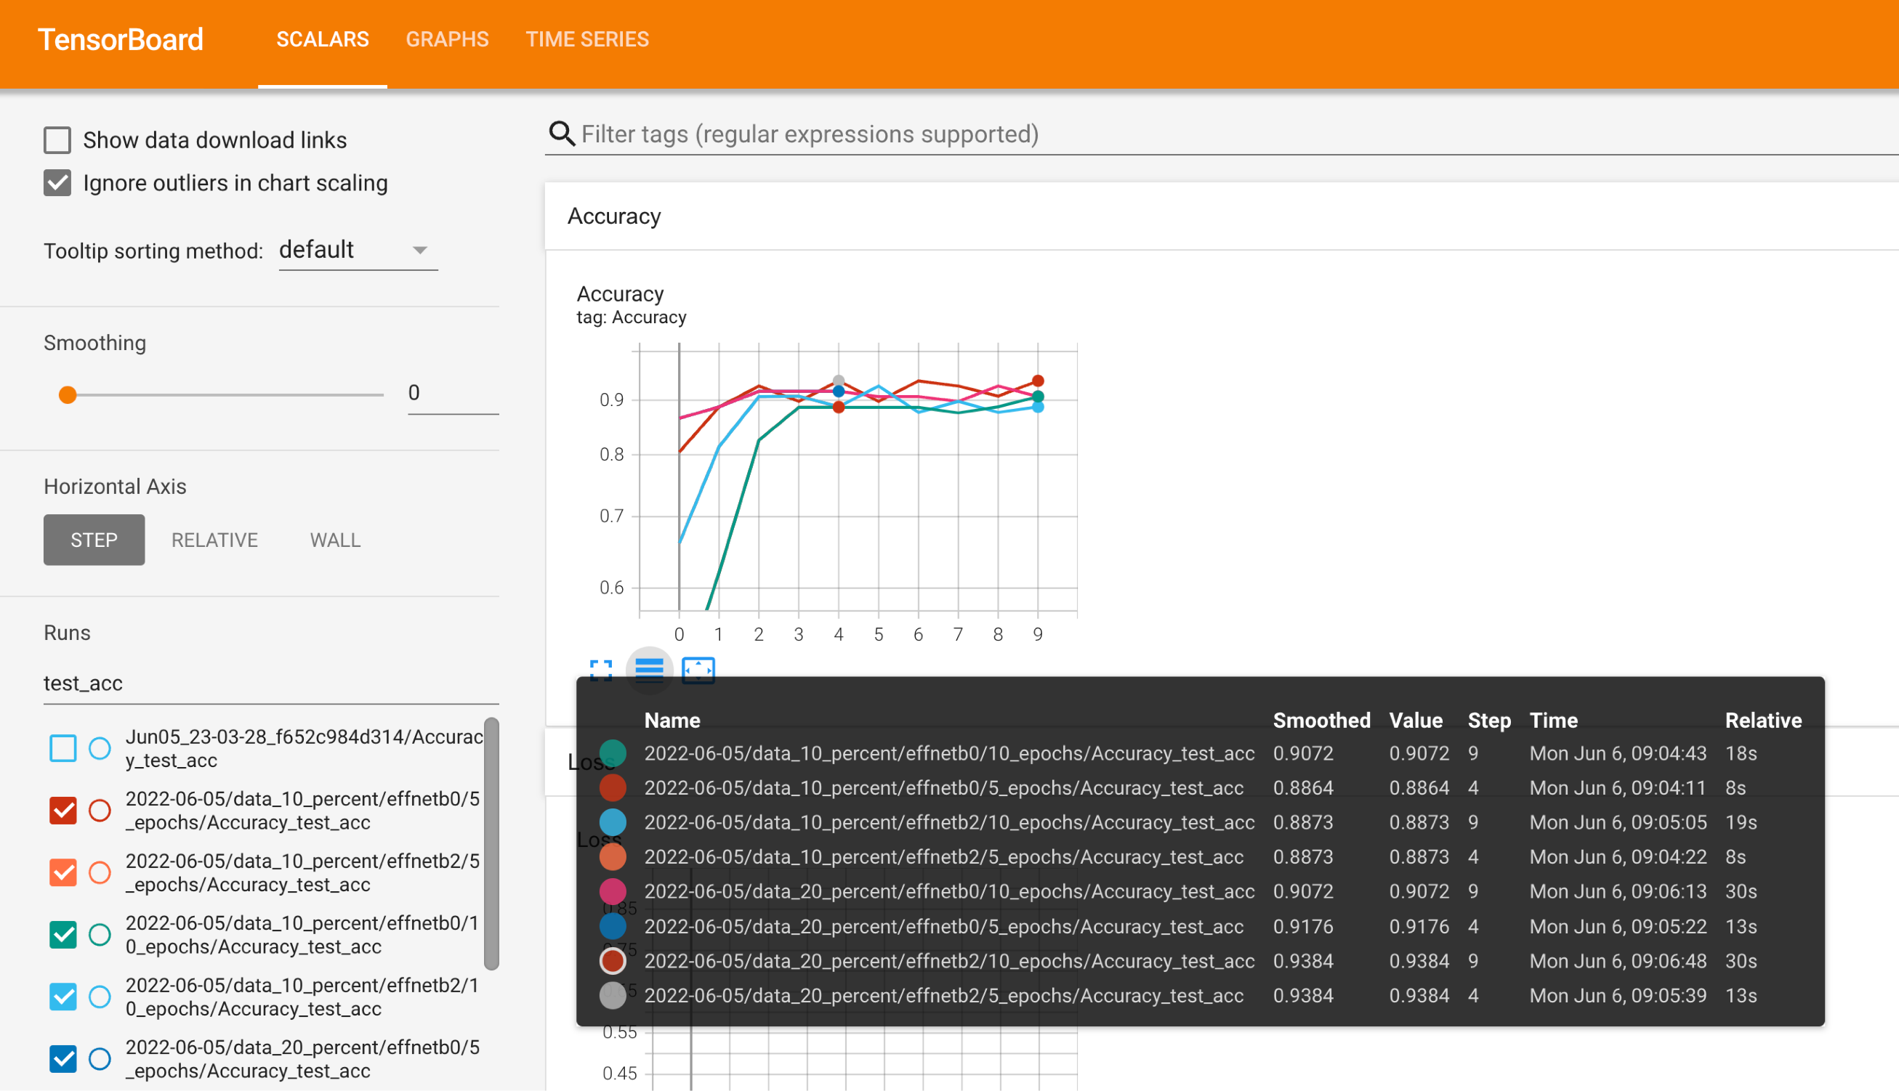
Inspecting test accuracy

Slide 17
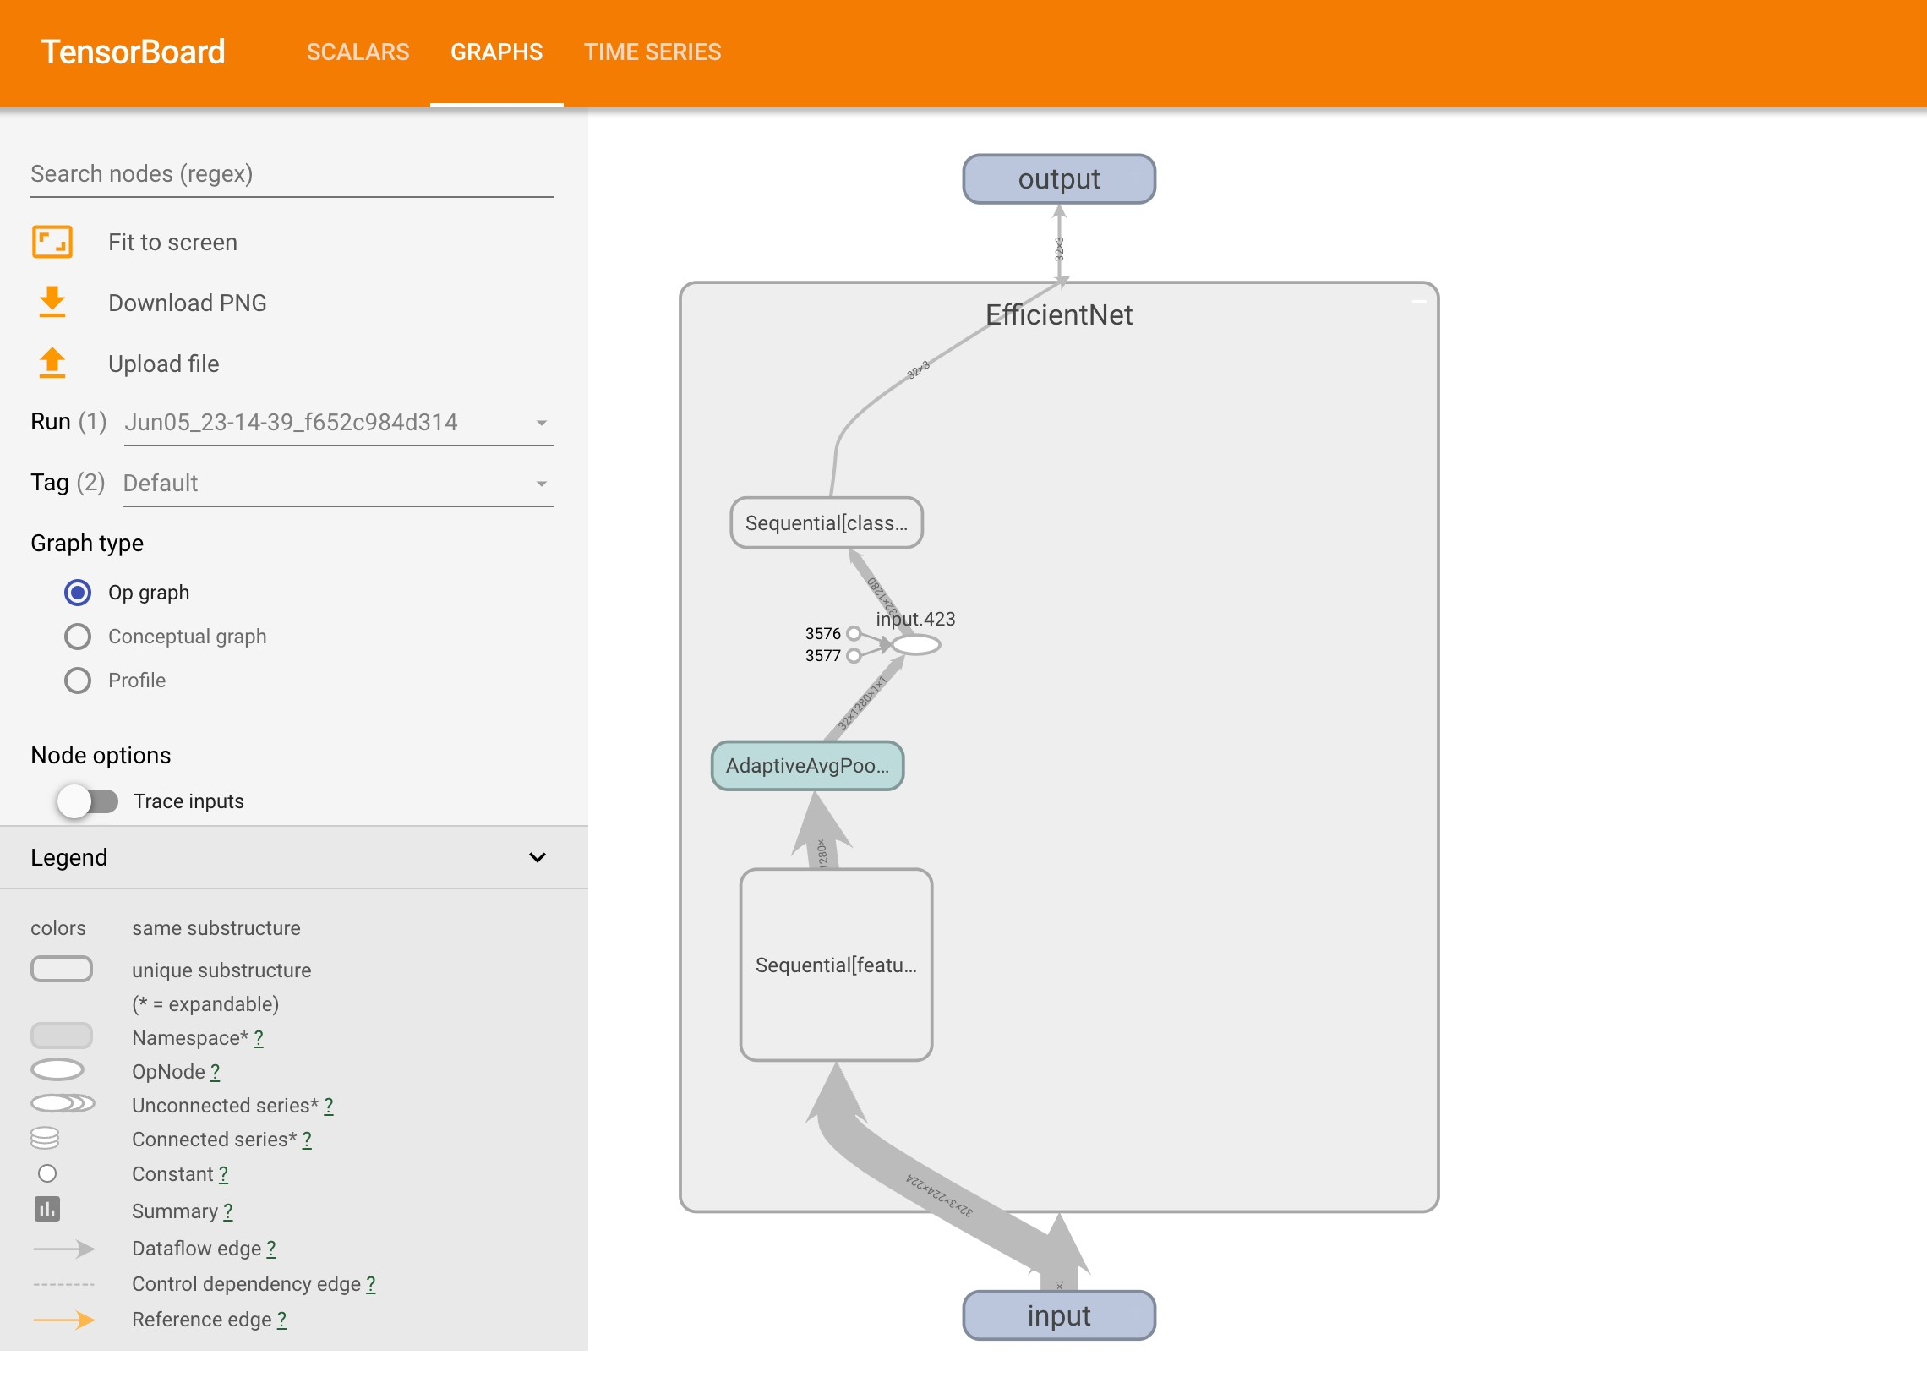
Inspecting the model architecture

