Slide 1

Paper Replicating with
Milestone Project 2

Slide 2
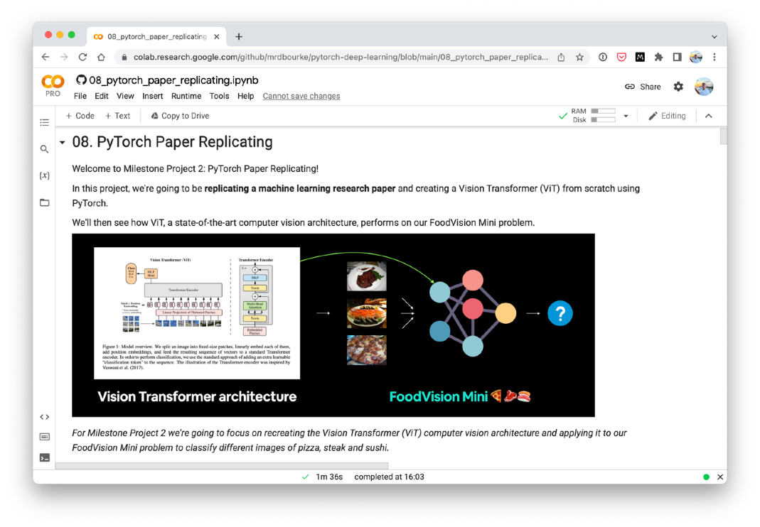
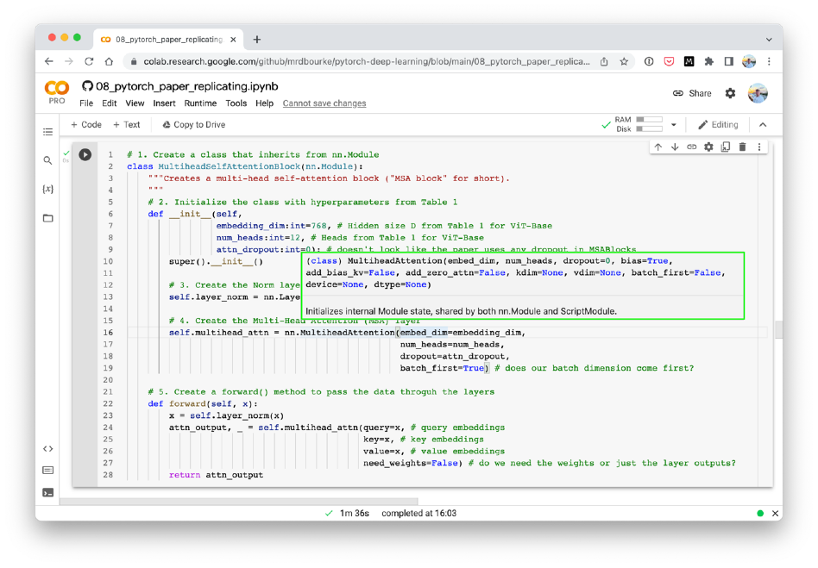



Where can you get help?
“If in doubt, run the code”
Follow along with the code
Try it for yourself
Press SHIFT + CMD + SPACE to read the docstring
Search for it
Try again
Ask
https://www.github.com/mrdbourke/pytorch-deep-learning/discussions

Slide 3
“What is machine learning research paper replicating?”
Turning research into usable code.

Slide 4


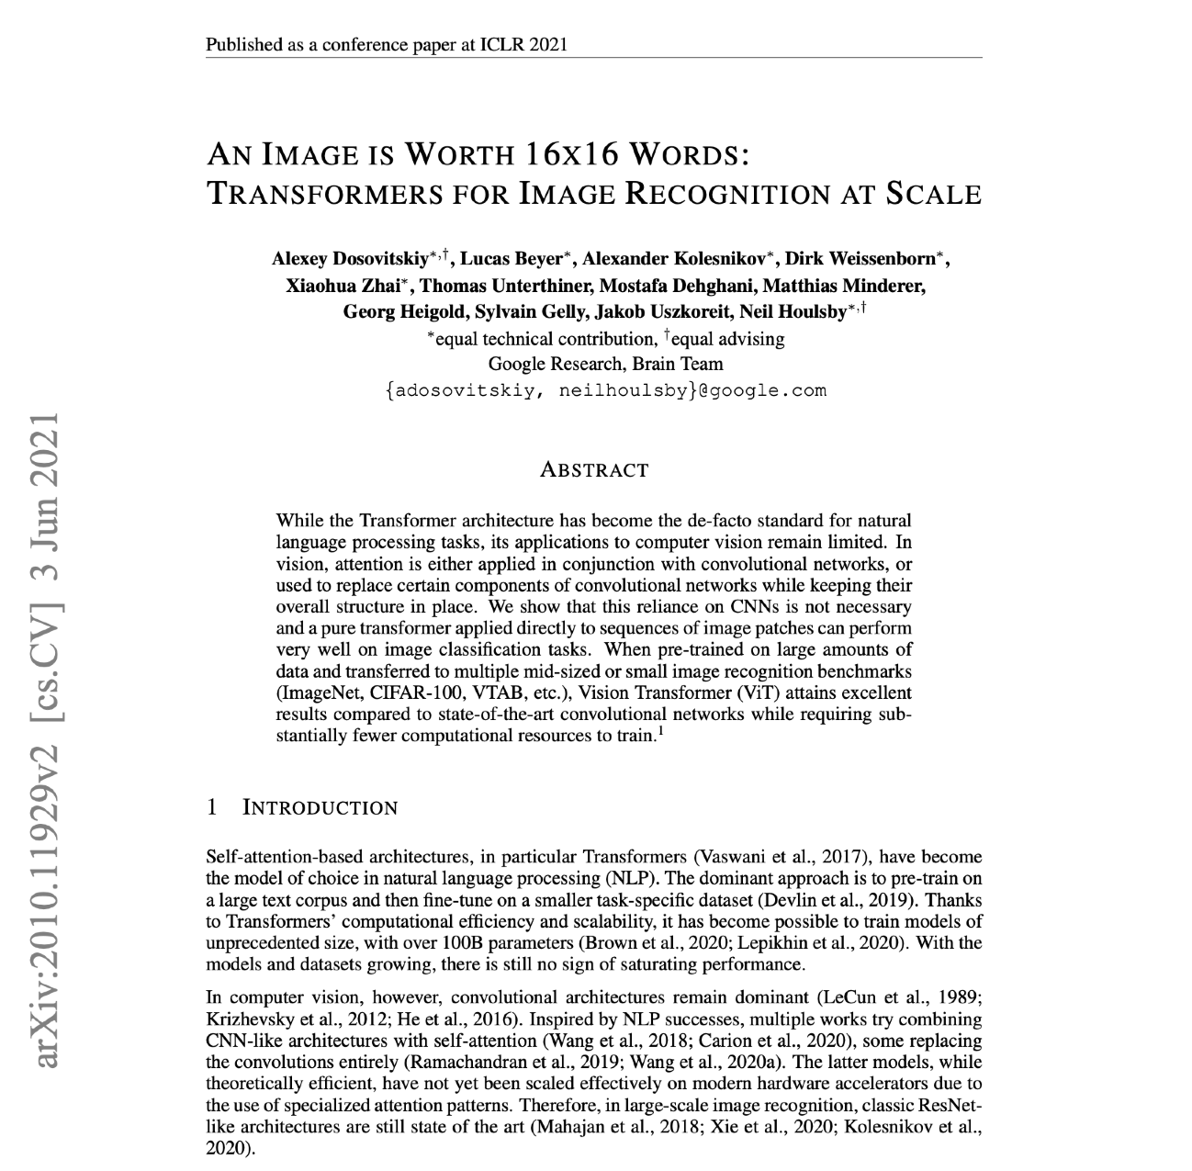

What is paper replicating?
Source: https://arxiv.org/pdf/2010.11929.pdf (ViT paper)
Machine learning paper
Cooking recipe

Slide 5
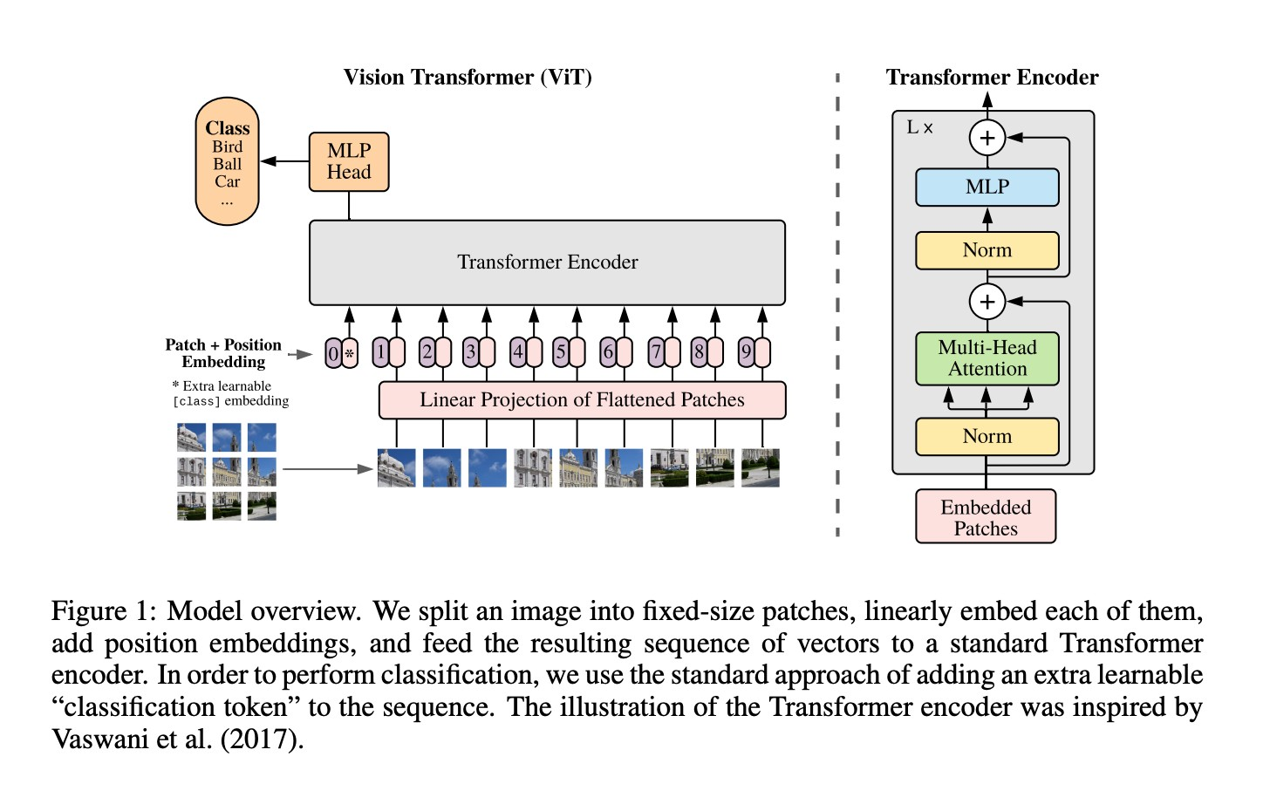
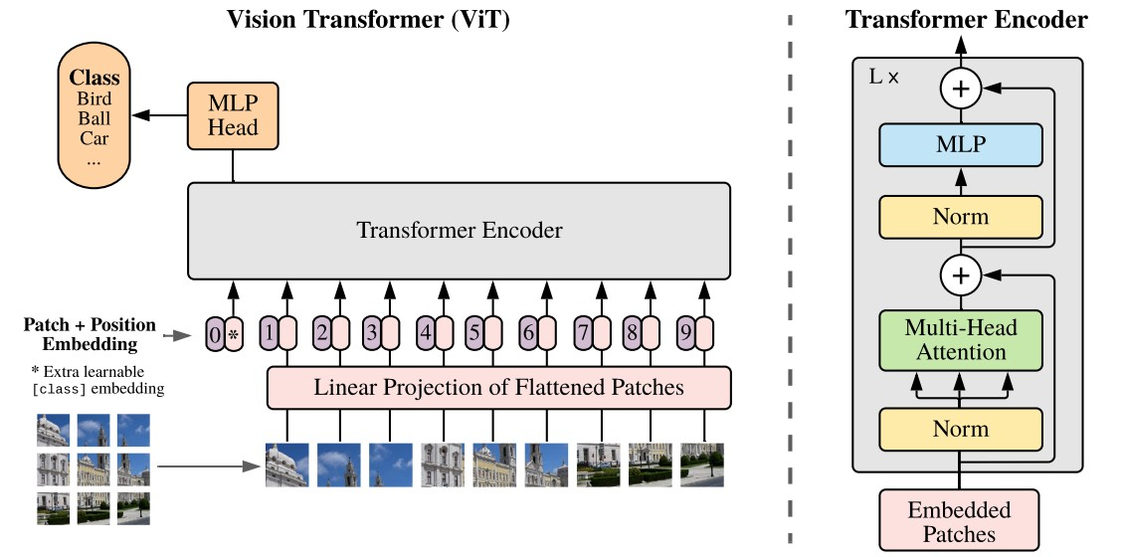
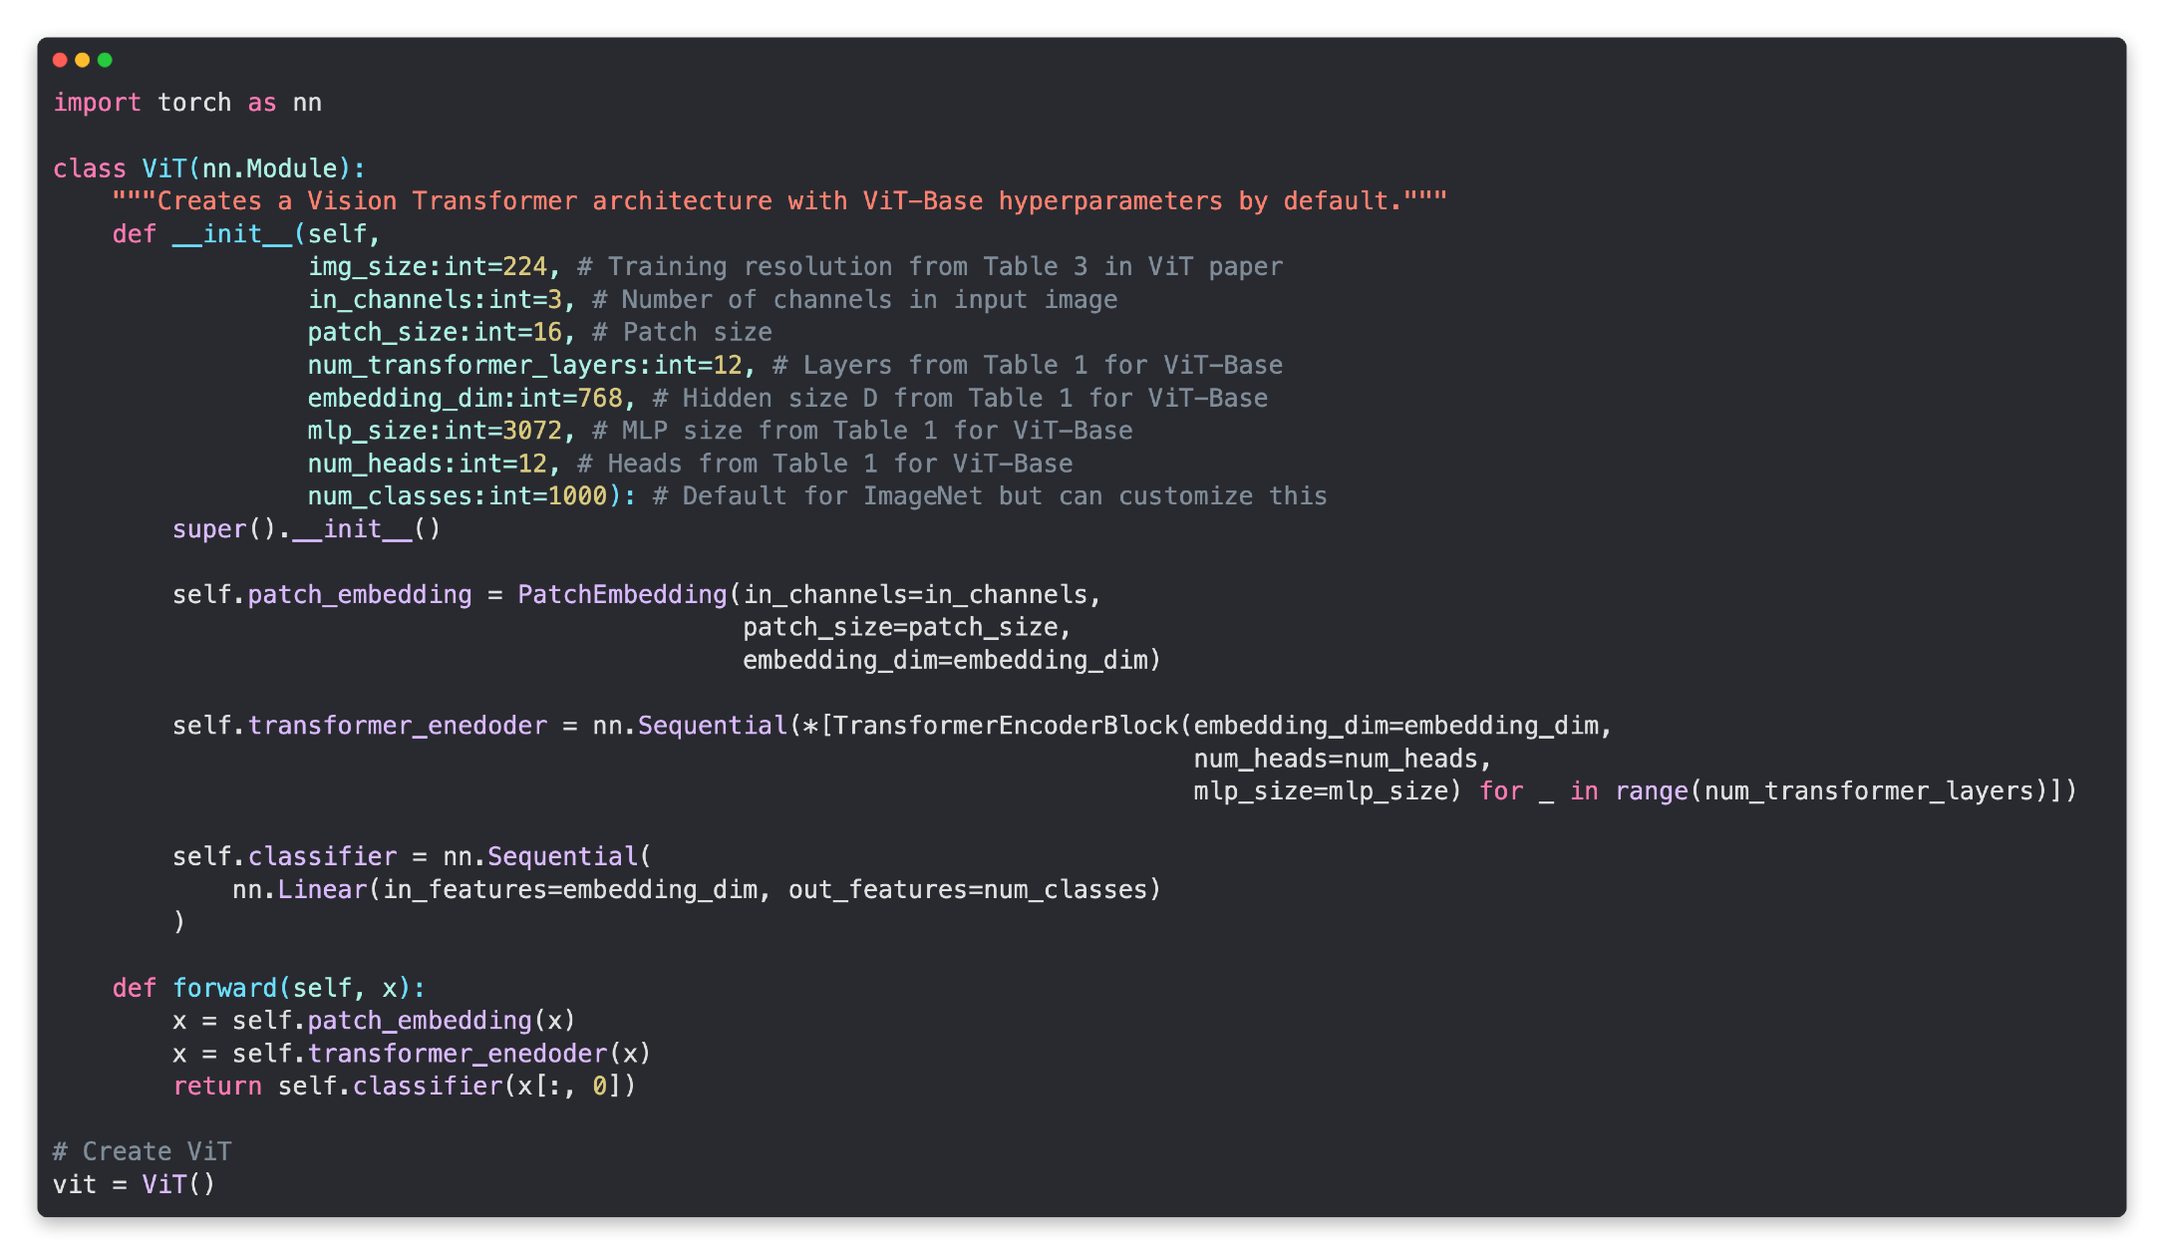
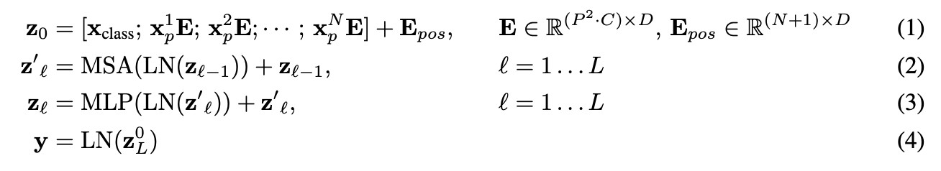
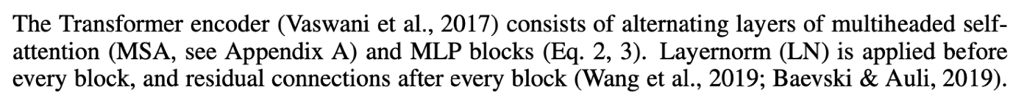
What is paper replicating?
Source: ViT paper
Images + math + text
Usable code

Slide 6
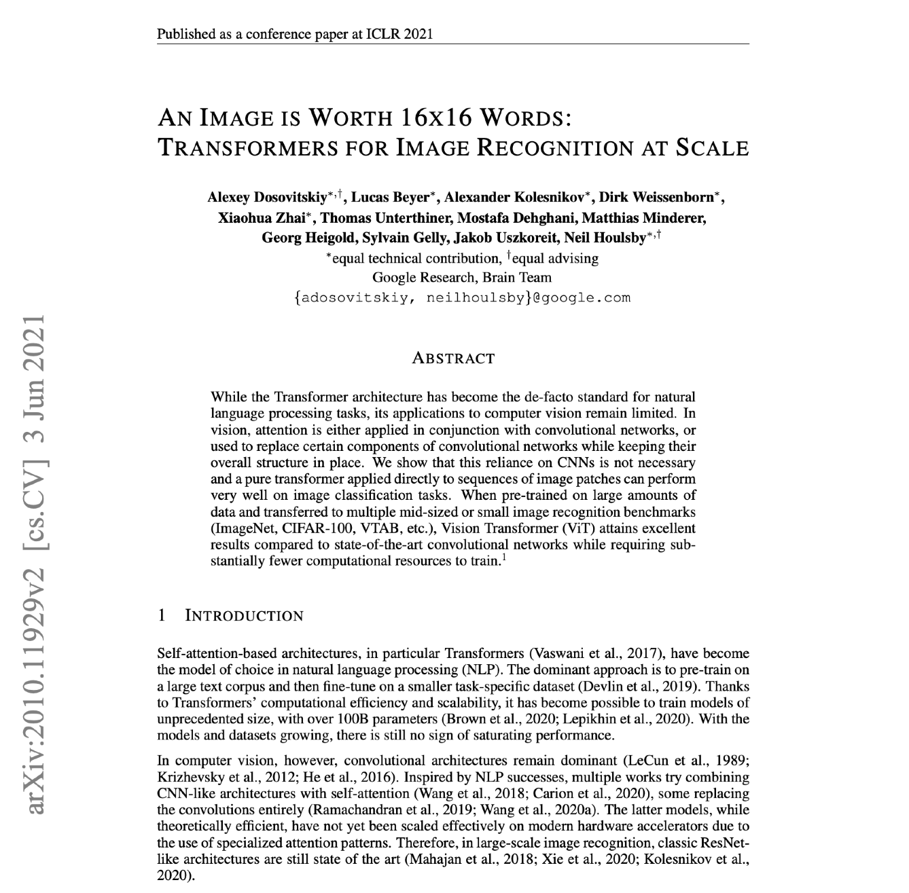
Terminology
Source: ViT paper
Source: https://arxiv.org/pdf/2010.11929.pdf (ViT paper)
Vision Transformer (ViT) architecture
ViT paper

Slide 7
“Why replicate machine learning research papers?”
1. It’s fun… and…

Slide 8
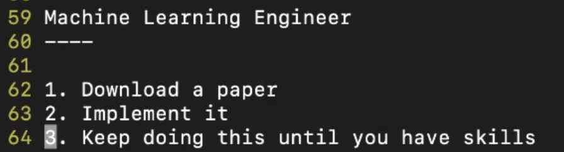
*
- George Hotz, founder of comma.ai
*Machine Learning Engineering also involves building infrastructure around your models/ data preprocessing steps

Slide 9
“What is a machine learning research paper?”

Slide 10
Anatomy of a research paper*
(and many other kinds of scientific papers)
Section | What is it?
Abstract | An overview/summary of the paper's main findings/contributions.
Introduction | What's the paper's main problem? And details of previous methods used to try and solve it.
Method | What steps did the researchers take when conducting their research? For example, what model(s), data sources, training setups were used?
Results | What are the outcomes of the paper? If a new type of model or training setup was used, how did the results of findings compare to previous works? (this is where experiment tracking comes in handy)
Conclusion | What are the limitations of the suggested methods? What are some next steps for the research community?
References | What resources/other papers did the researchers look at to build their own body of work?
Appendix | Are there any extra resources/findings to look at that weren't included in any of the above sections?
*This structure is quite fluid. It’s more of a general guide than a required outline.

Slide 11
Anatomy of a research paper*
Section What is it?
Abstract
An overview/summary of the paper's main findings/contributions.
Introduction
What's the paper's main problem? And details of previous methods used to try and solve it.
Method
How did the researchers go about conducting their research? For example, what model(s), data sources, training setups were used?
What are the outcomes of the paper? If a new type of model or training setup was used, how did the results of findings compare to previous works? (this is where experiment tracking comes in handy)
Results
Conclusion
What are the limitations of the suggested methods? What are some next steps for the research community?
References
What resources/other papers did the researchers look at to build their own body of work?
Are there any extra resources/findings to look at that weren't included in any of the above sections?
Source: https://arxiv.org/pdf/2010.11929.pdf (ViT paper)
Appendix
ViT paper

Slide 12
“Where can you find machine learning research papers?”

Slide 13

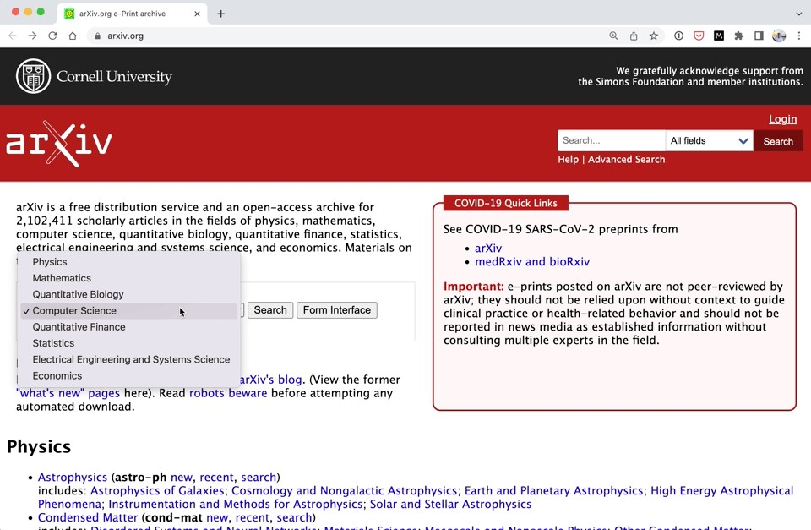
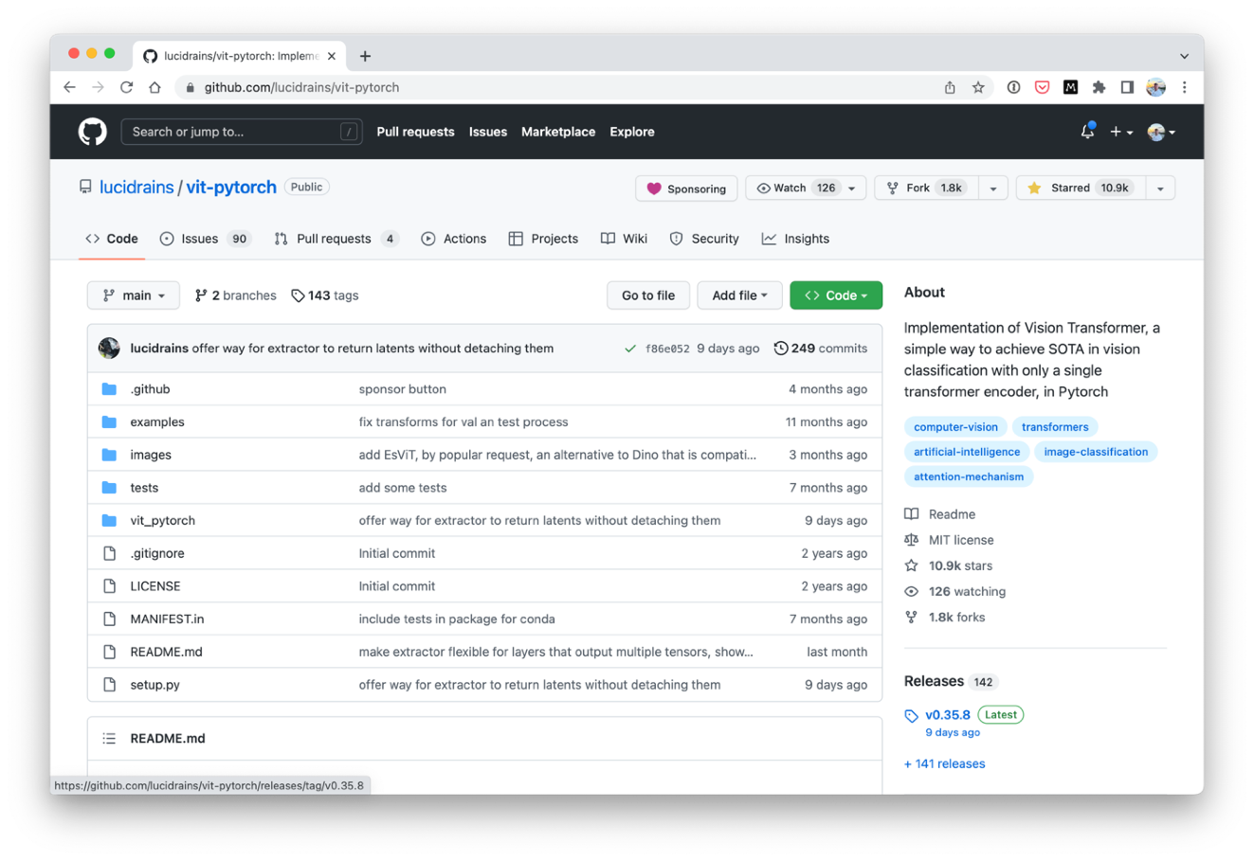

Finding machine learning papers
(and code)
Source: https://arxiv.org/
Source: AK Twitter
Source: https://github.com/lucidrains/vit-pytorch
Source: https://paperswithcode.com/

Slide 14
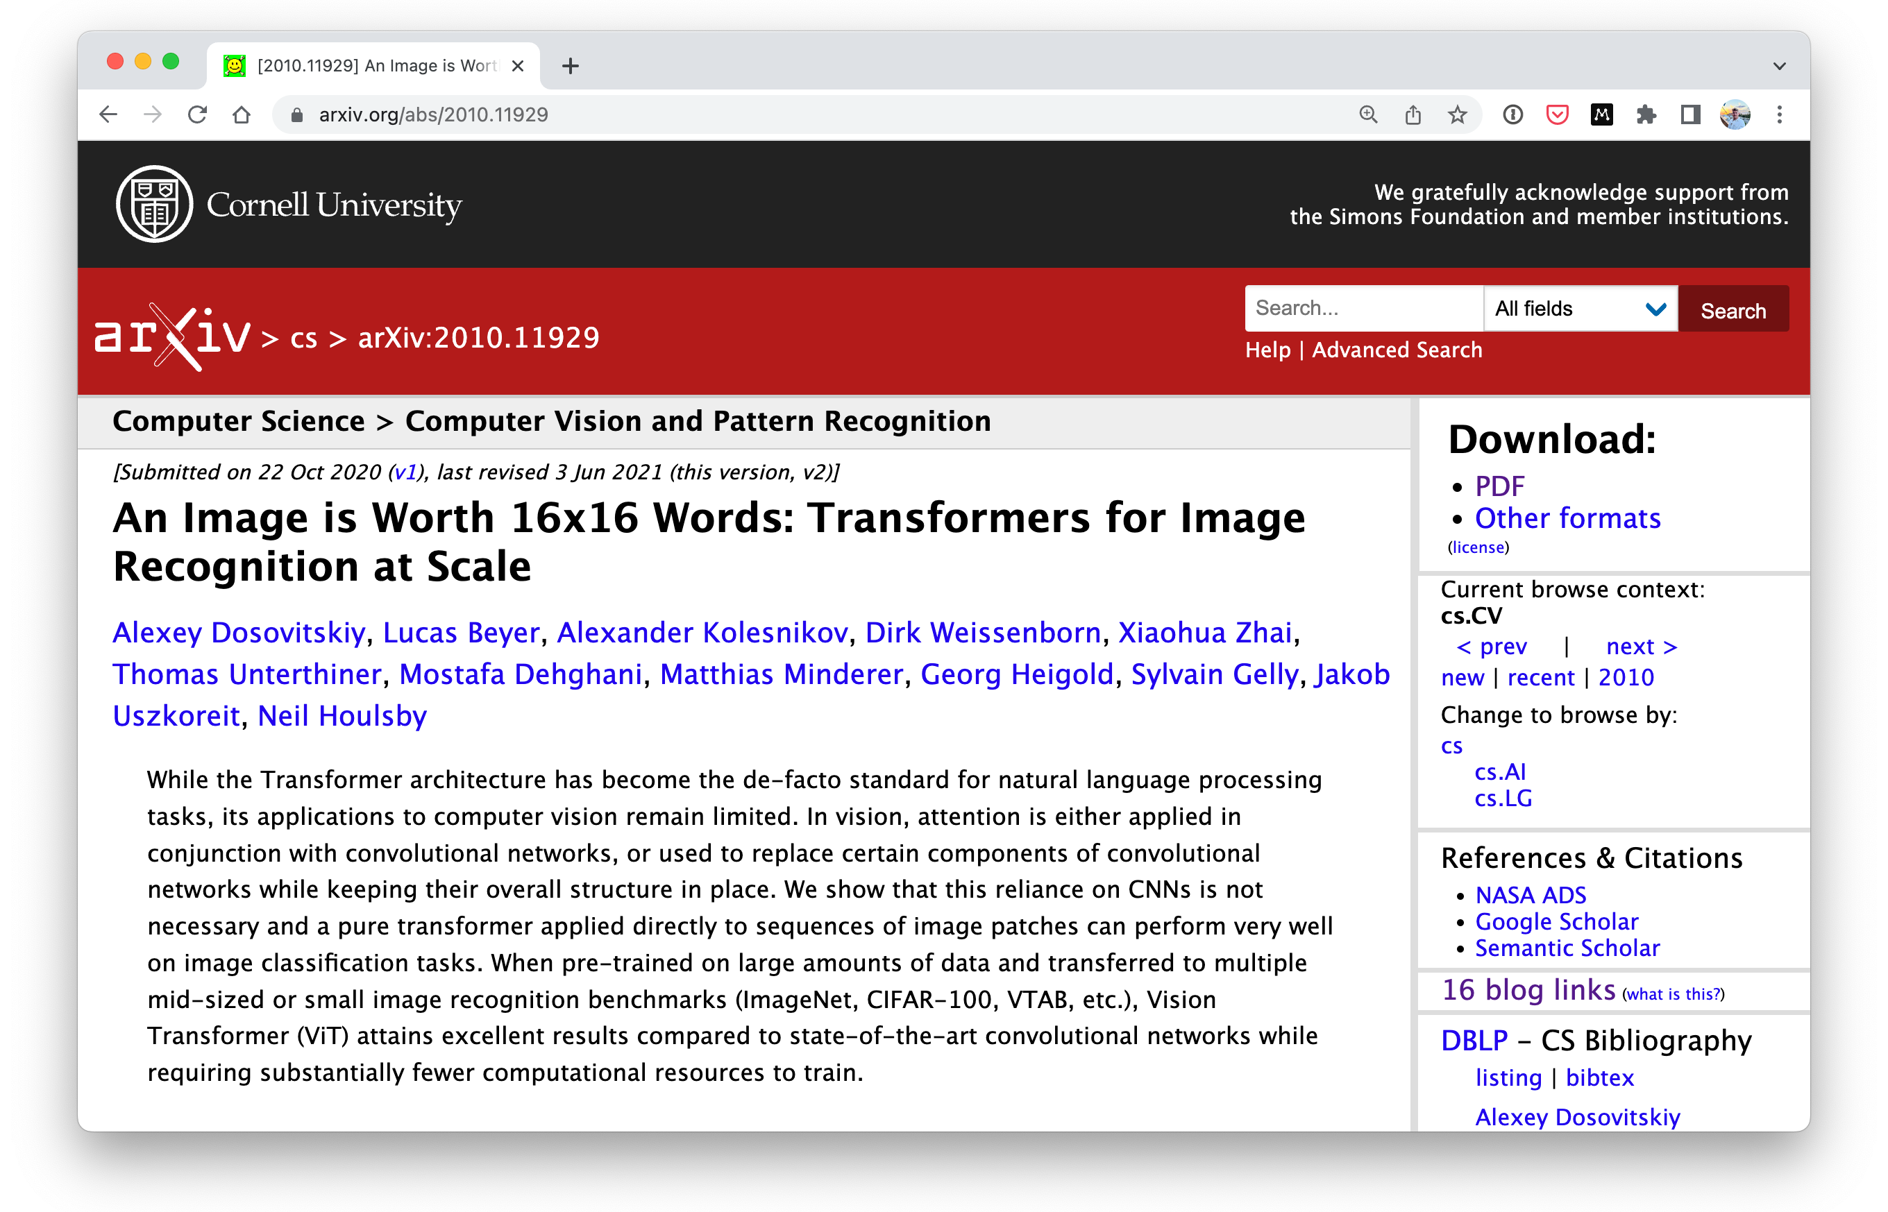
What we’re doing
Replicating the Vision Transformer paper (ViT paper)
Source: ViT paper

Slide 15
Machine Learning vs. Deep Learning
(common algorithms)
Neural networks
Fully connected neural network
Convolutional neural network
Recurrent neural network
Transformer
…many more
Random forest
Gradient boosted models
Naive Bayes
Nearest neighbour
Support vector machine
…many more
(since the advent of deep learning these are
often referred to as “shallow algorithms”)
What we’re focused on building (with PyTorch)
(depending how you represent your problem, many algorithms can be used for both)
Structured data
Unstructured data

Slide 16
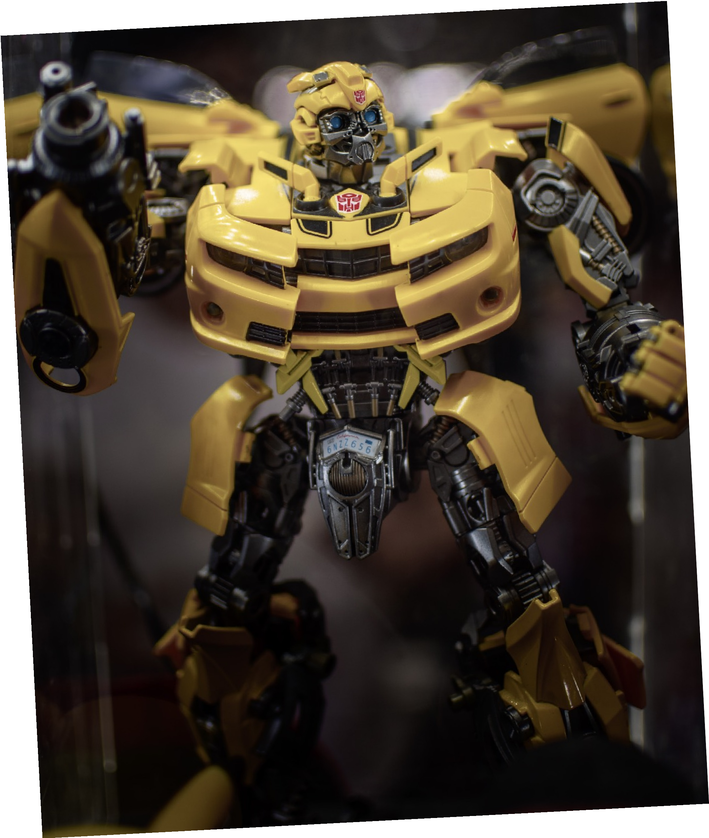
Machine Learning vs. Deep Learning
(common algorithms)
Neural networks
Fully connected neural network
Convolutional neural network
Recurrent neural network
Transformer
…many more
What we’re focused on building (with PyTorch)
Unstructured data
Source: Photo by John Tubelleza

Slide 17
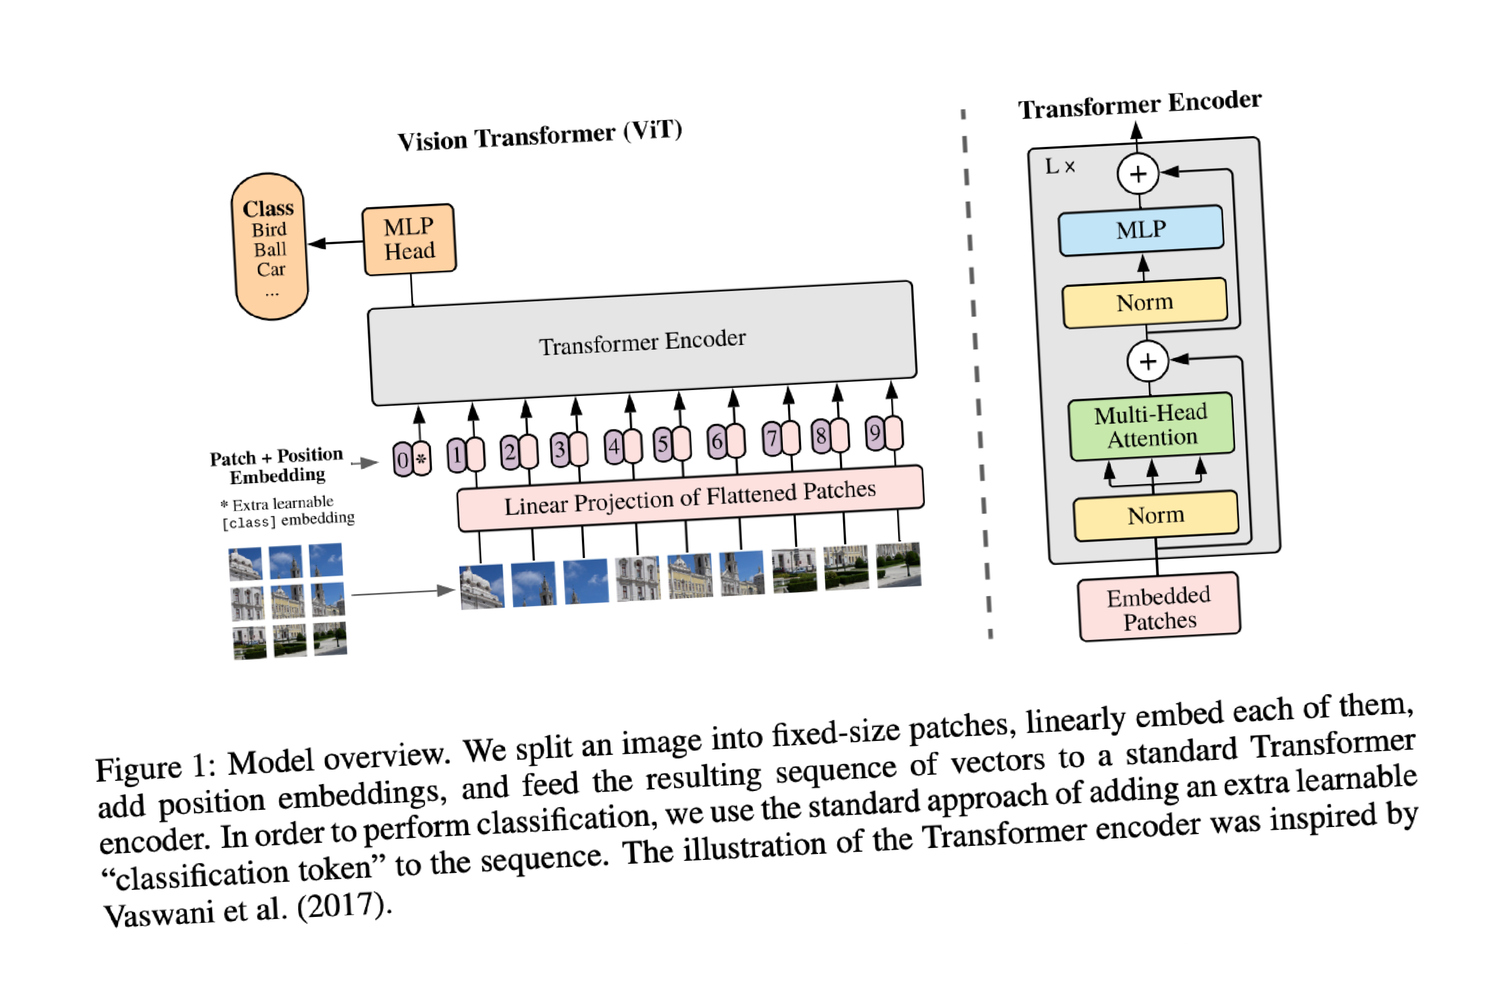
Machine Learning vs. Deep Learning
(common algorithms)
Neural networks
Fully connected neural network
Convolutional neural network
Recurrent neural network
Transformer
…many more
What we’re focused on building (with PyTorch)
Unstructured data
Source: Photo by John Tubelleza

Slide 18
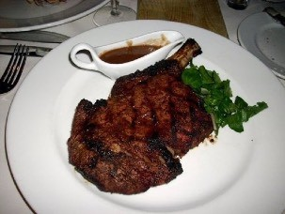

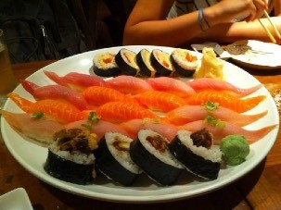

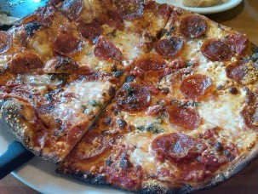

What we’re doing
Vision Transformer architecture
FoodVision Mini

Slide 19




What we’re doing
FoodVision Mini

Slide 20
What we’re doing
Original ViT Architecture
Source: ViT paper
FoodVision Mini

Slide 21

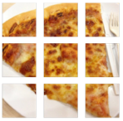









What we’re doing
ViT adapted to FoodVision Mini
Pizza
Source: ViT paper
FoodVision Mini

Slide 22


What we’re going to cover
(broadly)
Getting setup (importing previously written code)
Introduce machine learning paper replicating with PyTorch
Replicating ViT for FoodVision Mini
Training a custom ViT
Feature extraction with a pretrained ViT
How:
(we’ll be cooking up lots of code!)

Slide 23
Let’s code!

Slide 24
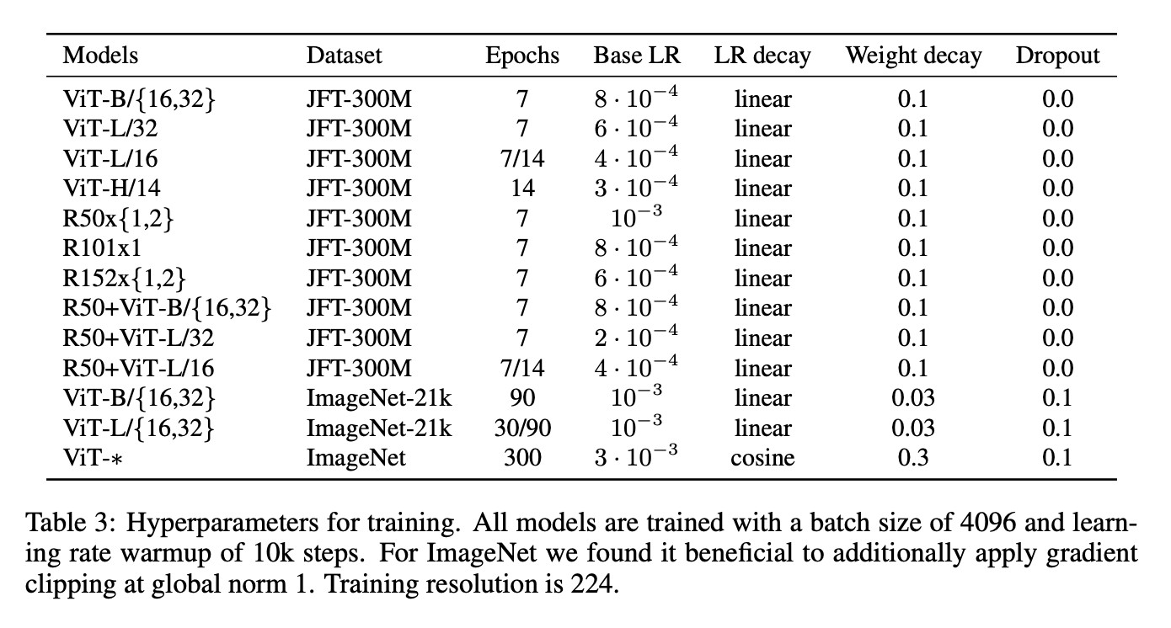
Image size and batch size
Batch size = 4096
Source: ViT paper
Image size = 224x224 (height=224, width=224)

Slide 25
Inputs, outputs, layers and blocks
Contains a function to manipulate an input , for example:
Attention(Q, K, V ) = softmax
Layer
Inputs
Outputs
QK^{T}
V
( d_{k} )
Block = stack of layers
Layer
Layer
Layer
Block
Inputs
Outputs
Model = stack of blocks
…
Layer
Layer
Layer
Block
Layer
Layer
Layer
Block
Model
Inputs
Outputs

Slide 26
ViT Overview: Inputs and Outputs
Blocks
Outputs
MLP = Multilayer perceptron
Layers
Inputs
Source: ViT paper

Slide 27

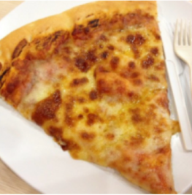
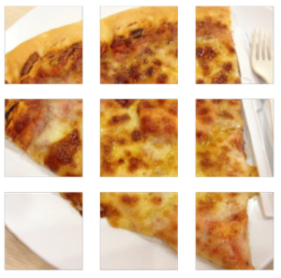









ViT Overview: Inputs and Outputs
Blocks
Outputs
MLP = Multilayer perceptron
Pizza
FoodVision Mini
Layers
Inputs
Source: ViT paper

Slide 28
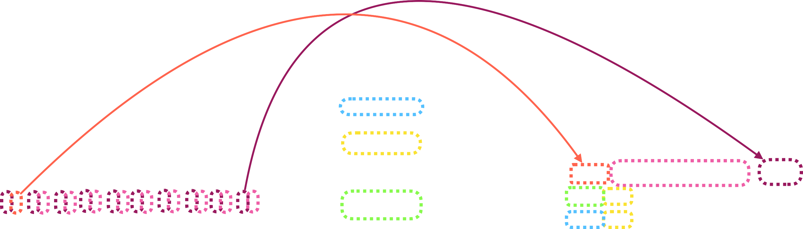
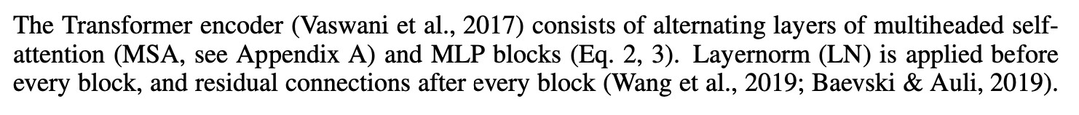
ViT Overview: Four Equations
Pizza
Source: ViT paper section 3.1
Source: ViT paper Figure 1

Slide 29
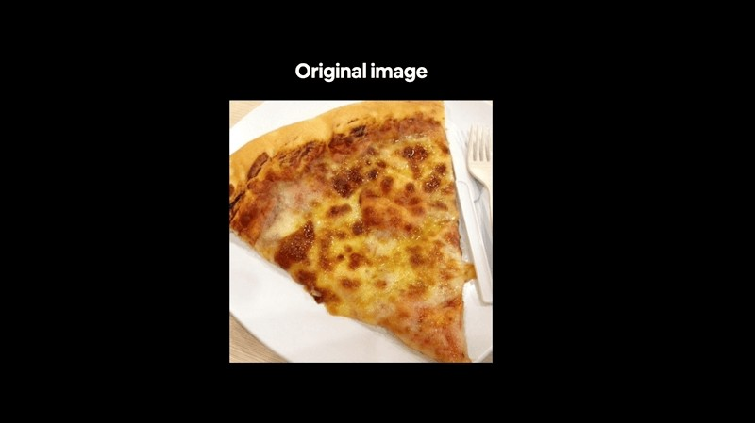
ViT Overview: Workflow
Visualize, visualize, visualize!
FoodVision Mini

Slide 30
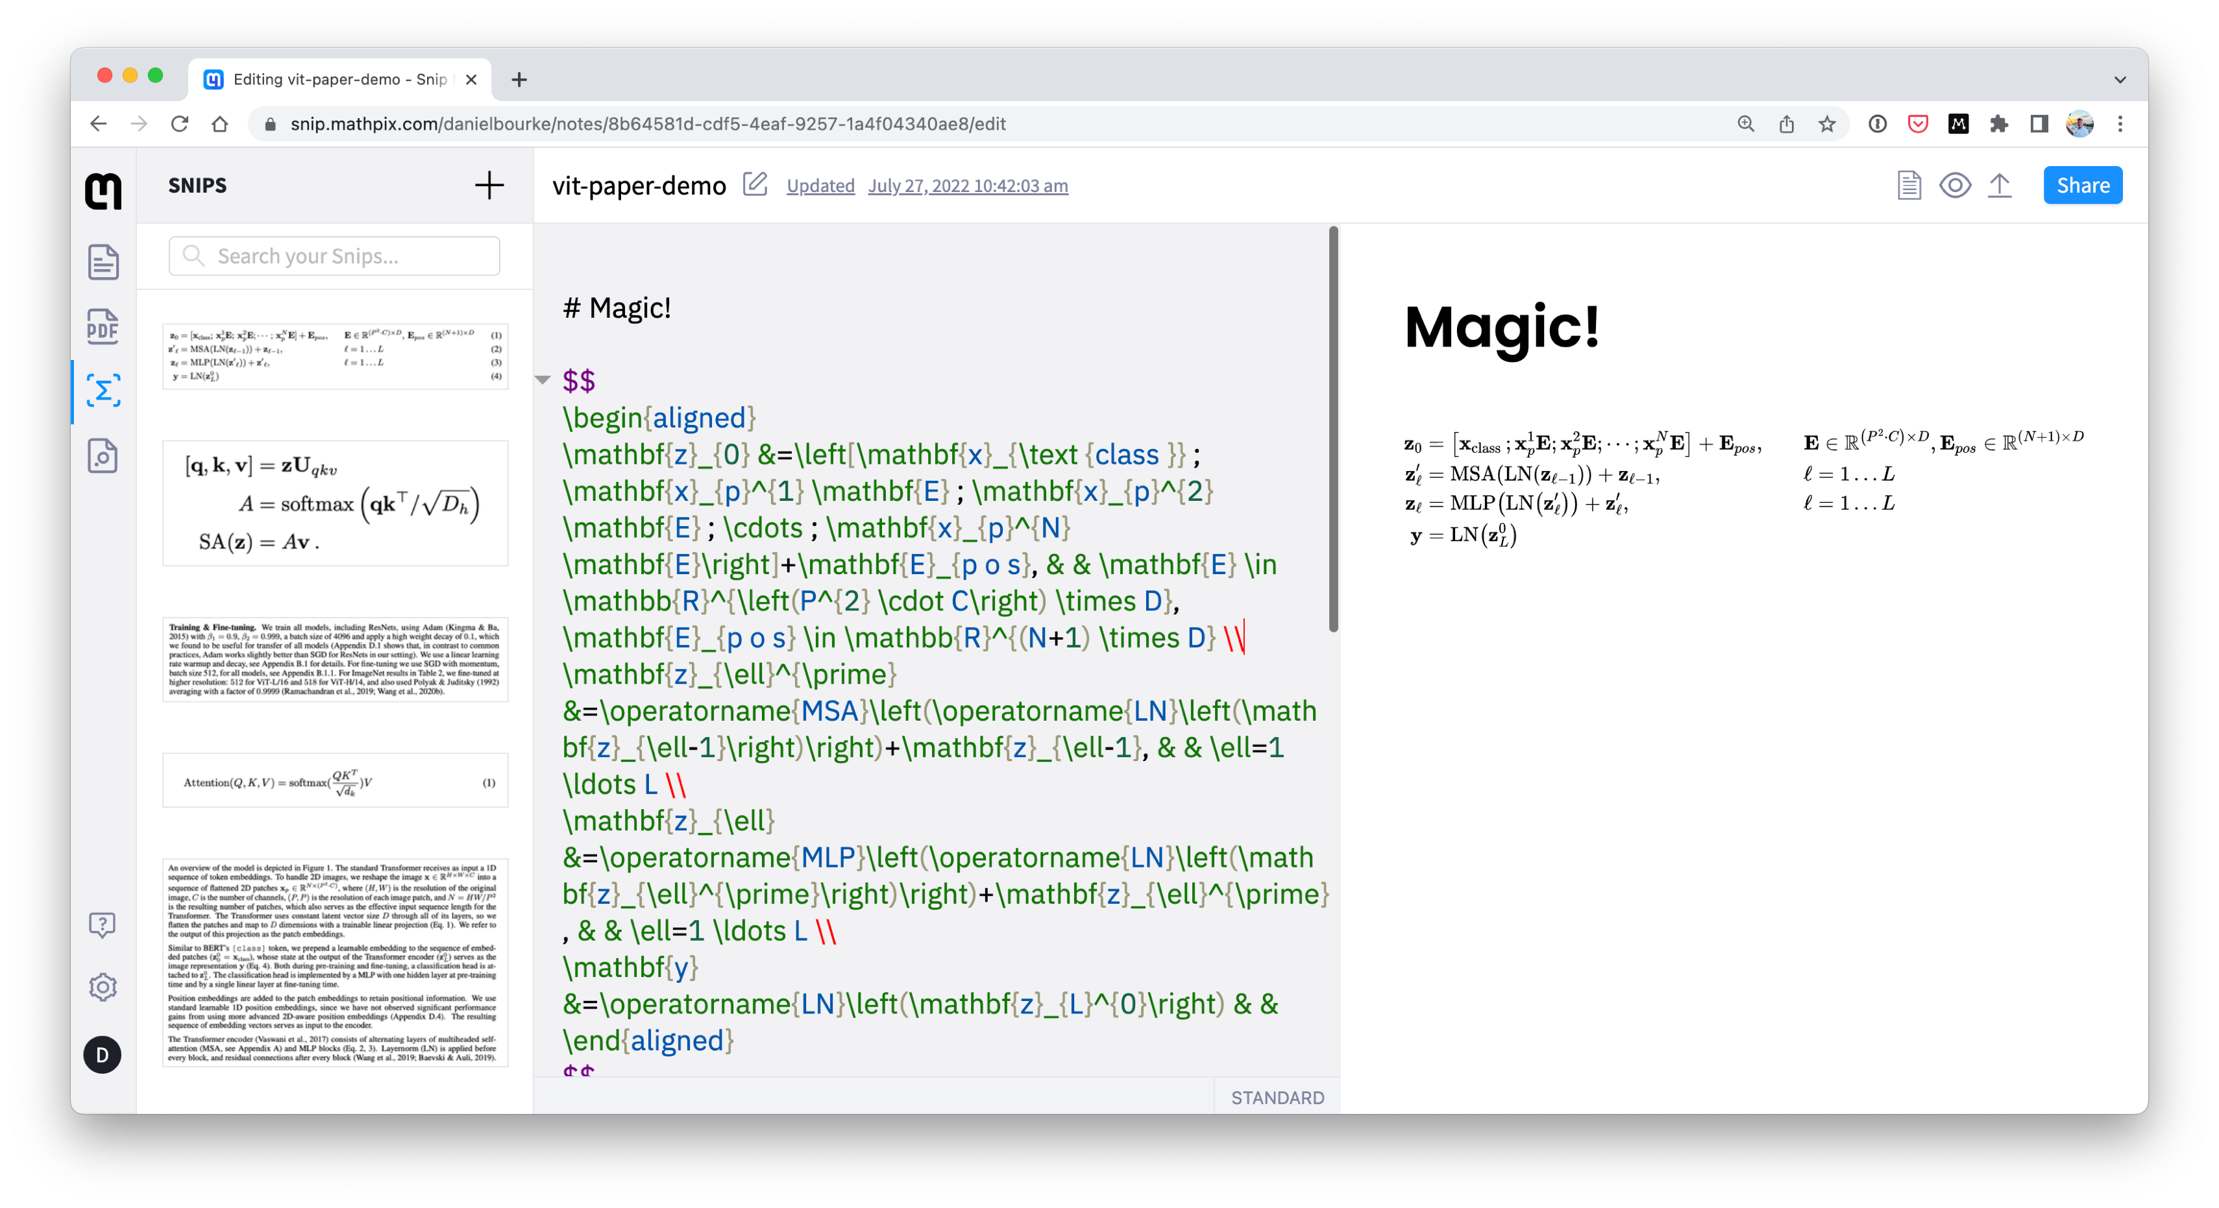
Paper reading tip: math to text
Source: mathpix.com, see a live demo

Slide 31
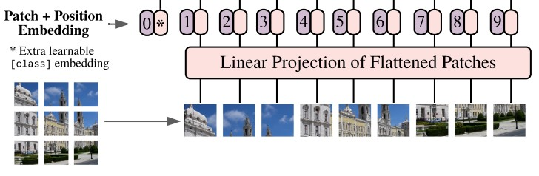
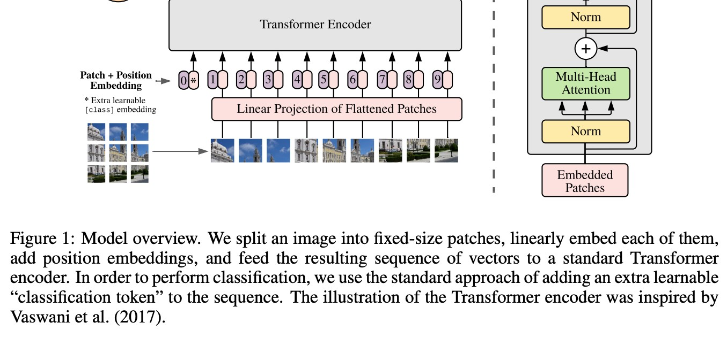
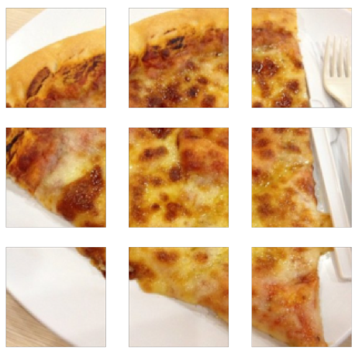
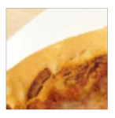
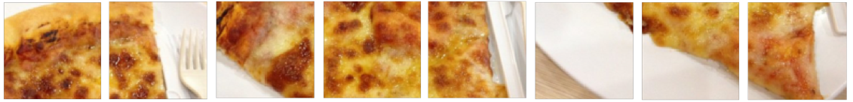
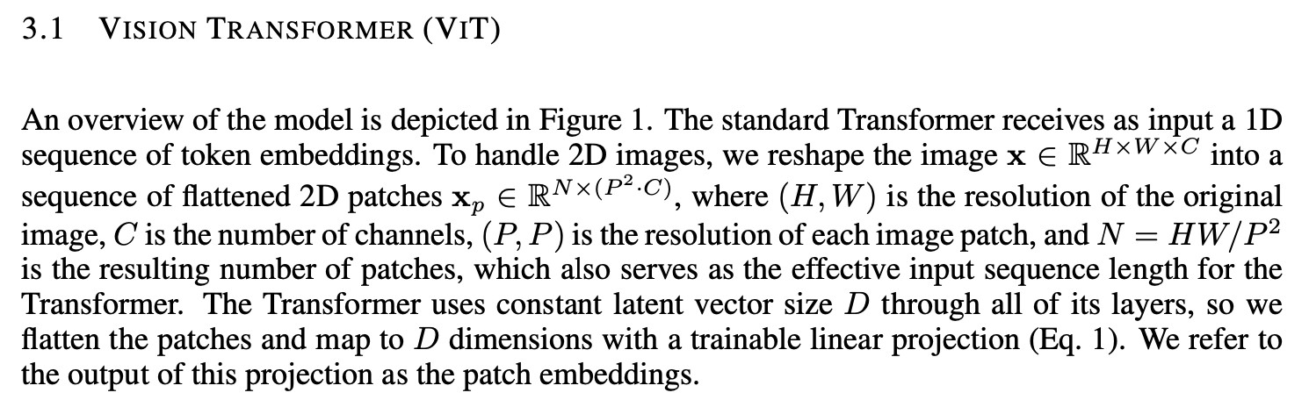
Equation 1: The Patch Embedding
Image size = (H, W, C) -> (N_Patches, (P² • C))
For example, patch size = 16 (ViT-Base) :
(224, 224, 3) -> (196, 768)
Embedding size (D) = 768(ViT-Base)

Slide 32
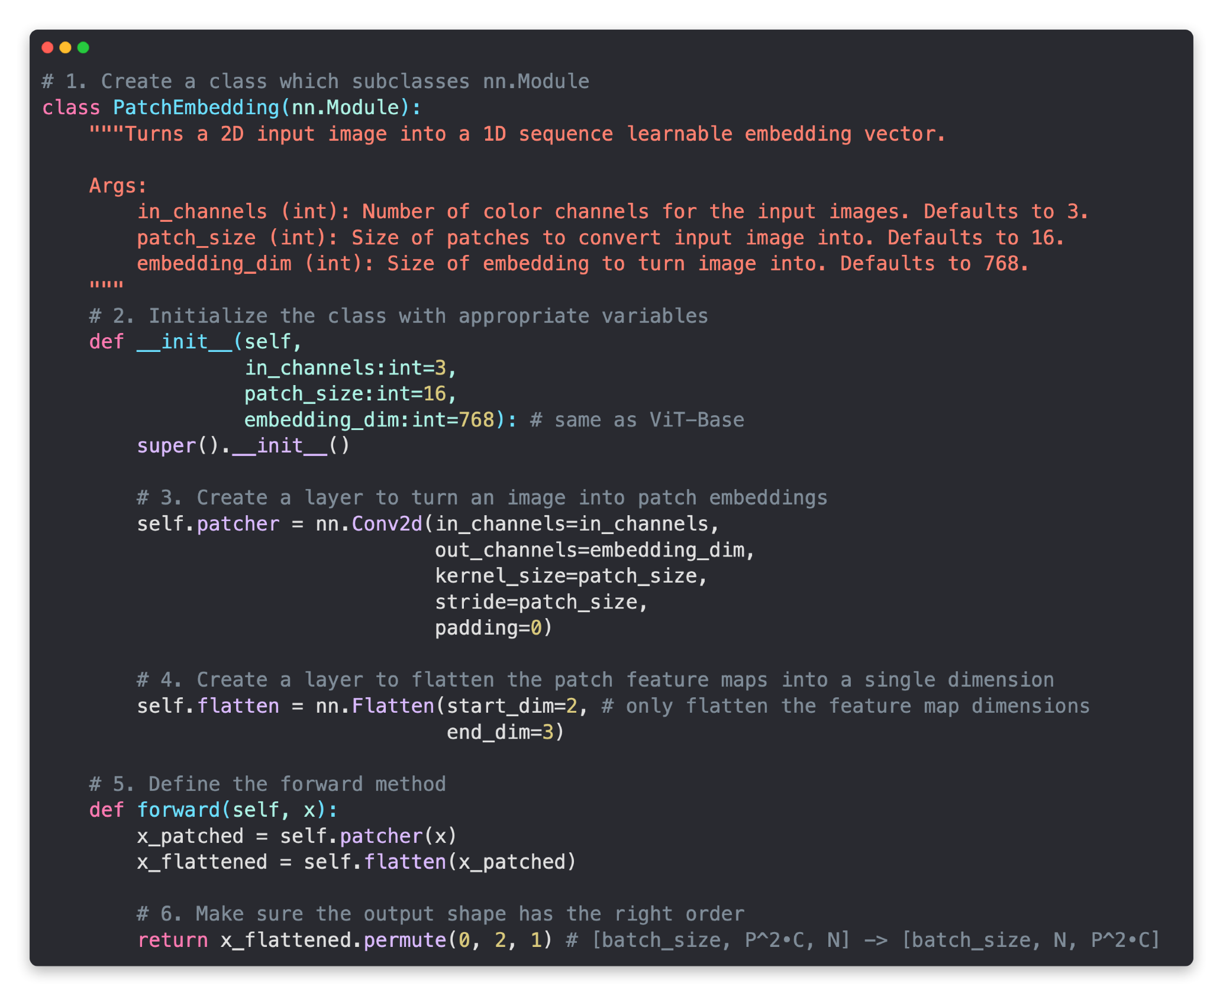
Equation 1: The Patch Embedding

Slide 33
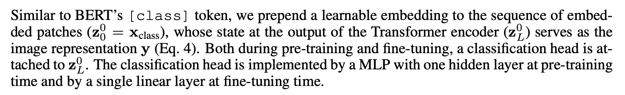
Equation 1: The Class Token
Prepend a learnable class embedding token to the 0 index of the patch embedding

Slide 34
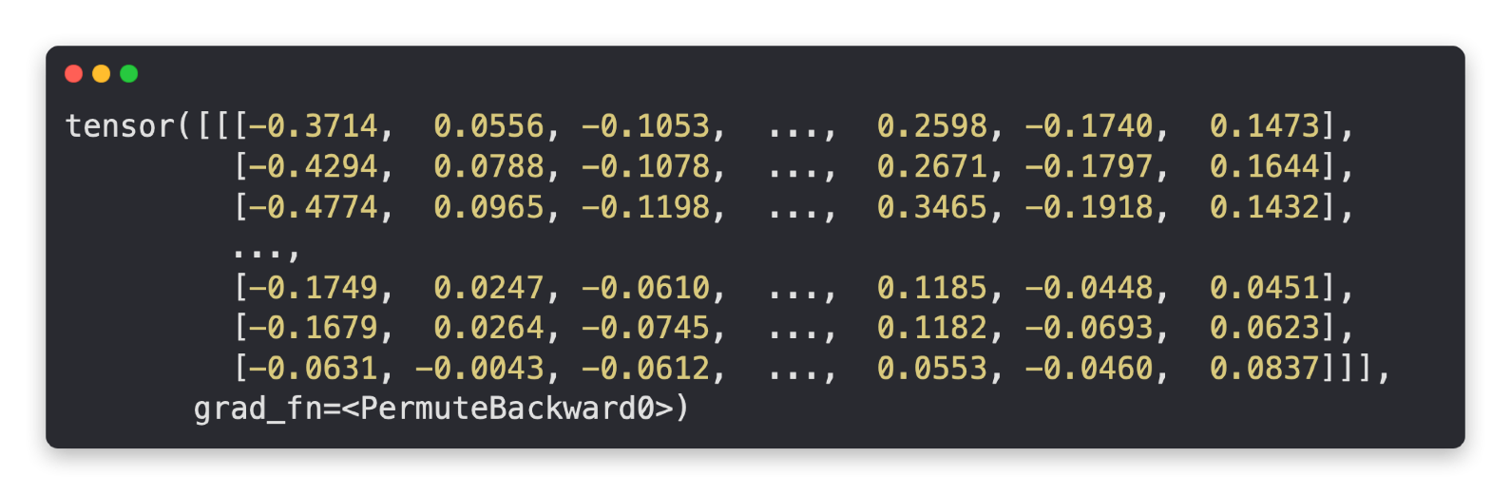
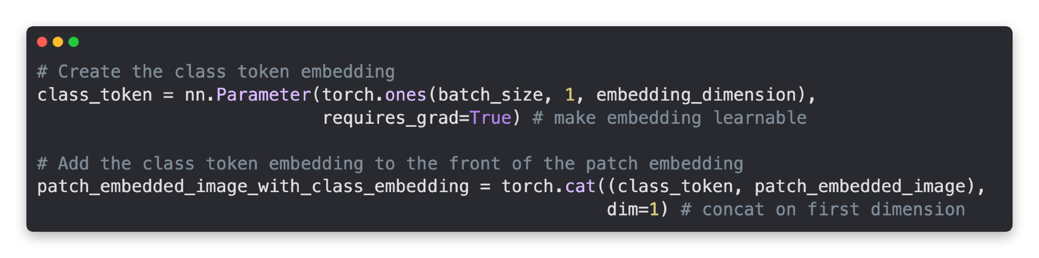
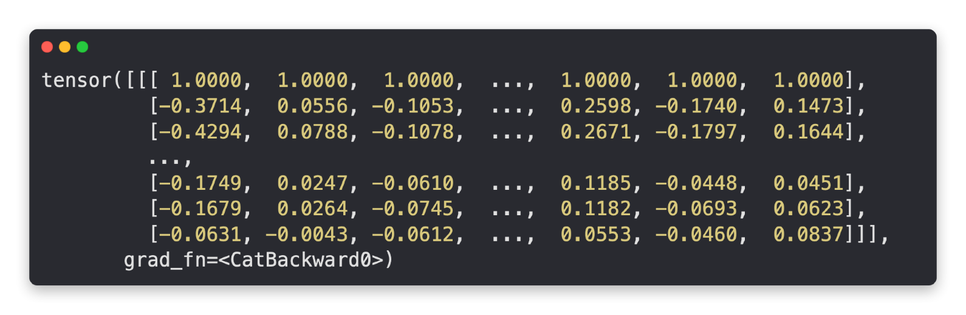
Equation 1: The Class Token
Sequence of patch embeddings
Shape: [1, 196, 786], [batch_size, number_of_patches, embedding_dimension]
Create learnable class token and prepend it to patch embeddings
Learnable class token
prepended
Patch embeddings with learnable class token
Shape: [1, 197, 786], [batch_size, number_of_patches + class_token, embedding_dimension]

Slide 35
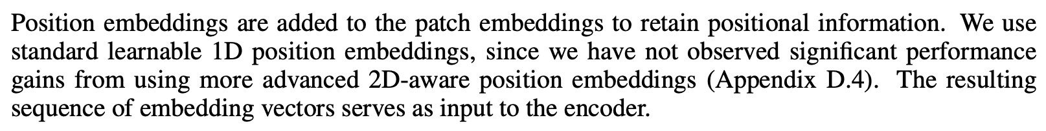
Equation 1: The Position Embedding
Position Embeddings Shape: [num_patches+1, embedding_dimension] (+1 is for the class_token)
Add a learnable 1D set of position embeddings to [class_token, patch embedding]

Slide 36
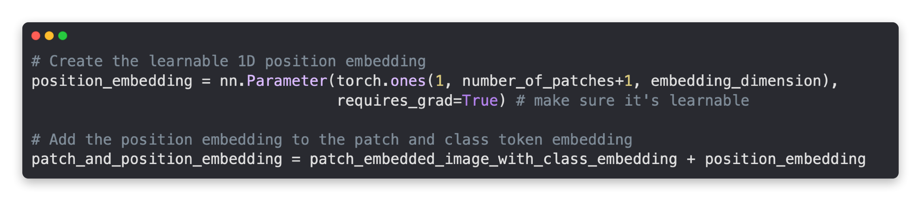
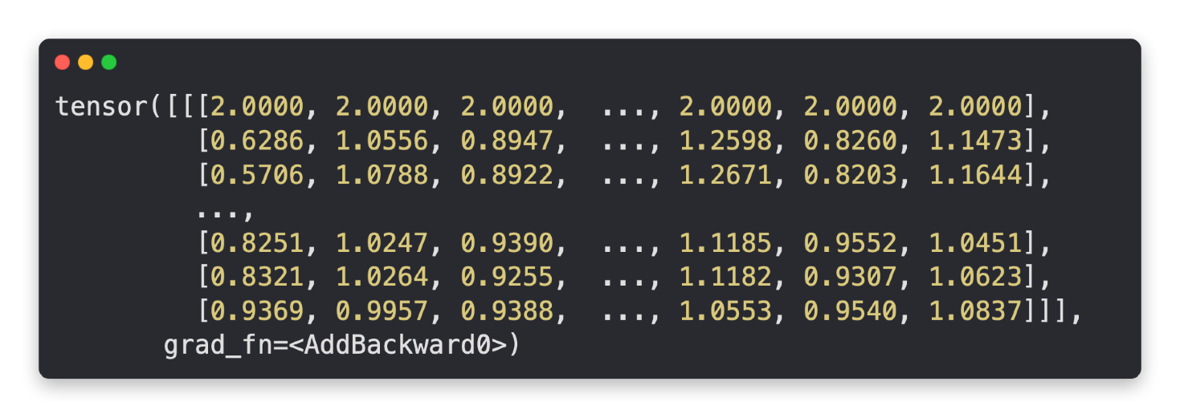
Equation 1: The Position Embedding
Learnable class token
prepended
Patch embeddings with learnable class token
Shape: [1, 197, 786], [batch_size, number_of_patches + class_token, embedding_dimension]
Create position embeddings and add to patch embeddings with learnable class token
Values all changed thanks to
position embeddings
Patch embeddings with learnable class token and position embeddings
Shape: [1, 197, 786], [batch_size, number_of_patches + class_token, embedding_dimension]

Slide 37
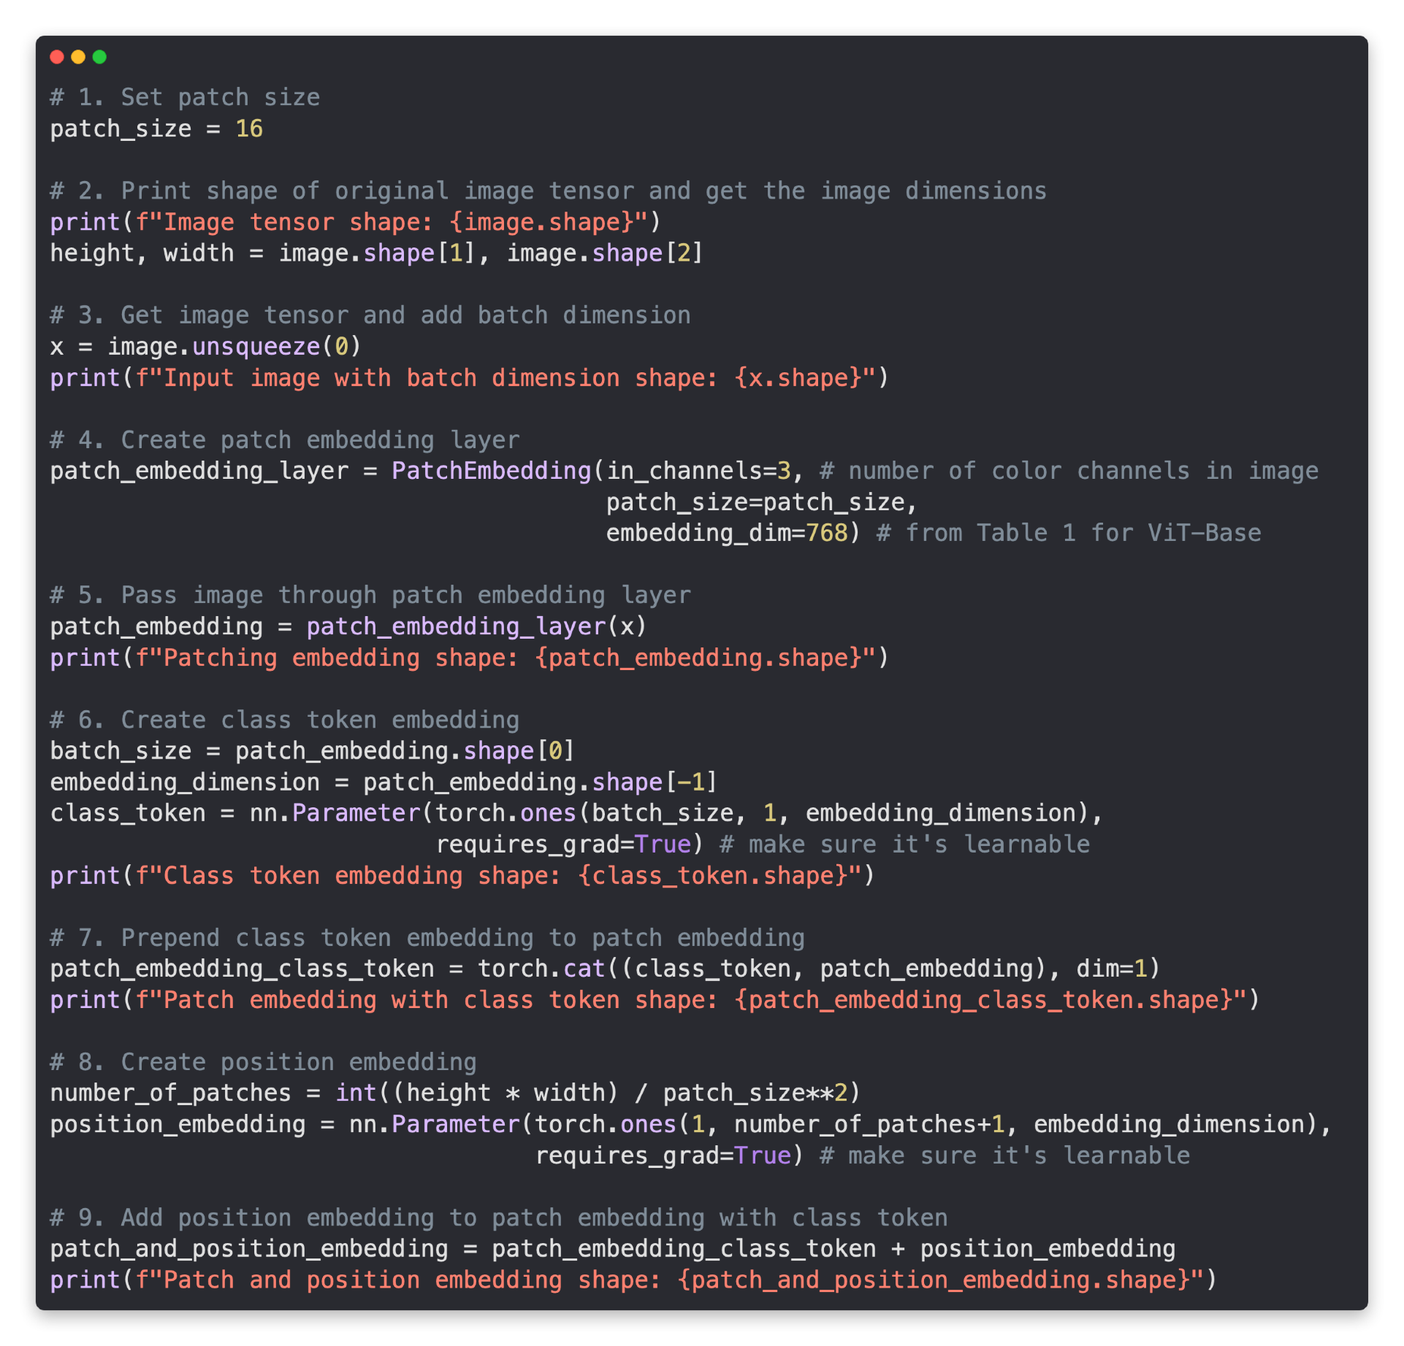
Equation 1: Putting it all together

Slide 38
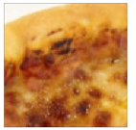
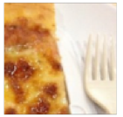
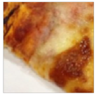
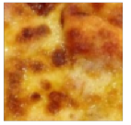
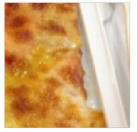

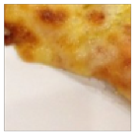
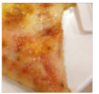
Equation 2: The MSA Block
MSA = Multi-Head Self Attention
Pizza
Equation 2 = “MSA block”

Slide 39
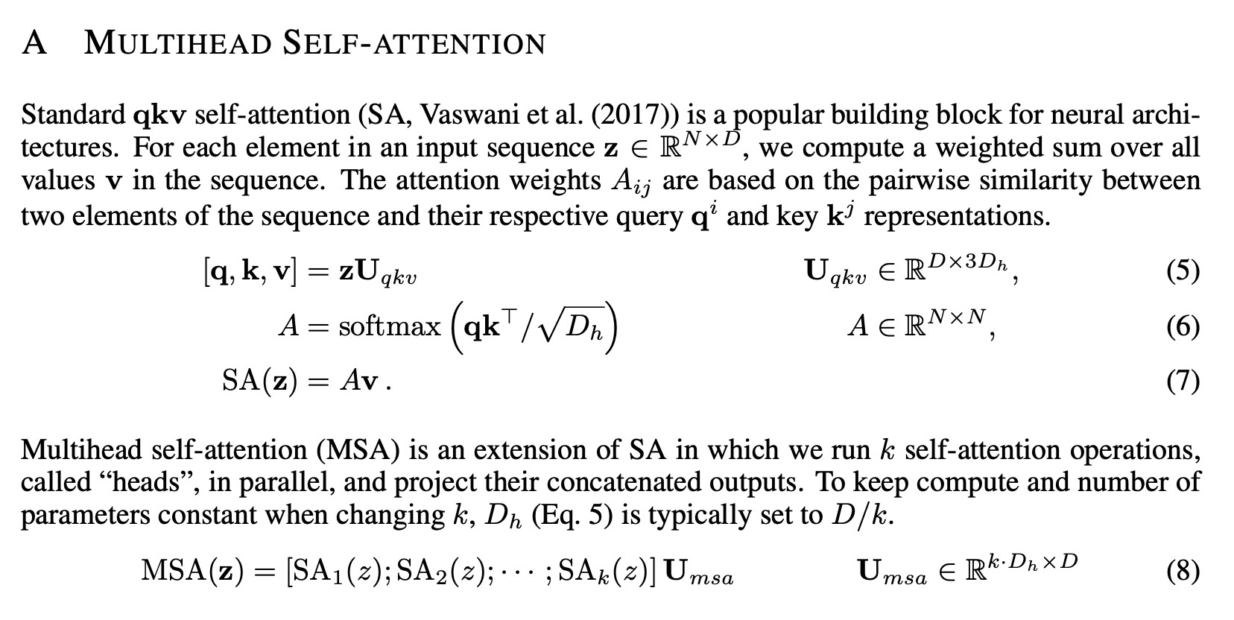
Equation 2: The MSA Block
MSA = Multi-Head Self Attention
Pizza
From “Attention is all you need” paper
q = query k = key
v = value

Slide 40
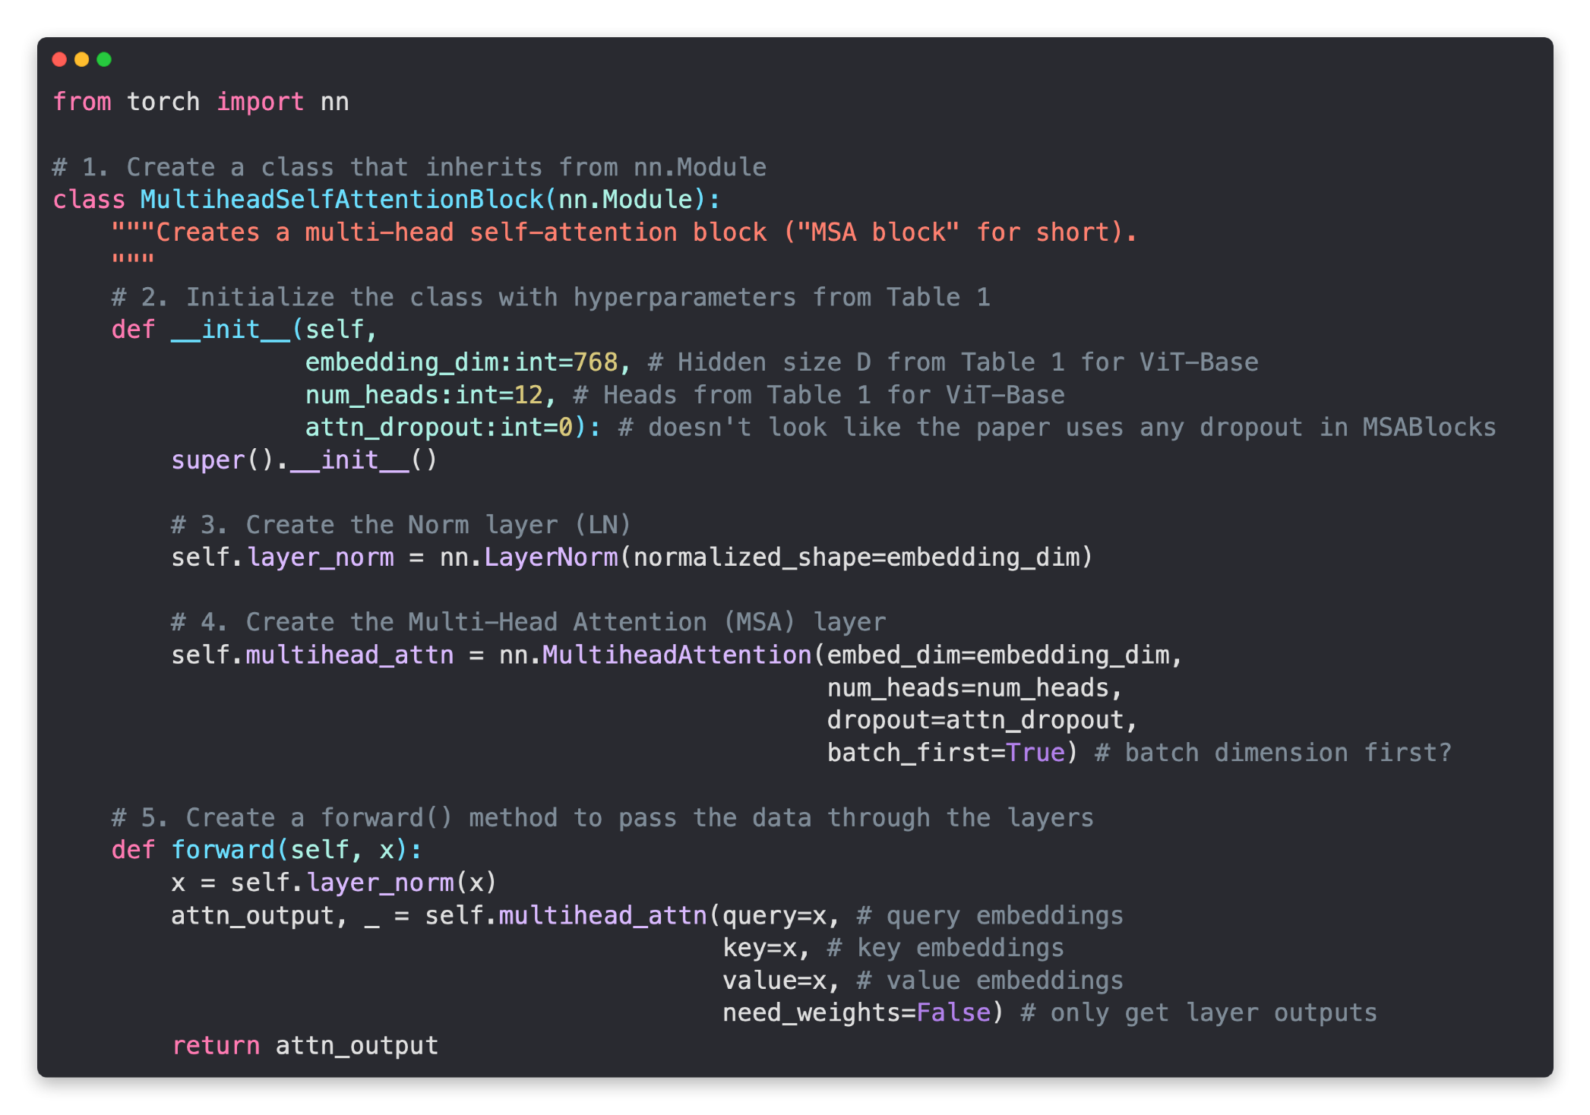
Equation 2: The MSA Block
MSA = Multi-Head Self Attention
Pizza

Slide 41
Equation 3: The MLP Block
MLP = Multilayer Perceptron
Pizza
Equation 3 = “MLP block”

Slide 42

Equation 3: The MLP Block
MLP = Multilayer perceptron
Pizza

Slide 43
The Transformer Encoder
Pizza
Transformer Encoder = Alternating layers of equation 2 and 3

Slide 44

The Transformer Encoder
Pizza

