Slide 1

Model Deployment with
Milestone Project 3

Slide 2
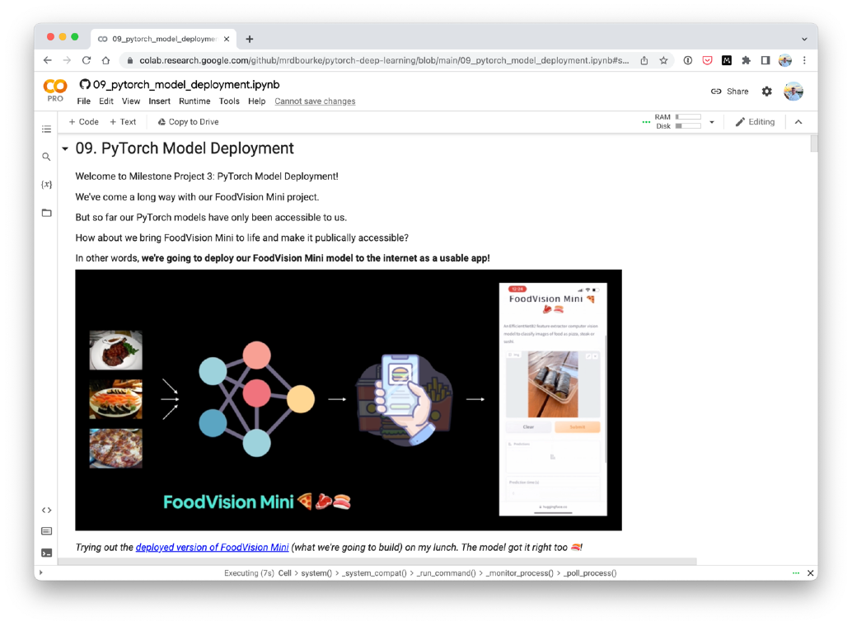
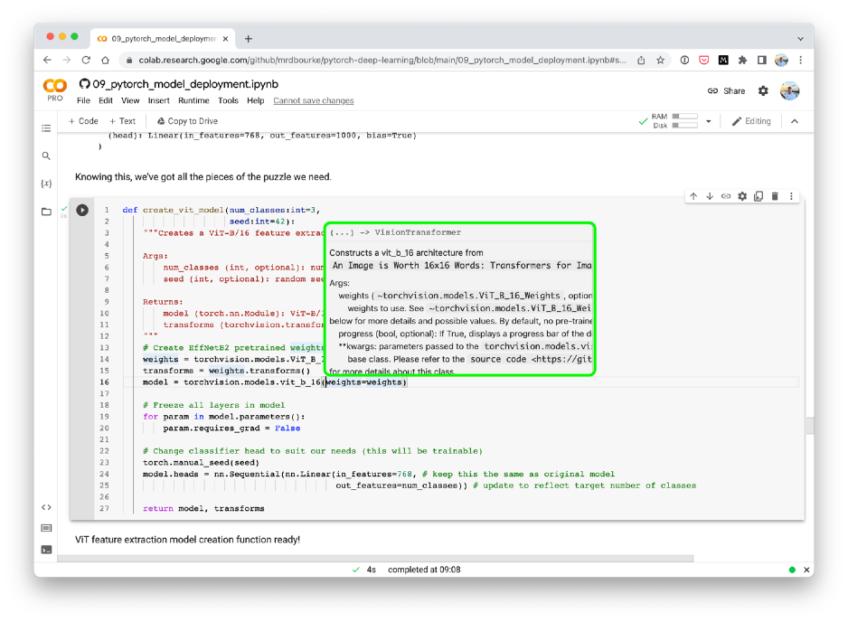
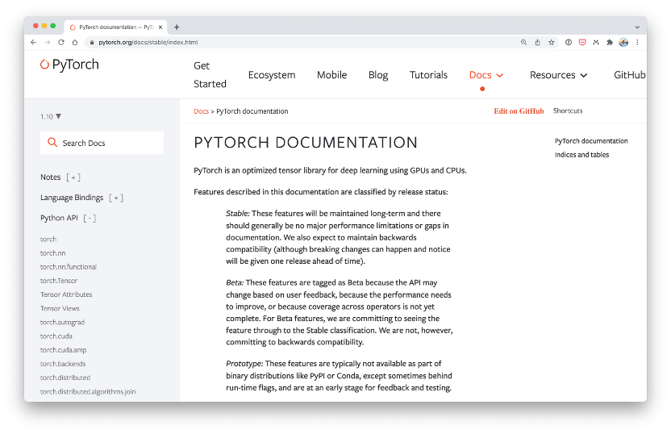
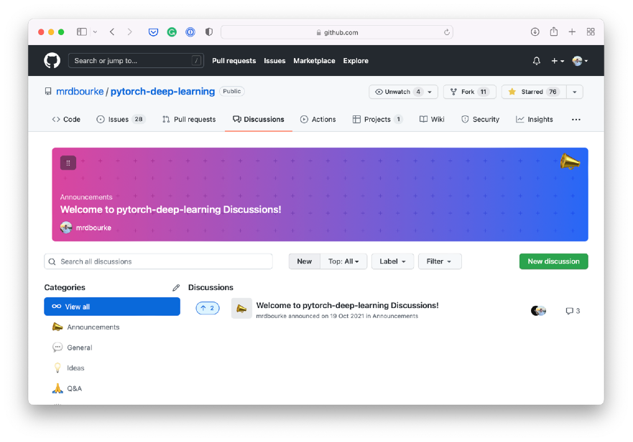
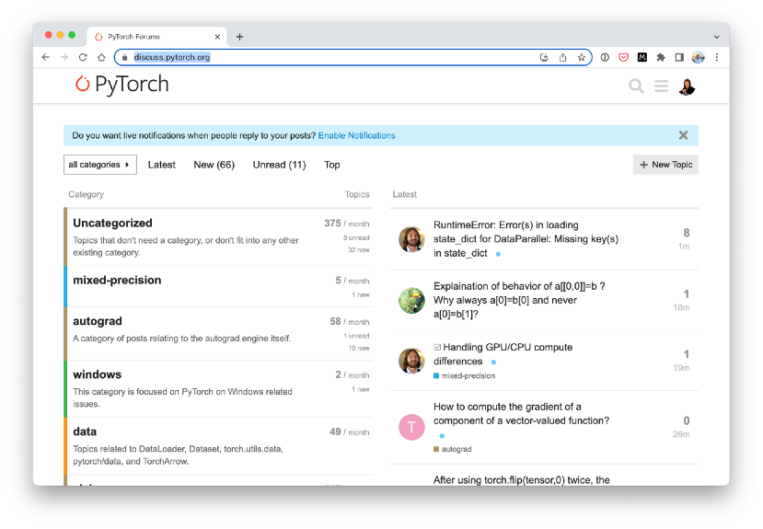
Where can you get help?
“If in doubt, run the code”
Follow along with the code
Try it for yourself
Press SHIFT + CMD + SPACE to read the docstring
Search for it
Try again
Ask
https://www.github.com/mrdbourke/pytorch-deep-learning/discussions

Slide 3
“What is machine learning model deployment?”
Making your machine learning model available to someone/something else.

Slide 4
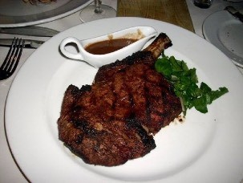
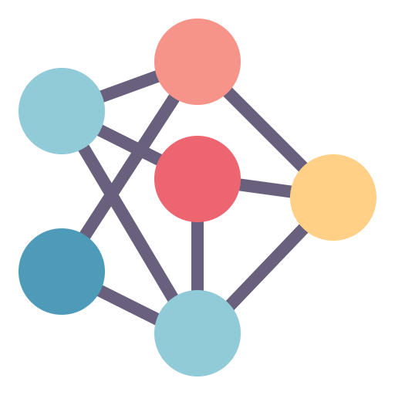

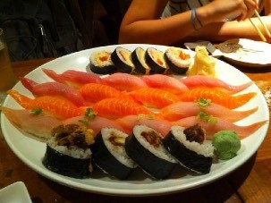
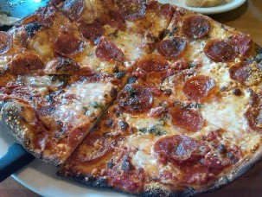



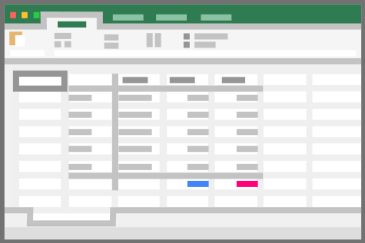

What is model deployment?
Someone else
These can mix and
match
Something else
(another app or program)
Data
Your model

Slide 5
“Why deploy machine learning models?”
1. It’s fun… and…

Slide 6
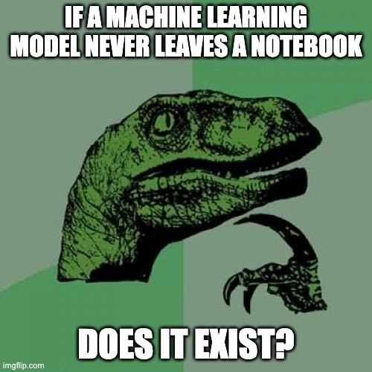

Slide 7




Three datasets
(possibly the most important concept in machine learning…)
Model learns patterns from here
Course materials (training set)
Practice exam (validation set)
Final exam (test set)
See if the model is ready for the wild
Tune model patterns
Generalization
The ability for a machine learning model to perform well on data it hasn’t seen before.

Slide 8

Three datasets
Four
Notebook/local environment
Course materials (training set)
Practice exam (validation set)
Final exam (test set)
Real world
(you can only test here by deploying!)

Slide 9
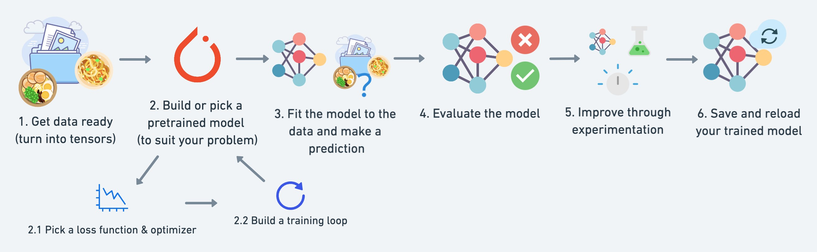
A PyTorch workflow
(one of many)

Slide 10
A PyTorch workflow
(one of many)
Update when necessary
X. Deploy & Monitor

Slide 11
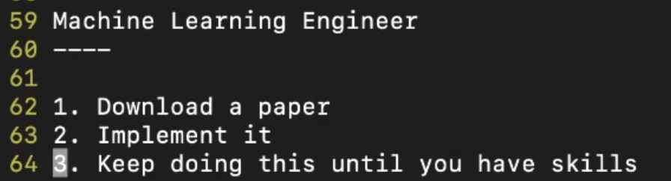
*
- George Hotz, founder of comma.ai
*Machine learning engineering also involves building infrastructure around your models/ data preprocessing steps

Slide 12
A PyTorch workflow
(one of many)
Machine learning
MLOps
X. Deploy & Monitor
(MLOps = machine learning
operations or machine learning
engineering)
See PyTorch Extra Resources for more on MLOps

Slide 13
“What kinds of machine learning model deployments are there?”

Slide 14

Deployment questions to ask
Start here and work backwards…
What is my most ideal machine learning model deployment scenario?
Works every time
Speed of light (fast)
On-device (edge)
Cloud
Where’s my model going to go?
These can mix and
match
Online (real-time)
Offline (batch)
How’s my model going to function?

Slide 15
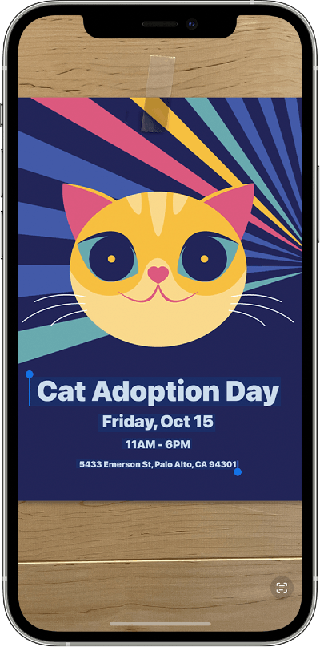




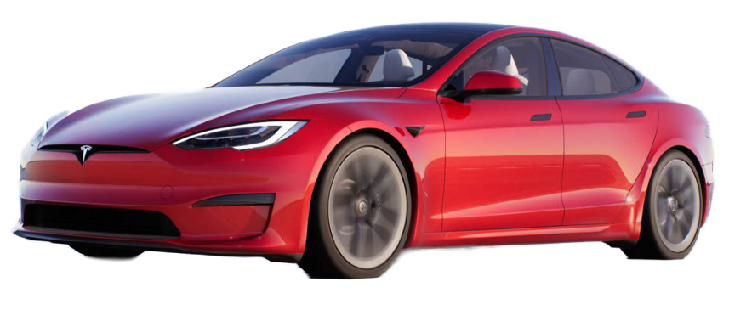
Deployment questions to ask
1. On-device (edge)
Where’s my model going to go?
2. Cloud (a remote computer
that isn’t the actual device you’re using)
+ more
Cloud
On-device (edge)

Slide 16

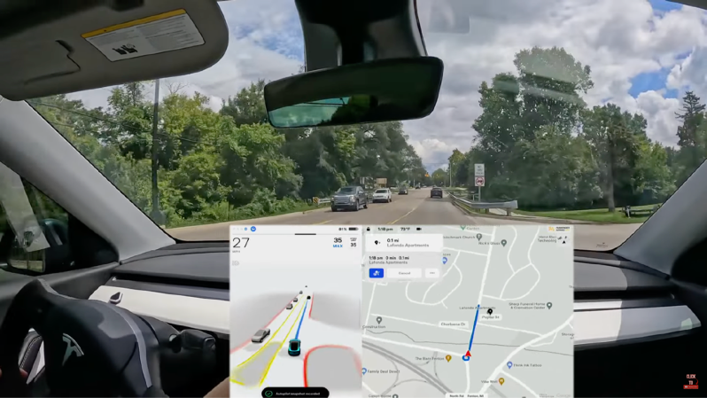
Where’s my model going to go?
On-device (edge)
Cloud
Bigger model, better
performance, slower
inference
Smaller model, less
performance, faster
inference
vs.
+ more
Source: Dirty Tesla YouTube channel
Source: Dirty Tesla YouTube channel

Slide 17
Where’s my model going to go?
Deployment location Pros Cons
On-device (edge/in-browser) Can be very fast (since no data leaves the device) Limited compute power (larger models take longer to run)
Privacy preserving (again no data has to leave the Limited storage space (smaller model size required) device)
No internet connection required (sometimes) Device-specific skills often required
On cloud (a compute device Near unlimited compute power (can scale up when Costs can get out of hand (if proper scaling limits aren't that isn’t the actual device) ^{needed) enforced)}
Predictions can be slower due to data having to leave Can deploy one model and use everywhere (via API) device and predictions having to come back (network latency)
Links into existing cloud ecosystem Data has to leave device (this may cause privacy concerns)
See a fantastic example of deploying a PyTorch model to a Raspberry Pi (edge) on the PyTorch blog and another write up of Moving ML Inference from the Cloud to the Edge by Jo Kristian Bergum.

Slide 18
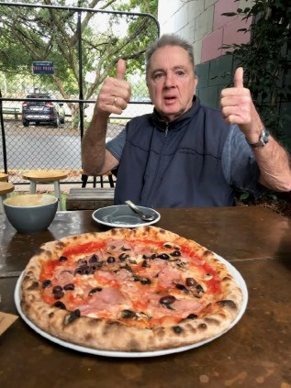

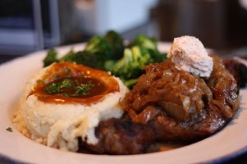
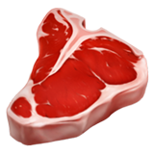

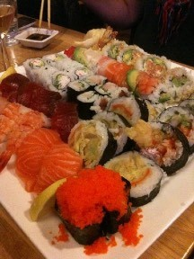
Deployment questions to ask
1. Online (real-time)
How’s my model going to function?
2. Offline (batch)
Online (real-time) Predictions happen immediately
Offline (batch) Predictions come at a delay
Wait
10-minutes
, ,

Slide 19
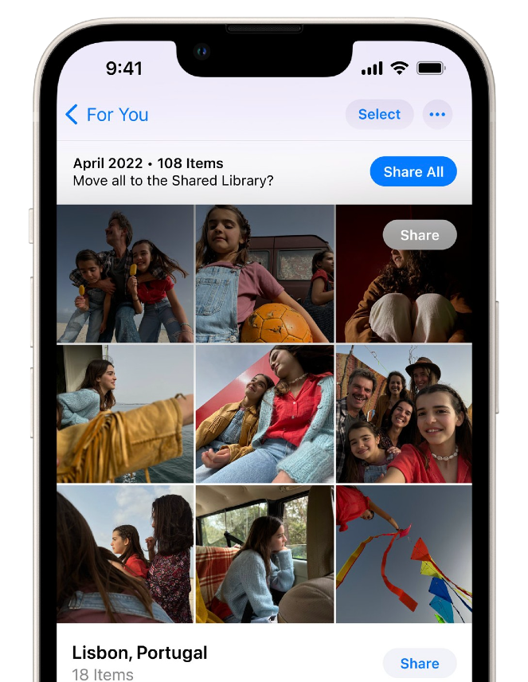
How’s my model going to function?
Offline prediction (batch/ asynchronous) |  | Online prediction (real-time/ synchronous)
Frequency | Periodical, such as every 10 minutes or every four hours or once per day | As soon as requests come (data comes in, prediction comes back ASAP)
Useful for | Processing/training on data when you don’t need immediate results | When predictions are required as soon as data comes in
Optimized for | High throughout (such as making predictions/training on many samples at a time) | Low latency/high frequency (fast results, often)
Example | Recommendation engines, Apple photos app sorting, YouTube video indexing/sorting, training models | FoodVision Mini, fraudulent transaction detection, spam detection, translation, Tesla self-driving vision system
Source: Designing Machine Learning Systems book by Chip Huyen
Apple Photos: Sort photos offline, when plugged into charge
FoodVision Mini: Classify
photos into , , online (as soon as photo is uploaded)

Slide 20

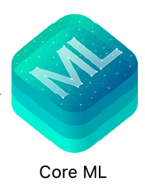
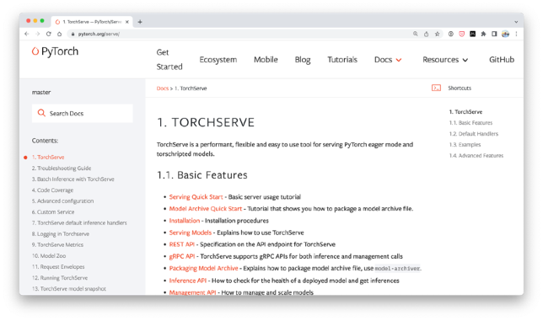



Places/tools to help deploy machine learning models
(some)
On-device (mobile/edge)
Cloud
Google’s MLKit
Apple’s CoreML
Google Cloud Vertex AI
AWS Sagemaker
General
FastAPI
TorchServe
Azure Machine
Hugging Face
Learning
ONNX (Open Neural Network Exchange)
Bonus
Gradio

Slide 21
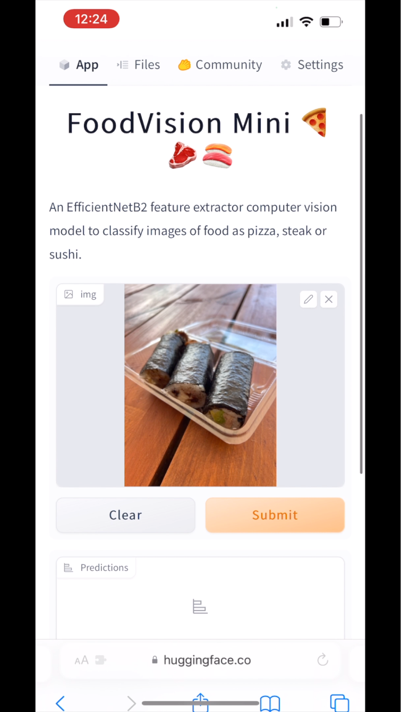

What we’re doing
Deploying our FoodVision Mini machine learning model
FoodVision Mini
https://huggingface.co/spaces/mrdbourke/foodvision_mini

Slide 22
What we’re doing
Deploying our FoodVision Mini machine learning model
What is my most ideal machine learning model deployment scenario?
FoodVision Mini
https://huggingface.co/spaces/mrdbourke/foodvision_mini

Slide 23



What we’re going to cover
(broadly)
Getting setup (importing previously written code)
Introduce machine learning model deployment with PyTorch
Deploy FoodVision Mini as a useable web application
Experimenting with multiple models (EffNetB2 and ViT)
A BIG surprise!
How:
(we’ll be cooking up lots of code!)

Slide 24
Let’s code!

Slide 25

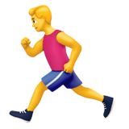
FoodVision Mini Deployment Goals
Performance: 95%+ accuracy
(good)
Speed: 30FPS+ (real-time)
(fast)
FoodVision Mini

Slide 26
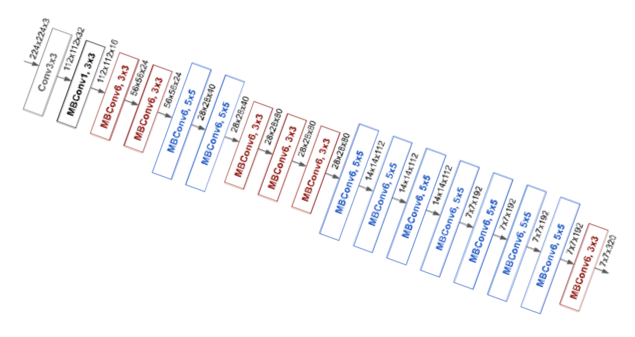
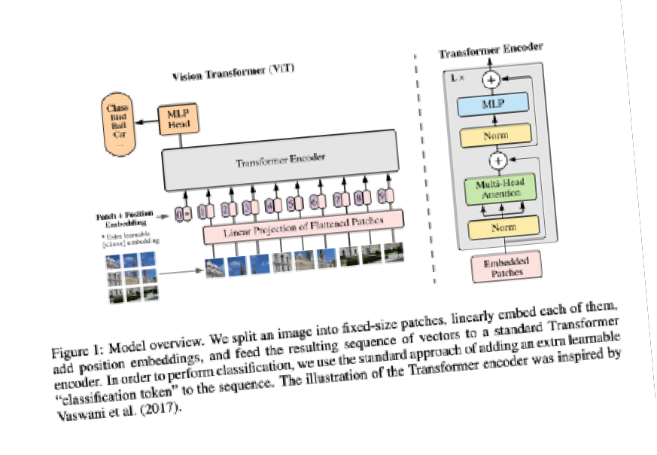
FoodVision Mini Deployment Experiments
Goals
Performance: 95%+ accuracy
(good)
Speed: 30FPS+ (real-time)
(fast)
Model 1 (EffNetB2)
Pizza, steak, sushi 20% data
Model 2 (ViT)

Slide 27
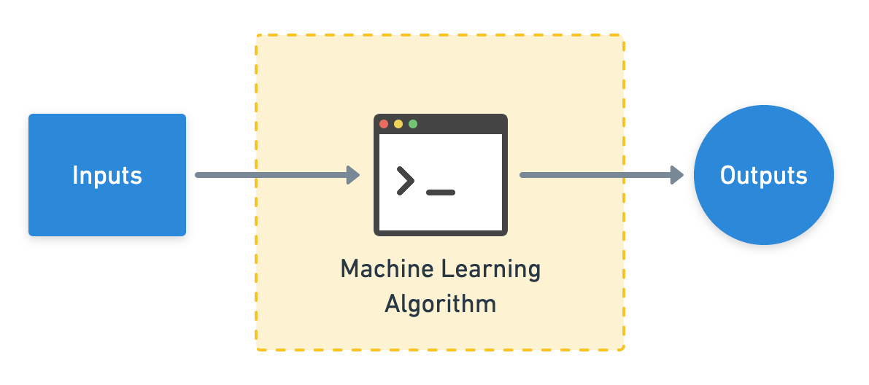
Gradio overview
Gradio helps create an interface for this workflow
Inputs
Model/function
Outputs

Slide 28
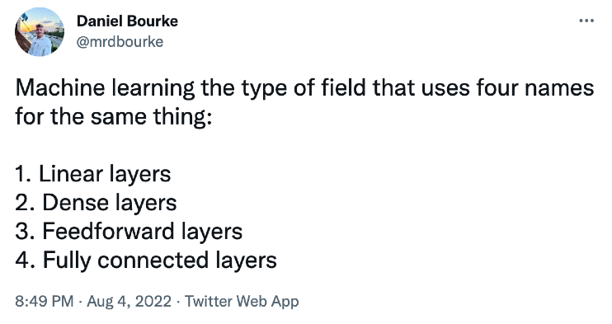
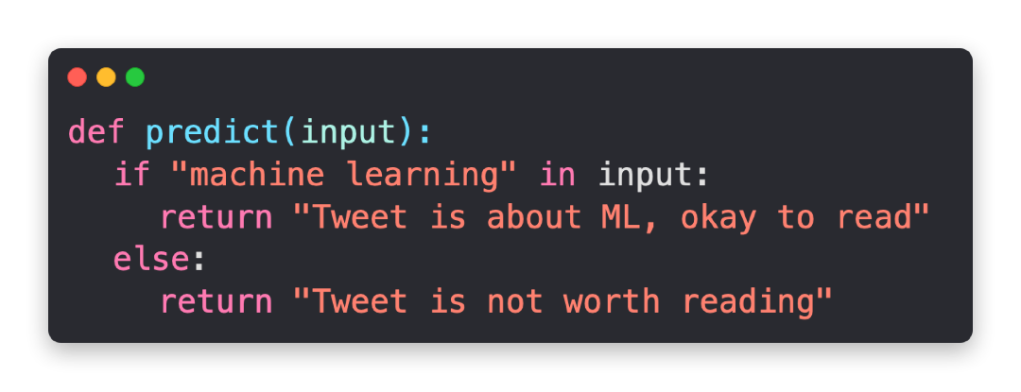

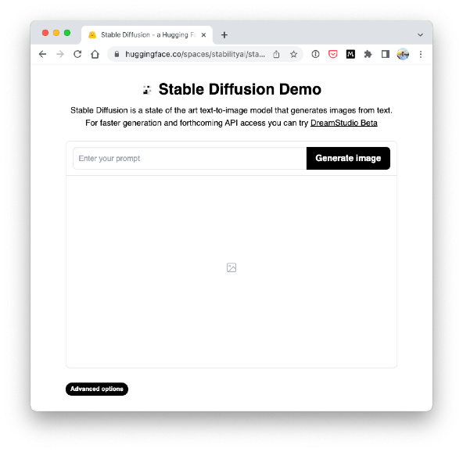
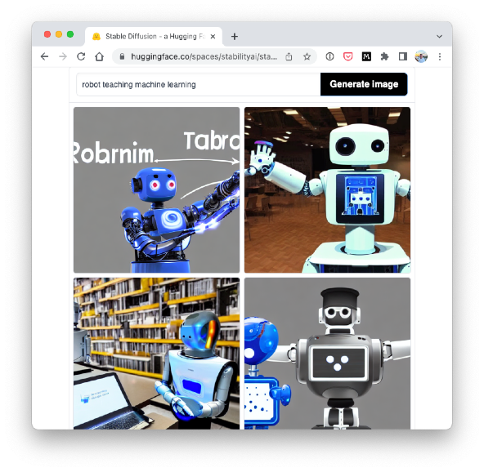
Gradio overview
Gradio helps create an interface for this workflow
Tweet is about ML, okay to read
“robot teaching machine learning”
Inputs
Model/function
Outputs
See more workflow ideas in the Gradio documentation.

Slide 29
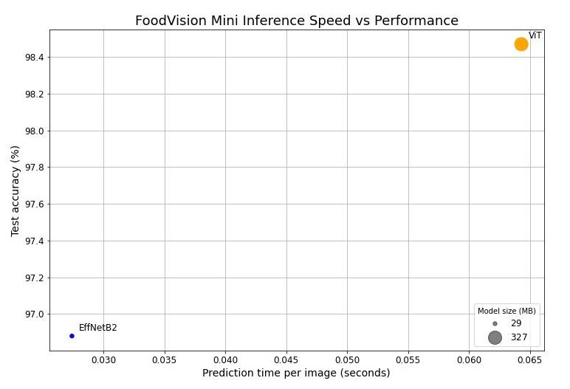
Performance vs. Speed trade-off
Most ideal position
With a larger model comes better performance but generally at the sacrifice of speed.

Slide 30
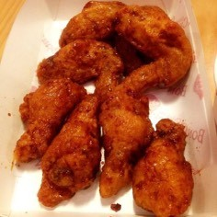
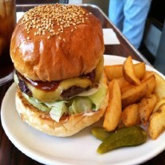
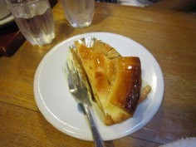
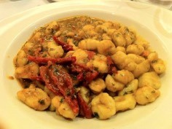
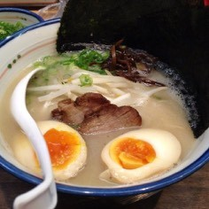
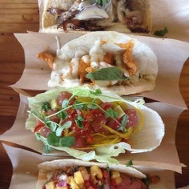
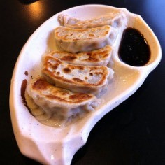
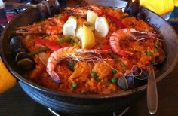
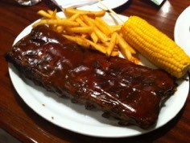
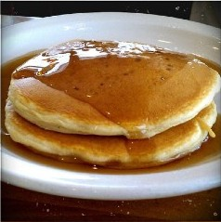
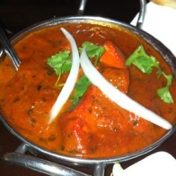
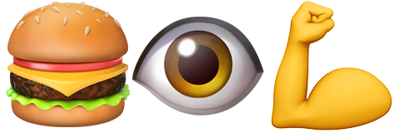
FoodVision Mini -> FoodVision Big
3 classes
FoodVision Mini
FoodVision Big
101 classes

Slide 31
Datasets we’re using/we’ve used
Notebook(s) | Project name | Number of Number of Dataset ^{Number of} training testing ^{classes} images images
04, 05, 06, 07, 08 | FoodVision Mini (10% data) | Food101 custom split ^{3 (pizza, steak,} 225 75 sushi)
07, 08, 09 | FoodVision Mini (20% data) | Food101 custom split ^{3 (pizza, steak,} 450 150 sushi)
09 (this one) | FoodVision Big (20% data) | Food101 custom split ^{101 (all Food101} 15150 5050 classes)
Extension | FoodVision Big | Food101 all data ^{101 (all Food101} 75750 25250 classes)
Original Food101 dataset from original Food101 paper, see how the splits were created in 04. Custom Data Creation notebook.

