Slide 1
Photosynthesis

Slide 2
KEY POINT
Energy is transformed from one form to another

Slide 3
Three basic processes occurring in leaves include
Transpiration (+diffusion + cohesion= water movement in plants)
1.
2.
Photosynthesis (making food)
3.
Respiration (using food for energy)

Slide 4
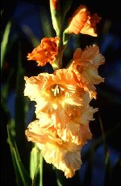
Photosynthesis
the process in plants that allows them to produce their own food and continually regenerate oxygen in the environment

Slide 5
The sun is the ultimate source of energy (It should burn for another 4-5 billion years)
It takes eight minutes for a photon of light to travel 93 million miles to Earth.
A green plant needs only a few seconds to capture the energy from the sun, process it, and store it.

Slide 6
What makes this process possible are organelles inside the plant cells called
chloroplasts.

Slide 7
chloroplast

Slide 8


Chloroplasts contain chlorophyll.
chloroplast
Chlorophyll is a compound that captures radiant (light) energy from the sun and transforms it into chemical energy.

Slide 9
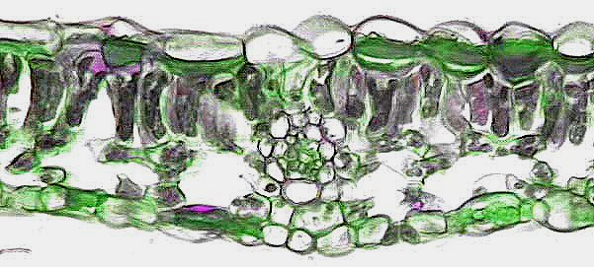
Photosynthesis
occurs in chloroplasts
occurs in 3 cells containing chloroplasts:
palisade cells, spongy cells, guard cells

Slide 10
Photosynthesis
uses
results in
raw materials
products
include
include
carbon dioxide
glucose
water
oxygen

Slide 11

CO₂
CO₂
CO₂
CO₂
CO₂
CO₂
CO₂
CO₂
CO₂
CO₂
CO₂
CO₂
CO₂
CO₂
CO₂
CO₂
CO₂
CO₂
CO₂
CO₂
CO₂
CO₂
CO₂
CO₂
CO₂
CO₂
CO₂
CO₂
CO₂
CO₂
CO₂
CO₂
CO₂
CO₂
CO₂
CO₂
CO₂
CO₂
CO₂
CO₂
CO₂
CO₂
CO₂
CO₂
CO₂
CO₂
CO₂
CO₂
Carbon Dioxide Producer
CO₂
CO₂
CO₂
CO₂
CO₂
CO₂
CO₂
CO₂
CO₂
CO₂
CO₂
CO₂
CO₂
CO₂
CO₂
CO₂
CO₂
CO₂
CO₂
CO₂
CO₂
CO₂
CO₂
CO₂
CO₂
Notes:
Carbon dioxide is produced through
burning of hydrocarbon fuels
respiration of plants
respiration of animals

Slide 12
CO₂
CO₂
CO₂
CO₂
CO₂
Notes:
What is happening here? (Water is entering the atmosphere.)

Slide 13
CO₂
CO₂
CO₂
CO₂
CO₂
raw materials
Notes:
Carbon dioxide and water are the raw materials needed for photosynthesis to begin.

Slide 14

CO₂
CO₂
O
CO₂
O
O
H₂
H₂
H₂
CO₂
O
H₂O
H₂
O
CO
CO
CO
CO
H⁺
CO
CO
H⁺
CO
CO
CO
CO
O
+
+
+
H₂O
O₂
H⁺
sugar
sugar
sugar
Notes:
Water enters the leaf through vascular tissue called xylem.
Chloroplasts capture radiant energy from the sun, and use it to split water molecules into H (hydrogen) and O (oxygen).
Hydrogen combines with carbon dioxide (?) to form glucose, a sugar the plant uses for food.
Glucose is transported through the vascular tissue called phloem from the leaves to the rest of the plant.

Slide 15
Review the process of photosynthesis. Take notes on your diagram from the next 4 slides.

Slide 16
CO₂
CO₂
CO₂
CO₂
CO₂
CO₂
CO₂
CO₂
CO₂
CO₂
CO₂
CO₂
CO₂
CO₂
CO₂
CO₂
CO₂
CO₂
CO₂
CO₂
CO₂
CO₂
CO₂
CO₂
CO₂
CO₂
CO₂
CO₂
CO₂
CO₂
CO₂
CO₂
CO₂
CO₂
CO₂
CO₂
CO₂
CO₂
CO₂
CO₂
CO₂
CO₂
CO₂
CO₂
CO₂
CO₂
CO₂
CO₂
Carbon Dioxide Producer
CO₂
CO₂
CO₂
CO₂
CO₂
CO₂
CO₂
CO₂
CO₂
CO₂
CO₂
CO₂
CO₂
CO₂
CO₂
CO₂
CO₂
CO₂
CO₂
CO₂
CO₂
CO₂
CO₂
CO₂
CO₂
Notes:
Carbon dioxide *(CO2) is produced through
burning of hydrocarbon fuels
respiration of plants
respiration of animals

Slide 17
CO₂
CO₂
CO₂
CO₂
CO₂

Slide 18
CO₂
CO₂
CO₂
CO₂
CO₂
raw materials
Notes:
Circle the raw materials needed for photosynthesis in red on your own paper.

Slide 19
CO₂
CO₂
O
CO₂
O
O
H₂
H₂
H₂
CO₂
O
H₂O
H₂
O
CO
CO
CO
CO
H⁺
CO
CO
H⁺
CO
CO
CO
CO
O
+
+
+
H₂O
O₂
H⁺
sugar
sugar
sugar
Notes:
Water enters the leaf through vascular tissue called xylem.
Chloroplasts capture radiant energy from the sun, and use it to split water molecules into H (hydrogen) and O (oxygen).
Hydrogen combines with carbon dioxide (?) to form glucose, a sugar the plant uses for food.
Glucose is transported through the vascular tissue called phloem from the leaves to the rest of the plant.

Slide 20
CO₂
CO₂
O₂
CO₂
O₂
O₂
O₂
CO₂
CO₂

Slide 21

Plants convert sugar to starch for short-term and long-term storage.
sugar
Starch molecules tend to cluster in certain plant cells.

Slide 22
The process of photosynthesis can be represented in a chemical equation.
6CO₂ +
6H₂O
chlorophyll
C₆H₁₂O₆ +
6O₂↑
raw materials
products

