Slide 1

整合式金融交易平台
資通電腦

Slide 2

Agenda
→INTRODUCTION
→OTHER OPPORTUNITIES
→THE ALTERNATIVES

Slide 3

I. The Challenges
The traditional press lacks the capacity to cover routine financial stories
  AP could only produce 300 such stories per quarter – that left thousands
    of potential company earnings stories unwritten
Routine stories waste reporters talent and energy
  “The quarterly bane of the existence of many business reporters.”
    --USA Today’s Roger Yu

Slide 4

I. The Challenges – the Existing Solution
The Automatic Report Generator
  The automation of natural language generation to turn data into a written, plain-language narrative. In Associated Press’s case, an innovative solution provider, Wordsmith, transforms earnings data from Zacks Investment Research into a publishable AP story in a fraction of a second.

Slide 5

II.OTHER OPPORTUNTIES
I ASK YOU: ARE YOU MY AUDIENCE?
To content providers:
  Enormous increase in automatic contents means revenue surge.
  Through continuous improvement, captivating stories created automatically are expected.
To professional audience:
  Numeric data could be a more realistic choice.
To current active investors and prospects:
  Articles from templates seem unenthusiastic.

Slide 6

III. THE ALTERNATIVES
Active investors and prospects focused.
  Links to related stocks in each news article
  Financial summary at the bottom of stories
  Company profiles with the numbers

Slide 7
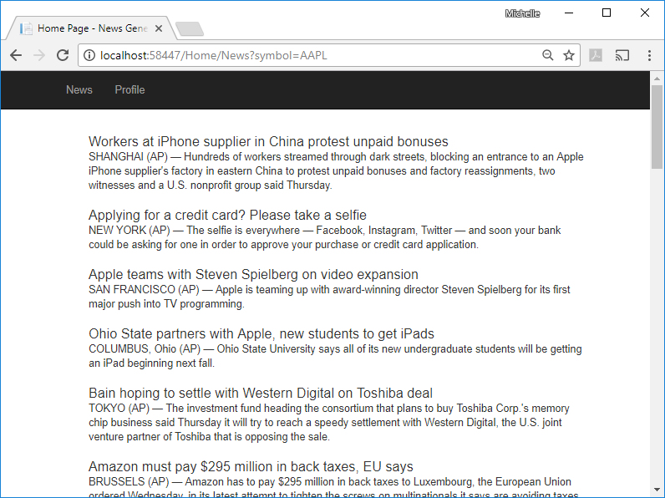
III. THE ALTERNATIVES - Demo

Slide 8
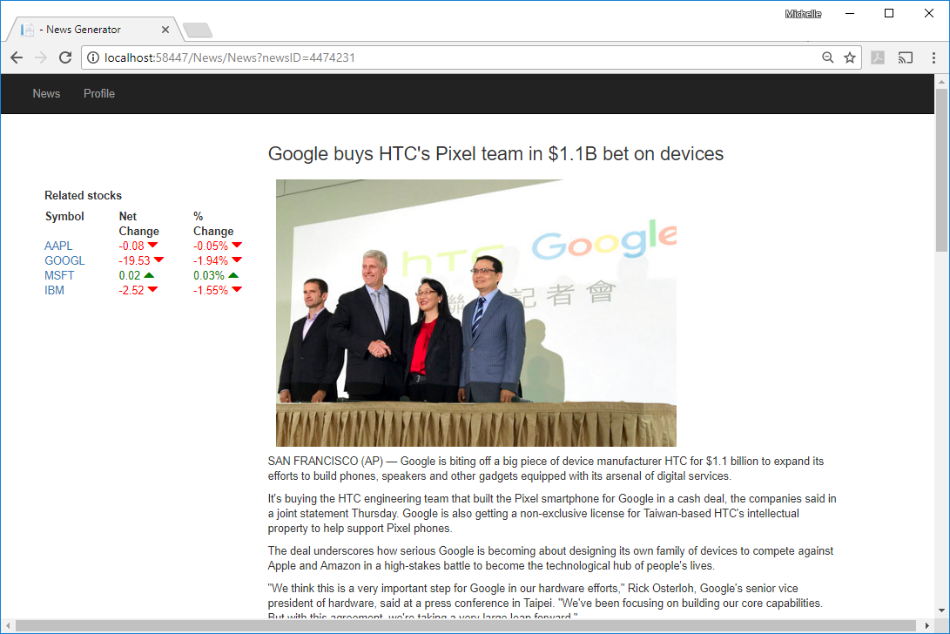
I. THE ALTERNATIVES —Demo

Slide 9
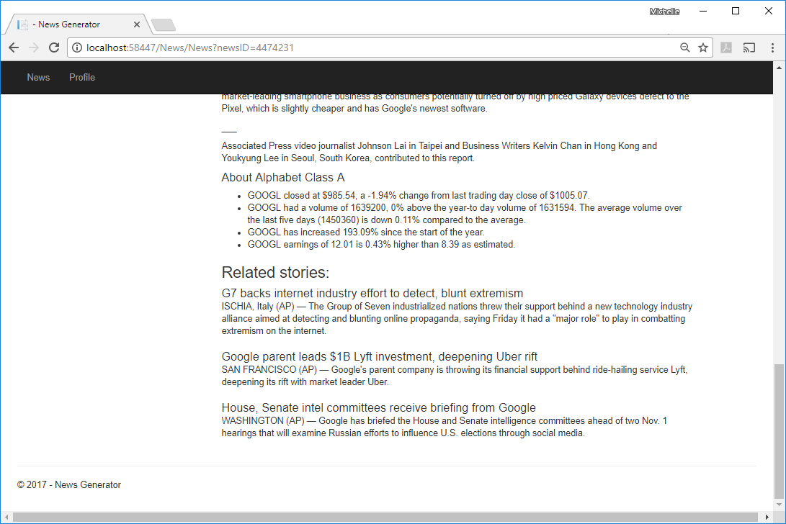
I. THE ALTERNATIVES —Demo

Slide 10
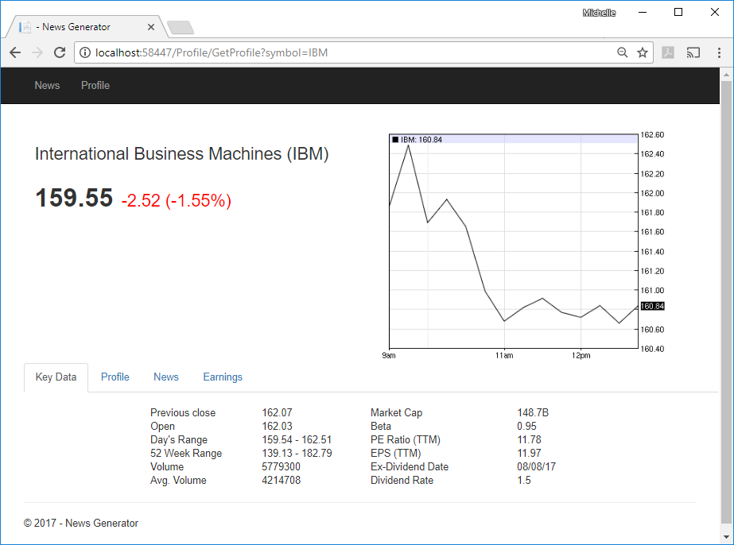
I. THE ALTERNATIVES —Demo
User friendly display
  Price
  Key data
  Profile
  News
  Earnings

Slide 11

The Alternative：
Time for your next move

