Slide 1

DS5230 Final: Phase 1
Michael Massone and Nelson Farrell
Spring 2024

Slide 2
Dry Bean Dataset
Size: (13611 x 17) – 13611 rows, 17 columns
This dataset is composed of data derived from 13,611 images of 7 species of beans. Bean images obtained by computer vision system were subjected to segmentation and feature extraction stages, and a total of 16 features; 12 dimensions and 4 shape forms, were generated.
KOKLU, M. and OZKAN, I.A., (2020), “Multiclass Classification of Dry Beans Using Computer Vision and Machine Learning Techniques.” Computers and Electronics in Agriculture, 174, 105507.
DOI: https://doi.org/10.1016/j.compag.2020.105507
Link: https://archive.ics.uci.edu/dataset/602/dry+bean+dataset

Slide 3
Target Class
Target: 7 Species of Dried beans
Barbunya
Bombay
Cali
Dermosan
Horoz
Seker
Sira
Numerical Encoding
Barbunya: 0
Bombay: 1
Cali: 2
Dermosan: 3
Horoz: 4
Seker: 5
Sira: 6

Slide 4
Features
Area (A): The area of a bean zone and the number of pixels within its boundaries.
Perimeter (P): Bean circumference is defined as the length of its border.
Major axis length (L): The distance between the ends of the longest line that can be drawn from a bean.
Minor axis length (l): The longest line that can be drawn from the bean while standing perpendicular to the main axis.
Aspect ratio (K): Defines the relationship between L and l.
Eccentricity (Ec): Eccentricity of the ellipse having the same moments as the region.
Convex area (C): Number of pixels in the smallest convex polygon that can contain the area of a bean seed.
Equivalent diameter (Ed): The diameter of a circle having the same area as a bean seed area.
Total: 16

Slide 5
Features
Extent (Ex): The ratio of the pixels in the bounding box to the bean area.
Solidity (S): Also known as convexity. The ratio of the pixels in the convex shell to those found in beans.
Roundness (R): Calculated with the following formula: (4piA)/(P^2)
Compactness (CO): Measures the roundness of an object: Ed/L
ShapeFactor1 (SF1)
ShapeFactor2 (SF2)
ShapeFactor3 (SF3)
ShapeFactor4 (SF4)
(continued)

Slide 6
Features
Features | Data Type | Measurement Scale
Area | float | Ratio
Perimeter | float | Ratio
Major Axis Length | float | Ratio
Minor Axis Length | float | Ratio
Aspect Ratio | float | Ratio
Eccentricity | float | Ratio
Convex Area | float | Ratio
Equivalent Diameter | float | Ratio
Extent | float | Ratio
Solidity | float | Ratio
Roundness | float | Ratio
Compactness | float | Ratio
ShapeFactor1 | float | Ratio
ShapeFactor2 | float | Ratio
ShapeFactor3 | float | Ratio
ShapeFactor4 | float | Ratio
Characteristics
All features in dataset are measurements based on image processing of the original bean images. Each feature is a ratio measure, based on a length measurement or some function of various lengths. The ShapeFactors are also calculated from measured dimensions, although which dimensions are not specified.

Slide 7

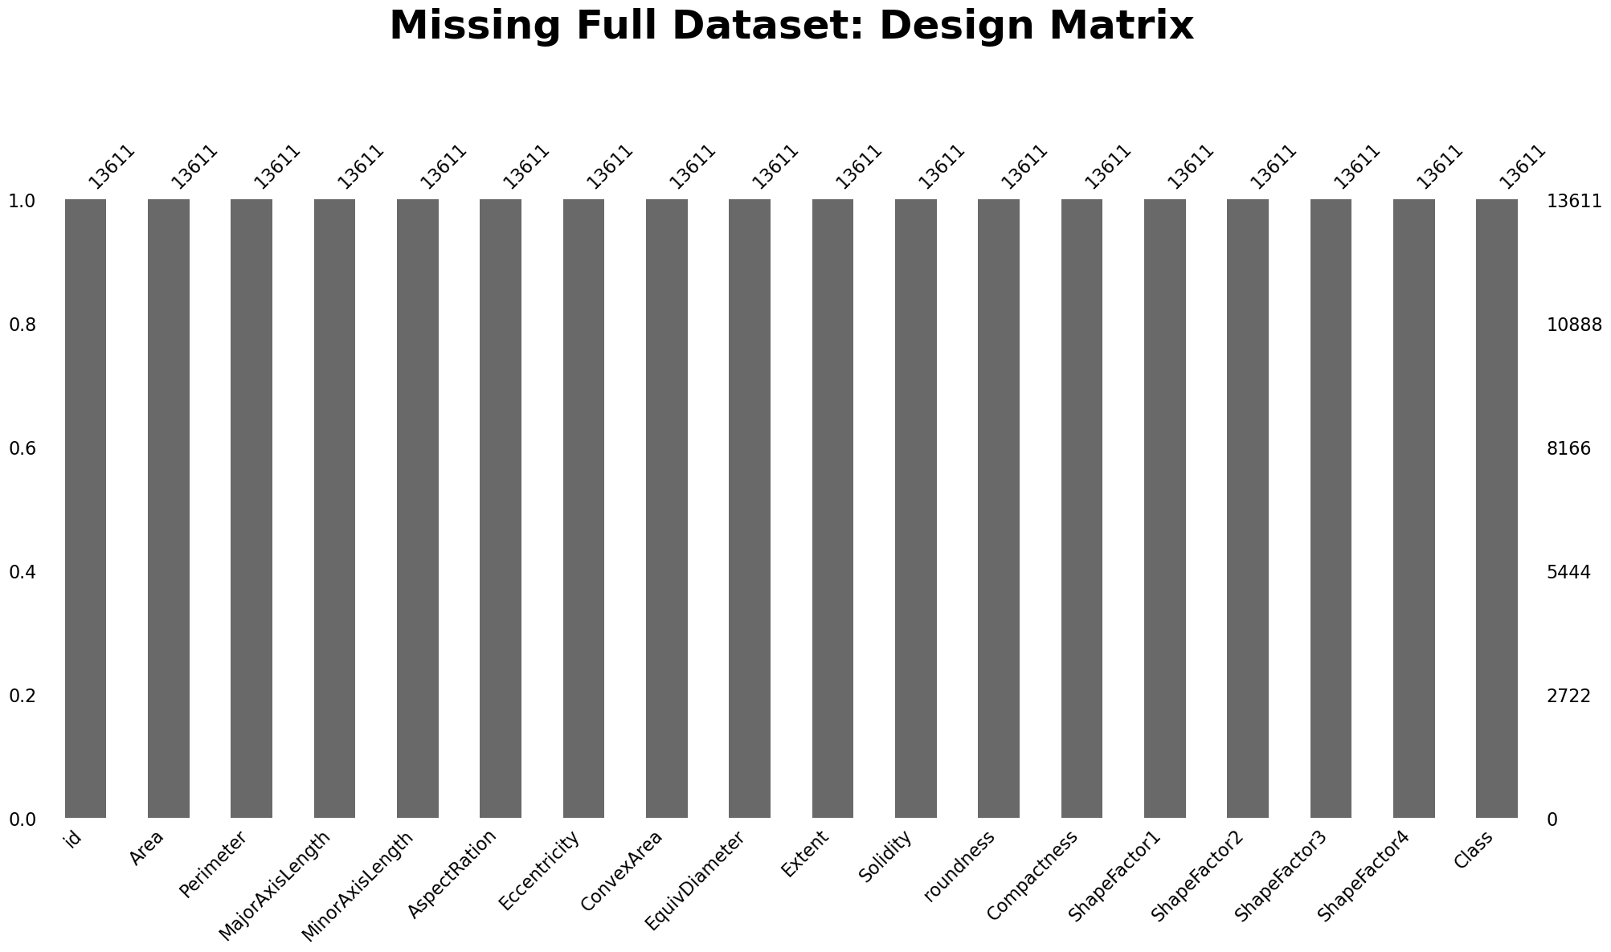
Missingness
Target Missingness: 0
Feature Missingness: 0

Slide 8
Acknowledgments
KOKLU, M. and OZKAN, I.A., (2020), “Multiclass Classification of Dry Beans Using Computer Vision and Machine Learning Techniques.” Computers and Electronics in Agriculture, 174, 105507. DOI: https://doi.org/10.1016/j.compag.2020.105507
Dr. Steve Morin – Class slides and labs.
UC Irvine Machine Learning Repository

