Slide 1

Generalization in deep learning
Who buys lunch?

Slide 2
Overview
Generalization: an introduction
The bound of Vapnik & Chervonenkis
Experimental evidence: the VC dimension is not relevant
The No Free Lunch paradox
Some empirical observations
Abstraction in deeper layers
Early vs late layers
Conclusion and speculation

Slide 3
Learning and Generalization
Abstract formulation of Machine Learning:
Collect set of training samples {(x, c)}
Find the optimal representative h* in a class of functions {h}
Minimize appropriate loss function E when evaluated on {(x, c)}
Typically use a gradient-based optimizer
Apply h* to unseen “test cases” {(x’, c’)}
Generalization is measured by the performance on generic x’ - e.g. E({(x’, c’)})

Slide 4
Analyzing generalization
A challenge: optimize on {(x, c)}, and evaluate on {(x’, c’)}!
But both sets are drawn from the same distribution (or at least similar)
Vapnik & Chervonenkis (1971):
if (a) the class of all h is not too big and (b) the set {(x, c)} contains sufficiently many samples
then it is likely that good performance on the training set implies similar performance during evaluation
Extent of {h} measured by Vapnik-Chervonenkis dimension
Related to the largest number of samples that can be given arbitrary labels within {h}

Slide 5
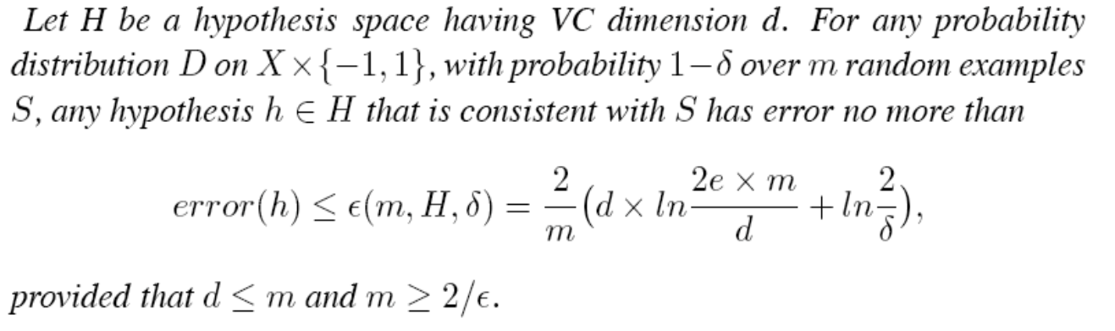
Typical VC bound

Slide 6
VC bounds and Deep Neural Nets
Does VC say anything about real Machine-Learning algorithms?
Sufficient, not necessary condition
Analytic results for soluble cases not very promising
E.g. linear classifier: d = dimension of space D, so E ~ D/m ln (m/D)
Proof of the pudding ...

Slide 7
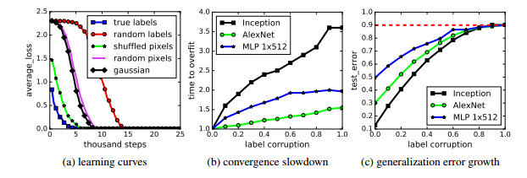
The surprise of Zhang (2018)
Training DNN with various corrupted forms of standard problems: perfect learning possible! (Effective VC dimension > m)

Slide 8
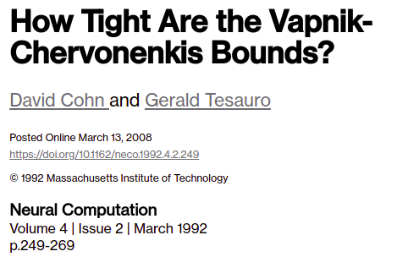

This observation is not totally unexpected

Slide 9
How mysterious is generalization?
From “Deep Learning”, by Goodfellow et al.:
The no free lunch theorem for machine learning (Wolpert, 1996) states that, averaged over all possible data generating distributions, every classification algorithm has the same error rate when classifying previously unobserved points. In other words, in some sense, no machine learning algorithm is universally any better than any other.
- Sec. 5.2.1, p. 116

Slide 10
How mysterious is generalization?
From “Deep Learning”, by Goodfellow et al.:
The no free lunch theorem for machine learning (Wolpert, 1996) states that, averaged over all possible data generating distributions, every classification algorithm has the same error rate when classifying previously unobserved points. In other words, in some sense, no machine learning algorithm is universally any better than any other.
- Sec. 5.2.1, p. 116
In precisely what sense?

Slide 11
Logic of the No Free Lunch theorem
Consider 2-class problem, over n binary variables { x_{i} }
2^n combinations of these variables
2^(2^n) functions over these combinations
In the absence of additional information: all functions equally probable
Now consider algorithms c₁ & c₂ with predictions c₁(x), c₂(x):
For each target function in which c₁(x) outperforms c₂(x), there is a corresponding target function with c₁(x) worse than c₂(x)
All target functions have the same prior probability
Thus, expected accuracies of c₁, c₂ exactly equal

Slide 12
What else can we prove with this logic?
Likelihood that a nearest-neighbor classifier > 60% accurate on arbitrary problem?
Equal likelihoods for both outcomes for each training sample
All outcomes independent events
Thus, scaled binomial distribution with parameter p = 0.5.
For N test samples: ~ Gaussian distribution with mean 0.5, variance 1/(4N).
For any realistic number of test samples, likelihood is zero for all practical purposes.
What is the impact of transposing 2 variables from training to testing?
Train with (. . . , x_{i}, x_{j}, . . . ), test with (. . . , x_{j}, x_{i}, . . . )
Because all outcomes equally likely, no impact on expected accuracy
This is not how Machine Learning works!

Slide 13
Understand the paradox and be free
Uniform assumption over functions leads to many paradoxical results (including NFL)
Further analysis in terms of “determination” (Barnard, 2011):
Uniform function prior is radically extreme case of “incoherence”
Conclusions arising from uniform prior can safely be ignored!

Slide 14
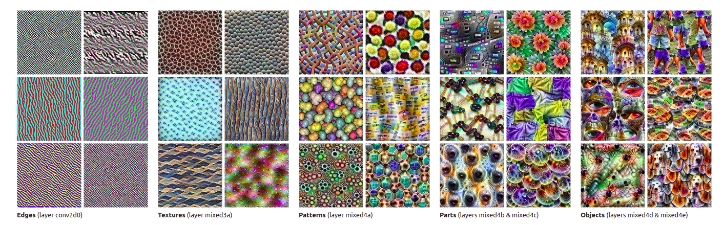
Depth and generalization
Observation: Increasing abstraction in deeper layers of convolutional DNNs (e.g. Olah et al. 2017)
Is this perhaps a general property of deep networks?

Slide 15
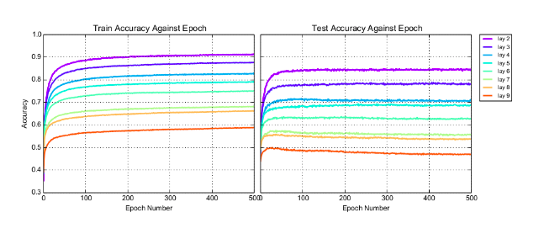
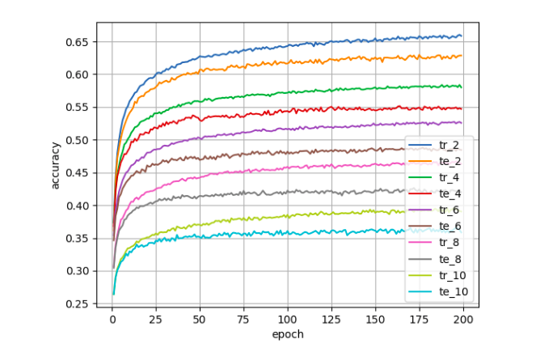
Training a single layer - earlier is better ...
(Raghu, 2017)
(Davel, unpublished)

Slide 16
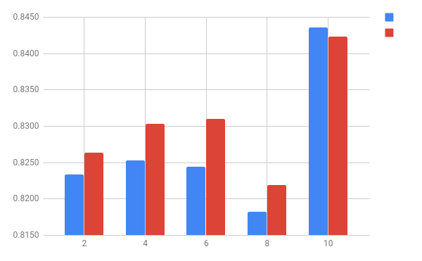
But only if your learning parameters are bad!
Train
Test
(Davel, unpublished)

Slide 17
Other speculations on generalization
Many other “capacities” being explored … but perhaps ‘capacity’ is the wrong place to look
The accuracy of a database does not depend on its capacity!
Tishby’s “information bottleneck” has made a reappearance
And seems as hocus-pocus as ever
Perhaps we need to take prior information more seriously
Given the NFL absurdities of an inappropriate prior

Slide 18
This work is based on the research supported by the National Research Foundation. Any opinion, finding and conclusion or recommendation expressed in this material is that of the author and the NRF does not accept any liability in this regard.

