Slide 1
Language and Speaker Recognition for Semi-Supervised Bilingual Acoustic Model Training
Maties Machine Learning meeting
09.03.2018
Emre Yılmaz
¹ CLS/CLST, Radboud University, Nijmegen, Netherlands
² STAR Lab, SRI International, Menlo Park, CA, USA

Slide 2
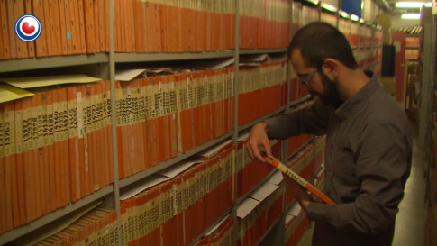

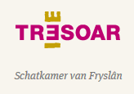



Frisian Audio Mining Enterprise: FAME! Project
Goal: Disclose the Omrop Fryslân (Frisian Broadcast) archives containing recordings from 1950s to present
2

Slide 3
Focus of this talk
FAME! Project: Spoken document retrieval in a radio archive with code-switching (CS) Frisian-Dutch speech
Unlike Dutch, Frisian is a low-resourced language with limited amount of manually annotated speech data
Semi-supervised training is common practice in monolingual scenarios
Contribution of this work: extension of this idea to bilingual scenarios by automatically annotating raw data from the archives containing CS speech
Relevant applications given the bilingual nature of the data
Bilingual automatic speech recognition (ASR)
Speaker diarization/linking on longitudinal data
Language diarization/recognition
3

Slide 4
Frisian language & FAME! CS speech corpus
4

Slide 5
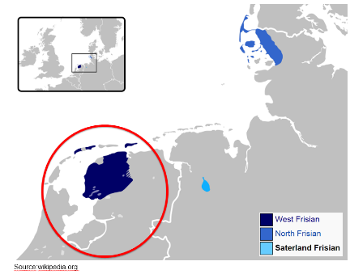
Frisian Language & FAME! CS Speech Corpus
West Frisian is one of the three Frisian languages (together with East and North Frisian spoken in Germany).
It has approximately half a million bilingual speakers mostly living in the province Fryslân located in the northwest of the Netherlands.
The Frisian speech data has
been collected from the
archives of Omrop Fryslân
The annotation protocol includes three kinds of information:
Orthographic transcription
Metadata such as dialect, speaker sex and name (if known)
Spoken language information
5

Slide 6
CS and Speaker Content of Reference Data
This bilingual data contains Frisian-only and Dutch-only utterances as well as mixed utterances with inter-sentential, intra-sentential and intra-word CS.
The database contains more than 10 hours of Frisian speech and 4 hours of Dutch speech.
The total number of word- and sentence-level code switching cases is 3837. 75.6% of the all switches are from Frisian to Dutch.
The content of the recordings is very diverse, including radio programs about culture, history, literature, sports, nature, agriculture, politics, society and languages.
There are 334 identified and 120 unidentified speakers in the FAME! speech database. 51 identified speaker appear at least in 2 different years in the database, mostly program presenters and celebrities.
There are 10 speakers who are labeled to speak in both languages.
6

Slide 7
Automatic Annotation of Raw Broadcast Data
7

Slide 8
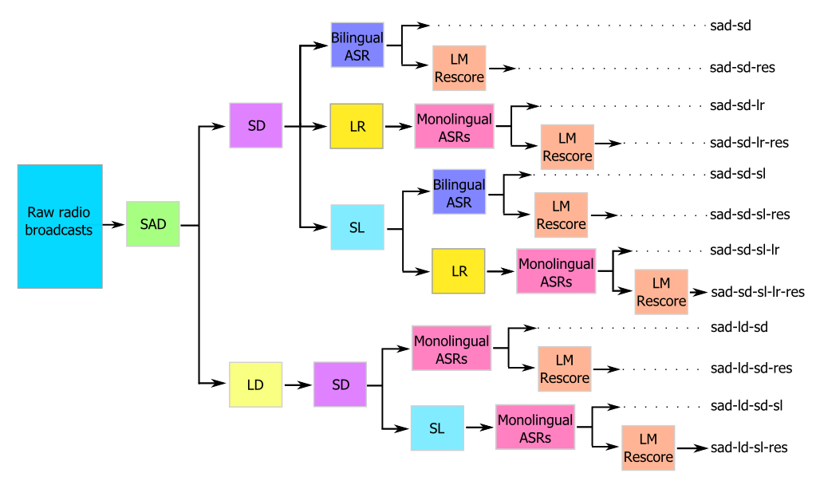
Overview of Automatic Annotation Approaches
8

Slide 9
Front-end Applications
9

Slide 10
Overview of Automatic Annotation Approaches
10

Slide 11

Front-end Applications
Speech Activity Detection (SAD)
In all approaches, speech-only segments are extracted from a large amount of raw broadcast data using a robust speech activity detection system
The speech-only segments belonging to the same recording are merged to extract a single speech segment for each raw recording
A DNN-based SAD approach has been used in the experiments which is detailed in (Graciarena, 2016)
11

Slide 12
Overview of Automatic Annotation Approaches
12

Slide 13

Front-end Applications
Speaker Diarization (SD)
The speech-only segments are labeled with speaker ids by using a SD system
The intent of SD in the current context is to aid in speaker-adaptive training which brings improved ASR performance in similar monolingual applications (Cerva, 2013)
Errors from diarization are expected to have limited impact on ASR since the errors will likely be due to similar sounding speakers
An i-vector+PLDA-based SD system has been used which resembles the system described in (Sell, 2014)
13

Slide 14
Overview of Automatic Annotation Approaches
14

Slide 15

Front-end Applications
Speaker Linking (SL)
Linking the speaker labels assigned by the SD system is a straightforward step towards improving the quality of the speaker labels assigned to the raw data
For this purpose, we use a speaker identification system trained on a large amount of multilingual data to assign speaker similarity scores
Similarity scores for all possible speaker pairs are calculated
Speaker linking is performed by applying complete-linkage clustering as described in (Ghaemmaghami, 2016)
15

Slide 16
Overview of Automatic Annotation Approaches
16

Slide 17

Front-end Applications
Language Recognition (LR)
The speech segments are labeled with a language tag in two different stages to investigate the impact of different pipelines on the automatic annotation quality
The first approach performs language labeling after assigning the speaker labels
With the assumption of monolingual speakers, the same-speaker segments are merged and labeled using a language recognition system
After assigning the labels, each utterance is automatically transcribed by the corresponding monolingual ASR system
17

Slide 18
Overview of Automatic Annotation Approaches
18

Slide 19
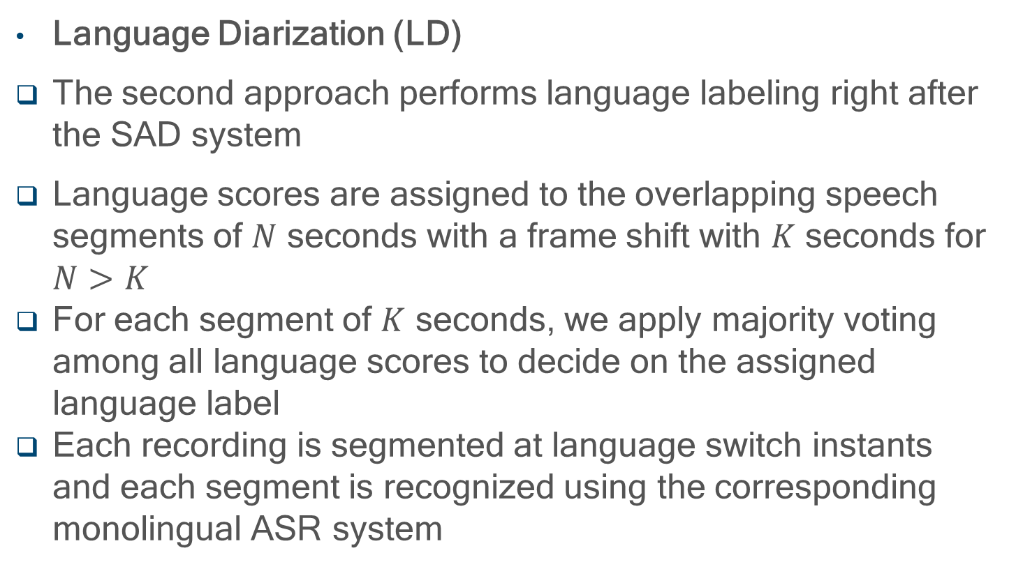
Front-end Applications
Language Diarization (LD)
The second approach performs language labeling right after the SAD system
Language scores are assigned to the overlapping speech segments of $N$ seconds with a frame shift with $K$ seconds for $N>K$
For each segment of $K$ seconds, we apply majority voting among all language scores to decide on the assigned language label
Each recording is segmented at language switch instants and each segment is recognized using the corresponding monolingual ASR system
19

Slide 20
Back-end Applications
20

Slide 21
Overview of Automatic Annotation Approaches
21

Slide 22
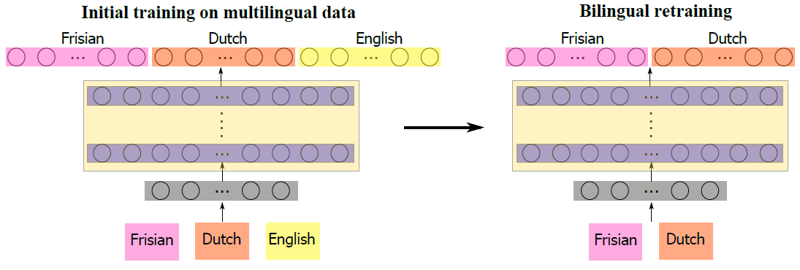

Back-end Applications
Bilingual ASR System
Two-stage training using the target CS speech in the second step to tune the DNN models
The most likely hypothesis output by the recognizer is used as the reference transcription
22

Slide 23
Overview of Automatic Annotation Approaches
23

Slide 24
Back-end Applications
Monolingual ASR Systems
One low-resourced and one high-resourced language as mixed languages in our case
Monolingual resources of the highly resourced language, Dutch in this case, provides better ASR performance compared to a bilingual ASR
The multilingual training approach can also help with the recognition of Frisian-only segments, which will also be better than a bilingual ASR
Higher ASR accuracy implies better automatic transcription given a decent LR/LD performance
24

Slide 25
Overview of Automatic Annotation Approaches
25

Slide 26
Back-end Applications
Language Model (LM) Rescoring
In previous work, the automatic transcriptions extracted with and without the rescoring stage have given similar results
Rescoring was performed with a bilingual LM which has a higher perplexity compared to the monolingual LMs
In this work, we include the rescoring stage expecting more significant improvements in transcription quality by using monolingual LMs for rescoring
26

Slide 27
Experimental Setup
27

Slide 28
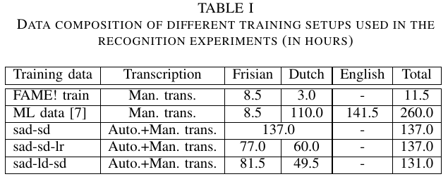
Experimental Setup
ASR: Kaldi nnet models
SAD, LR, SR, SD: OLIVE
There are two baseline system:
ASR trained only on the manually annotated data,
ASR trained using the ML DNN approach trained only on the manually annotated data.
Other ASR systems incorporate acoustic models trained on the combined (manually + automatically annotated) data
28

Slide 29
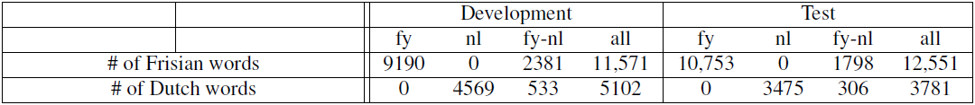
Experimental Setup
These systems are tested on the development and test data of the FAME! speech corpus
The word error rate (%) results are reported separately for Frisian only (fy), Dutch only (nl) and mixed (fy-nl) segments
The overall performance (all) is also provided as a performance indicator
After the ASR experiments, we compare the CS detection performance of these recognizers by using a time-based CS detection accuracy metric
29

Slide 30
ASR Results
30

Slide 31
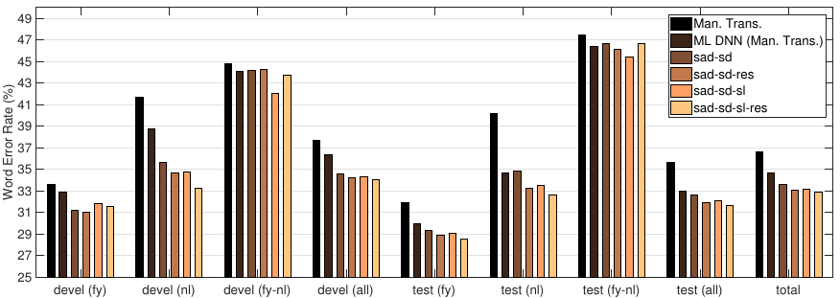
ASR Results – I: Speaker labeling w/o LR
The first baseline system provides the total WER of 36.7%, while ML DNN training reduces the total WER to 34.7%
31

Slide 32
ASR Results – I: Speaker labeling w/o LR
The first baseline system provides the total WER of 36.7%, while ML DNN training reduces the total WER to 34.7%
32

Slide 33
ASR Results – I: Speaker labeling w/o LR
The first baseline system provides the total WER of 36.7%, while ML DNN training reduces the total WER to 34.7%
Adding only automatically transcribed data with pseudo speaker labels (sad-sd) reduces the total WER to 33.6%
33

Slide 34
ASR Results – I: Speaker labeling w/o LR
Bilingual rescoring helps further with a total WER of 33.1%
34

Slide 35
ASR Results – I: Speaker labeling w/o LR
Bilingual rescoring helps further with a total WER of 33.1%
Acoustic models obtained on the data with speaker linking and bilingual rescoring provides the best performance with a total WER of 32.9% (henceforth the best performing bilingual pipeline)
35

Slide 36
ASR Results – I: Speaker labeling w/o LR
The performance gains are obtained on the monolingual segments namely (fy) and (nl)
Segments with switches (fy-nl) are still challenging
36

Slide 37
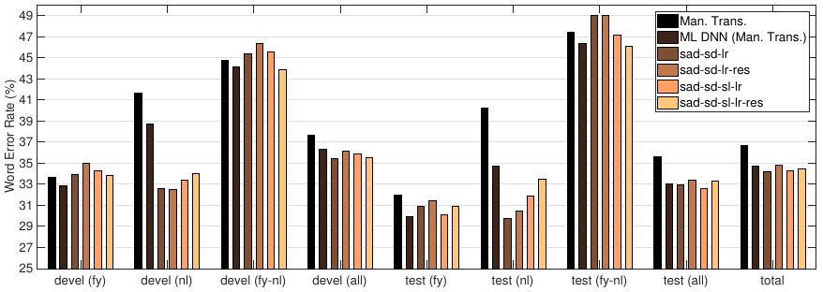
ASR Results – II: Speaker labeling with LR
Language recognition followed by speaker labeling yields worse results in general
The annotation accuracy in this setting highly depends on the language homogeneity in speaker-labeled segments
Monolingual speaker assumption was not also realistic given that there are 10 bilingual speaker in the reference data
37

Slide 38
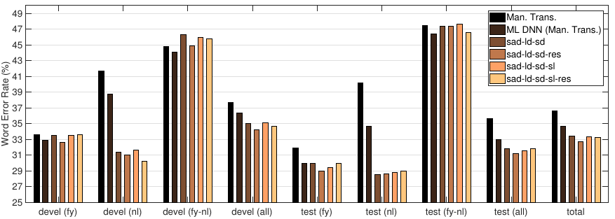
ASR Results – III: Language labeling after SAD
When language labeling is performed first, results get better
ASR trained on sad-ld-sd-res has a total WER of 32.7%
This is the lowest total WER obtained so far (henceforth the best performing monolingual pipeline)
Speaker linking did not bring further improvements in this scenario
38

Slide 39
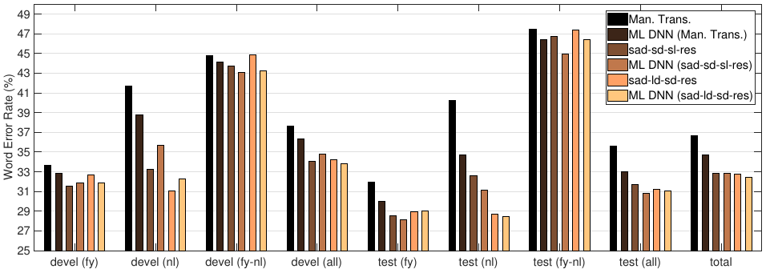
ASR Results – IV: ML DNN training
We pick the best performing monolingual (sad-ld-sd-res) and bilingual (sad-sd-sl-res) pipeline and apply ML DNN training to investigate the effects on WER and CS detection
39

Slide 40
ASR Results – IV: ML DNN training
We pick the best performing monolingual (sad-ld-sd-res) and bilingual (sad-sd-sl-res) pipeline and apply ML DNN training to investigate the effects on WER and CS detection
Marginal improvements are obtained compared to the systems trained only on the combined data with the lowest total WER of 32.5% provided by ML DNN (sad-ld-sd-res)
40

Slide 41
CS Detection Results
41

Slide 42
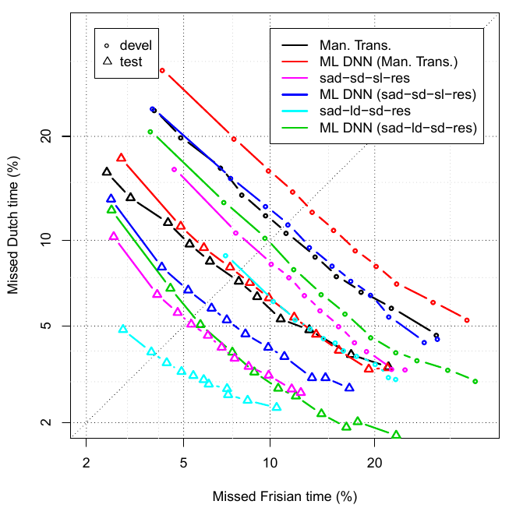
CS Detection Results
ML DNN training has an adverse impact on the CS detection
Including a third language in the training reduces the quality of assigned language tags
42

Slide 43
CS Detection Results
ML DNN training has an adverse impact on the CS detection
Including a third language in the training reduces the quality of assigned language tags
ASR trained only on the sad-ld-sd-res data has the best CS detection with an EER of 8.1% on devel and 3.9% on test data
43

Slide 44
Employing Other Acoustic and Textual Data Resources
44

Slide 45
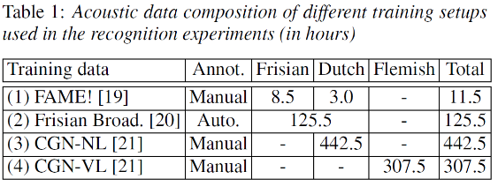
Some More Acoustic Data...
Increased amount of CS speech training data: we can benefit from monolingual speech from the high-resourced language
Dutch and Flemish speech data from the Spoken Dutch Corpus
Diverse speech material including conversations, interviews, lectures, debates, read speech and broadcast news
Other ways of increasing acoustic data: standard 3-fold data augmentation by creating two copies of a database with x0.9 and x1.1 speed
45

Slide 46
...and More Sophisticated Acoustic Models
Increased amount of CS speech training data: we can benefit from more sophisticated neural network architectures consisting of time-delay and recurrent layers which were ineffective before
46

Slide 47
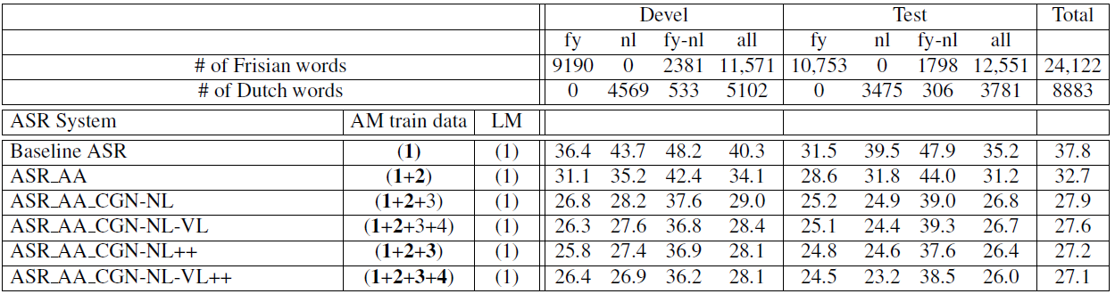
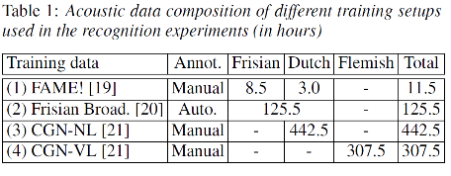
...and More Sophisticated Acoustic Models
Increased amount of CS speech training data: we can benefit from more sophisticated neural network architectures consisting of time-delay and recurrent layers which were ineffective before
47

Slide 48
What about the language model?
Enrich the language model with more CS text which is almost non-existent in practice
We look for ways of creating CS text using the transcriptions of the training speech corpus (140k) as reference
Text generation using LSTM-LM trained on CS text
Use the automatically generated transcriptions
Machine translation to create text using transcriptions of Dutch speech
48

Slide 49
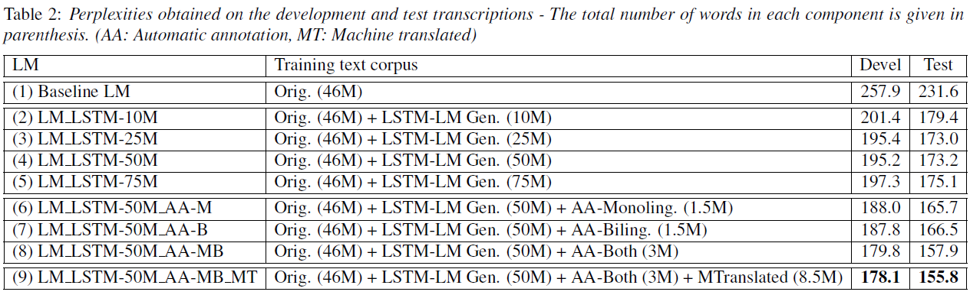
What about the language model?
Enrich the language model with more CS text which is almost non-existent in practice
We look for ways of creating CS text using the transcriptions of the training speech corpus (140k) as reference
Text generation using LSTM-LM trained on CS text
Use the automatically generated transcriptions
Machine translation to create text using transcriptions of Dutch speech
49

Slide 50
What about the language model?
Enrich the language model with more CS text which is almost non-existent in practice
We look for ways of creating CS text using the transcriptions of the training speech corpus (140k) as reference
Text generation using LSTM-LM trained on CS text
Use the automatically generated transcriptions
Machine translation to create text using transcriptions of Dutch speech
50

Slide 51
What about the language model?
Enrich the language model with more CS text which is almost non-existent in practice
We look for ways of creating CS text using the transcriptions of the training speech corpus (140k) as reference
Text generation using LSTM-LM trained on CS text
Use the automatically generated transcriptions
Machine translation to create text using transcriptions of Dutch speech
51

Slide 52
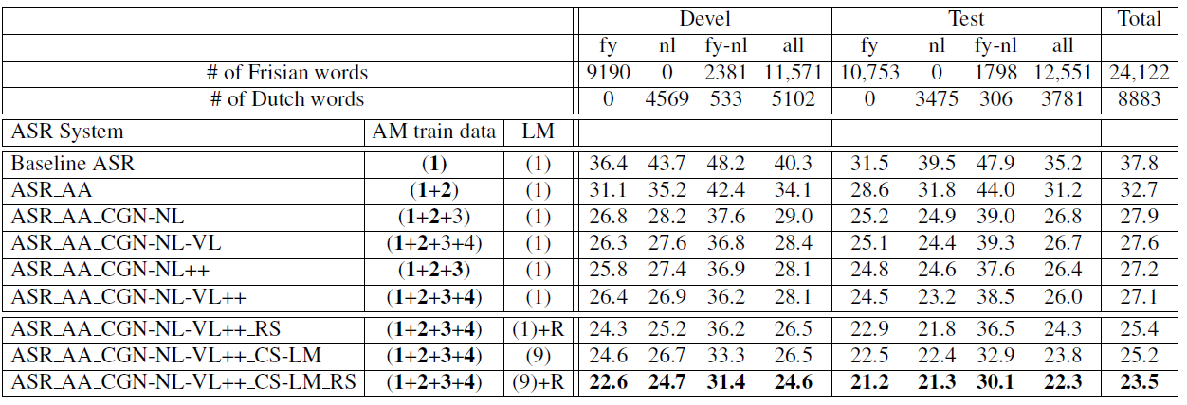
Using the new LM in the ASR system
New LM enriched with automatically created text help further with reducing the total WER from 27.1% to 25.2%
Lattice rescoring improves the ASR performance with a total WER of 23.5%
52

Slide 53
Using the new LM in the ASR system
New LM enriched with automatically created text help further with reducing the total WER from 27.1% to 25.2%
Lattice rescoring improves the ASR performance with a total WER of 23.5%
This is significantly better than 32.7% of the ASR trained only on Frisian-Dutch speech data
53

Slide 54
Conclusions
We first use language and speaker recognition for automatically annotating raw broadcast to increase training data for an ASR system operating on CS speech using a small amount of reference data
Several pipelines have been described using different applications and the automatically annotated data is merged with the reference data to train new acoustic models
The ASR and CS detection experiments have demonstrated the potential of using automatic language and speaker tagging in semi-supervised bilingual acoustic model training
Later, we used/generated other resources to increase the amount of speech and textual data for acoustic and language model training which provided further improvements in the ASR performance
54

Slide 55
Relevant FAME! References
E. Yılmaz, H. van den Heuvel and D. van Leeuwen, “Acoustic and Textual Data Augmentation for Improved ASR of Code-Switching Speech,” Submitted to INTERSPEECH, Hyderabad, India, September 2018.
E. Yılmaz, M. McLaren, H. van den Heuvel and D. van Leeuwen, “Semi-Supervised Bilingual Acoustic Model Training for Speech with Code-switching,” Submitted to Speech Communication, 2018.
E. Yılmaz, M. McLaren, H. van den Heuvel and D. van Leeuwen, “Language Diarization for Semi-Supervised Bilingual Acoustic Model Training,” in Proc. IEEE Automatic Speech Recognition and Understanding (ASRU), pp. 91-96, Okinawa, Japan, December 2017.
E. Yılmaz, H. van den Heuvel and D. van Leeuwen, “Exploiting Untranscribed Broadcast Data for Improved Code-switching Detection,” in Proc. INTERSPEECH, pp. 42-46, Stockholm, Sweden, August 2017.
E. Yılmaz, J. Dijkstra, H. Van de Velde, F. Kampstra, J. Algra, H. van den Heuvel and D. van Leeuwen, “Longitudinal Speaker Clustering and Verification Corpus with Code-switching Frisian-Dutch Speech,” in Proc. INTERSPEECH, pp. 37-41 Stockholm, Sweden, August 2017.
E. Yılmaz, H. van den Heuvel and D. van Leeuwen, “Code-switching Detection Using Multilingual DNNs,” in IEEE Workshop on Spoken Language Technology (SLT), pp. 610-616, San Diego, CA, USA, December 2016.
E. Yılmaz, H. van den Heuvel, J. Dijkstra, H. Van de Velde, F. Kampstra, J. Algra and D. van Leeuwen, “Open Source Speech and Language Resources for Frisian,” In Proc. INTERSPEECH, pp. 1536-1540, San Francisco, CA, USA, Sept. 2016.
E. Yılmaz, H. van den Heuvel and D. van Leeuwen, “Investigating Bilingual Deep Neural Networks for Automatic Recognition of Code-switching Frisian Speech,” Procedia Computer Science, vol. 81, pp. 159-166, May 2016.
E. Yılmaz, M. Andringa, S. Kingma, J. Dijkstra, F. van der Kuip, H. Van de Velde, F. Kampstra, J. Algra, H. van den Heuvel and D. van Leeuwen, “A Longitudinal Bilingual Frisian-Dutch Radio Broadcast Database Designed for Code-switching Research,” In Proc. LREC, pp. 4666-4669, Portorož, Slovenia, May 2016.
55

Slide 56
Thank you!
56

