Slide 1


A card game built on the blockchain
Stogiannidis Ilias - Marios 3180178
Diamantopoulos – Pantaleon Odyssefs 3180049
BSC Thesis Presentation
Athens University of Economics and Business
School of Information Sciences and Technology
Department of Informatics
Led by Professor George C. Polyzos and PhD Candidate Iakovos Pittaras

Slide 2
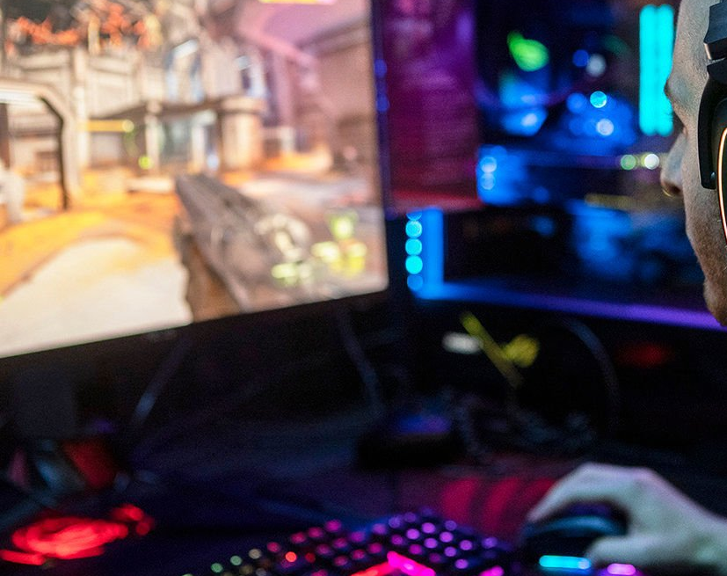
How did we come up with the idea?

Slide 3

Our first contact with Blockchain technology
In a discussion, Prof. Polyzos shared with us his current interests and work, that led us to learn more about Blockchains, their use and their application
We were also invited to the MMLab facilities and participate in a summer program led by Prof. Polyzos that brought us closer to many new technologies including Blockchains

Slide 4

Ethereum Blockchain Advantages
Data coordination (Decentralized System)
Rapid contract deployment
Access in test networks
Finality
Tokenization of assets (e.g. Cards and other game objects)
Has its own programming language that is being executed on the Blockchain and allows development and execution of Dapps

Slide 5
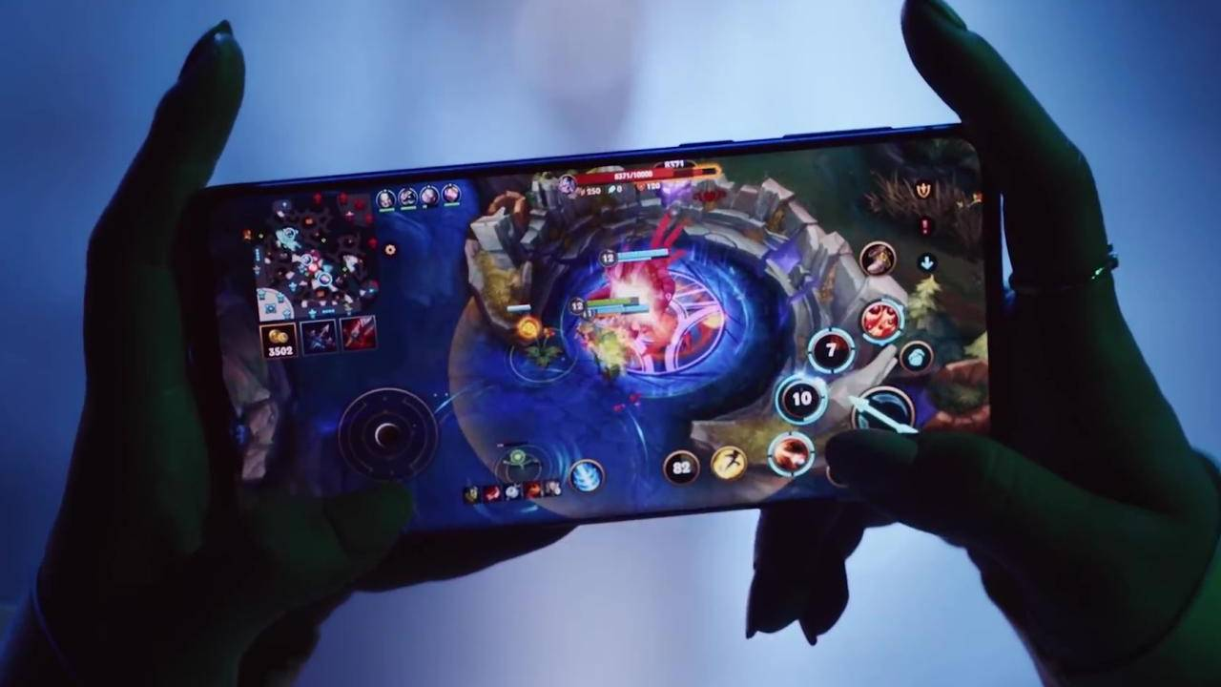
A majority of video games that have been initially released for PCs have made their way in the mobile gaming area
Games such as:
League Of Legends
Hearthstone
Legends of Runeterra

Slide 6
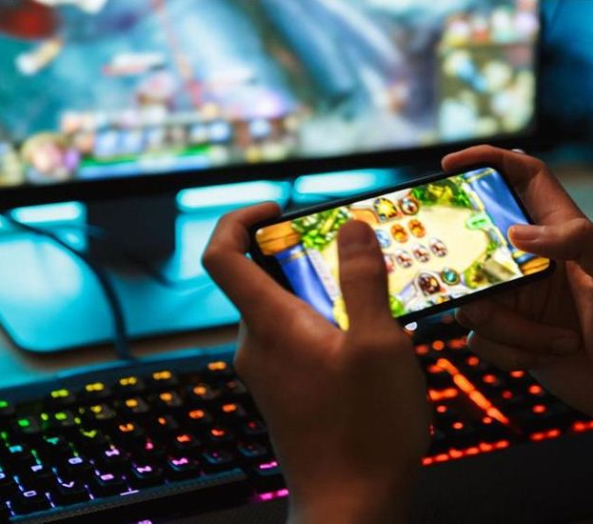
We are huge fans of mobile gaming
We value the Blockchain technology and its advantages
We noticed the lack of mobile games utilizing this technology in the market
So, we decided to create one!

Slide 7
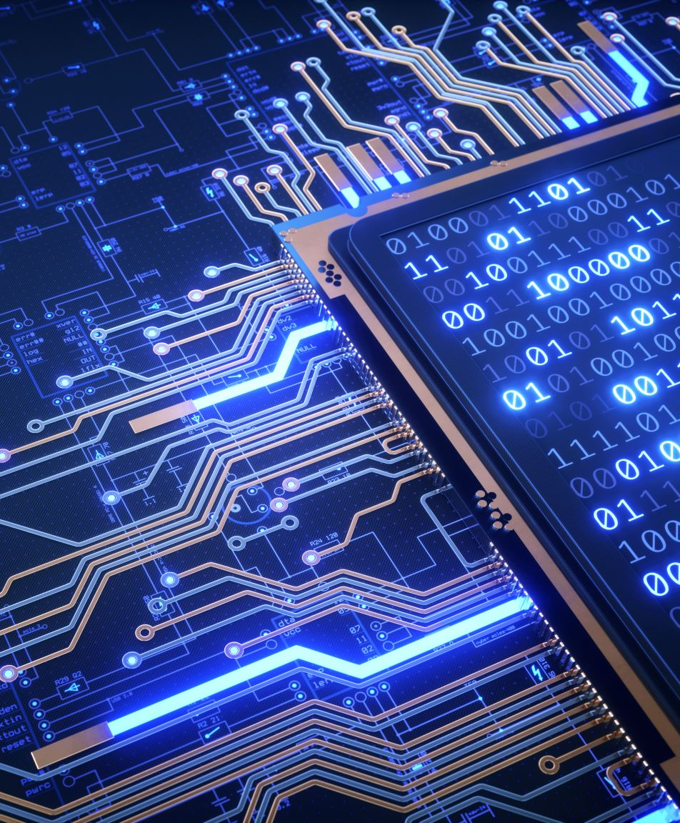
Our Game
We decided that our game will be a turned based card game
Our cards will be represented as tokens on the Ethereum Blockchain
We use the ERC-20 and ERC-721 token standards
The former represents a group of cards that are common and less powerful
The latter represents a limited number of cards that are unique
The goal is to win against an AI that uses its own deck

Slide 8
Project Overview

Slide 9

Analyzing the Components

Slide 10
Unity
The game aspect of the project was created using the Unity Engine
It was developed using C#
The project is embedded in the android application
It communicates with the JS server using the Socket IO library

Slide 11
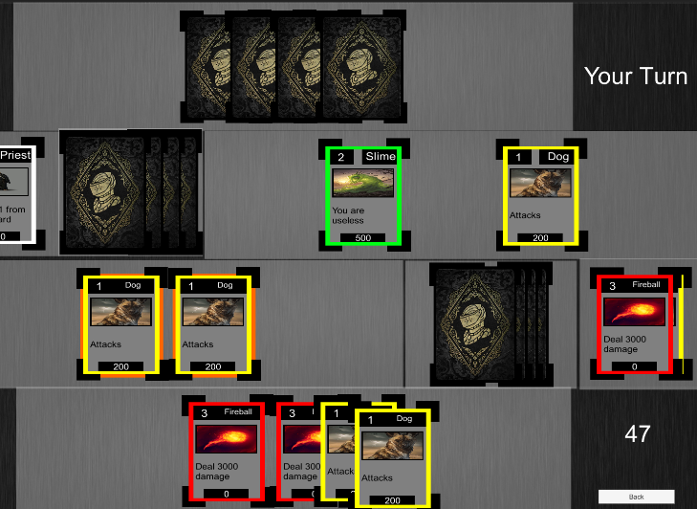
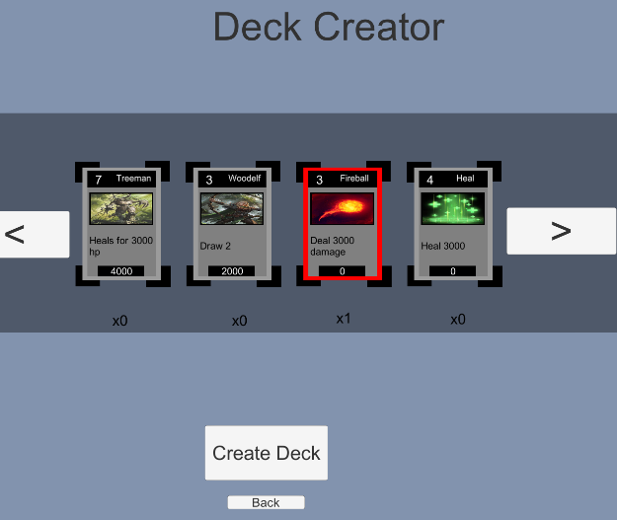
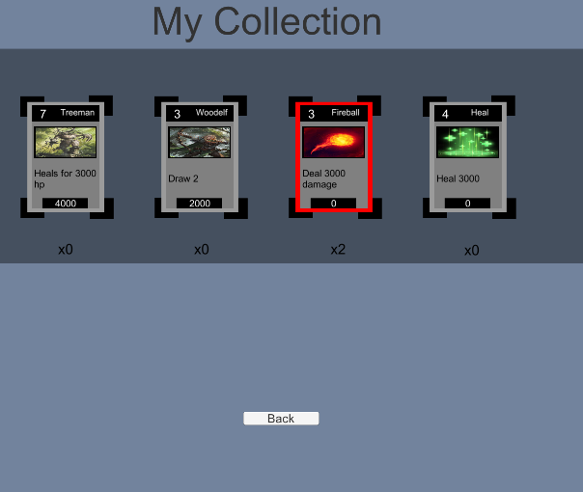
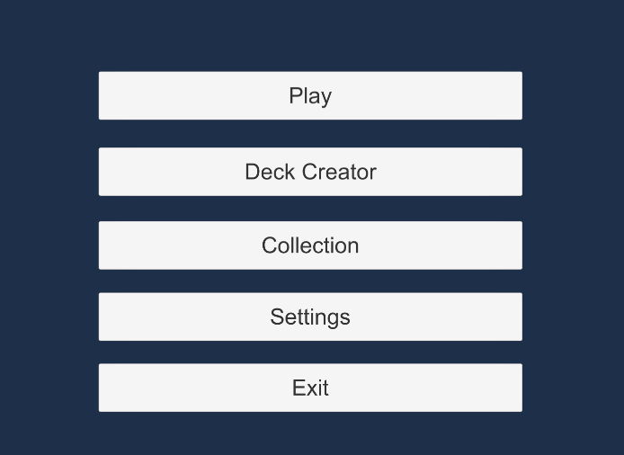
Screenshots

Slide 12
Android Application
This aspect of the project is developed using Android Studio
It is written in Java
The app offers a log in screen for the user
It sends to the Java server the information needed to connect to the user’s wallet

Slide 13
Screenshots

Slide 14
Servers
The Java server forwards the user information to the JS server
The JS server has two functions:
To establish a connection with the Ethereum Blockchain and retrieve information from it
To send the information retrieved to the game

Slide 15
Ethereum Blockchain
This aspect of the project was developed using solidity and the Remix IDE
As a wallet provider we use MetaMask
We use Infura and the Rinkeby network for testing
Each contract offers an API for the JS server to retrieve any information needed
There are two types of token standards that were used: ERC-20, ERC-721

Slide 16
Future Improvements
Multiplayer
New cards
User information Database
UI/UX improvements
New AI opponents
Reward System

Slide 17

Thank you for your attention!

