Slide 1
MMLab Blockchain Game
Διαμαντόπουλος - Πανταλέων Οδυσσεύς
Στογιαννίδης Ηλίας - Μάριος

Slide 2
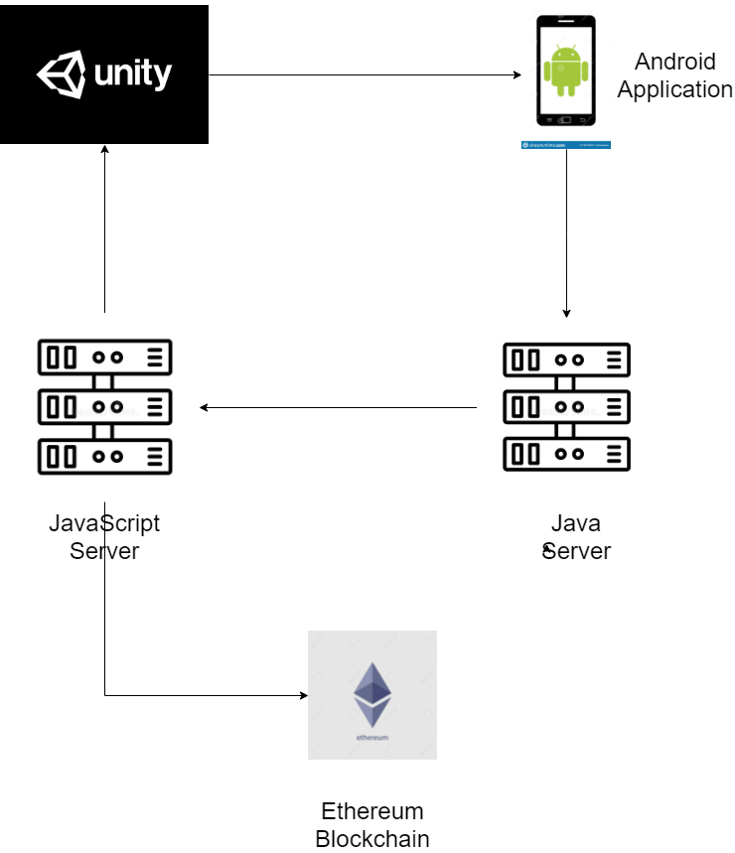

Slide 3
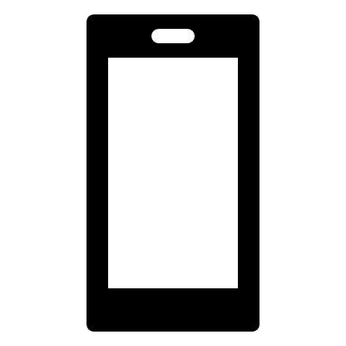
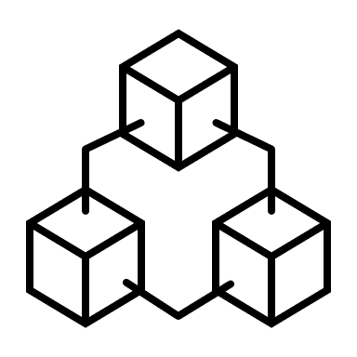
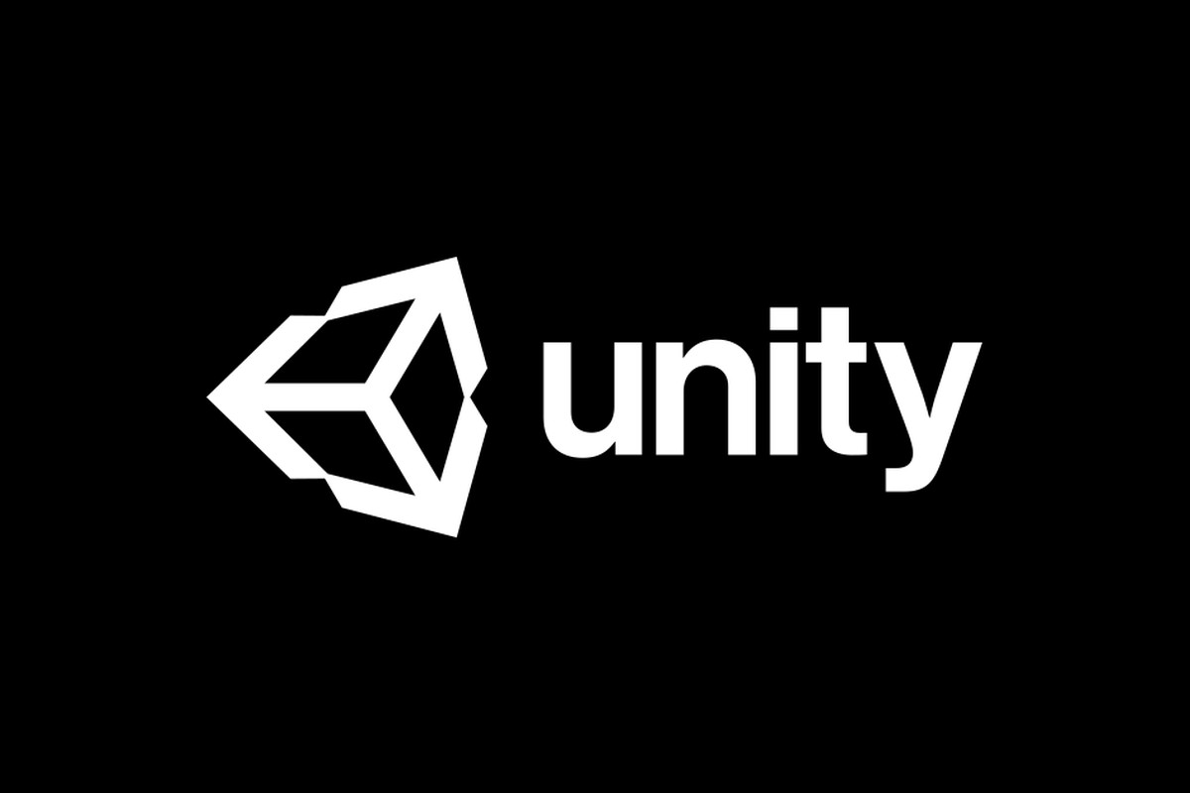
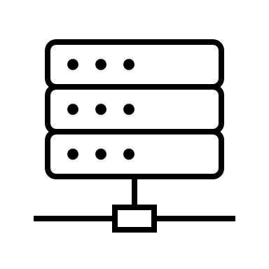
Android App
Java server
JavaScript server
Ethereum Blockchain
The game is developed using the Unity Engine.
The Android application is developed using Java.
The application communicates with the Java server which then communicates with JavaScript server that communicates with the Ethereum Blockchain.
We are using the ERC-20 token standard to represent most of the cards and we are using the ERC-721(NFT) token standard to represent the rare cards

