Slide 1
Dataset

Slide 2
EDA findings
CFs are distributed across sites in similar manner e.g. all sites are dominated by lignin class, followed by Tannin, Protein, ConHC etc.
Site clustering based on richness index (Jaccard) followed analyses on the CFs class distribution reveals similar finding as (1)

Slide 3
Back to research question
Site metadata
Examining the ecological processes influencing the
assembly of molecules into OM assemblages
Binary CFs data
How to identify DOM cluster?

Slide 4
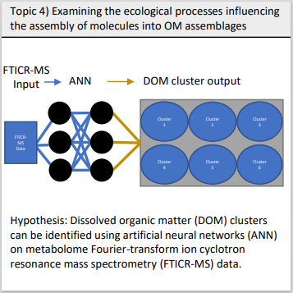
Available datasets
Data:
CF data by site: Presence/absence of CFs
CF metadata: chemical properties and class
Site metadata: (97+) so one site has ~2-3 sample data
ANN Input: Any suitable data
ANN Output: DOM cluster output
Problem: For supervised learning such as ANN or RF, we must know the output first e.g. DOM cluster.
However, our goal is to identify DOM cluster and site-clustering are not equivalent to DOM clustering e.g. all sites are dominated by Lignin etc.
We have achieved site-clustering based on richness index and is able to examine ecological process influencing richness of molecules instead.

