Slide 1
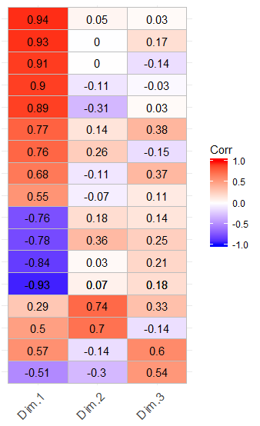
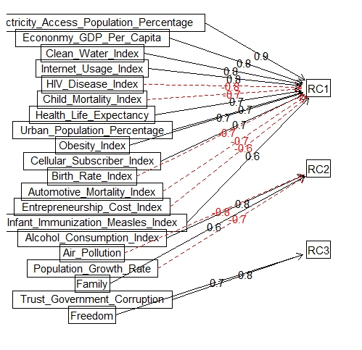
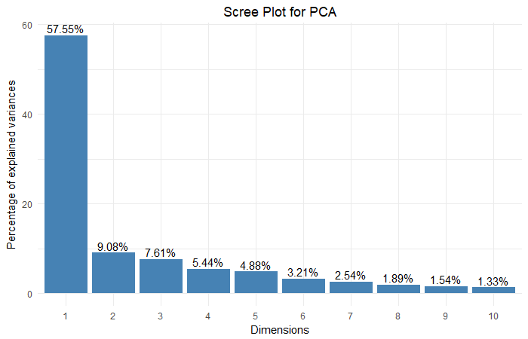
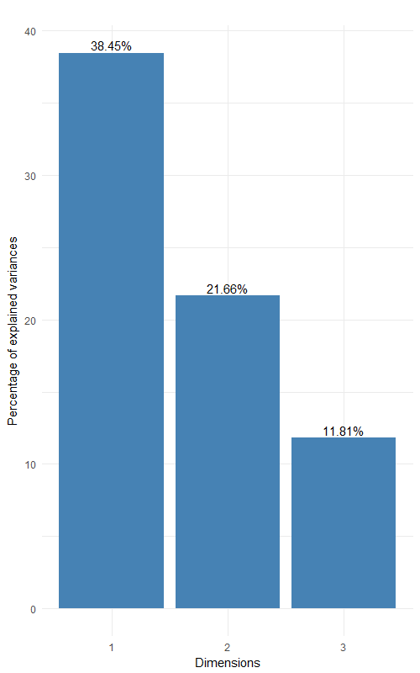














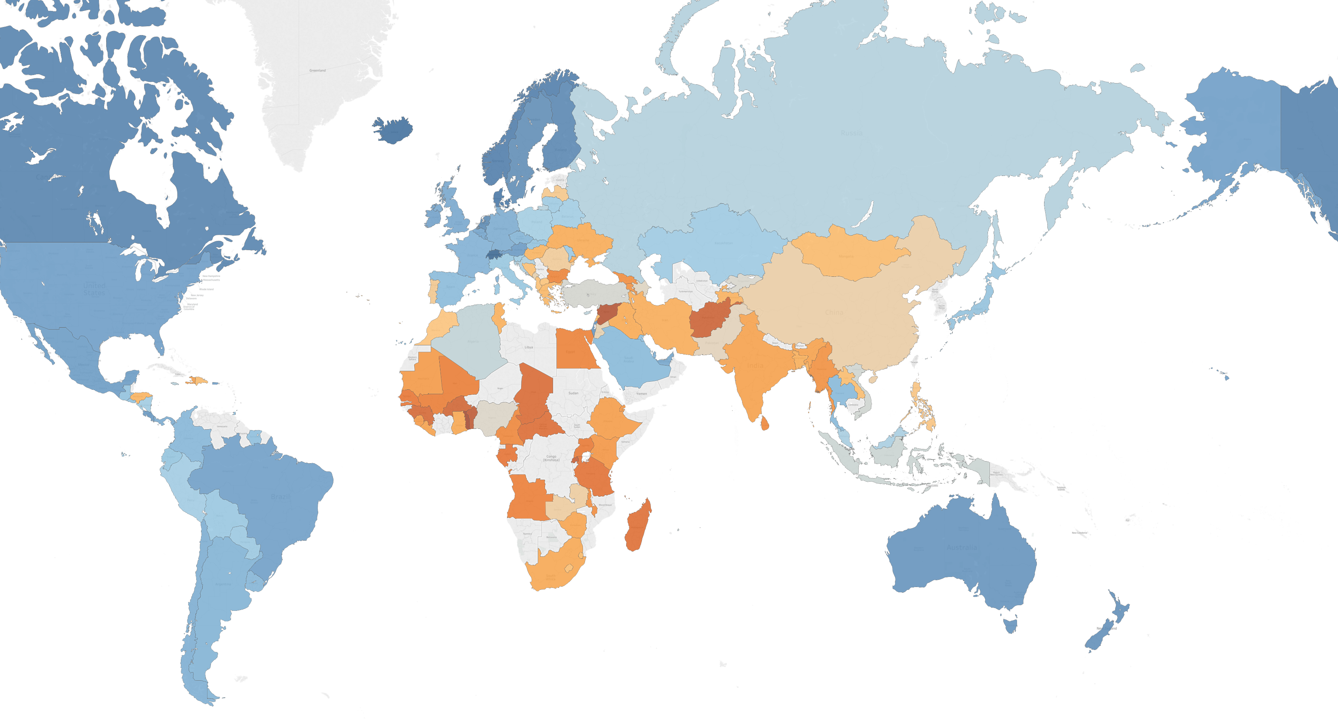
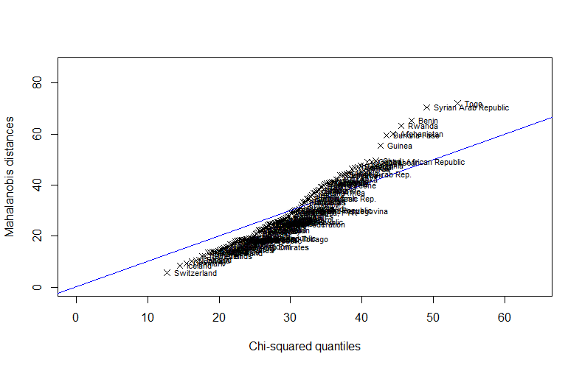
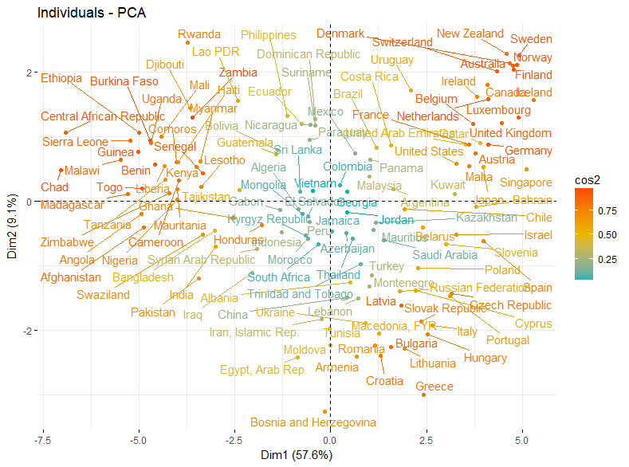
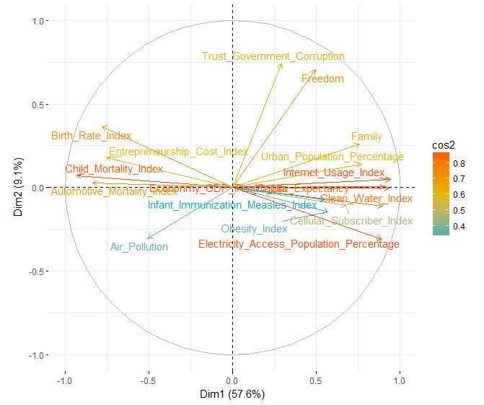
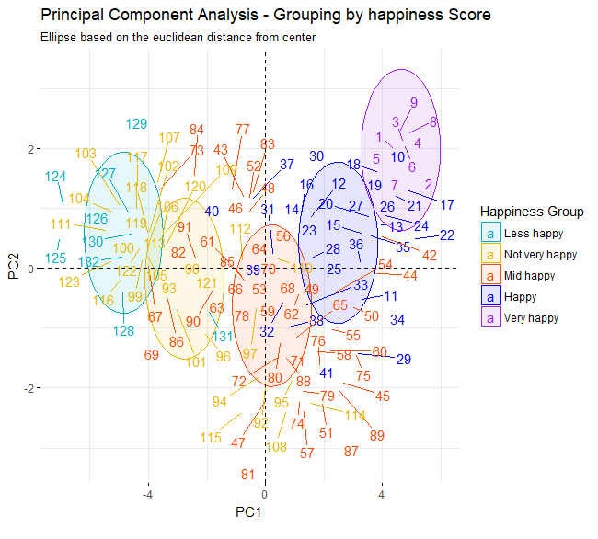
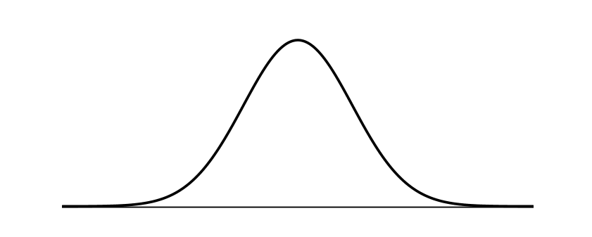
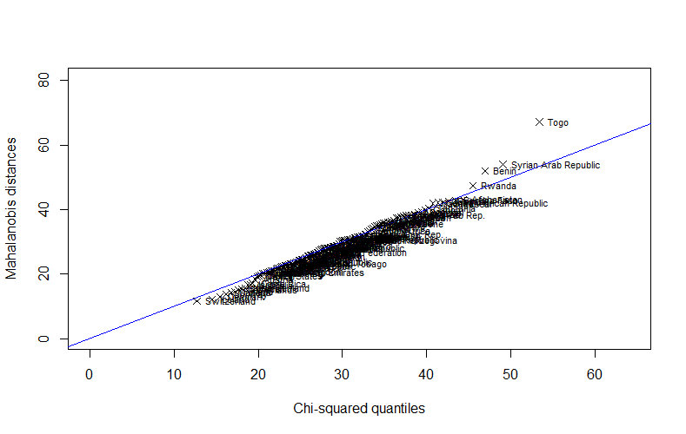
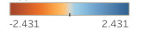
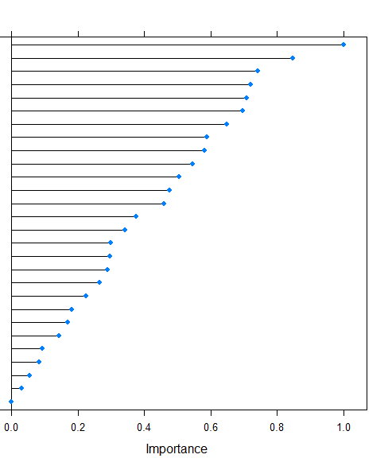
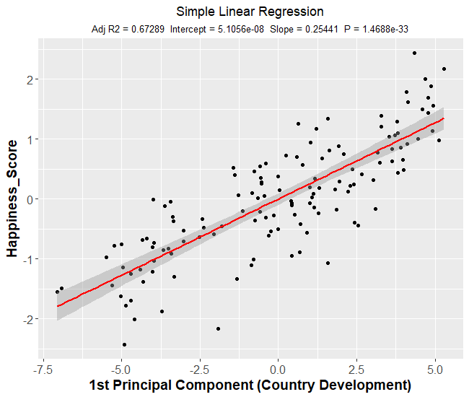
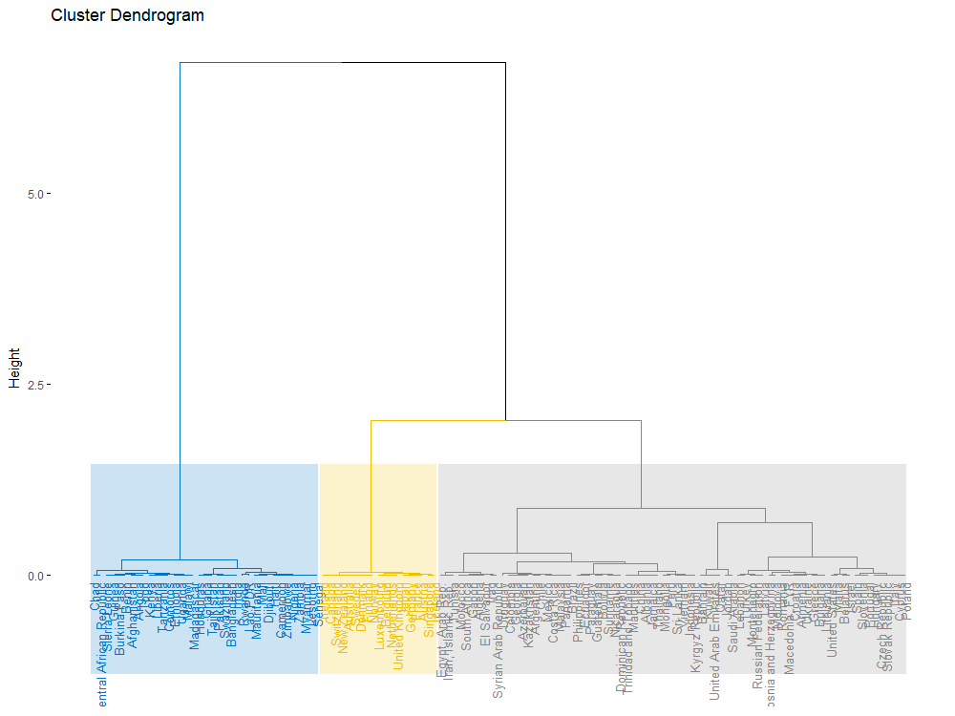
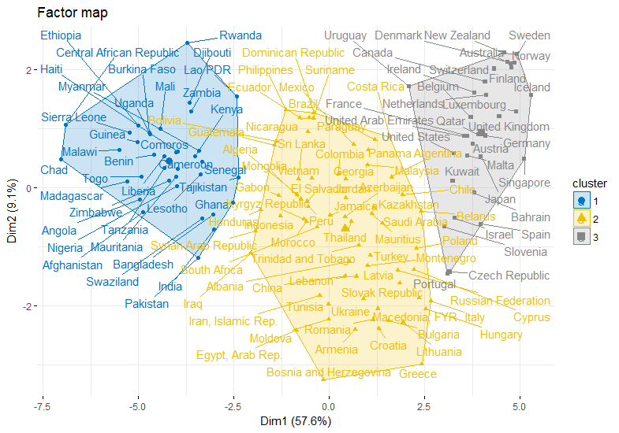
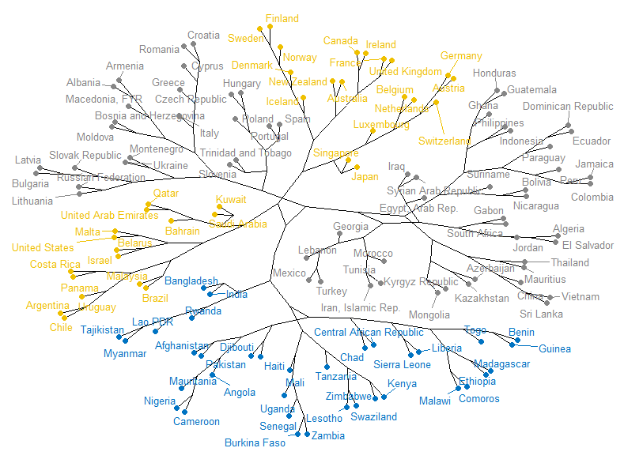


World Happiness – How happy was your country in 2015?
Data Exploration
Dimension Reduction
PCA Loadings
0000
Data Source
United Nations
Our World in Data
World Bank
32 variables, 132 countries
Methodology
Data preparation
Dimension Reduction (PCA, FA)
Clustering
Linear Regression
Variable Importance (Features selection)
Objective
Analysis of happiness around the world
Discover the factors that influence happiness
Which factors lead to high, mid or low happiness
Prediction of happiness
Analysis similarity of countries
Principal Component Analysis (PCA)
Factor Analysis (FA)
PCA Scree Plot
Urban Population
Automotive Mortality
Infant Immunization Measles
Entrepreneurship Cost
Electricity Access
Obesity
Clean Water
Birth Rate
Child Mortality
Cellular Subscriber
Internet Usage
Air Pollution
Trust Government (Corruption)
Freedom
Health Life Expectancy
Family
Economy GDP per Capita
FA Scree Plot
Air Pollution
Variables
World Happiness Rank
Switzerland
Iceland
Denmark
…
Benin
Syria
Togo
Freedom & Corruption
Country Development
The worlds happiest countries are Switzerland, Iceland and Denmark. The variables that are the most contributing to this result is high quality of Family Life, Health Life Expectancy and Freedom. The least happy countries are Benin, Syria and Togo. The variables indicating their happiness are Economy, Family and Automotive Mortality.
In general the people living in the countries of Western Europe and America tend to be happier than the people living in Africa and Asia.
Country Development
Quality of Life
Quality of Life
Health
Population
Infrastructure
Freedom
PCA Interpretation
The results of FA show how the assignment of the variables to the dimensions changed. After rotating the PC’s, the second and the third dimensions explains more variance. Furthermore, the Loadings are more clear in terms of interpretation.
Environment
Education
Economy
Politics
The results of PCA show the quality of representation (cos2) of the countries and variables on PC1 and PC2.
Finally, this dimensionality reduction has a clustering impact on Happiness Score of countries. This trend starts from left middle to upper right of the biplot.
Air Pollution
Freedom & Corruption
Data Pre-processing
Country Development
Q-Q Plot – Assessment of multivariate normality
Q-Q Plot – Normalized data
Happiness Score
Cluster Analysis
Predictive Analysis
Discussion
Hierarchical Clustering on Principal Components
Variable Importance on Happiness Score
Principal Components
Simple Linear Regression
Cluster Dendrogram
According to the results of the Dendrogram, 3 clusters seem to make the most accurate division among the countries. To proof the optimal number of clusters, we also perform Elbow and Silhouette methods. The results confirm number of clusters equal to 3. The distance measure used is Euclidean Distance.
Economy GDP Per Capita
Internet Usage
Child Mortality
Electricity Access
Health Life Expectancy
Clean Water
Urban Population %
Automotive Mortality
Birth Rate
Entrepreneurship Cost
Cellular Subscriber
Family
Obesity
Population Growth Rate
Infant Immunization Measles
Trust Government (Corruption)
Freedom
Air Pollution
HIV Disease
Mental and Substance Disorder
Alcohol Consumption
Agricultural Land %
Generosity
Compulsory Education
Forest Area Land %
Total Population
Suicide
Legal Rights
But what is “happiness”?
Explain outcome variables quickly
Interpretation of happiness (UN Data doesn’t match with term happiness in the world) -> cant measure happiness
The clusters are visualized in a Scatter Plot across the two primary PC’s where Dimension 1 represents “Country Development” and Dimension 2 represents Freedom and Trust in Governement (Corruption).
Africa
low Country Development
high Freedom & Corruption
Western Europe, North America, Australia
high Country Development
high Freedom and Corruption
Asia, South America, Eastern Europe
mid to low Country Development
mid Freedom and Corruption
Multiple Linear Regression with 2 Principal Components
Variables that predict happiness: (R² = 78% ~ 3 PC) → Variable Importance grpah
Economy GDP per Capita
Family
Freedom
Internet Usage Index
Health Life Expectancy
Variables explain low, mid, high with corrmatrix as interpretion
Interpret corr matrix
$${ y}_{i = }{β_{1}+β_{2}x_{i2}+β_{3}x_{i3}+ε_{i} i=1,2,…,n}_{ }$$
Adjusted R-squared : 0.7502
PC1 and PC2 are highly significant on Happiness Scoring
Assumptions of the model:
Linear in parameters
No perfect collinearity
Zero Conditional Mean
Homoscedasticity
No correlation of the errors
Normality
The clusters show a geographical pattern among the grouped countries. Looking at the Phylogenetic Tree, the geographical distance becomes more clear as branches represent similarity.
What is Happiness for you?

