Slide 1
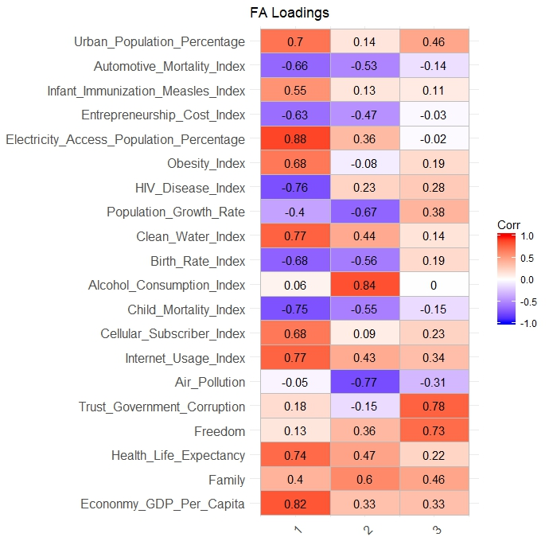
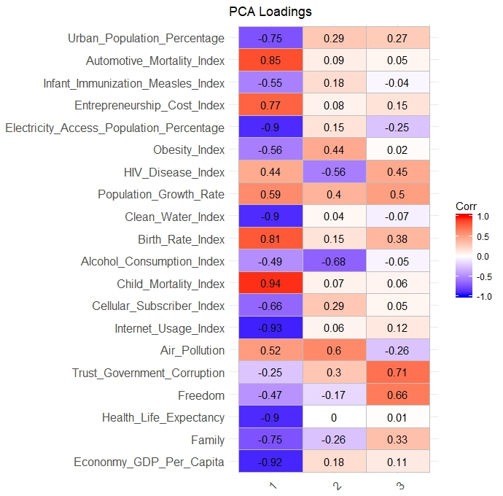
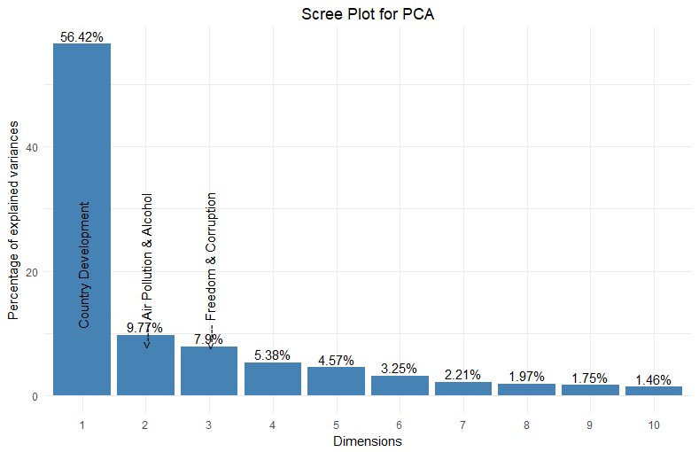




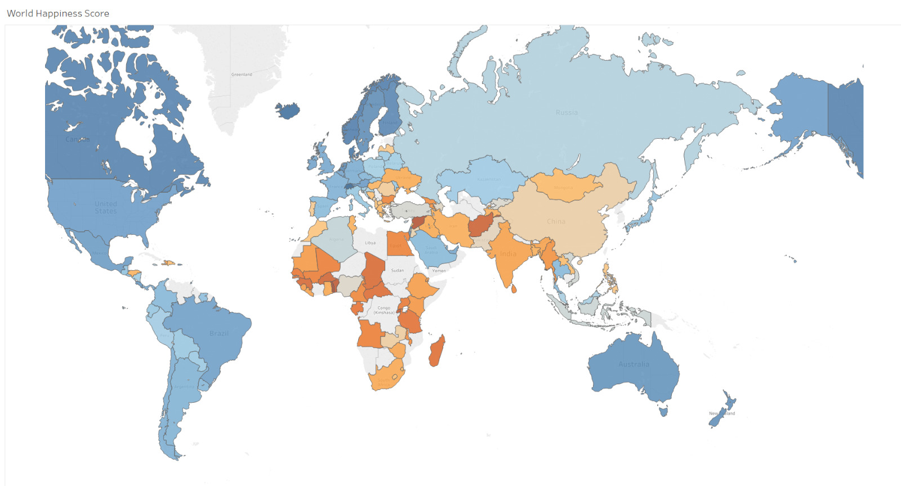




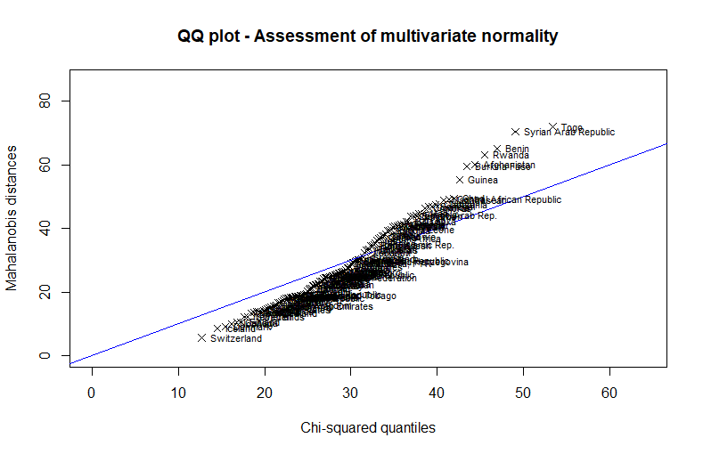
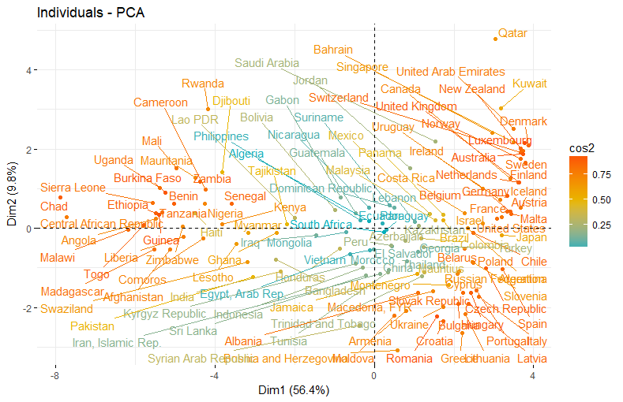
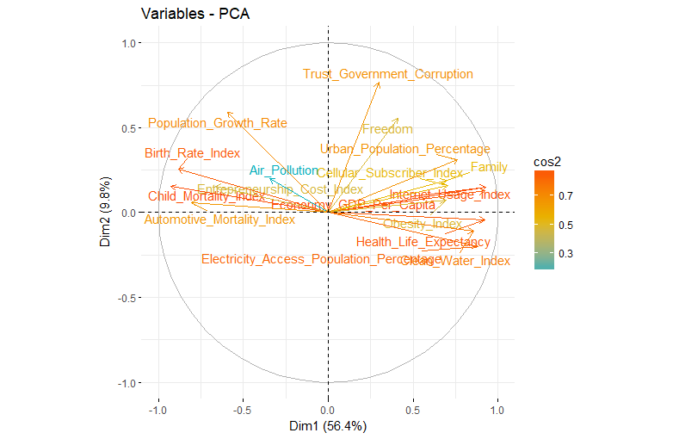
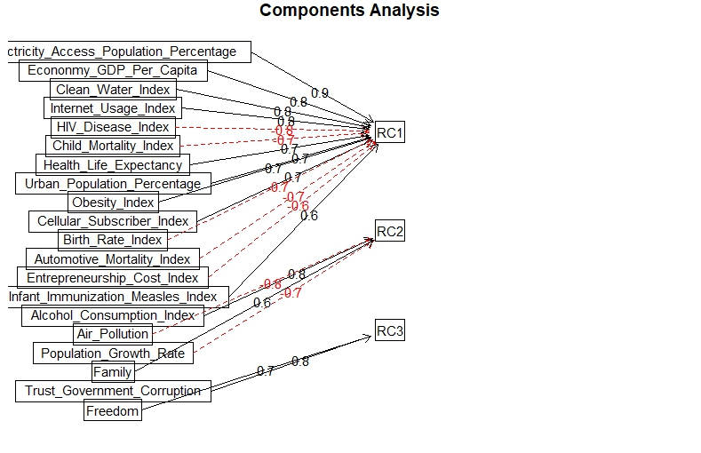
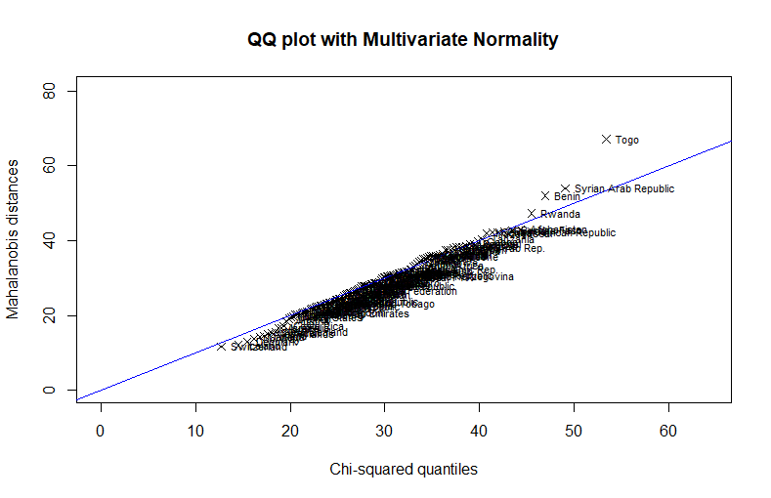
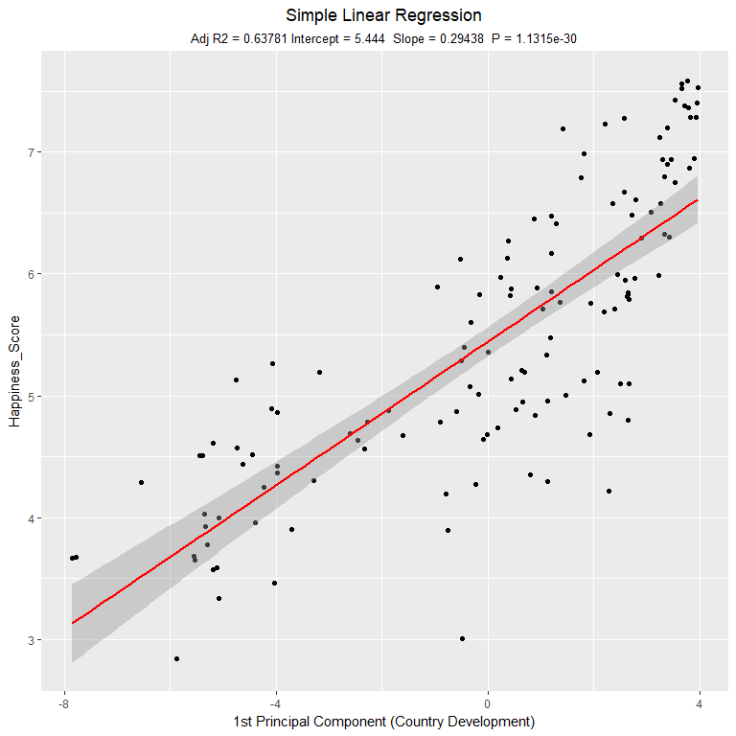
World Happiness – How happy was your country in 2015?
Data Exploration
Dimension Reduction
Objective
Analyse happiness around the world
Discover the factors that influence happiness
Which factors lead to high, mid or low happiness
Prediction of happiness
Methodology
Data preparation
Dimension Reduction (PCA, FA)
Clustering
Regression
Principal Component Analysis (PCA)
Factor Analysis (FA)
Variables
Quality of Life
Health
Population
Infrastructure
Environment
Education
Economy
Politics
Data Pre-processing
World Happiness Rank
Switzerland
Iceland
Denmark
…
149. Togo
Cluster Analysis
Predictive Analysis
Discussion

