Slide 1














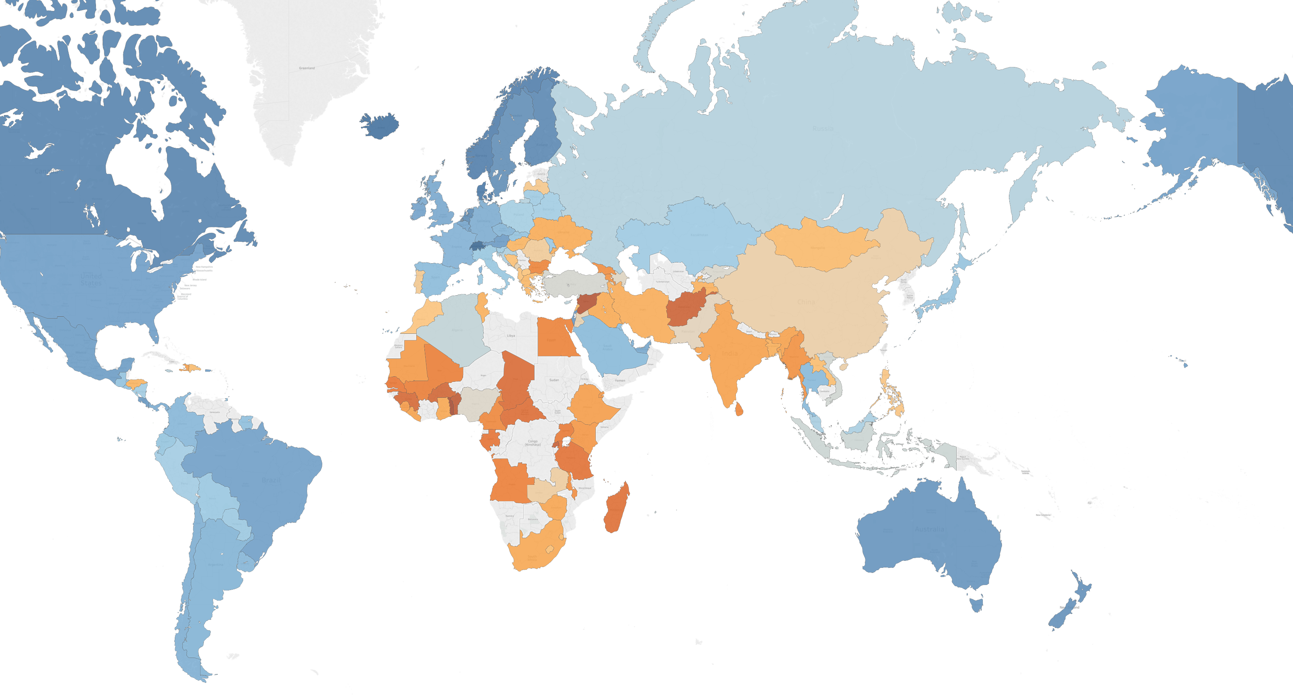
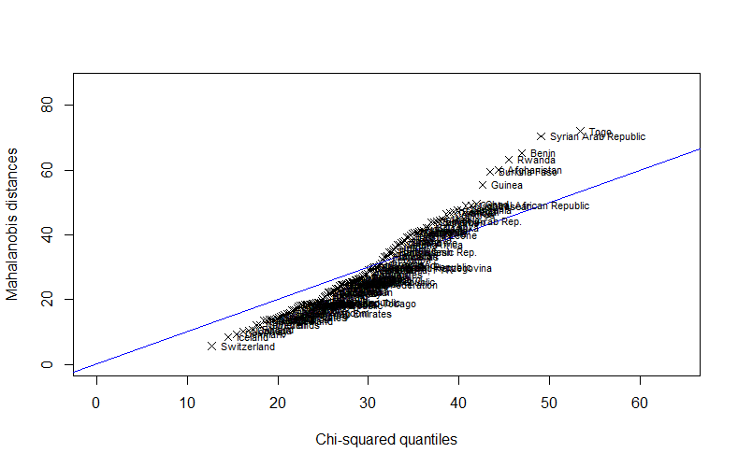

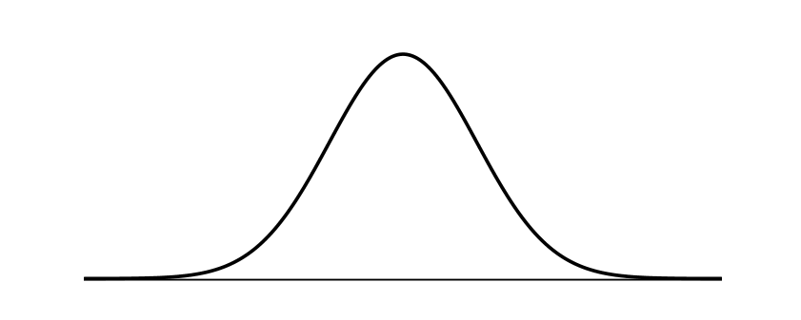
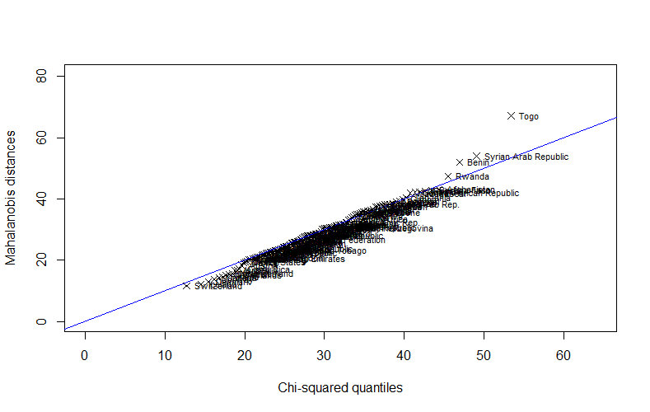
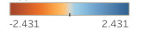
Data Exploration
Data Source
Merging different datasets:
United Nations Report
Our World in Data
World Bank
32 variables, 132 countries
Methodology
Data preparation
Dimension Reduction (PCA, FA)
Clustering
Variable Importance (RFE)
Linear Regression
Objectives
Analysis of happiness around the world
Reduce dimensionality to facilitate interpretation
Discover the factors that influence happiness
Prediction of happiness
Analysis of similarity among countries
Variables
World Happiness Rank
Switzerland
Iceland
Denmark
…
Benin
Syria
Togo
The worlds happiest countries are represented by Switzerland, Iceland and Denmark (Western Europe), whereas the least happy countries are Benin, Syria and Togo (Asia and Africa). In general, people living in the countries of Western Europe, Australia and North America tend to be happier than the people living in Eastern Europe, Africa and Asia. Portugal was ranked as number 84 out of 132, which results in being one of the least happy countries in Europe. This ranking is based on a Happiness Score that is conducted by a poll survey. People from all around the world were asked to evaluate their life on a scale from 0 to 10.
Quality of Life
Health
Population
Infrastructure
Environment
Education
Economy
Politics
Data Pre-processing
Q-Q Plot – Assessment of multivariate normality
Q-Q Plot – Normalized data
Happiness Score

Slide 2
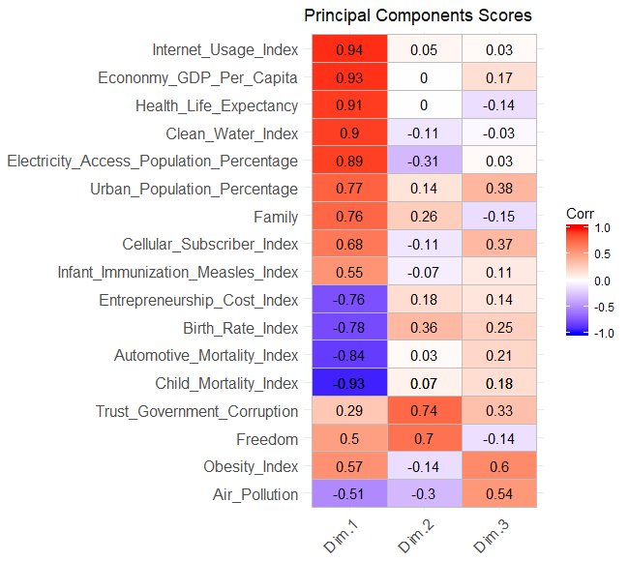
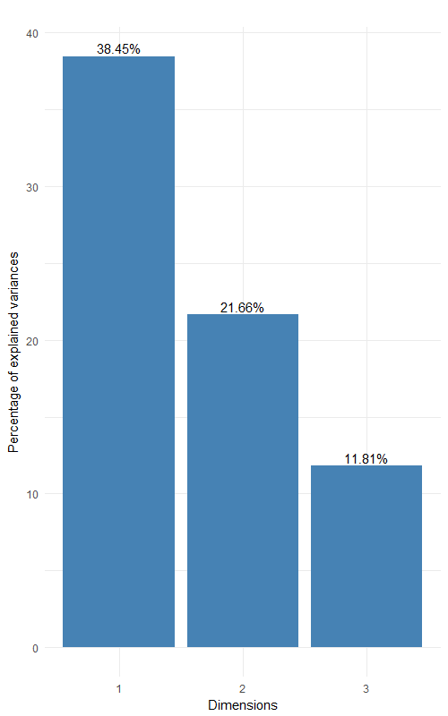
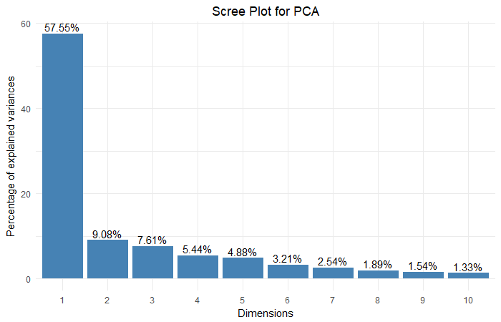
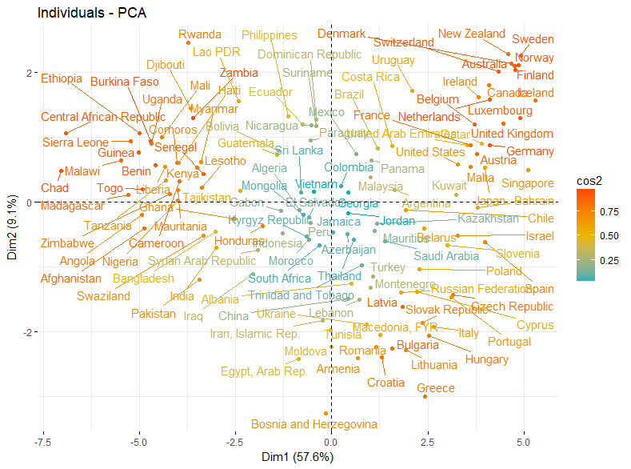
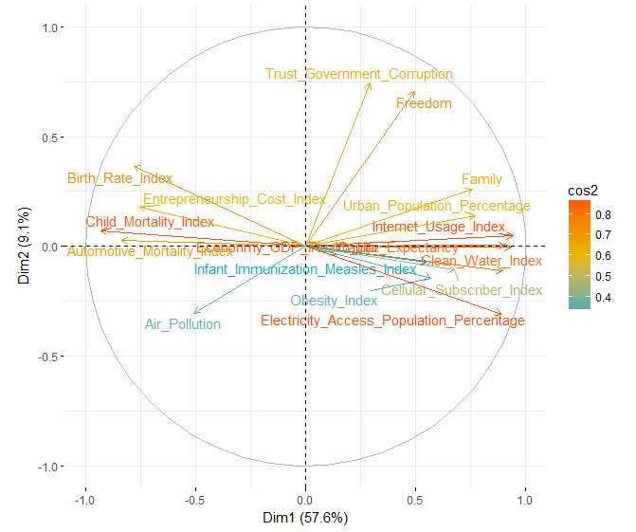
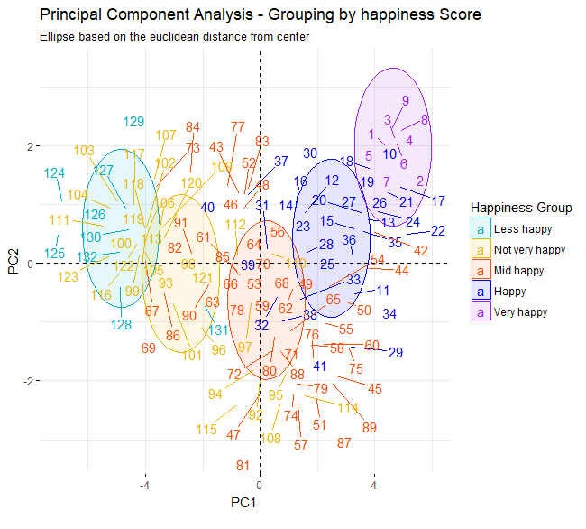
Dimension Reduction
Freedom & Corruption
Country Development
Air Pollution
PCA Loadings
Factor Analysis (FA)
Principal Component Analysis (PCA)
Internet Usage
Economy GDP per Capita
Health Life Expectancy
Clean Water
Electricity Access
Urban Population
Family
Cellular Subscriber
Infant Immunization Measles
Entrepreneurship Cost
Birth Rate
Automotive Mortality
Child Mortality
Trust Government (Corruption)
Freedom
Obesity
Air Pollution
FA Scree Plot
Child Mortality
Birth Rate
Health Life Expectancy
Automotive Mortality
Electricity Access
Clean Water
Internet Usage
Entrepreneurship Cost
Economy GDP per Capita
Air Pollution
Family
Infant Immunization Measles
Obesity
Urban Population
Cellular Subscriber
Freedom
Trust Government (Corruption)
-0.9
PCA Scree Plot
-0.8
0.8
-0.8
0.8
RC1
-0.8
0.7
-0.7
0.7
Country Development
-0.6
Country Development
0.6
Air Pollution
Freedom & Corruption
0.4
Quality of Life
0.8
RC2
Freedom
0.7
0.7
0.8
RC3
0.8
PCA Interpretation
The results of FA show how the assignment of the variables to the components changes. After rotating the PC’s, the second and the third dimensions explain more variance and the loadings become more clear in terms of interpretation.
The below presented results of PCA show the quality of representation (cos2) of the countries and variables on PC1 and PC2. Finally, this dimensionality reduction has a clustering impact on Happiness Score of countries. This trend starts from left middle to upper right of the Biplot.

Slide 3
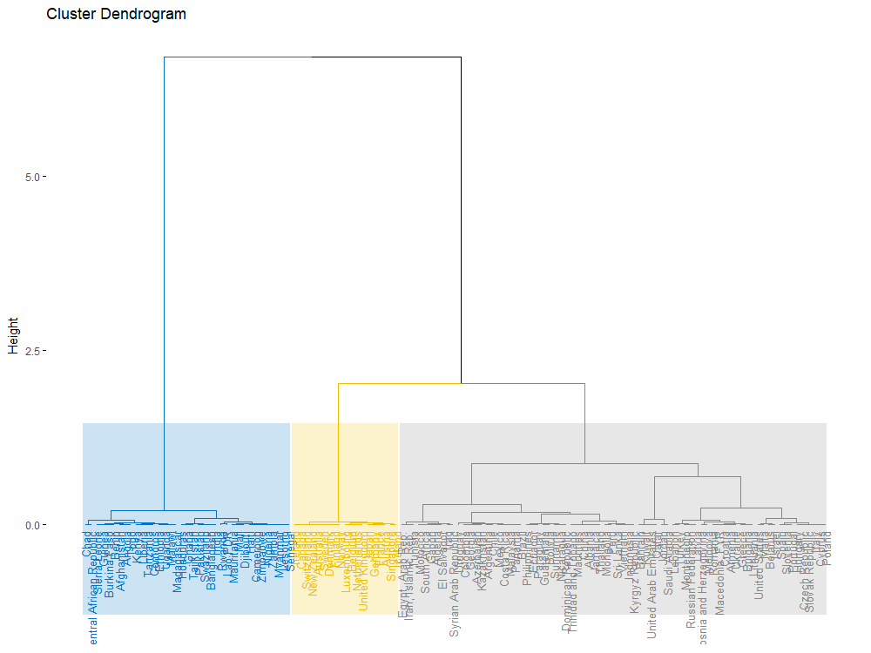
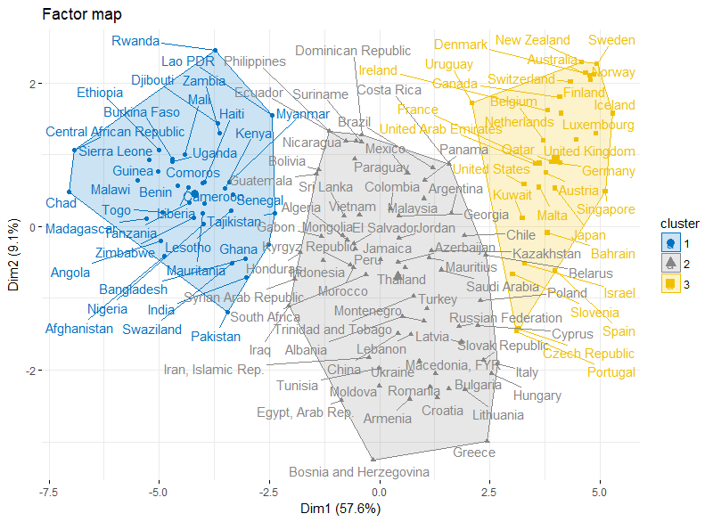
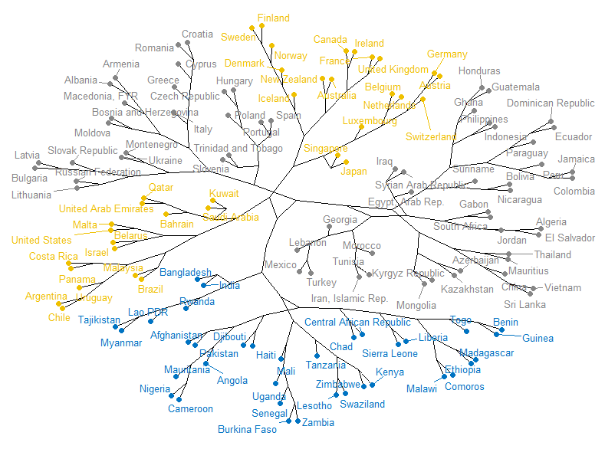
Cluster Analysis
Hierarchical Clustering on Principal Components
Cluster Dendrogram
According to the results of the Dendrogram, 3 clusters seem to make the most accurate division among the countries. To proof the optimal number of clusters, we also perform Elbow and Silhouette methods. The results confirm number of clusters equal to 3. The distance measure used is Euclidean Distance.
Cluster Plot
The clusters show a geographical pattern among the grouped countries. Looking at the Phylogenic Tree, we can see that countries in the same branches tend to be geographically close to each other.
Africa
lower Country Development
mid to higher Freedom & Trust in Government
Western Europe, North America, Australia
higher Country Development
mid to higher Freedom & Trust in Government
Asia, South America, Eastern Europe
mid Country Development
lower to mid Freedom & Trust in Government

Slide 4
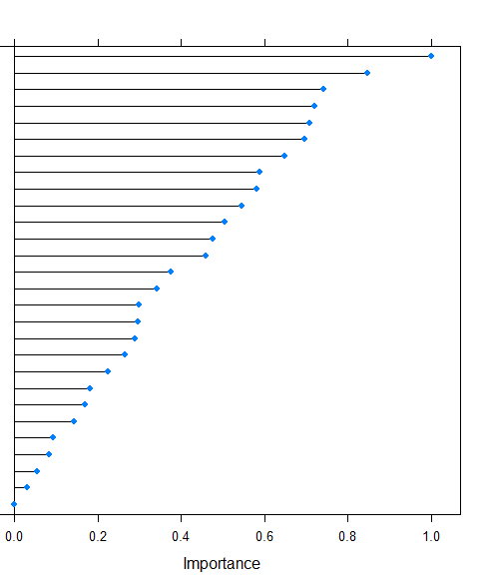
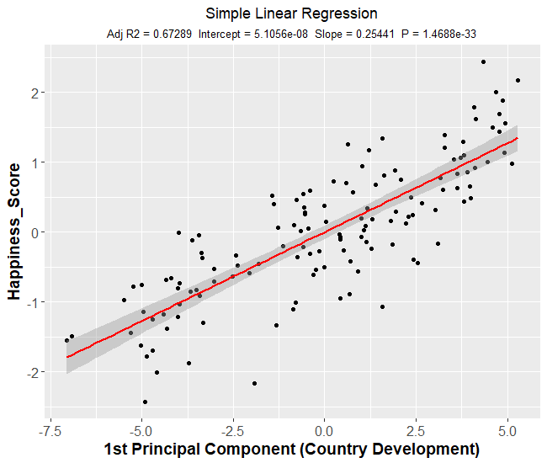

Predictive Analysis
Variable Importance on Happiness Score
Simple Linear Regression with 1 Principal Component
Economy GDP Per Capita
Internet Usage
Electricity Access
Health Life Expectancy
Child Mortality
Clean Water
Urban Population %
Automotive Mortality
Birth Rate
Entrepreneurship Cost
Cellular Subscriber
Family
Obesity
Population Growth Rate
Infant Immunization Measles
Trust Government (Corruption)
Freedom
Air Pollution
HIV Disease
Mental and Substance Disorder
Alcohol Consumption
Agricultural Land %
Generosity
Compulsory Education
Forest Area Land %
Total Population
Suicide
Legal Rights
Multiple Linear Regression with 2 Principal Components
$${ y}_{i = }{β_{1}+β_{2}x_{i2}+β_{3}x_{i3}+ε_{i} i=1,2,…,132}_{ }$$
R-squared: 75%
Significance: PC1 and PC2 are highly significant on Happiness Score.
Assumptions of the model:
Linear in parameters
No perfect collinearity
Zero Conditional Mean
Homoscedasticity
No correlation of the errors
Normality
Performing Recursive Feature Elimination (RFE) to obtain Variable Importance provides a ranking of the variables. It shows their level of explanation in regard to the target variable Happiness Score. The first 4 variables predict happiness with R² = 70%. One can conclude, that the higher the GDP, Internet Usage, Electricity Access and Health Life Expectancy, the happier the people living in a country.
Economy
Infrastructure
Health

Slide 5





Discussion
United Nations assigns a Happiness Scoring to countries:
Factors related to this “Happiness Score” given:
Variables such as Economy, Health and Infrastructure do have a considerable higher impact on this Happiness than variables like Suicide, Population Size and Compulsory Education
Geographical pattern in Happiness around the world
By taking into account the linear combination of a set of variables, we can enhance interpretability:
Visual inspection of components to derive trends and clusters
Predictive model proves its efficiency on Happiness
But… In the end, happiness is something you can not measure accurately.
What is Happiness for you?
NOVA IMS – Descriptive Analytics, Spring Semester 2018
Dahmane Sheikh Daniel Cooper Maria Lechleitner

