Slide 1
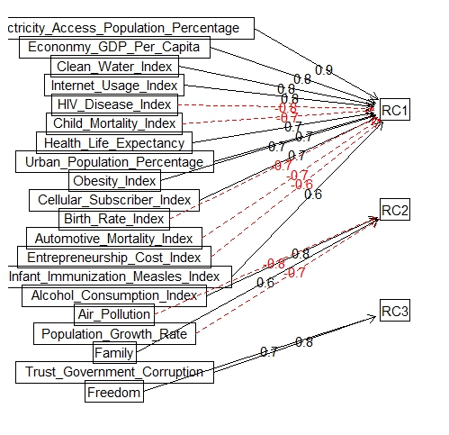
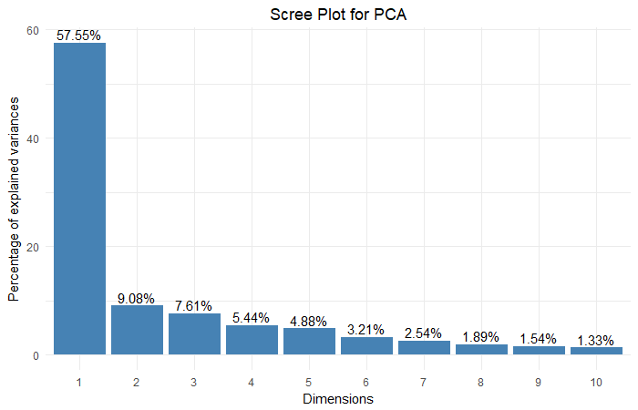
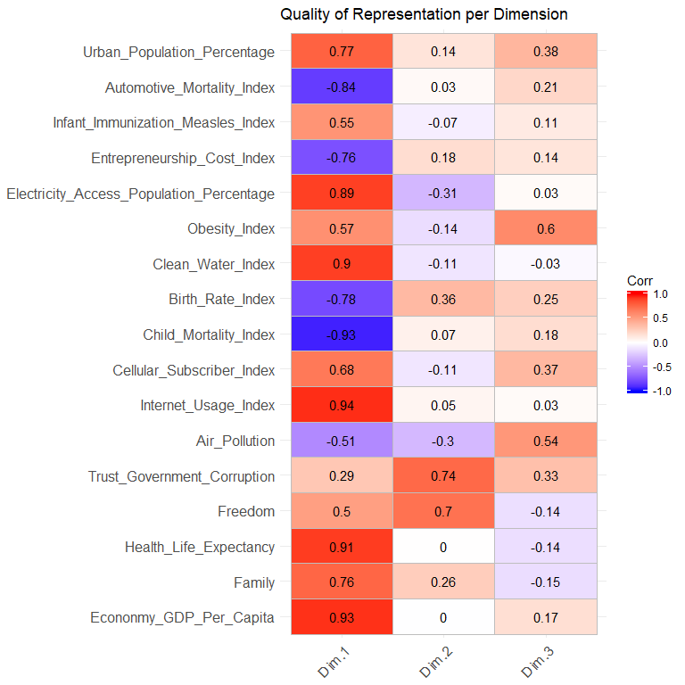
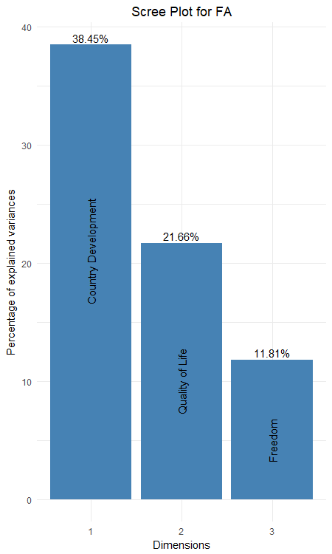












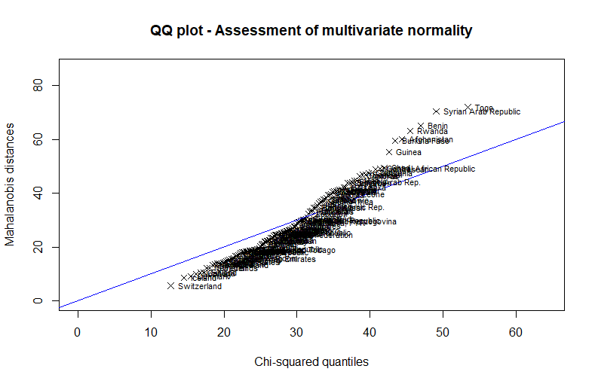
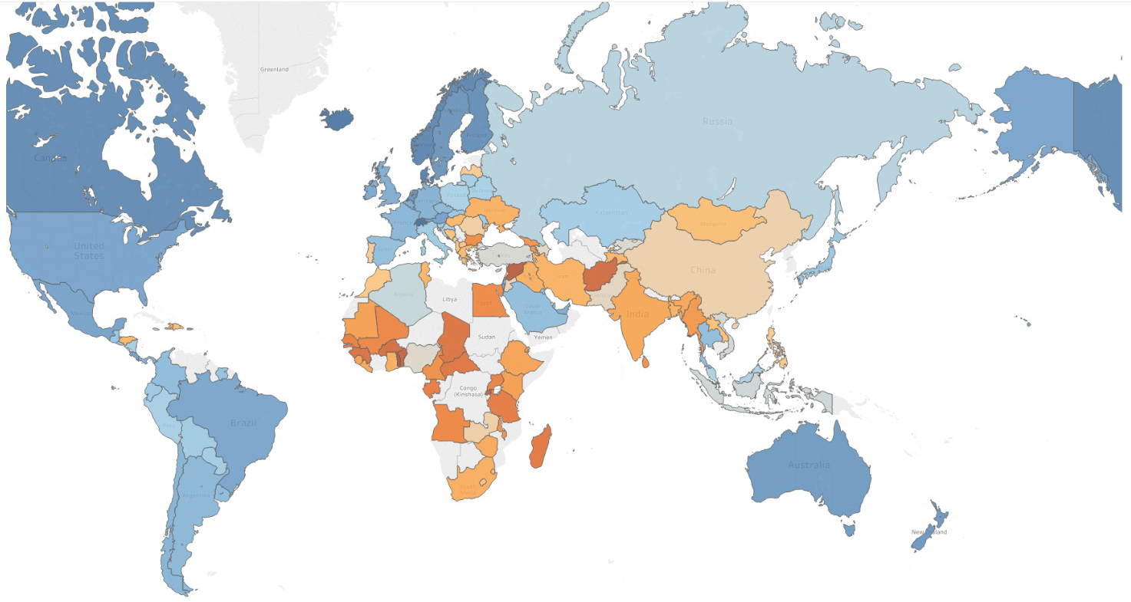
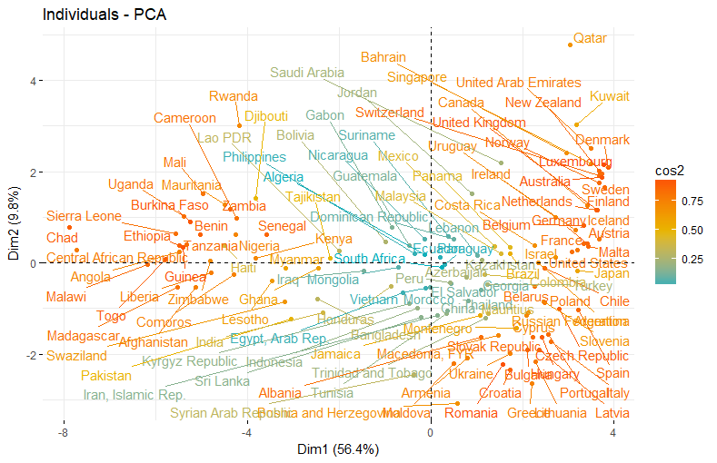
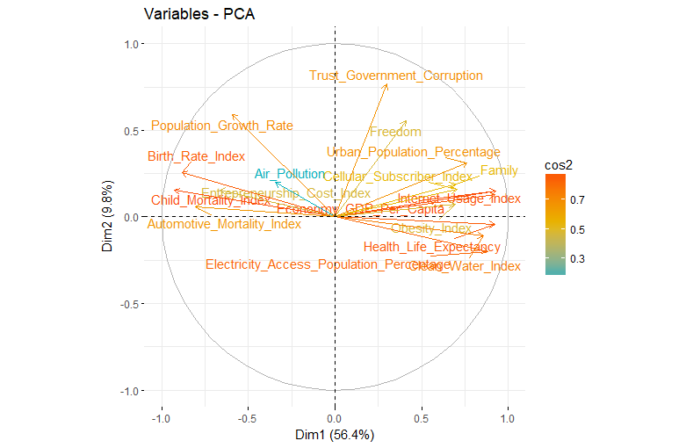
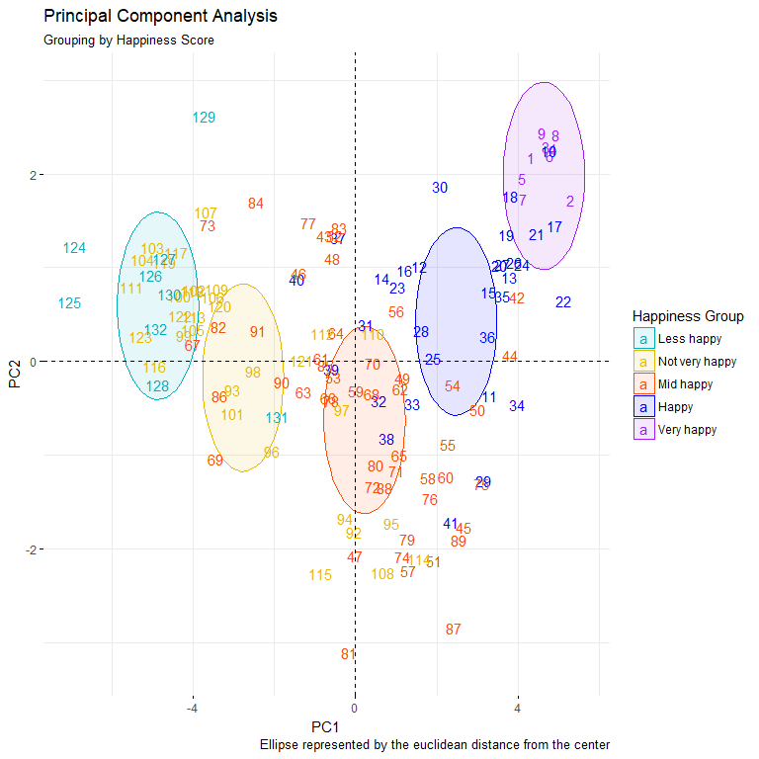
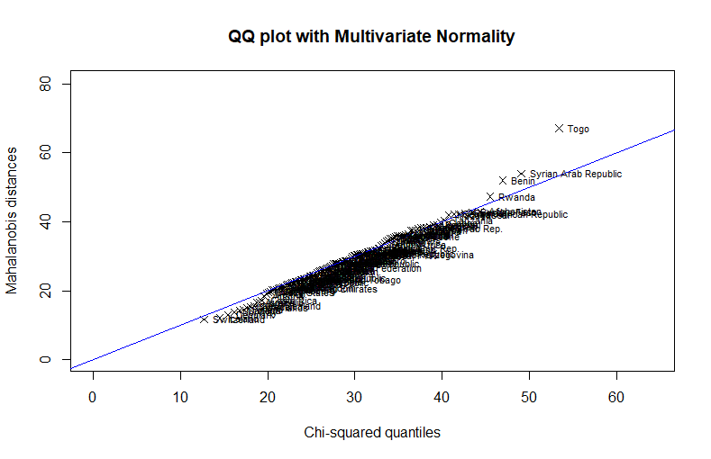
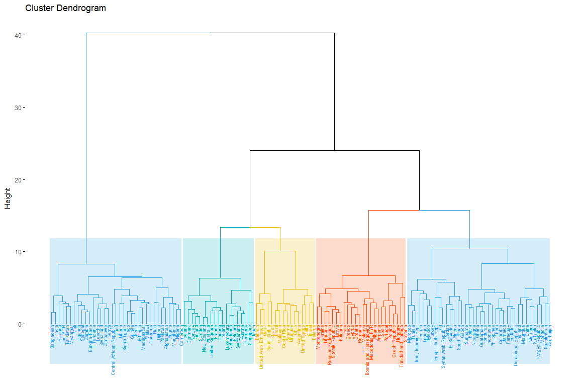
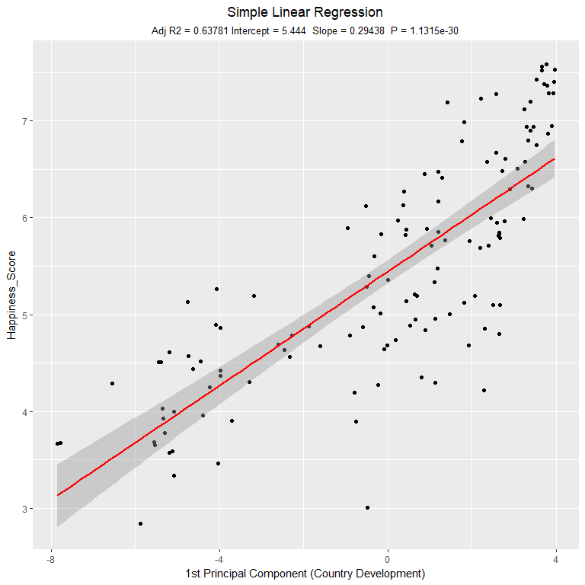
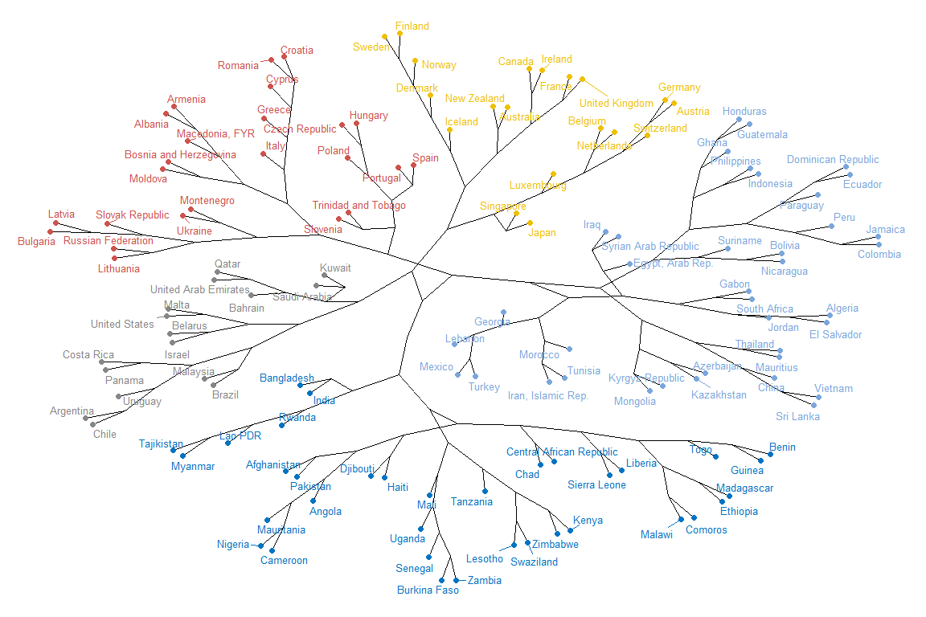

World Happiness – How happy was your country in 2015?
Data Exploration
Dimension Reduction
Objective
Analyse happiness around the world
Discover the factors that influence happiness
Which factors lead to high, mid or low happiness
Prediction of happiness
Analyse similarity of countries
Methodology
Data preparation
Dimension Reduction (PCA, FA)
Clustering
Regression
Principal Component Analysis (PCA)
Factor Analysis (FA)
Air Pollution
Freedom & Corruption
Variables
World Happiness Rank
Switzerland
Iceland
Denmark
…
Togo
Country Development
Quality of Life
Health
Population
Infrastructure
The worlds happiest country is Switzerland with a rank of 7.6/10. The variables that are the most contributing to this result is high quality of Family Life, Health Life Expectancy and Freedom. The least happy country in the world is Togo. The strongest variables are Economy, Family and Automotive Mortality. In general the people living in the countries of Western Europe and America tend to be happier than the people living in Afrika and Asia.
The results of FA show how the assignment of the variables to the dimensions changed. After rotating the PC’s, the second and the third dimensions explains more variance. Furthermore, the Loadings are more clear in terms of interpretation.
Environment
Education
Economy
Politics
The results of FA show how the assignment of the variables to the dimensions changed. After rotating the PC’s, the second and the third dimensions explains more variance. Furthermore, the Loadings are more clear in terms of interpretation.
Data Pre-processing
Air Pollution
Country Development
PCA Interpretation
Freedom & Corruption
Cluster Analysis
Predictive Analysis
Discussion
The results of FA show how the assignment of the variables to the dimensions changed. After rotating the PC’s, the second and the third dimensions explains more variance. Furthermore, the Loadings are more clear in terms of interpretation.
Variables
Principal Components
But what is “happiness”?
Explain outcome variables quickly
Interpretation of happiness (UN Data doesn’t match with term happiness in the world) -> cant measure happiness
Variables that predict happiness: (R² = 78% ~ 3 PC) → Variable Importance grpah
Economy GDP per Capita
Family
Freedom
Internet Usage Index
Health Life Expectancy
Variables explain low, mid, high with corrmatrix as interpretion
Interpret corr matrix

