Slide 1
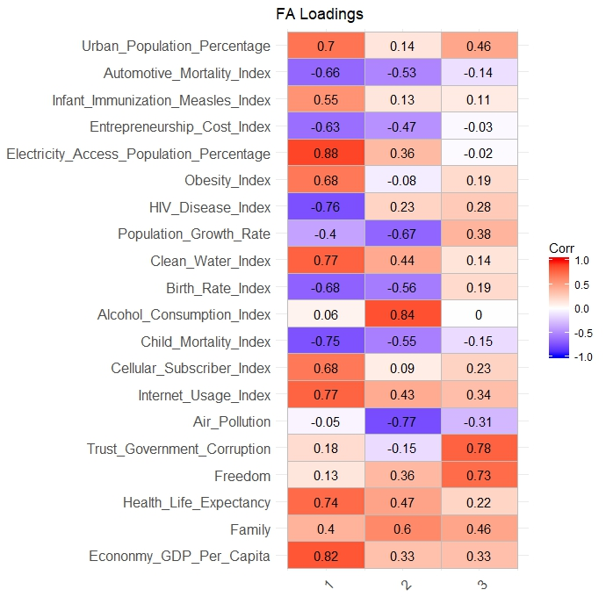
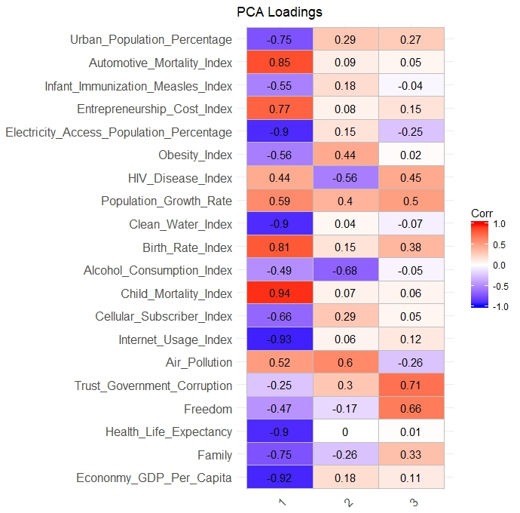
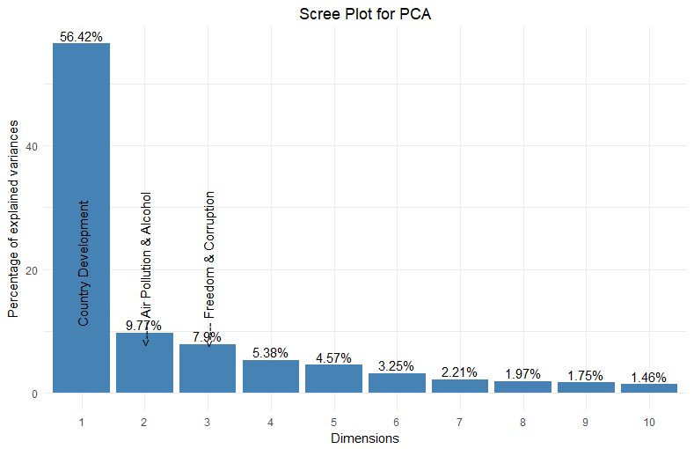


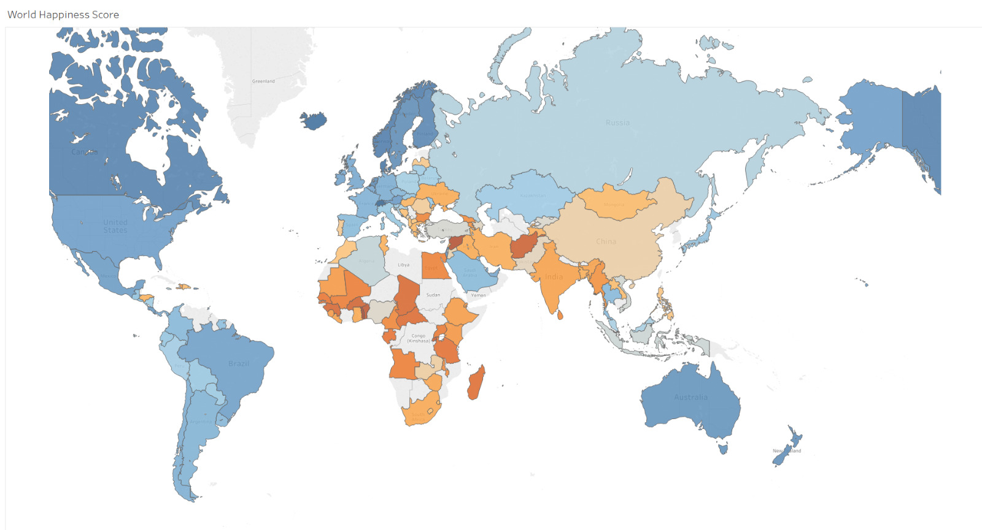
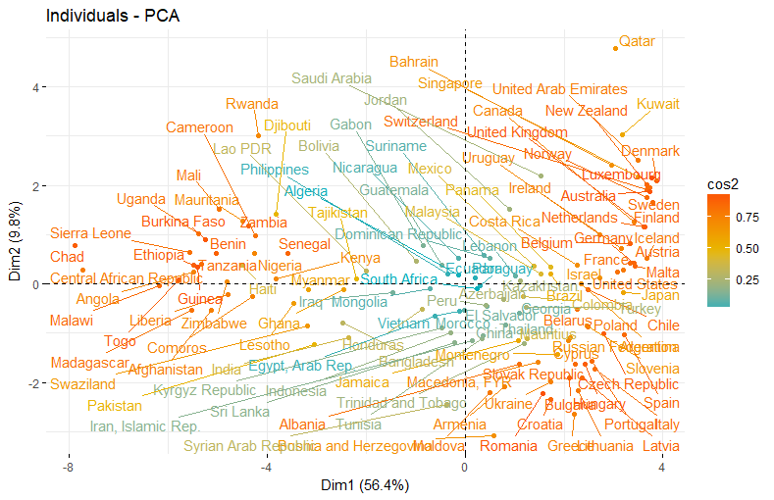
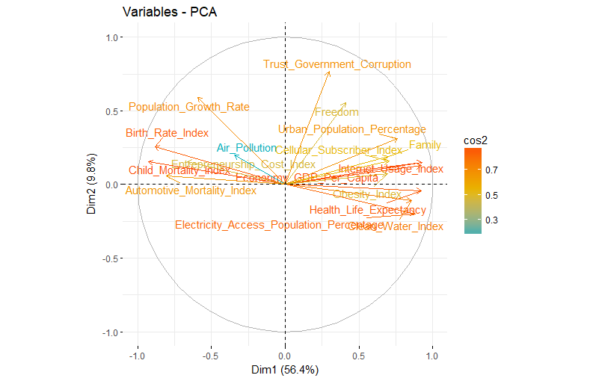
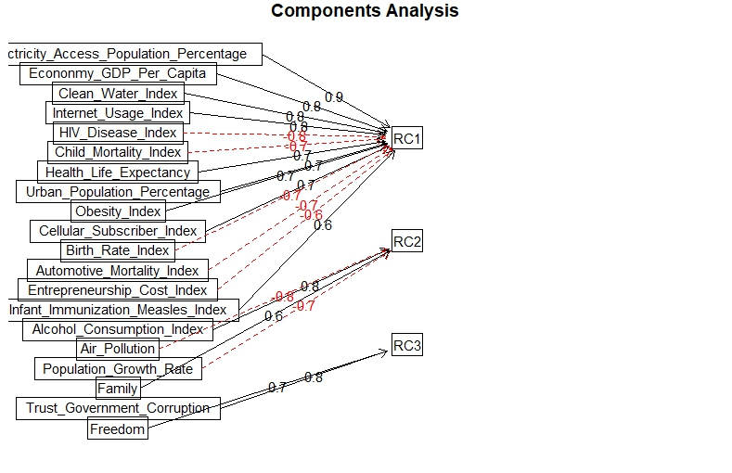
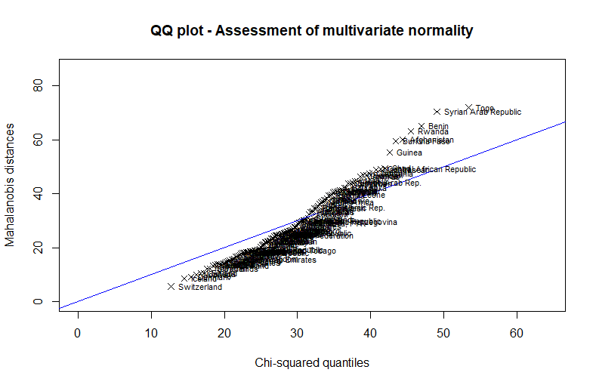
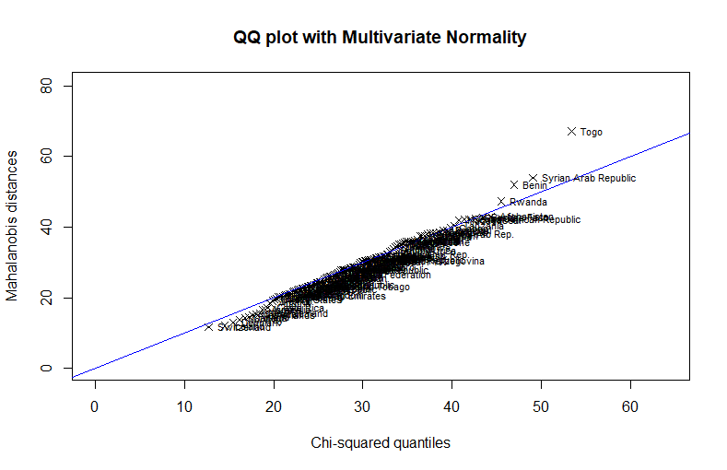
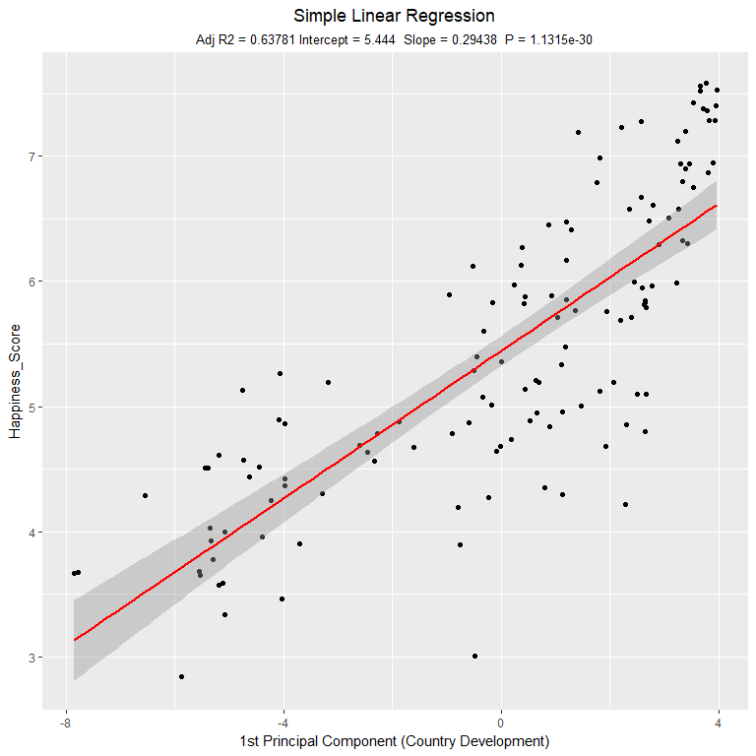
World Happiness – How happy was your country in 2015?
Data Exploration
Dimension Reduction
Objective
Analyse happiness around the world
Discover the factors that influence happiness
Prediction of happiness
Methodology
Data preparation
Dimension Reduction (PCA, FA)
Clustering
Regression
Principal Component Analysis (PCA)
Factor Analysis (FA)
Quality of Life
Cluster Analysis
Predictive Analysis
Discussion

