Slide 1
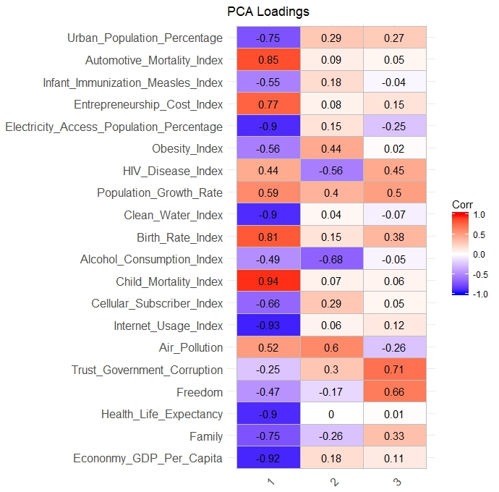
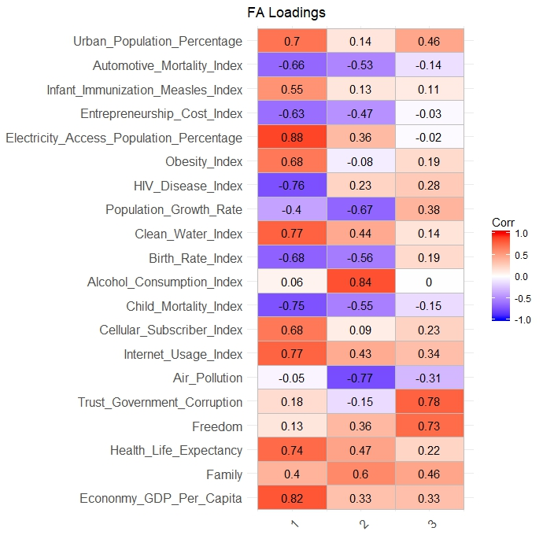
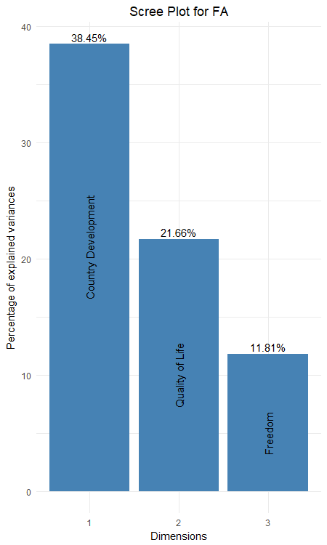




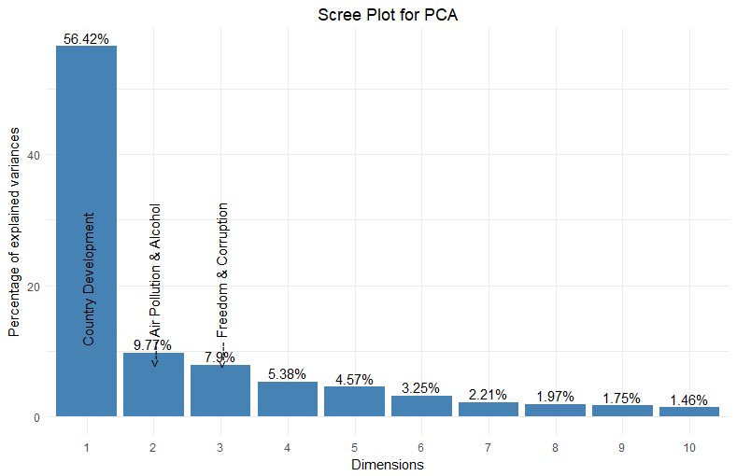








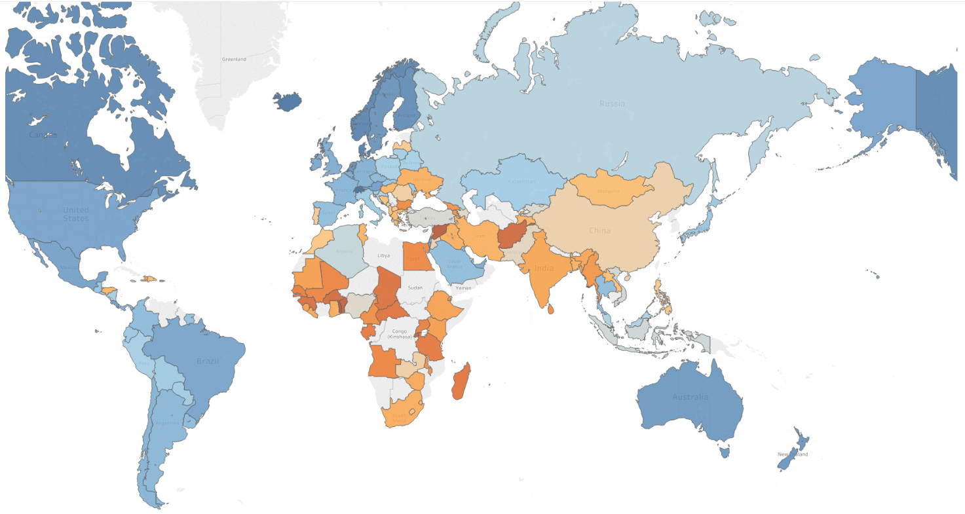
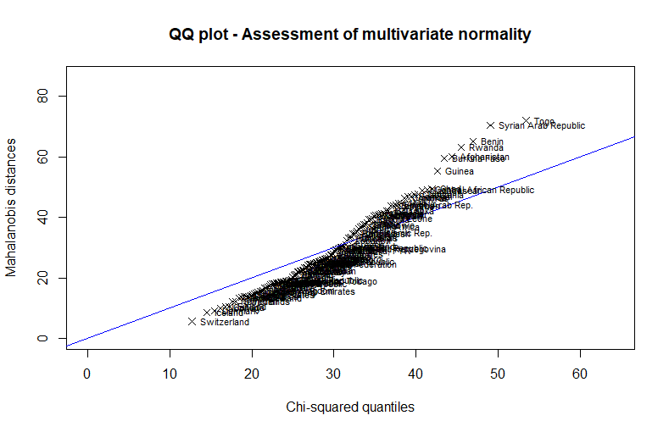
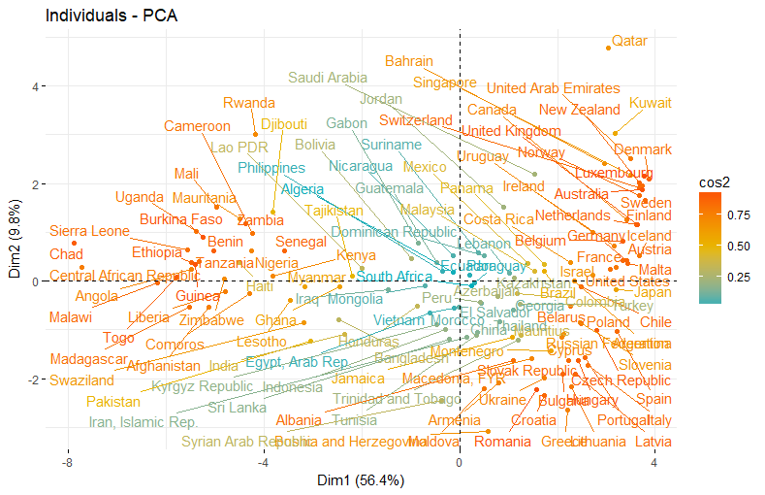
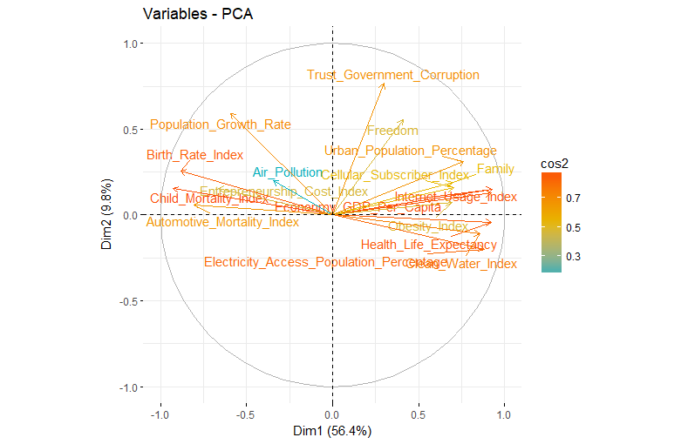
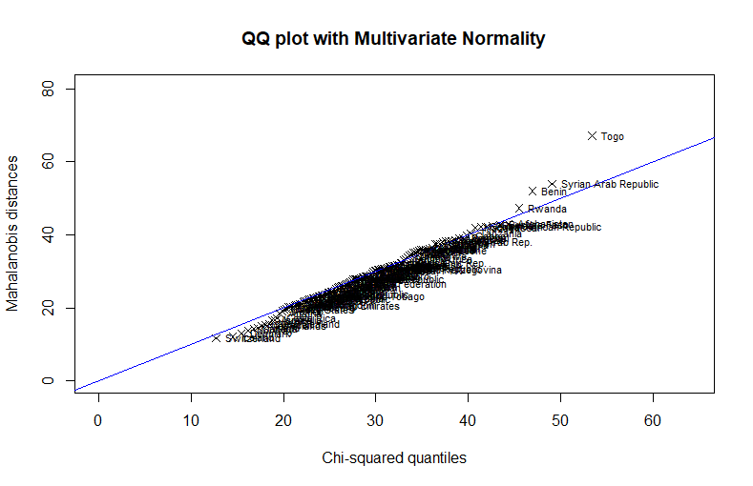
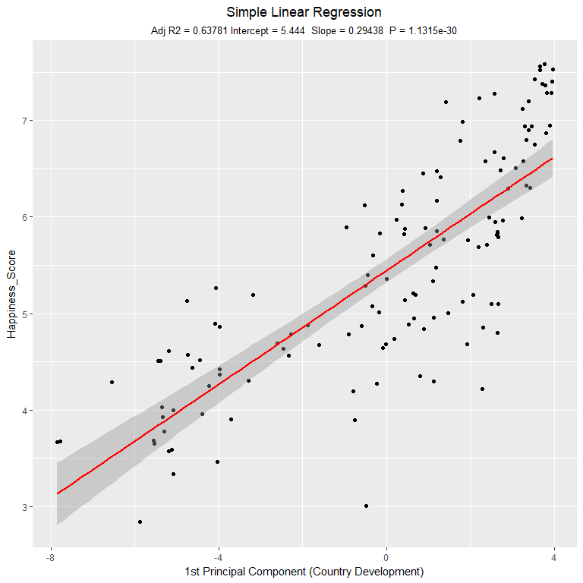
World Happiness – How happy was your country in 2015?
Data Exploration
Dimension Reduction
Objective
Analyse happiness around the world
Discover the factors that influence happiness
Which factors lead to high, mid or low happiness
Prediction of happiness
Methodology
Data preparation
Dimension Reduction (PCA, FA)
Clustering
Regression
Principal Component Analysis (PCA)
Factor Analysis (FA)
Variables
World Happiness Rank
Switzerland
Iceland
Denmark
…
Togo
Quality of Life
Health
Population
Infrastructure
The worlds happiest country is Switzerland with a rank of 7.6/10. The variables that are the most contributing to this result is high quality of Family Life, Health Life Expectancy and Freedom. The least happy country in the world is Togo. The strongest variables are Economy, Family and Automotive Mortality. In general the people living in the countries of Western Europe and America tend to be happier than the people living in Afrika and Asia.
Environment
Education
Economy
Politics
The results of FA show how the assignment of the variables to the dimensions changed. After rotating the PC’s, the second and the third dimensions explains more variance. Furthermore, the Loadings are more clear in terms of interpretation.
Data Pre-processing
Cluster Analysis
Predictive Analysis
Discussion

