Slide 1
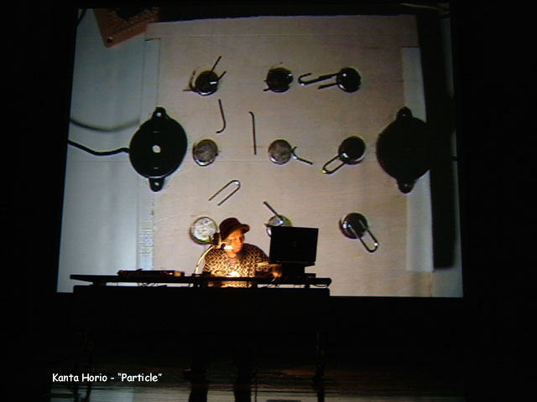
Module C: Aesthetics of NIME
Technological Expressionism
NIME & the Music Process
Challenge of Performance
Mapping & the Audience: Transparency
Visual Feedback
Interaction Metaphor
©2009, S. Fels and M. Lyons

Slide 2
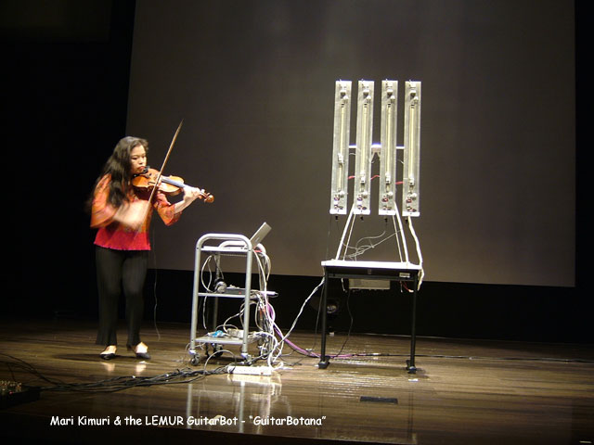
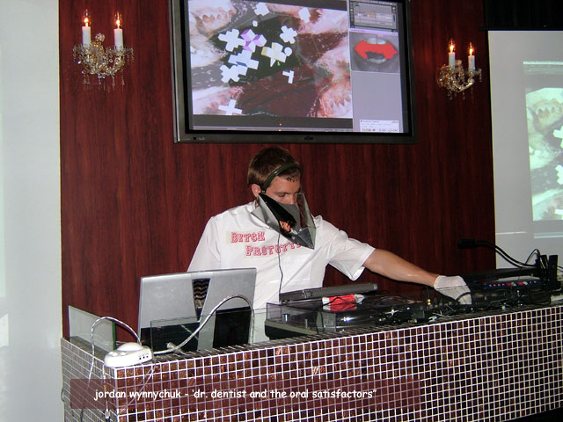
Technological Expressionism
Shock of the New
Human-machine relationship
Techno-fetishism
Experimentalism
Video Clip
©2009, S. Fels and M. Lyons
Notes:
Would like to show brief video clips for the robotic guitar with Mari.
The tension here is the contrast between the human performer and that of an automaton. In fact, the actions of the the guitar robot are not determined but respond to audio input from the violin. The audience understands that there is a relationship but it is not clear exactly what that relationship is, or to what degree the robot is autonomous. The degree of determinacy seems a bit low in this performance so far perhaps due to the complexity of controlling the robot in real time to play. It is not always clear that the robot is responding to the playing of the human performer.
On a more basic level there is a techno aesthetic at work here: contrast of the human and machine like instrument.
WAS ORIGINALLY PLANNING OT USE THE TOOKA, but I think we are using this somewhere else
Here a significant part of the aesthetic is the experimental nature of the instrument and the style of performance: it is rare to see a performance that requires such intimate collaboration between two performers.
Another part of the aesthetic is the obvious effort required for the performers to coordinate their efforts. Audience feels involved – sometimes feeling suspense over whether the next phrase or even note will emerge from the coordination of the two players.
Another part of this aest
The Tooka is an example of such an instrument (Fels and Vogt, 2002). The Tooka is a two-performer wind instrument, consisting of a long 􏰇exible tube with a mouthpiece and keys at each end. Two performers play simultaneously, a process which results in interesting demands on the performers and the instrument itself. The body of the instrument had to be designed in such a way as to allow two performers to comfortably manipulate it and to stand up to stresses from possible con􏰇icting movements by the performers. Such instruments also present interesting challenges for the performers, both with regard to cooperation during performance and communication and collaboration during practice and rehearsal.

Slide 3
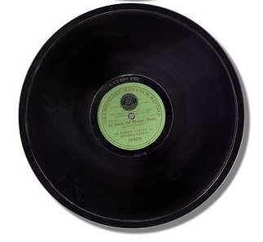
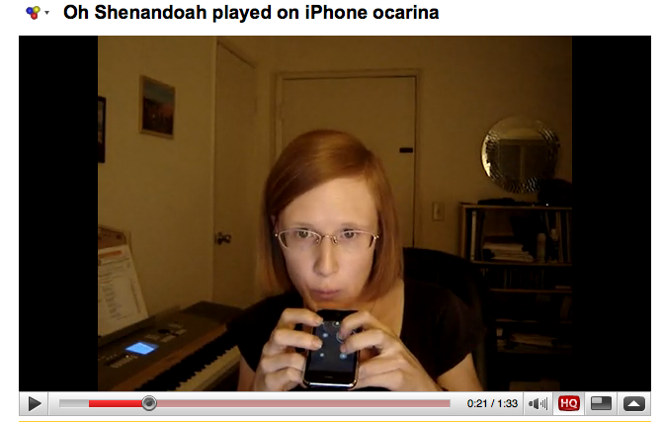
NIME Favors a Return
Process-oriented Music
“…we are in a period of restoring fluidity to the musical transformative process – of making music more process-oriented again and less artifact-oriented.”
Gideon D’Arcangelo, NIME-04
20th century
21st
©2009, S. Fels and M. Lyons
Notes:
BUT NIME IS NOT JUST ABOUT TECHNO-FETISH
Before talking about specific aesthetic factors and how these impact design strategies, I want to point out the most important aesthetic message that we have to offer: these new musical technologies are encouraging a return to music making, not just by experts but by amateurs have a variety of skill levels. This is because with new instruments the focus is again on process – the forms have not been set, there are few virtuosos and the new technologies have an infectious DIY attitude that is intended to carry over to players as well.
Surely the focus is supremely on process when the instruments themselves are in such a high state of flux
We have a rapidly changing situation where popular music culture is no longer focused on the rigid top-down technologies that were the norm for most of 20th century musical culture.
That was surely an anomaly in human history – for most of which music making has been participatory, community oriented.
A nice recent example is the iPhone Ocarina a virtual recreation of an ancient instrument. Here the cultural activity encourages the amateur to make music and share it globally.

Slide 4
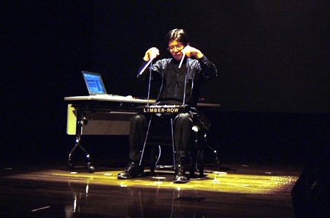
Challenge of Performance
Audience may not understand your NIME
Expectations may be varied
No musical tradition to fall back on
A demo is not a performance
Hisashi Okamoto, NIME-04
The First Sailing with Limber-Row
©2009, S. Fels and M. Lyons
Notes:
When this guy came out on stage and started to set up, I remember not have any kind of idea whatsoever what his performance would be like. Indeed, I had low expectations, based on the appearance of the instrument which looked clumsy and perhaps geeky to me.
However the performance was surprisingly good. I think this is because the performers gestures could be clearly seen, and their relationship to the interface understood once the musician started to operate or play it. Also the relationship of the gestures to the resulting sound output was also fairly clear, so that the audience could establish some common understanding, or empathize with what the performer was doing to create the sounds.
The clumsiness of the interface perhaps adds to some perception of ‘effort’ required to play it. This increases dramatic tension, heightening the audiences interest and participation in the performance. They enter the performer’s ‘motor narrative’, which is a story about a dialogue between man and a machine to produce something of interest and beauty.

Slide 5
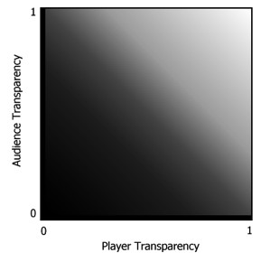
Transparency for Performer & Audience
OT
TT
Complicated mapping OO
Simplify OT
Complex mapping TO
OO
TO
How to achieve OO?
©2009, S. Fels and M. Lyons
Notes:
Transparency is a term we use to describe the degree to which the relationship between the gesture and the resulting sound can be grasped or intuitively understood, whether by the performer or by the player. Several situations are possible, it may be transparent for the player but opaque for the audience, etc…

Slide 6
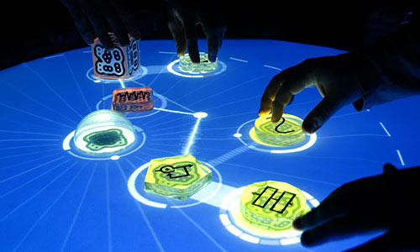
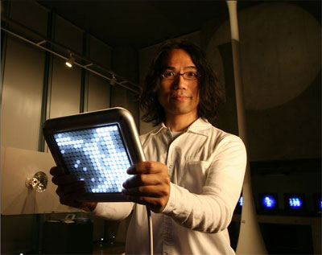
Visual Cues & Transparency
Visual Appearance of Instrument
Visualization of Interaction
Visualization of Sound Output
Module E
Visual Interfaces
Reactable
Tenori-on
©2009, S. Fels and M. Lyons
Notes:
We’ll see several examples of this in more detail later in module 8.

Slide 7
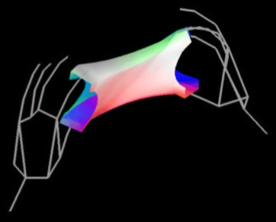
Transparency & Interaction Metaphor
SoundSculpting (Mulder and Fels, 1998)
- two Cybergloves and Trackers
- map metaphor of rubber sheet onto sound space
- transparent for audience and performer
©2009, S. Fels and M. Lyons

Slide 8
Transparency
Simple & Direct Interface
Contact Mics
Magnets
Paper clips
Video Clip
Kanta Horio, NIME-04
©2009, S. Fels and M. Lyons
Notes:
Part of the effectiveness of this performance is its directness. Actually it is questionable whether we can talk of a mapping since the acoustics of the setup are used for input, though the sound was processed by various effects. Still the point about directness and simplicity leading to transparent performances is well made by this example. I think that this is probably quite fun to play for the performer too because of the element of indeterminacy – in other words the interaction has enough complexity for the performer but enough transparency for both that it makes for a very enjoyable performance. OR IS IT JUST A REALLY COOL IDEA! (And the magnets wake up the kid in everyone)
Not terribly innovative technologically. But it is simple and effective. There is also a very interesting balance between deterministic motion of the paper clips in the magnetic field and some chance motion due to the complexity of the fields and shape and number of the paper clips.
Tension between predictable motion and indeterminacy can be quite gripping for the audience. Also when the paper clips hit the magnets there is a satisfying clicks and pops from the contact microphones.

Slide 9
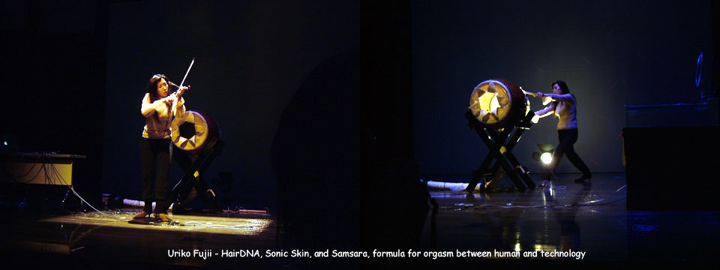
Aesthetics of Failure
Suspense highlights the technological challenge
If there are never difficulties, glitches etc… then the limits are not being pushed
Technical difficulty delayed this performance, but improved the outcome
©2009, S. Fels and M. Lyons
Notes:
Initial failure, or appearance of failure can enhance an eventual success.
Suspense of whether a complicated new piece of technology will work or not.
Part of this is about the challenge of trying to get a complex technological system to perform in real-time.
When this fails to work, this underlines the difficult of the challenge. So a certain degree of unintentional failure is part of the NIME aesthetic
Differences from the aesthetics of failure in turn-tablism (e.g. glitch music) which are mainly about indeterminacy, subversion, wabi-sabi etc…
Unintentional failure as opposed to intentional use of failures, or the appreciation of the beauty of mistakes
WOULD LIKE TO FIND A FUNNY IMAGE OF EARLY AVIATION TO ILLUSTRATE THIS POINT
ALSO MIGHT LIKE TO HAVE AN IMAGE OF A GLITCHED LP

Slide 10
Summary
Technology is increasing the fluidity of musical culture
NIME presents special challenges for performers
Well-designed visual feedback can greatly improve mapping transparency for audience and player
Interaction metaphors another strategy
Initial failure can enhance eventual success
©2009, S. Fels and M. Lyons

