Slide 1
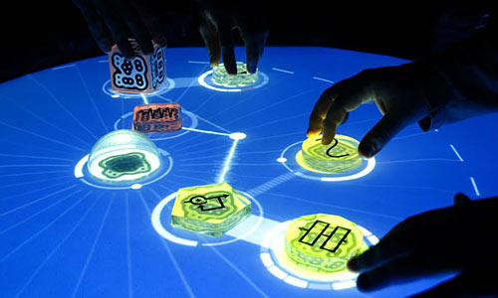
Module E: Visual Interfaces
Imaginary Piano: visual input only
Iamascope: visual input and output
Facial gesture musical interfaces: when vision may be your best option
Reactable: vision + (passive) touch, through alignment)
©2009, S. Fels and M. Lyons

Slide 2
Visual Interfaces
Multi-modal interfaces: focus is on relationship between sound and vision
Two broad classes:
  Vision based interfaces use camera as sensor
  Graphical interfaces provide visual feedback to performer and audience
Most works combine the two classes
©2009, S. Fels and M. Lyons

Slide 3

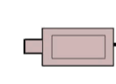

Visual Interfaces
Computer Vision System
M
Sound Synthesis
F₁
F₁ : visual feedback in the form of aligned graphics
©2009, S. Fels and M. Lyons
Notes:
Input and primary feedback are visual in nature. As usual we have sound output and the mapping here is from visual input, or more accurately features derived from the visual input, to sound synthesis parameters.
Visual nature of the input suggests some natural mappings of the the features to sound parameters, as we will see in the examples.

Slide 4
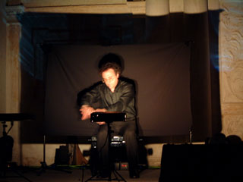
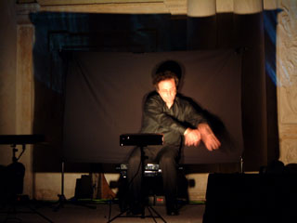
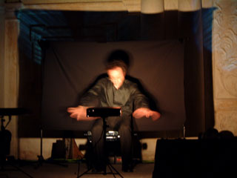
Visual Input Only: Imaginary Piano
Leonello Tarabella, NIME-02
Video camera with motion-sensitive zone
No primary feedback
©2009, S. Fels and M. Lyons
Notes:
Triggering zones. There are many systems like this. Rokeby’s VNS is a famous one. EK’s DIMI-O is another. Motion in zones triggers sound activity, notes etc…
The novelty value is good.
There is a mirror effect to some extent in that your gestures are mirrored by some output, without any touch, as though by magic. As though an agent is observing you and mimicing you or copying you.
This kind of empty handed gesture can be engrossing in the hands of the right performer. For example, a skilled mime might be able to milk it for quite a lot. As an instalation it is probably interesting for about 10 minutes for the average person. Perhaps a bit longer if the mapping is well designed. But make no mistake there are limitations.
What are the ultimate limitations? Lack of tactile or haptic feedback. Lack of visual feedback in this extreme case (so that the mirroring effect is reduced). Lack of transparency, intimacy. In the extreme case of no visual reference point, this is like a theremin where we cannot see the antennas.

Slide 5
Visual Input & Output
Iamascope
This gives a colourful kaleidoscopic feedback of part of the player. Gestures are used to trigger harmonious chord progressions and arpeggios.
Quite good coordination between sound and graphics
©2009, S. Fels and M. Lyons
Notes:
Limitations are the same as for the previous case but not as serious. There is much more of a mirroring effect going on here. Also the kaleidoscope can hold attention for extended periods, particularly when it mirrors the user. Music is fairly well designed and again mirrors the gestures. In short this is a fun, playful but somewhat narcissistic (fascination with mirrors).
Also, we certainly have ‘instant music’ & ‘low entry fee’, but there is a low ‘ceiling on virtuosity’, in other words, most users will get bored after a short time. So it works well as an installation, ‘walk up and play’ interface, but probably fails as an expressive instrument for performance or musical expression for extended use.

Slide 6
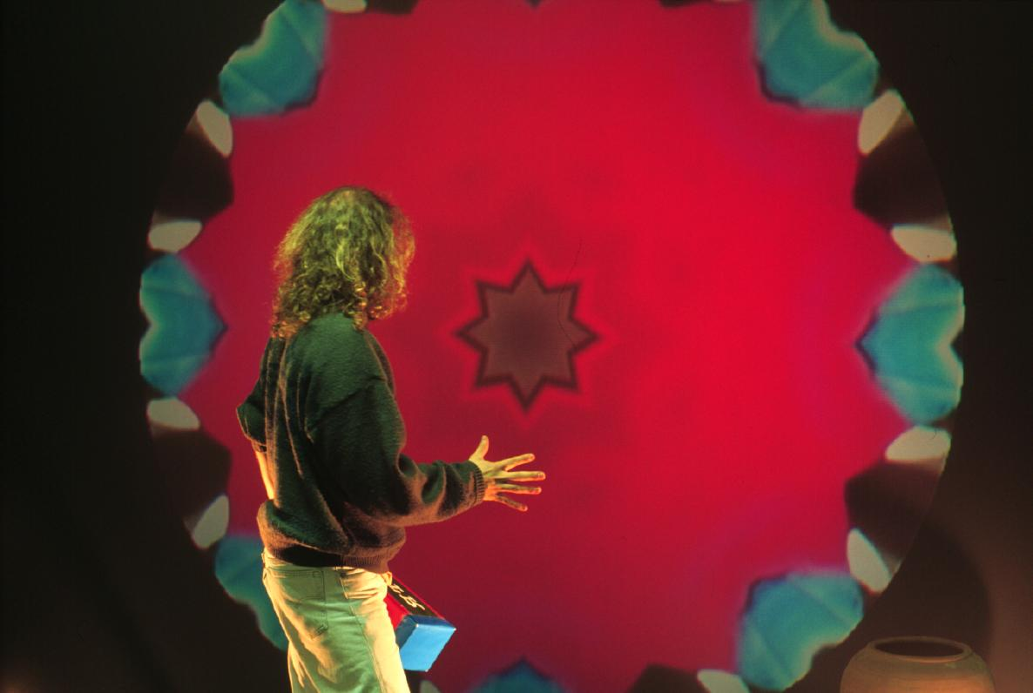
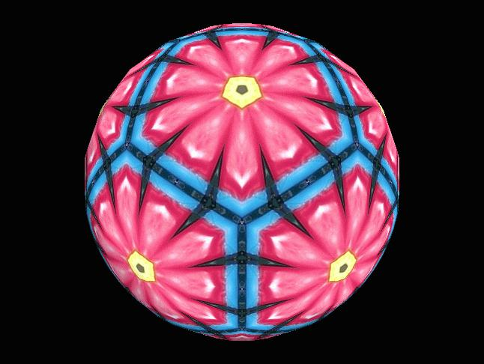
Iamascope
Interactive multimedia artwork
Participants are put inside a large kaleidoscope
Participants movements also map to music
Immersive, interactive, satisfying and fun

Slide 7
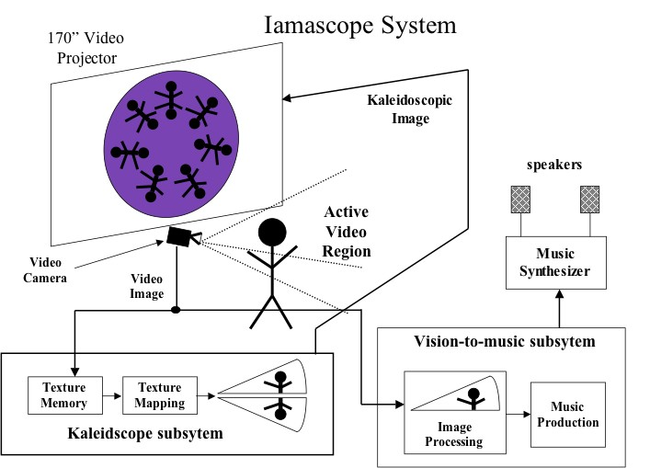

Slide 8
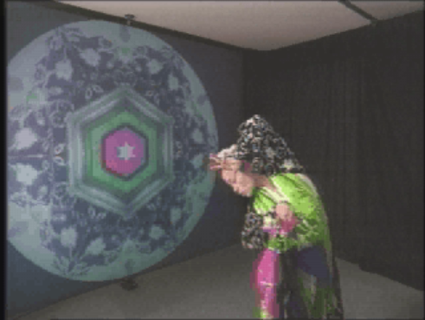
Iamascope - video

Slide 9
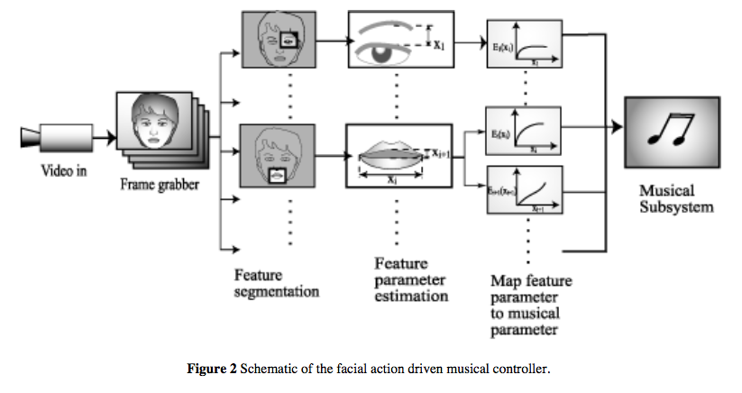
Facial Gesture Musical Interface
Lyons, NIME-01
©2009, S. Fels and M. Lyons
Notes:
When trying to capture information from the face, computer vision is a very attractive option precisely because it is non-intrusive. So the non-contact aspect has desirable feature to it.
Interested in the face because of it’s complexity and role in my complex sensory motor behaviour which is critical to social aspect of human beings such as facial expression, speech and so on.
This looks like a prescription for one-to-one mapping, however in fact most of the mappings we actually implemented were complex at the level of single features.
In other words, combinations of facial features were mapped to several sound synthesis control parameters. The mappings were chosen guided by two principles one based on facial expression and the other based on the acoustics of speech.
Details of the synth patches were adjusted by ‘feel’ which led to some quite complex mappings.

Slide 10
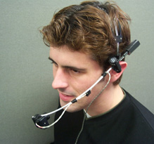
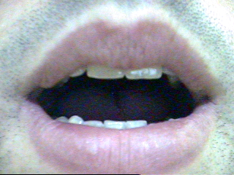
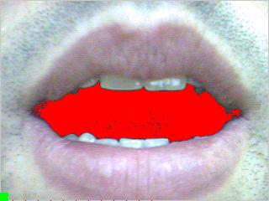
Mouthesizer
Colour & intensity thresholding
Morphological transform & filtering
Connected components + shape analysis
Image processing operations
Lyons et al., NIME-03
©2009, S. Fels and M. Lyons
Notes:
Here our motivation is motivated by facial expression and acoustics of sound production.
Roughly speaking height correlates with resonant low-pass filtering (also known as wah-wah).
Width roughly correlates with distortion. So that making a grimace increases the distortion of the sound.
These are high level (mid-layer in the three layer model), low level features and sound effect parameters had to be selected to implement this high level mapping.
In fact, we used the x an y moments of the distribution of pixels in the mouth shadow. These features are both influenced by both the width and height of the mouth, which anyways can not be completely adjusted independently.
Simiarly multiple sound control parameters were used in the synthesis engine.
So we actually have a complex many-to-many mapping, which is driven by a simplified middle layer.

Slide 11
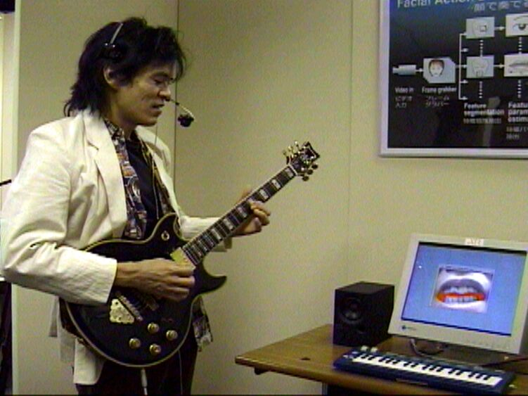
Mouthesizer Video
Guitar Effects Controller
Mapping:
Lyons (2001)
H Cutoff Frequency of Resonant Low Pass Filter
W Distortion
©2009, S. Fels and M. Lyons
Notes:
In fact the mapping used is complex: we don’t actually use height and width of the open mouth, but rather the x and y second moments of the distribution of pixels. This means that movements of the mouth have a coupled effect on both input parameters, so that there is no a strictly simple relationship between stretching the mouth or opening it vertically and the resultant audio effects.
One of the audio effects is intended to convey emotional valence, whereas the other is related to the acoustic effect of the mouth itself.
Also we are mapping at the high level and then translating this mapping into a complex action on the effects unit.

Slide 12
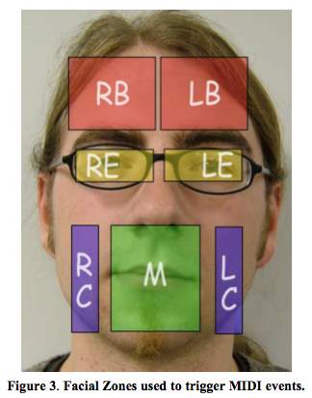
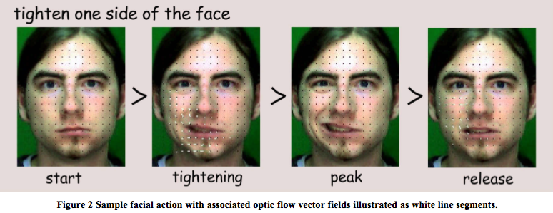
Sonification of Facial Actions (SoFA)
Optical Flow triggers samples
Samples mapped to facial zones
Frame is recalibrated with face
detection “Saccades”
Funk et al., NIME-05
©2009, S. Fels and M. Lyons

Slide 13
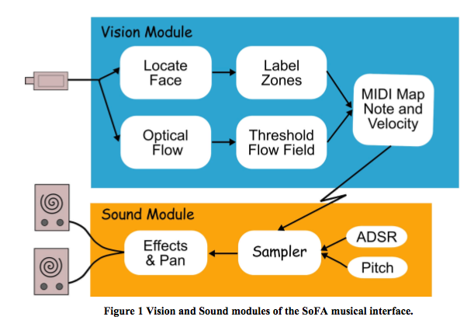
Sonification of Facial Actions (SoFA)
Funk et al., NIME-05
©2009, S. Fels and M. Lyons
Notes:
This is a generalization of the mouthesizer to the entire face. However here we mapped movement of parts of the face to trigger discrete sound events, in the form of
samples. The system is difficult to control and is more like an effect than an intimate musical controller.
It may be possible to modify this with better design in the future …

Slide 14
Reactable
Video tracking of marked pucks on a table
Projection of visual feedback
Sergi Jordà et al., Universitat Pompeu Fabra
first presented at NIME-03
Video
©2009, S. Fels and M. Lyons
Notes:
Mature musical interface which has reached the stage of commercialization and has also been used in performances with large audiences (by Bjork’s band).
Visual input is used to track blocks on a table. These are assigned to modules of a flexible software synthesizer, so that patches can be constructed and controlled in real-time performance. The blocks and table provide passive tactile primary feedback. There is also visual feedback in the form of computer graphics representation of the synthesizer patch.
This is enabled by computer vision tracking of the location of the blocks and careful alignment with a projector.
So this gives a kind of augmented reality interface to a software synth. Tangible interface project.
There have been other similar interfaces, such as the Augmented Groove, Block Jam, and so on.
This work has received the longest concentrated development effort and has reached a level of maturity that other projects have not.

Slide 15
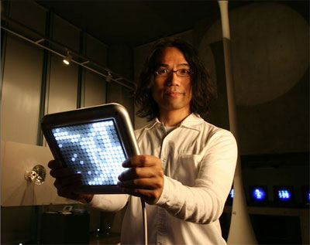
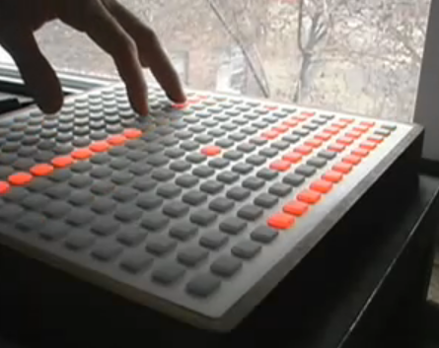
Power of Visual Feedback
see also Module A (Theory) and Module C (Aesthetics)
Yamaha Tenori-on
Nishibori & Iwai, NIME-06
Monome
Crabtree & Cain
Notes:
Monome: http://monome.org/
Monome Image grabbed from http://www.youtube.com/watch?v=-1tTABS_Ugs Cycling 74 interview of Brian Crabtree & Kelli Cain
Monome is an open source hardware project. Numbers are limited and the manufacturing is local and human scaled.

Slide 16
Summary
Large number of works have used visual input and output as a way to enhance new musical interfaces
Have give a very few case studies
General principle is that vision offers a powerful way to capture gestural input
Visual output can enhance aesthetics & experience of performer and audience
©2009, S. Fels and M. Lyons

