Slide 1
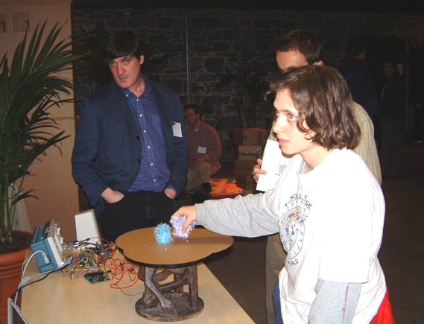
Module F: Education and NIME
Perry’s Principles: Guidelines for the beginner
NIME Curricula
©2009, S. Fels and M. Lyons

Slide 2
Some Guidelines:
Perry’s Principles
Rules of thumb for the design of digital musical
instruments
Several of the principles are heavily subscribed
“Principles for Designing Computer Music Controllers” P. Cook, NIME-01
Revised:
“Principles for Controlling Computer Music Designers” P. Cook, Keynote talk, NIME-07
©2009, S. Fels and M. Lyons
Notes:
Perry’s principles seems preferable to Cook’s Recipes!
WIT & WISDOM
NIME-07 proceedings p. 19

Slide 3
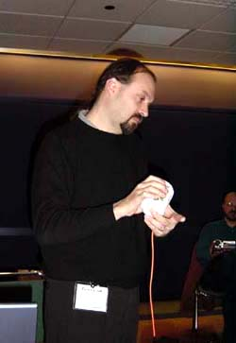
Perry’s Principles
Human/Artistic Principles
P1: Programmability is a curse
P2: Smart instruments are often not smart
P3: Copying an instrument is dumb, leveraging expert technique is smart
P4: Some players have spare bandwidth, some do not
P5: Make a piece, not an instrument or controller
P6: Instant music, subtlety later
©2009, S. Fels and M. Lyons
Notes:
THE original set fit onto TWO TABLETS
Let’s look at P1 & P2 together.
Then lets look at P5 & P6 together.

Slide 4
Perry’s Principles*
Technological:
P7: Miracle, Industry Designed, Inadequate
P8: Batteries, Die (a command not an observation)
P9: Wires are not that bad (compared to wireless)
P10: New algorithms suggest new controllers
P11: New controllers suggest new algorithms
P12: Existing Instruments suggest new controllers
P13: Everyday objects suggest amusing controllers
Misc.:
©2009, S. Fels and M. Lyons
Notes:
Since this section comes nearly at the end, we can mention how some of the principles relate to what has already been discussed in the course.
For example ‘existing instruments suggest new controllers’ relates to Marshall’s category of instrument-inspired DMIs.
One I would like to pick up here is P13, giving the example of some of Perry’s own instruments, or perhaps the Sonic Banana, and/or the Vegetable Orchestra.

Slide 5
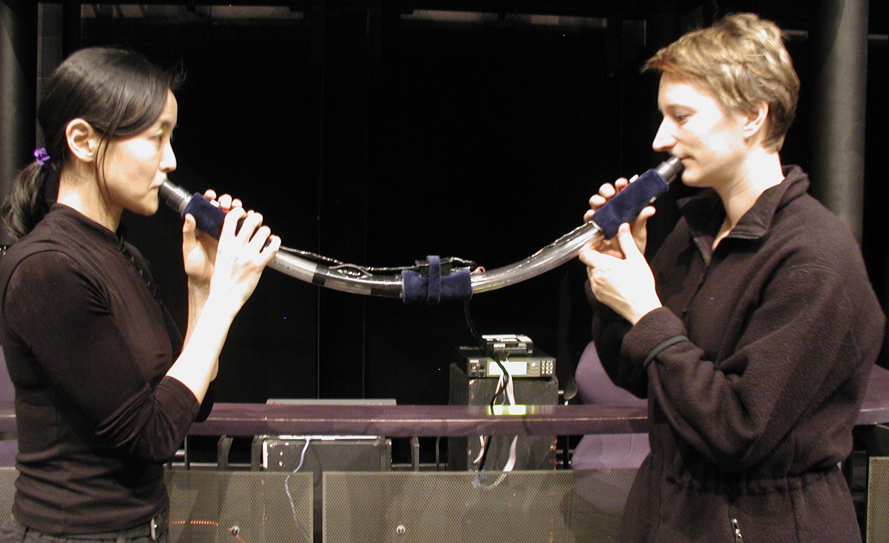
Perry’s Principles*
New (as of 2007)
P14: More can be better (but hard)
P15: Music + Engineering is a great Teaching (and Marketing) tool
P17: Younger students are more fearless
©2009, S. Fels and M. Lyons
Notes:
Not sure what happened to No. 16. I have to ask Perry about it. Anyways looks like he’s updated his principles again for a paper at NIME-09.

Slide 6
P1: Programmability is a curse
P2: “Smart” Instruments are Often Not
“Easy to add complexity, features, bandwidth”
But instruments can quickly become complex, unstable, and difficult to learn
It is tempting to A.I. to instruments but this can often be bad design if the player feels the instrument too obviously has a ‘mind of its own’
©2009, S. Fels and M. Lyons

Slide 7
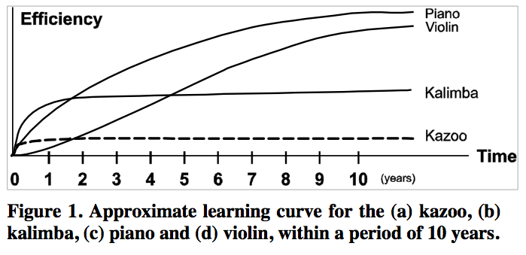
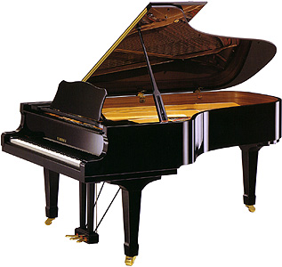
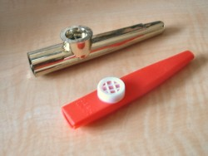
P5: Make a piece not a controller
P6:Instant Music, Subtlety later
Making music is the goal
The ideal new musical interfaces has:
‘Low entry fee with no ceiling on virtuosity’ Wessel & Wright, NIME-01
Jorda, NIME-04
©2009, S. Fels and M. Lyons

Slide 8
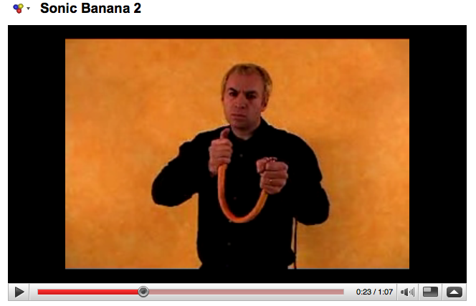
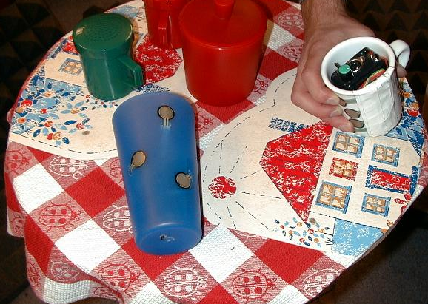
P13: Everyday objects suggest controllers that are both amusing & good
Sonic Banana (E. Singer, NIME-03)
Java mug & Fillup Glass (P. Cook, NIME-01)
Vienna vegetable orchestra
©2009, S. Fels and M. Lyons
Notes:
Would be nice to show a video of Eric’s SONIC Banana here.
Sonic Banana: http://www.youtube.com/watch?v=F70jvS3PgVY
Videos of Perry’s NIME-01 demos are here:
http://www.cs.princeton.edu/~prc/CHI01Web/chi01.htm

Slide 9
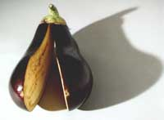
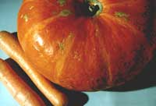
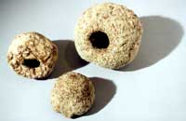
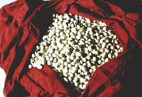
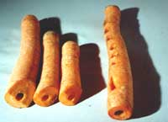
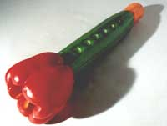
Vienna vegetable orchestra
melanzaniklappe
kuerbis
zellerbongos
bohnen
karottenfloeten
gurkophon
©2009, S. Fels and M. Lyons

Slide 10
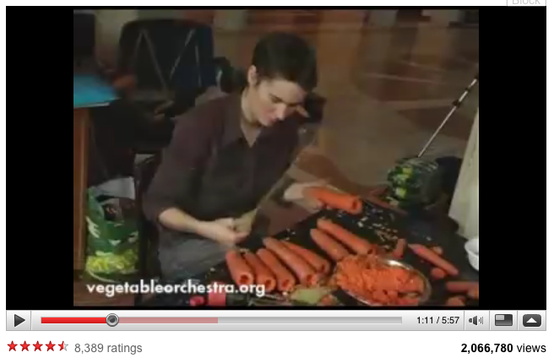
Vienna vegetable orchestra
http://www.youtube.com/watch?v=hpfYt7vRHuY
©2009, S. Fels and M. Lyons

Slide 11
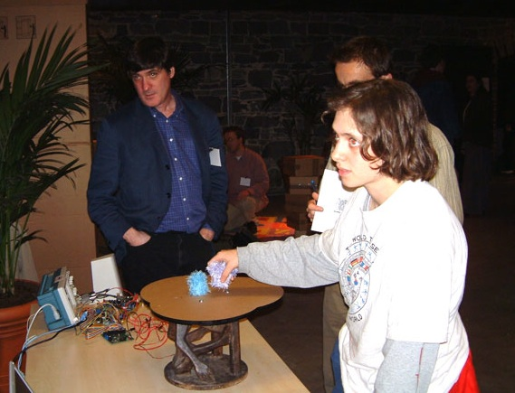
P15: Music + Engineering is a great Teaching Tool
High student interest
Motivation for learning a range of core topics including:
  Sensors
  HCI
  DSP
  Math skills
  Programming
  Networking
Joe Paradiso & student (NIME-02)
©2009, S. Fels and M. Lyons

Slide 12
Education and NIME
Sound Synthesis
Sensors, Effectors, Microcontrollers
Basic Electronics
Communication Protocols (MIDI, OSC, TCP etc.)
Sound Synthesis and Processing
Acoustics
Human-Computer Interaction
Music
©2009, S. Fels and M. Lyons

Slide 13
Where to study this field?
IRCAM, Paris
CCRMA, Stanford
CIRMMT, McGill
Princeton, CS & Music
MIT Media Lab
NYU Interactive Telecommunications Program
SARC, Queen’s, Belfast
Growing field …
URLs listed in the References
©2009, S. Fels and M. Lyons
Notes:
Should list URLs in the reference section

Slide 14
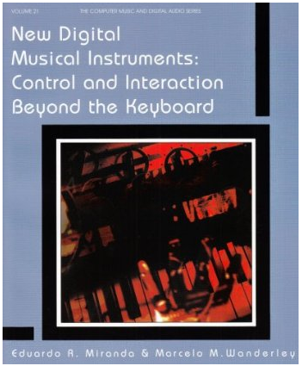
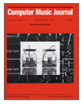
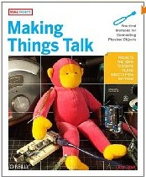
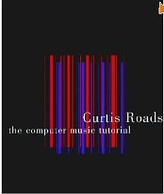
Specific Learning Resources
Miranda & Wanderley (2006)
Igoe (2007)
Roads (1996)
NIME Proceedings
ICMC Proceedings
Computer Music Journal
Organized Sound
J. New Music Research
©2009, S. Fels and M. Lyons

Slide 15
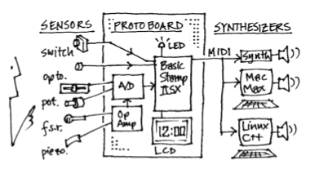
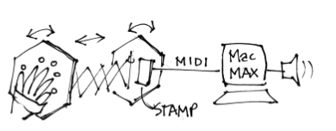
Curricula
beginning graduate or senior undergraduate level
Courses tend to be project oriented
Students learn what they need
Live performance or Demo is necessary for completion of the course (ITP, CCRMA)
Verplank, Sapp, Matthews (NIME-01)
©2009, S. Fels and M. Lyons
Notes:
So that students already have some of the needed skill sets
Concrete goal of performance or live demonstration means that students have to focus on learning what they need to get a working system together.
These are sketches of Bill Verplank’s from his NIME-01 paper on the Physical Computing/Human Interface Design course at Stanford CCRMA. ‘A Course on Controllers’.

Slide 16

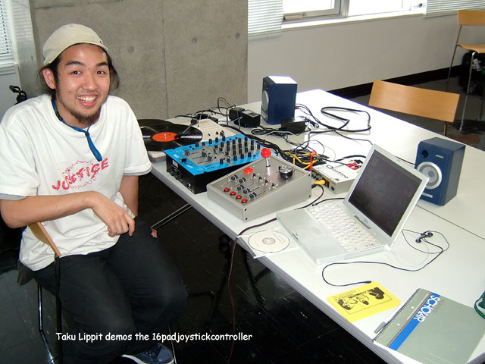
NYU ITP NIME Course
Master’s program in design & technology attracting students from a wide range of backgrounds
Gideon D’Arcangelo
Hans C. Steiner
Jamie Allen
Taku Lippit (NIME-04)
©2009, S. Fels and M. Lyons
Notes:
NIME course founded by Gideon D’Arcangelo, adjunct professor at ITP, after he attended the CHI’2001 NIME workshop
Course is being continued by Hans-Christoph Steiner and Jaime Allen
Taku is now Artistic Director at STEIM in Amsterdam, which is one of the world centers for this kind of work.
First presented his work in this field at NIME-03. Got started in this field via the Gideon’s course.
This page has many resources: http://itp.nyu.edu/nime

Slide 17
NYU ITP NIME Course
ITP tradition in Phys. Comp.
Course offered to 2nd year students
Students already have exposure to sensors, microcontrollers, flash, processing
Formal music background not a prerequisite
Review basics of music tech. as needed
©2009, S. Fels and M. Lyons
Notes:
Formal music background not required and there is a widely varying range of musical skills amongst students.
The ITP students have the advantage of prior exposure to physical computing methods from the 1st year curriculum. Also the ITP facilities are conducive to the kind of work that NIME involves – workshops, electronic benches etc… people who are knowledgeable about electronics and so on.

Slide 18
NIME Curriculum
Project based – each student designs and develops a novel musical controller
Review of musical controller literature and discussion of design issues and approaches
Preparation for a recital with new musical controllers
©2009, S. Fels and M. Lyons

Slide 19
NIME Curriculum - Topics
Historical Survey of Musical Instrument Types
Attributes of Musical Expression
Music Theory and Composition
Musical Interface Responsiveness
Discrete vs. Continuous Controllers
Gestures and Mapping
Novice and Expert Interfaces
Spectacle and Visual Feedback in Performance
Collaborative Interfaces
©2009, S. Fels and M. Lyons
Notes:
Based on

Slide 20
Summary
Substantial resources for learning about NIME
Good place to start: Perry’s principles
NIME courses are usually project based
Number of universities offering programs of study is expanding
Next frontier: high schools, science fairs
©2009, S. Fels and M. Lyons
Notes:
I would like to propose that the tools are now accessible enough that basic NIME projects should be do-able by well motivated high school students of reasonable non-genius ability. And experience has shown that this area can provide strong motivation for young people to learn about several areas of engineering, science, and music. This seems like a golden opportunity for an interesting project for educators interested in high school education. Also, though I haven’t looked very hard, I am not aware of any projects like this.

