Slide 1
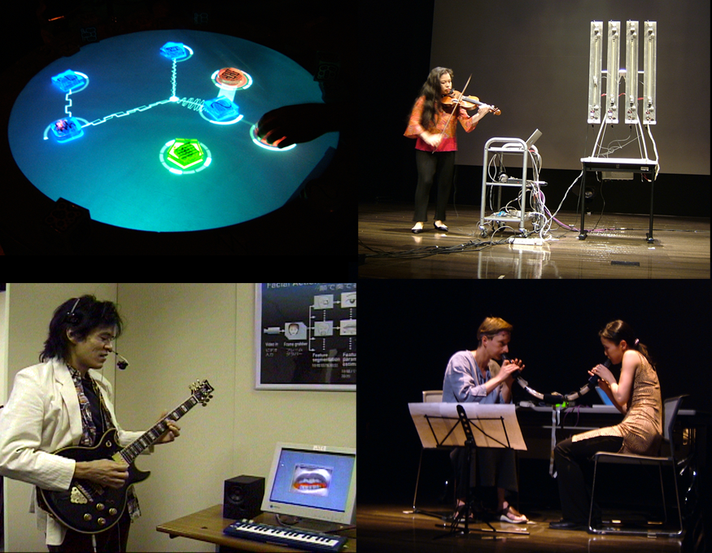
Siggraph’09 Course
Creating New Interfaces for
Musical Expression
- Introduction to NIME -
Sidney Fels
University of British Columbia
Michael Lyons
Ritsumeikan University
©2009, S. Fels and M. Lyons

Slide 2
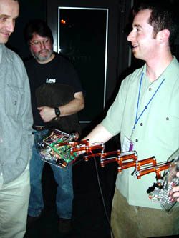
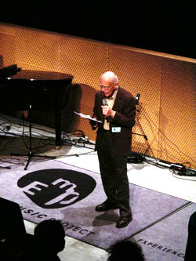
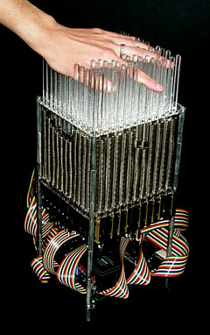
A Brief History of NIME
“New Interfaces for Musical Expression”
First organized as a workshop of ACM CHI’2001
Experience Music Project - Seattle, April, 2001
Lectures/Discussions/Demos/Performances
©2009, S. Fels and M. Lyons

Slide 3
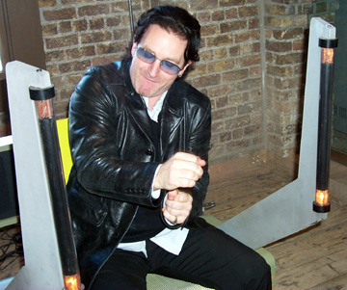
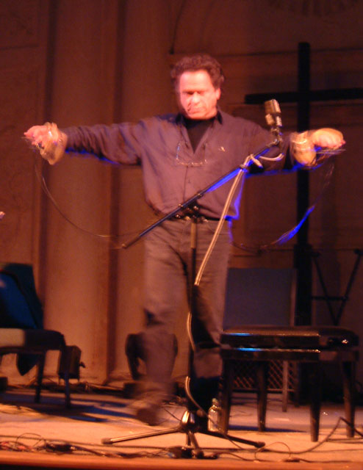
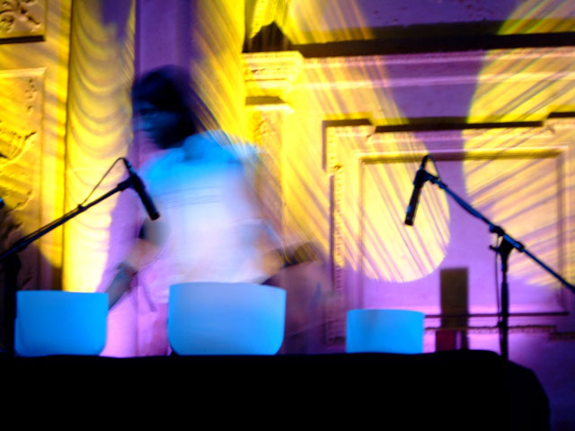
A Brief History of NIME
NIME-02 - Media Lab Europe, Dublin in May 2002
Conference-scale event with similar format to the NIME-01 workshop
©2009, S. Fels and M. Lyons

Slide 4








… held annually since 2001
©2009, S. Fels and M. Lyons

Slide 5
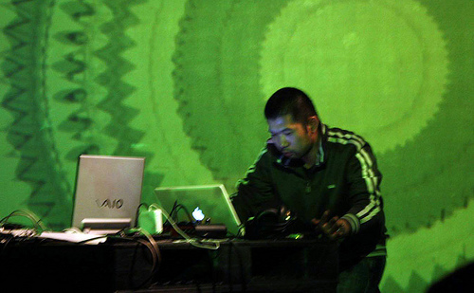

What is NIME about?
The Problem:
The “Office Gesture”
Digital Technology &
computers involved in nearly
all forms of contemporary
music
But the computer is not a
Musical Instrument
Laptop Battle Tokyo
Superdeluxe Roppongi
11/2008
sml!
©2009, S. Fels and M. Lyons

Slide 6
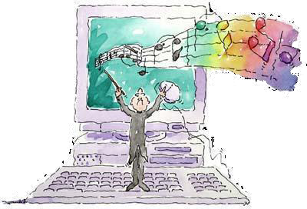
How to Play the Computer?
Computers offer a wide range of sound and
music creation opportunities
How can we create new interfaces to play computers
in a way that is appropriate to human brains & bodies?
©2009, S. Fels and M. Lyons

Slide 7
How to Play the Computer?
This course is
all about
new human- computer
interfaces for
making music
©2009, S. Fels and M. Lyons

Slide 8
NIME Themes
Novel controllers & interfaces
Performance & composition with new interfaces
Interfaces for collaborative performance
Real-time gestural control of music
Interfaces for musical novices & education
Cognition in Musical Interface Design
Haptic & force feedback in musical control
Artistic, cultural, and social impact
©2009, S. Fels and M. Lyons

Slide 9
NIME Themes: A Selection
Mapping & Digital Instrument Design
Musical Instrument theory: what makes a good instrument?
Visual Musical Interfaces
Haptic & Force feedback
Collaborative Musical Interfaces
©2009, S. Fels and M. Lyons

Slide 10
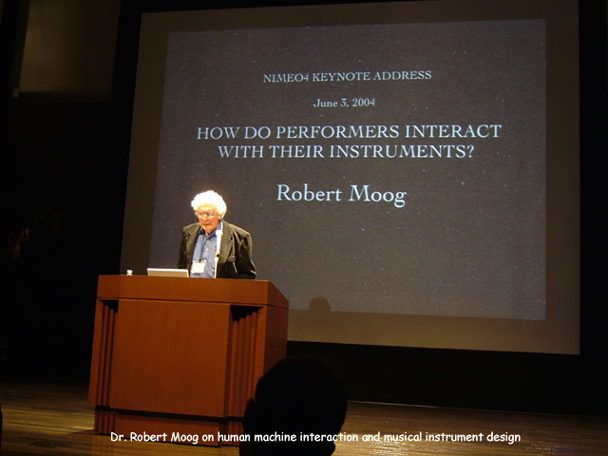
Module A: NIME Theory
Generic model of a musical interface
Role of feedback from the interface
Mapping problem
©2009, S. Fels and M. Lyons

Slide 11
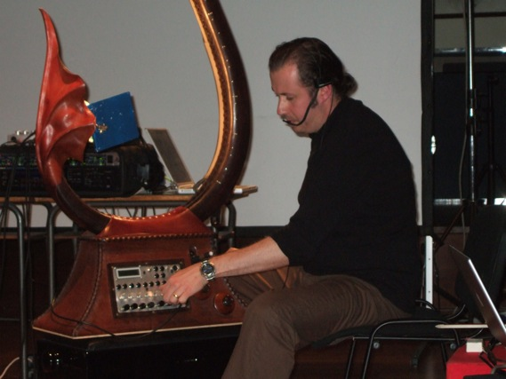
Module B: Tools
So, you want to build a NIME…
©2009, S. Fels and M. Lyons

Slide 12
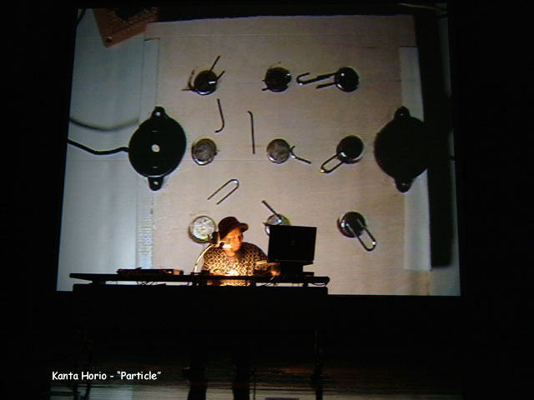
Module C: Aesthetics of NIME
Technological Expressionism
NIME & the Music Process
Challenge of Performance
Mapping & the Audience: Transparency
Visual Feedback
Interaction Metaphor
©2009, S. Fels and M. Lyons

Slide 13
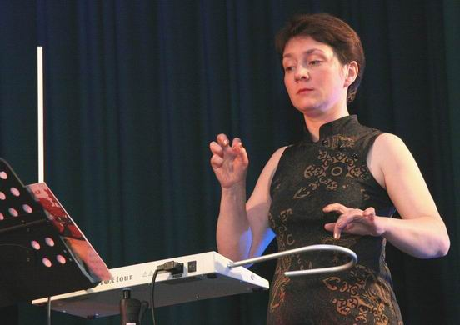
Module D: Case Studies
NIMEs of our TIMES
Sensor(s)
Mapping
Sound
©2009, S. Fels and M. Lyons
photo: Lydia Kavina

Slide 14
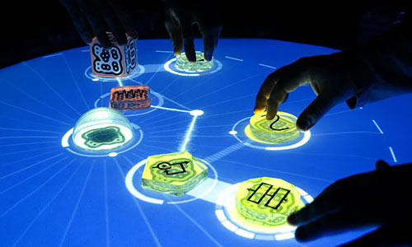
Module E: Visual Interfaces
Imaginary Piano: visual input only
Iamascope: visual input and output
Facial gesture musical interfaces: when vision may be your best option
Reactable: vision + (passive) touch, through alignment)
©2009, S. Fels and M. Lyons

Slide 15
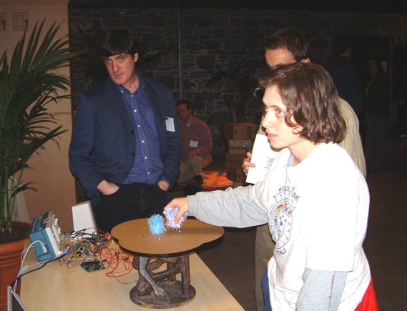
Module F: Education and NIME
Perry’s Principles: Guidelines for the beginner
NIME Curricula
©2009, S. Fels and M. Lyons

