Slide 1
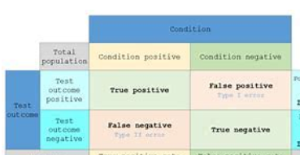
% TP=364,FN=88,FP=64,TN=378%
TP=511,FN=202,FP=140,TN=501%
TP=83,FN=30,FP=32,TN=81
894,1354,226
 | Predicted label
True label | 511 | 202
 | 140 | 501
TrueOlympic Table Tennis MS label
Predicted label
 |  | Condition
 | 226 samples | Condition positive | Condition negative
Test outcome | Test outconme positive | 83 | 30
 | Test outconme negative | 32 | 81
 | Predicted label
True label | 364 | 88
 | 64 | 378
 | Predicted label
True label | 83 | 30
 | 32 | 81
1354 samples | Condition positive | Condition negative
Test outconme positive | 511 | 202
Test outconme negative | 140 | 501
894 samples | Condition positive | Condition negative
Test outconme positive | 364 | 88
Test outconme negative | 64 | 378
226 samples | Condition positive | Condition negative
Test outconme positive | 83 | 30
Test outconme negative | 32 | 81

