Slide 1
Multistep prediction

Slide 2
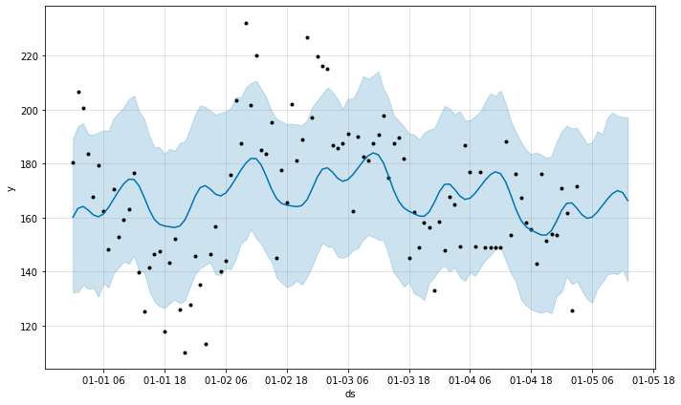
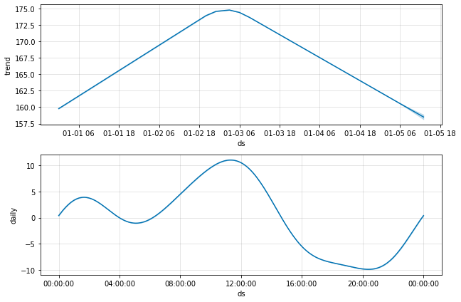
Related information
Time series usually have yearly seasonality, weekly seasonality and daily seasonality
y_hat = trend + [ [daily_seasonality] +[ weekly_seasonality] +[ yearly_seasonality] ]
Example:
Tool: Prophet https://facebook.github.io/prophet/docs/quick_start.html

Slide 3
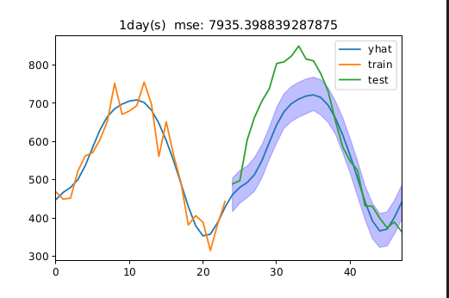
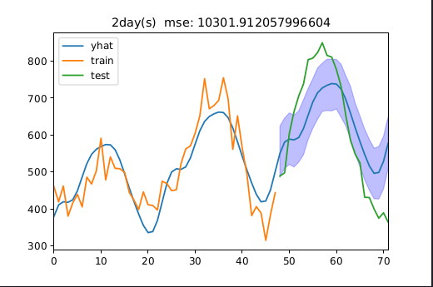
Overview of my ideas
N period points before current point C must have a trend,using this trend to predict M period points later (trend(N)-->valueOf(M))
Set lowerN and upperN , then let N differs in [lowerN, upperN], different trends can be get, so we get multi valueOf(M) sequences.
Give the valueOf(M) weights, make weighted summation, finally got the hat_valueOf(M)
More>>

Slide 4
Pseudocode
For N in range(lowerN, upperN, step):
  ValueOfM_pre_list = []
  Trend = get_trend(N_points_sequence)
  ValueOfM_pre = next_M_points_predict(Trend, C, M)
  ValueOfM_pre_list.append(ValueOfM_pre)
For weight in weights, ValueOfM_pre in ValueOfM_pre_list:
  ValueOfM_hat += weight * ValueOfM_pre
Finally get the predict of next M periods values ValueOfM_hat

Slide 5
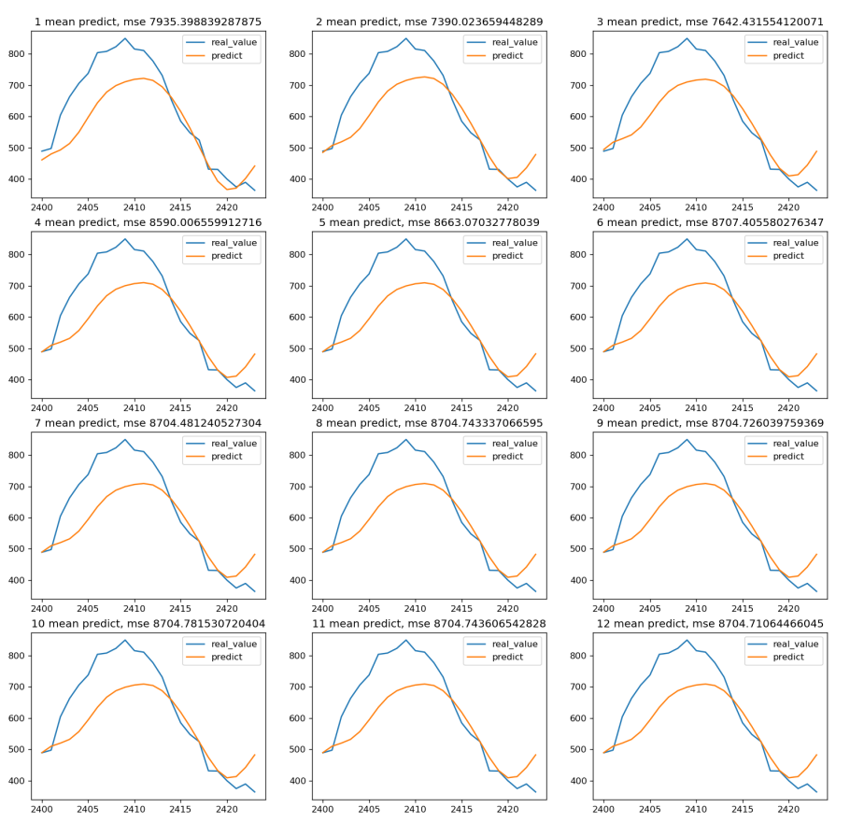
Result obtained 1
C = 2015-04-11 00:00:00
N in range([24,24*12+1,24])
M = 24

Slide 6
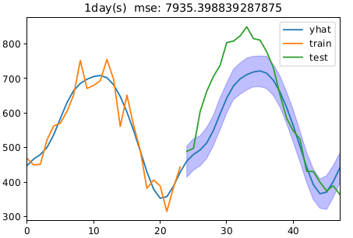
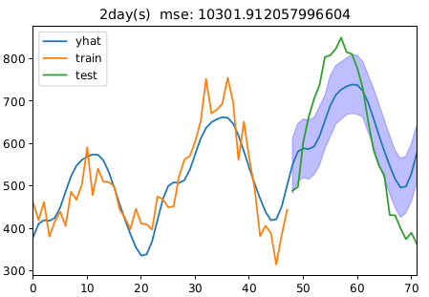
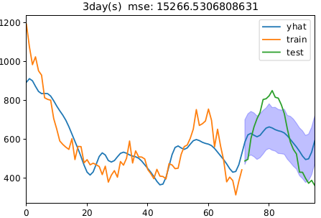
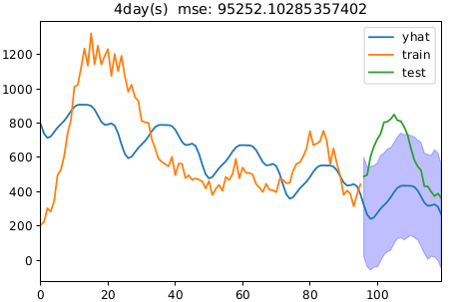
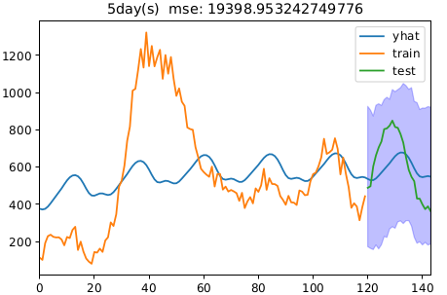
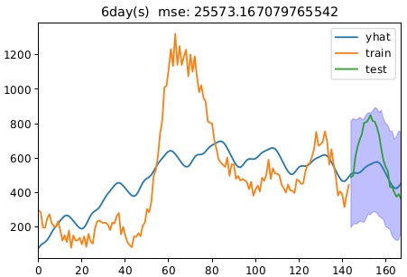
Result obtained 1 details
……

Slide 7
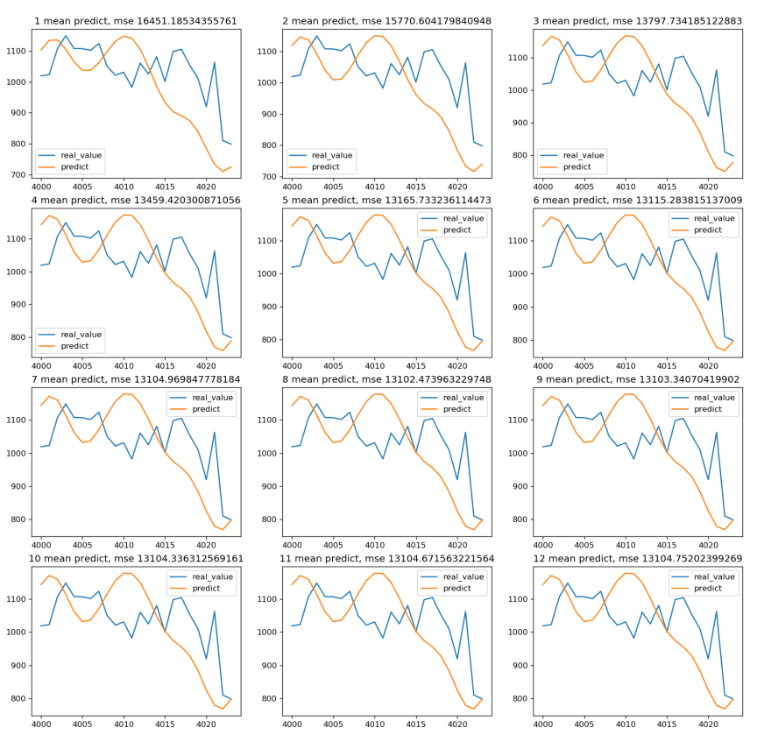
Result obtained 2
C = 2015-06-16 16:00:00
N in range([24,24*12+1,24])
M = 24

Slide 8
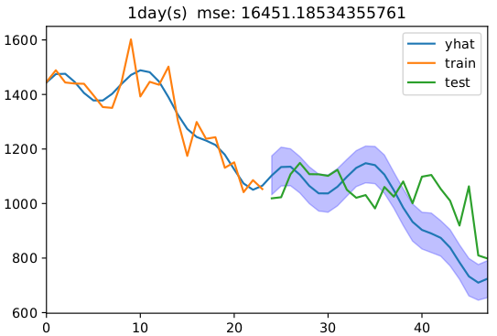
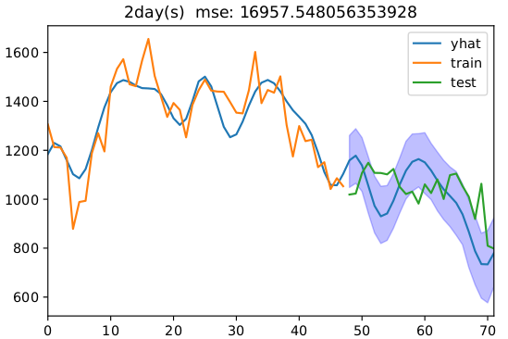
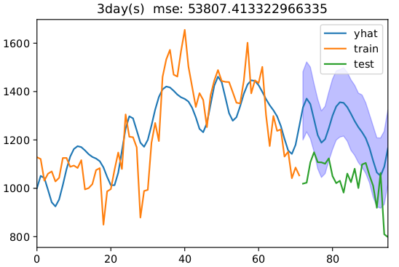
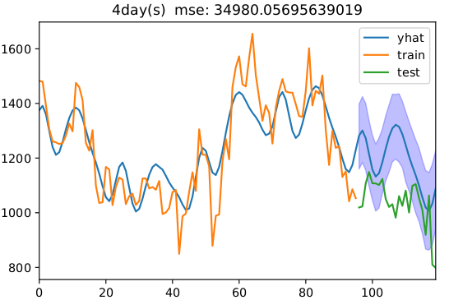
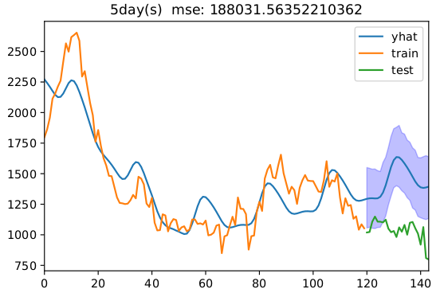
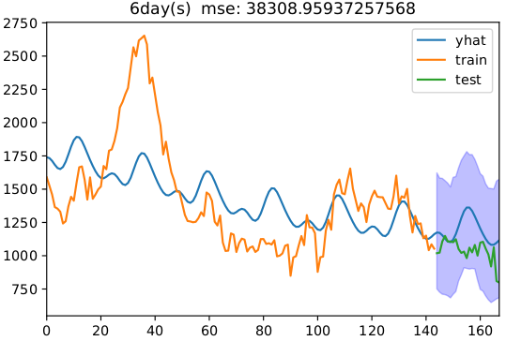
Result obtained 2 details
……

Slide 9
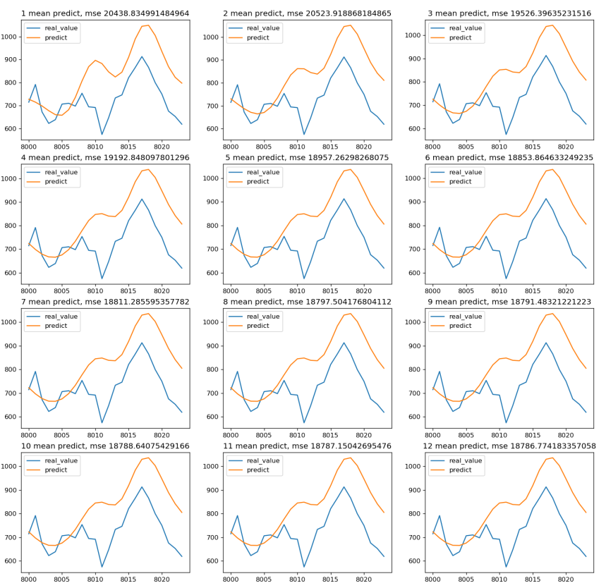
Result obtained 3
C = 2015-11-30 08:00:00
N in range([24,24*12+1,24])
M = 24

Slide 10
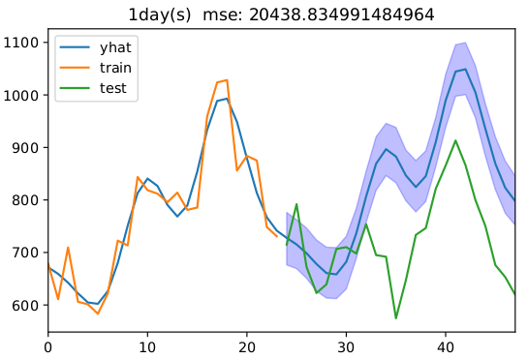
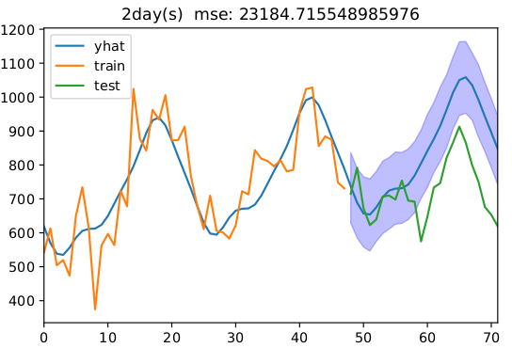
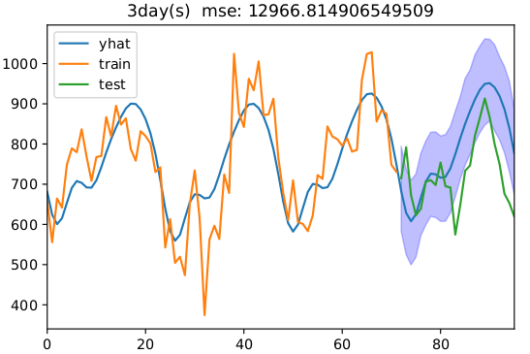
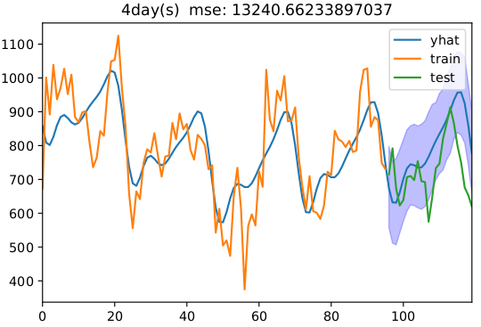
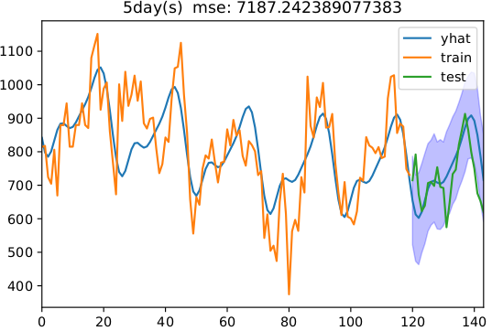
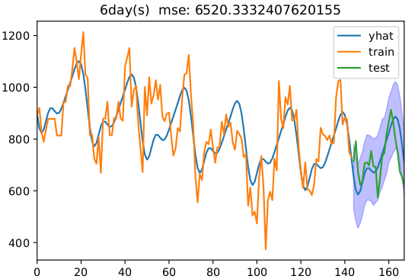
Result obtained 3 details
……

Slide 11
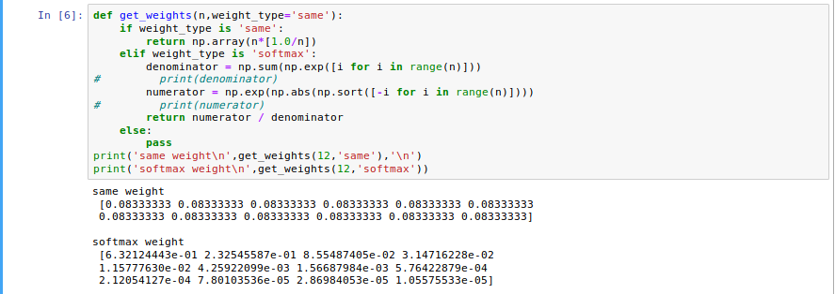
Weight strategies
Let n = Number of next period points prediction sequences
  Strategy1: share the same weight 1/n
  Strategy2: e^{i} / sum(e^{j}) (i , j in range(n) )
Code:

Slide 12
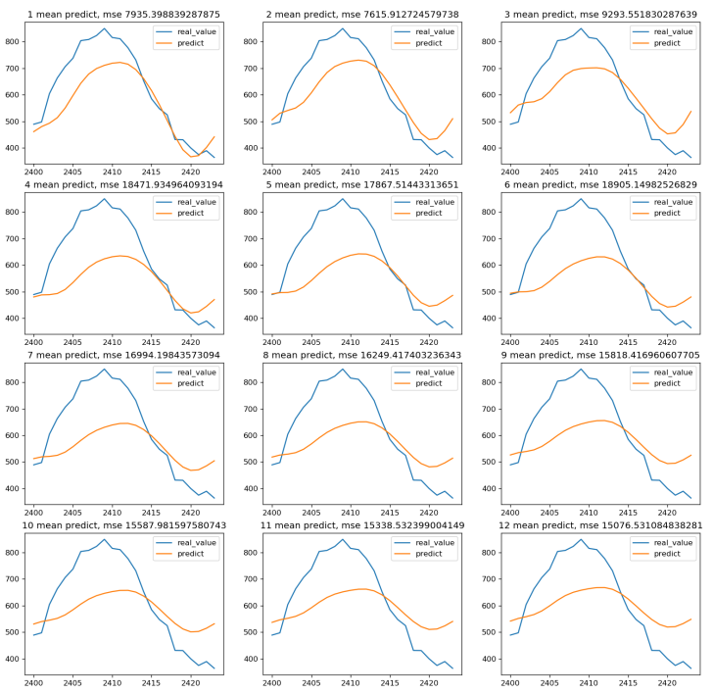
Comparison of two strategies
‘same’ VS ‘softmax’

Slide 13
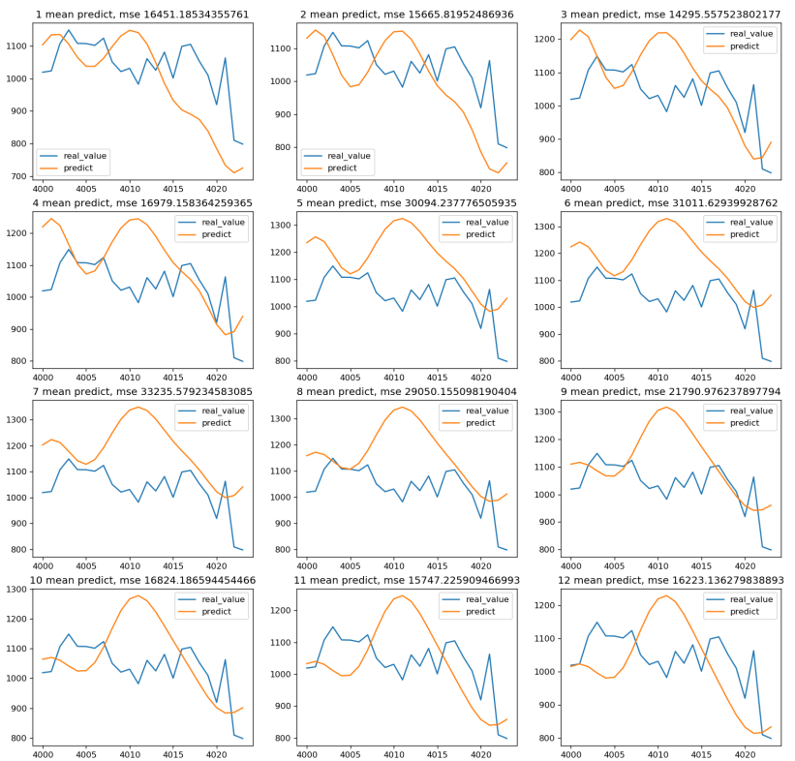
Comparison of two strategies
‘same’ VS ‘softmax’

Slide 14
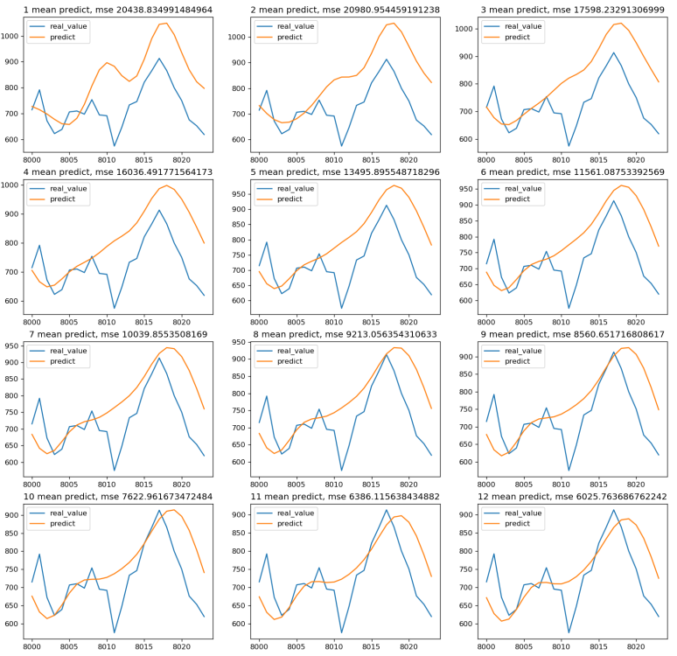
Comparison of two strategies
‘same’ VS ‘softmax’

Slide 15
Advantages and disadvantages
Advantages:
  The model is very simple, just focus on the data of the recent Npoints, it only takes very little training data and time.
  Models can 'remember' the impact of data points far away from themselves on current data trends
  The effects of recent and distant trends on current data trends can be adjusted with different weights
Disdvantages:
  Finding the optimal weight assignment strategy may be difficult
  The trend of different Npoints sequence may be quite different, which is unfavorable for the prediction of the results.

Slide 16
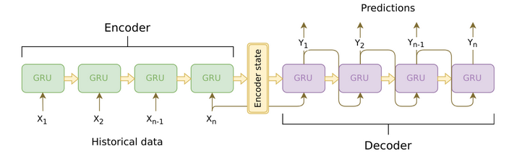
Solution assumption
Improve weights assignment strategy
Construct a supervised learning model to 'learn' weights
Using Encoder, Decoder(seq2seq)
  Mapping a fixed length sequence to a consecutive fixed length sequence(with GRU or LSTM layers)
Demo implementation
  https://www.kaggle.com/c/web-traffic-time-series-forecasting/discussion/43795#latest-567361

Slide 17
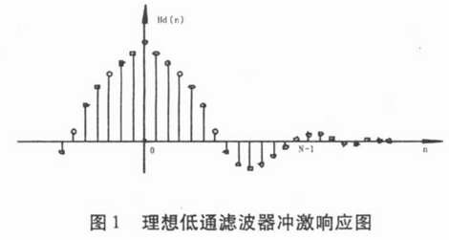
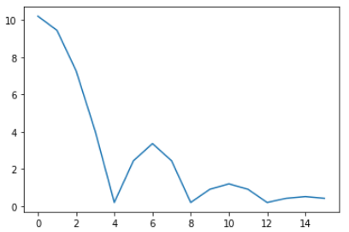
Improved weight strategy
Lower pass filter

Slide 18
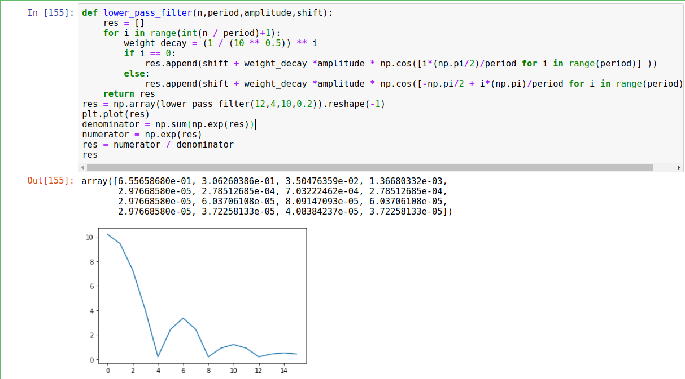
Improved weight strategy
Lower pass filter

Slide 19
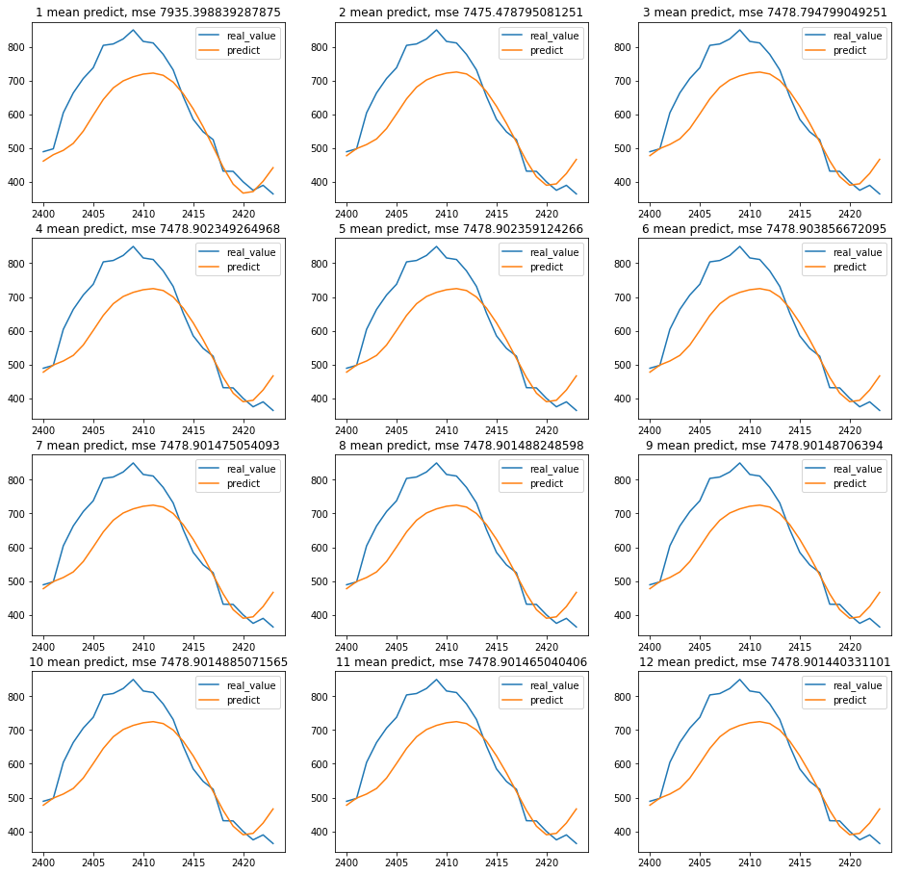
Improved results

Slide 20
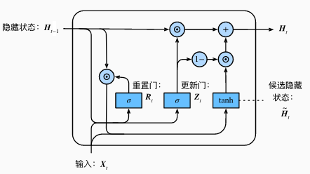


GRU(gated recurrent unit)
Reset Gate & Update Gate
Candidate hidden state
Hidden state
Summary
  Reset gate can be used to discard some historical information unrelated to prediction
  Reset gate helps capture short-term dependencies in the time series
  Update gate helps capture long-term dependencies in time series
References
  https://arxiv.org/pdf/1409.1259.pdf
  https://arxiv.org/pdf/1412.3555.pdf

Slide 21
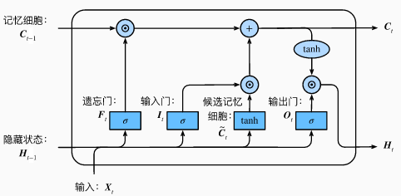



LSTM(long short-term memory)
Input, Forget, Output Gate
Candidate Memory Cell
Memory Cell
Hidden state
Summary
  The hidden layer output of LSTM includes Ht and Ct. Only Ht is passed to the output layer
  LSTM network can cope with the gradient attenuation problem in the cyclic neural network and better capture the dependence of the time step distance in the time series.
References
  https://link.springer.com/content/pdf/10.1007%2F978-3-642-24797-2.pdf

Slide 22
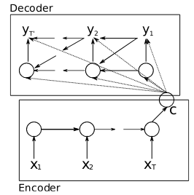


Encoder&Decoder(seq2seq)
Encoder
Decoder
How to choose c ????
Summary
  Encoder transforms the hidden state of each time step into a background variable through a custom function q
  Decoder
References
  https://arxiv.org/pdf/1406.1078.pdf
  https://arxiv.org/pdf/1409.3215.pdf

Slide 23

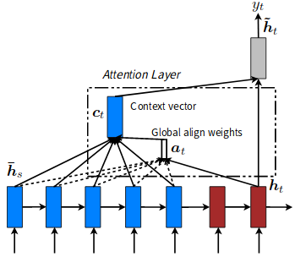

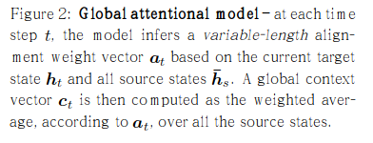
Attention mechanism in seq2seq
The attention should assigned differently by different steps.
  Global Attention

Slide 24
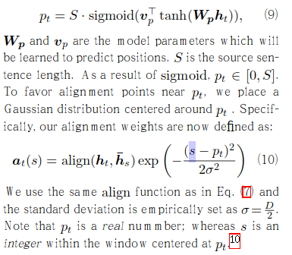
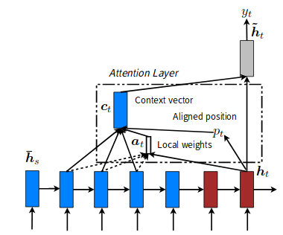
Attention mechanism in seq2seq
The attention should assigned differently by different steps.
  Local Attention

Slide 25
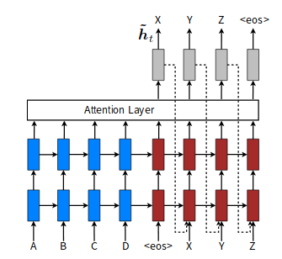

Attention mechanism in seq2seq
The attention should assigned differently by different steps.
  Input-feeding Approach
References
  https://arxiv.org/pdf/1508.04025.pdf

Slide 26

Using seq2seq
Data preprocessing: MinMaxScaler((-1,1))
Make data into: sequences → sequences
We can build data set seq(len:N) → seq(len:M) in any N&M
Have a try with N = 3, M = 3

Slide 27
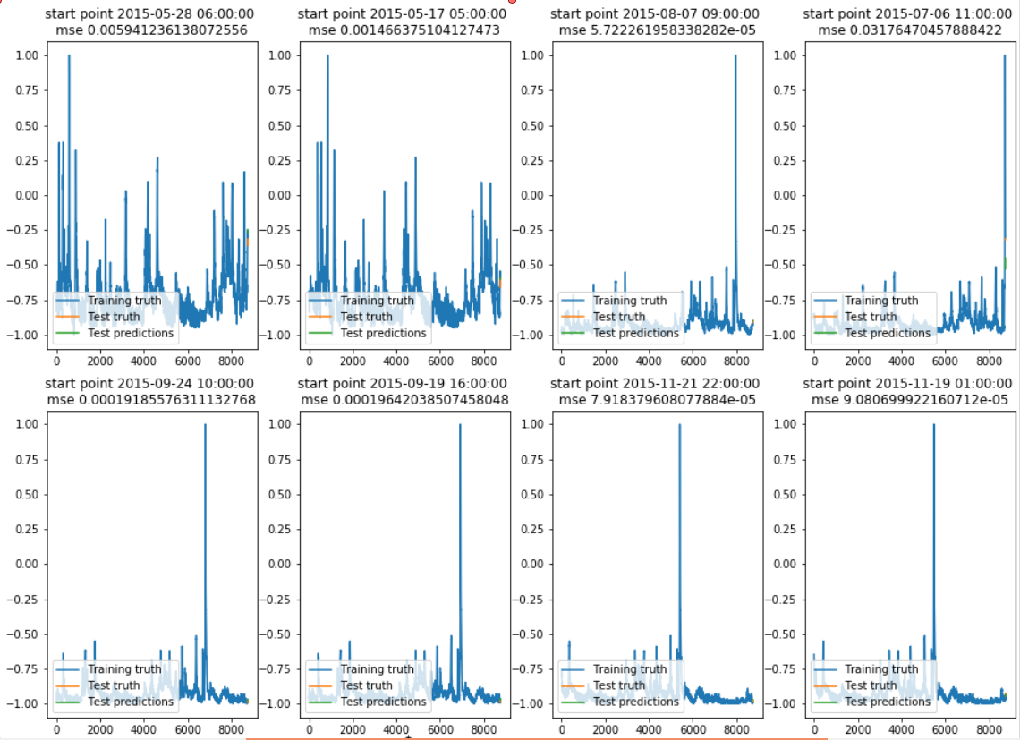
Result obtained

Slide 28
Single step prediction

Slide 29
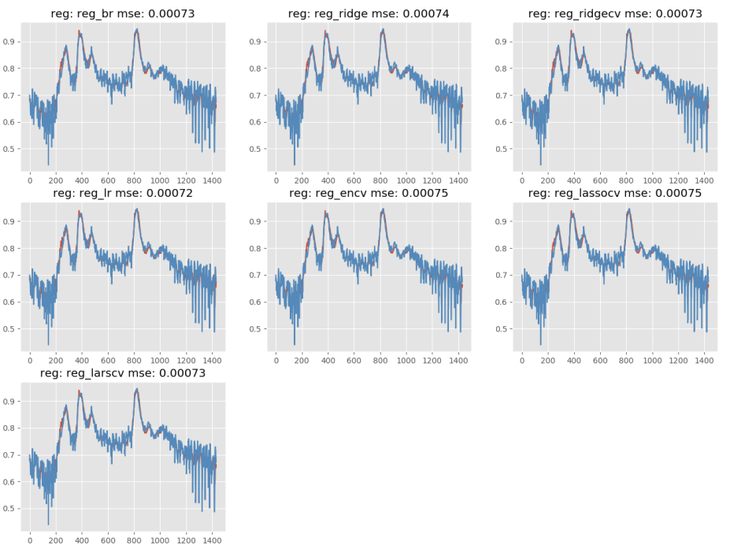
Linear model
Feature engineering
Params tuning

Slide 30
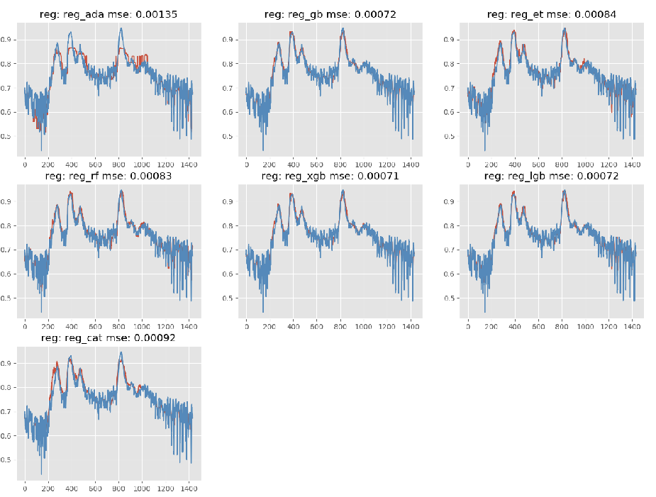
Tree Based model

Slide 31
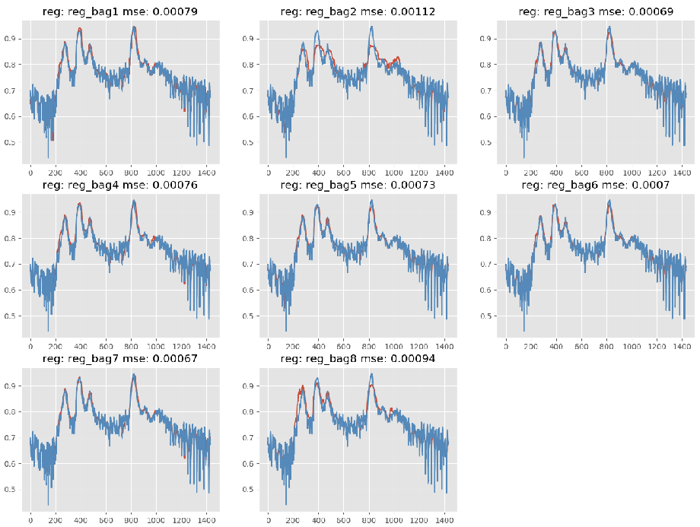
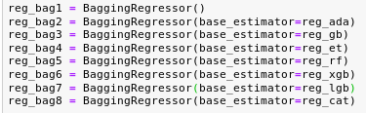
Bagging

Slide 32
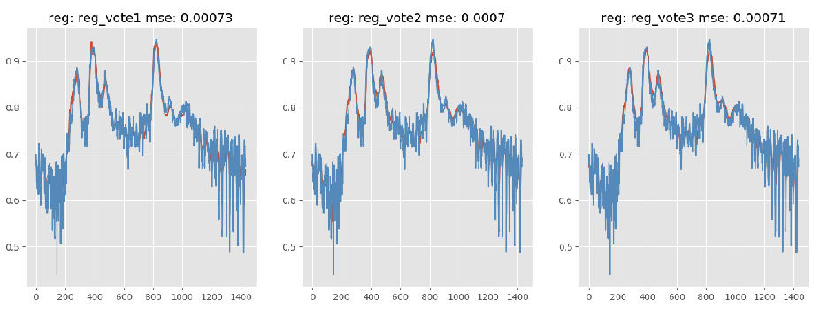
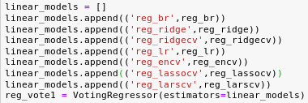
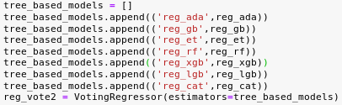

Voting

