Slide 1

Module of Flappy bird
in p5.js

Slide 2

Introduction to p5.js
P5.js is a JavaScript library that starts with the original goal of Processing (https://processing.org/), to make coding accessible for artists, designers, educators, and beginners, and reinterprets this for today’s web.
P5.js is a platform to write JavaScript in an easier way (based on Processing).
Every p5.js project will come along with html file, users can upload the project to website.

Slide 3
Coding
p5.js | Environment: Use code editor of your choice (Processing, Sublime Text 2, Brackets, Atom) or use p5.js editor (download here).
p5.js | Example: https://p5js.org/examples/
p5.js | References: https://p5js.org/reference/

Slide 4
Web hosting
A web host, or web hosting service provider, is a business that provides the technologies and services needed for the website or webpage to be viewed in the Internet.
Eg: 000webhost , Freehostia , 5GBfree

Slide 5
FTP software
It's a File Transfer Protocol client to assist in transferring files between two machines or computers and networks.
Eg: Cyberduck , FileZilla , FireFTP

Slide 6
Steps to Upload p5.js sketch online using p5.js, Cyberduck,000webhost

Slide 7
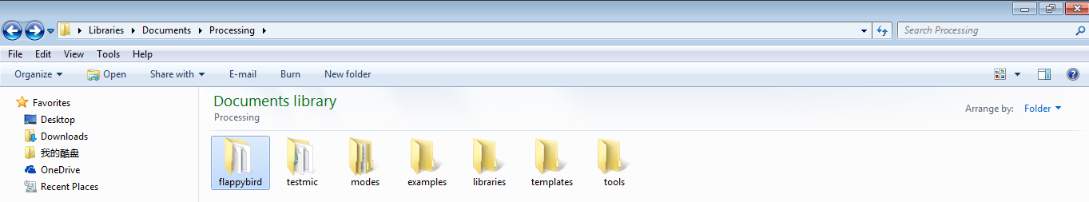
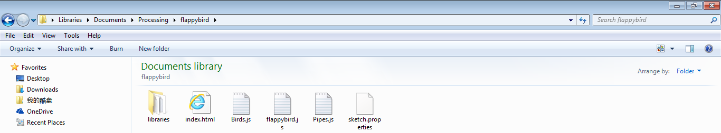
1. Save your p5.js project in a file.

Slide 8
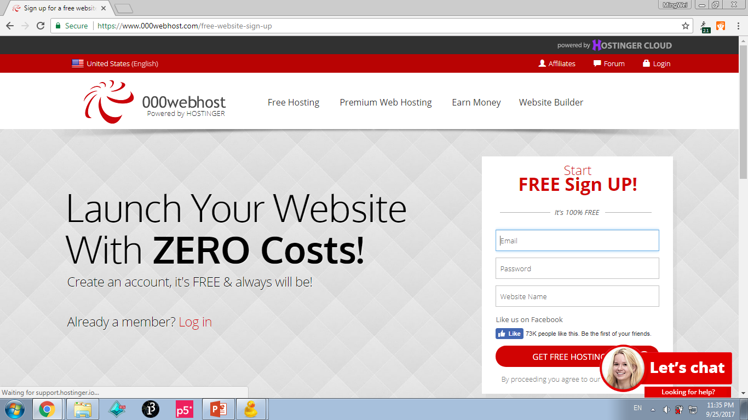
2. Create an account on web hosting provider (000website)

Slide 9
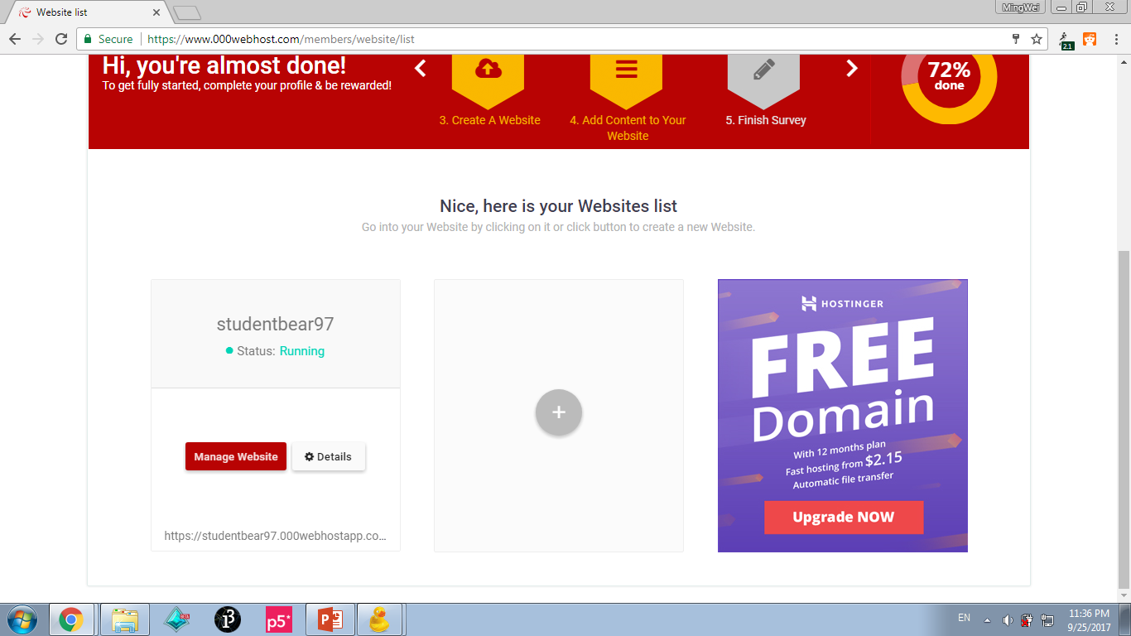
3. Create your website

Slide 10
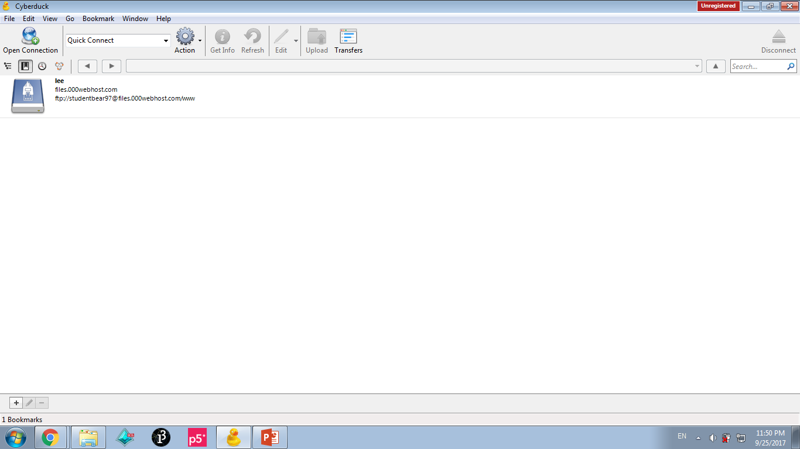
4. Open Cyberduck
Click to add bookmark

Slide 11
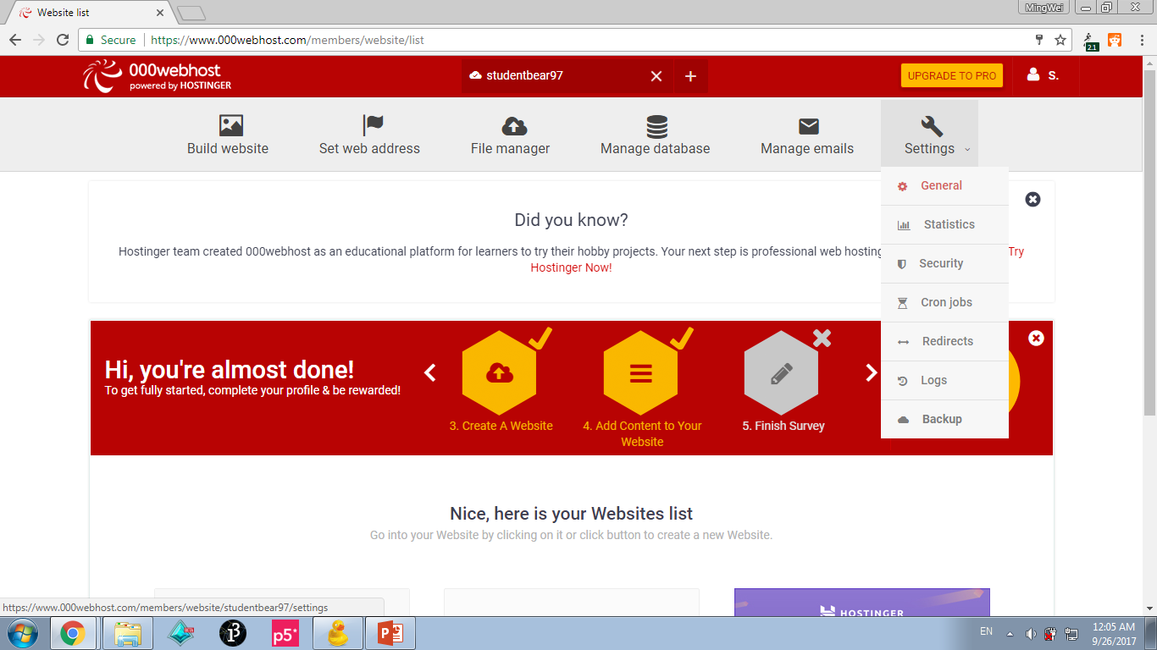
5. Find the information of your website.
Get the information here

Slide 12
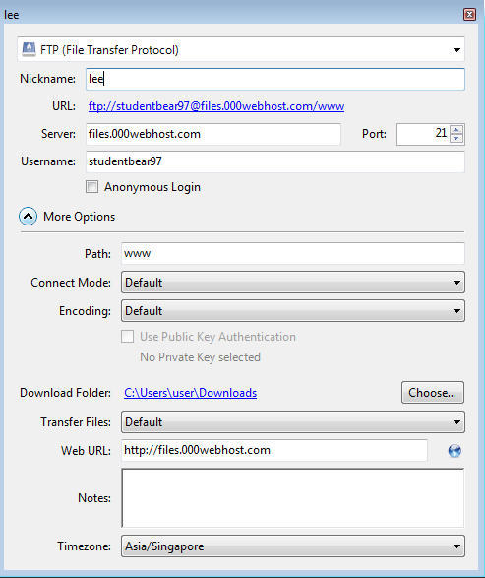
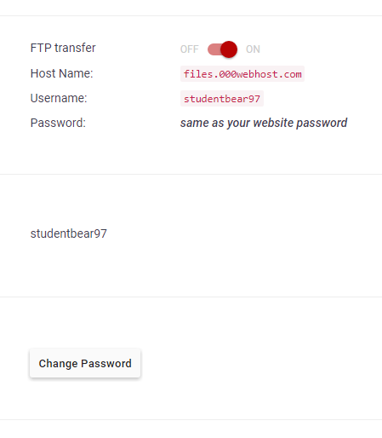
6. Fill in the bookmark by referring to the information
any name
add ‘www’

Slide 13
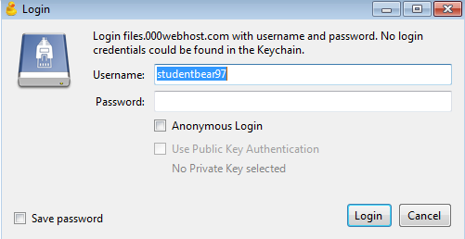
7. Login to the file
(same with 000webhost password)

Slide 14
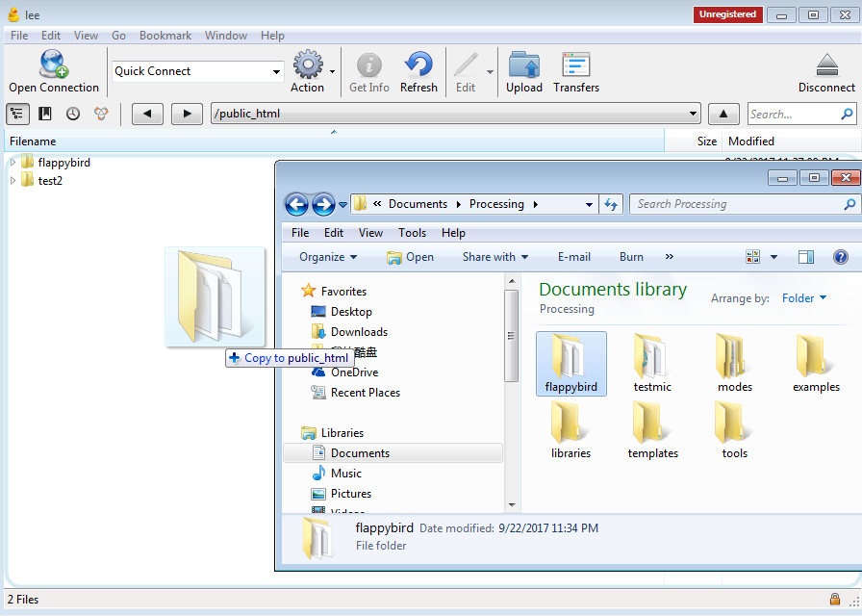
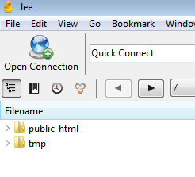
8. Upload the p5.js project to the server
Drag the file to here
Open file

Slide 15
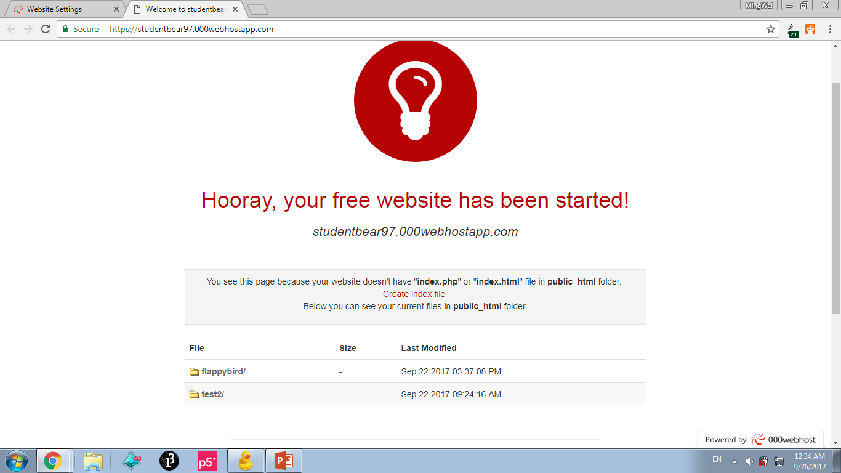
9. Go to your website

Slide 16
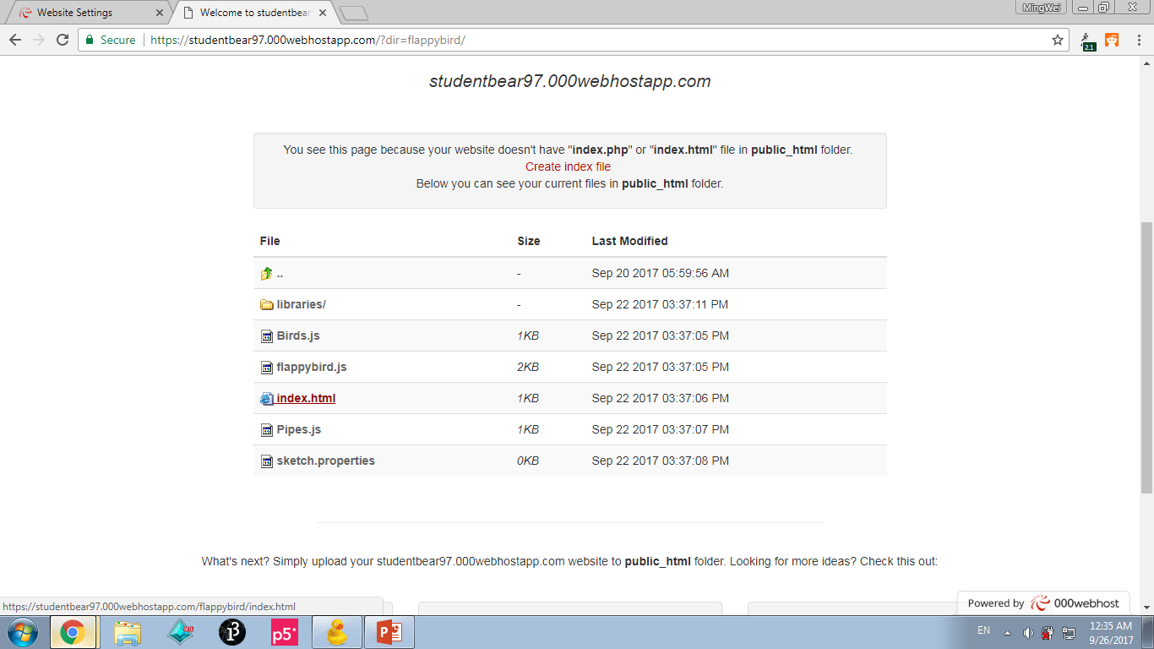
10. Open ‘index_html’ in your project file.
Open file

Slide 17
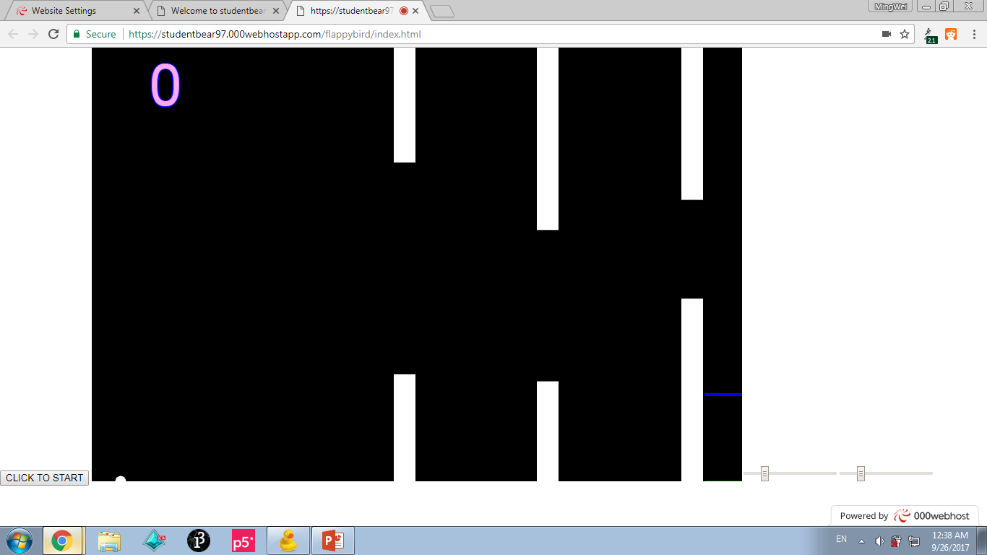
11. Play your game/project!

Slide 18
Thank you ! ☺ by Lee Ming Wei

