Slide 1
Present tense
By Mohammad

Slide 2
The present tenses in English are of four main types:
Present Simple
Present Continuous
Present Perfect
Present Perfect Continuous

Slide 3
1. Present Simple
Used for habitual actions, general truths, or facts.
Formula: (Subject + Verb (s/es) + Object)
Examples:
I study English every day.
She works in an office.
The sun rises in the east.

Slide 4
Used for general truths:
Water boils at 100°C.
In first conditional sentences and fixed future schedules:
If she works hard, she will succeed.
The train leaves at 6 PM tomorrow.
Complex Examples:
He always forgets where he puts his keys, which drives me crazy.
The sun never sets on the British Empire (historical fact).
If it rains tomorrow, the match will be canceled.

Slide 5
1. Present Simple
Negative Form:
Formula: Subject + do/does + not + base verb
Examples:
I do not (don’t) like coffee.
She does not (doesn’t) play tennis on weekends.
Question Form:
Formula: Do/Does + subject + base verb
Examples:
Do you like ice cream?
Does he work here?

Slide 6
2. Present Continuous
Used for actions happening right now or fixed plans in the near future.
Formula: (Subject + am/is/are + Verb-ing + Object)
Examples:
I am reading a book right now.
She is cooking dinner.
They are traveling to Sydney tomorrow.

Slide 7
To express annoyance or emphasize habits:
She is always complaining about her workload!
For certain fixed future plans:
We are meeting the client at 2 PM tomorrow.
Complex Examples:
He is constantly borrowing money from his friends, which annoys everyone.
I am working on a project that could potentially change the way we use technology.
Are you still considering moving abroad next year?

Slide 8
2. Present Continuous
Negative Form:
Formula: Subject + am/is/are + not + verb-ing
Examples:
I am not watching TV right now.
They are not (aren’t) coming to the party.
Question Form:
Formula: Am/Is/Are + subject + verb-ing
Examples:
Are you studying for your exam?
Is she working on the project?

Slide 9
3. Present Perfect
Used for actions that started in the past and continue to the present or experiences up to now.
Formula: (Subject + has/have + Past Participle + Object)
Examples:
I have visited Melbourne twice.
She has already finished her homework.
They have lived in this house for five years.

Slide 10
Differences between just, already, yet:
Just: Recently completed action:
I have just finished my homework.
Already: Sooner than expected:
She has already left the office.
Yet: In questions/negative sentences:
Have they arrived yet?
We haven’t seen the movie yet.
Expressing experiences or results:
I have met many interesting people during my travels.
The government has improved the healthcare system significantly over the last year.

Slide 11
Complex Examples:
I have already sent the email, but I’m not sure if they have received it yet.
Have you ever wondered what life would be like if you had chosen a different path?
They have just announced a new policy, which is likely to affect all employees.

Slide 12
3. Present Perfect
Negative Form:
Formula: Subject + have/has + not + past participle
Examples:
I have not (haven’t) finished my homework yet.
She has not (hasn’t) visited Paris.
Question Form:
Formula: Have/Has + subject + past participle
Examples:
Have you ever been to Australia?
Has he completed his tasks?

Slide 13
4. Present Perfect Continuous
Used for actions that started in the past and are still ongoing, or recently ended but with visible effects.
Formula: (Subject + has/have + been + Verb-ing + Object)
Examples:
I have been learning English for two hours.
She has been working here since morning.
They have been playing soccer all day.

Slide 14
To emphasize the duration of an action or its effect:
I have been running, and now I’m out of breath.
Difference between Present Perfect and Present Perfect Continuous:
Present Perfect: Focus on result:
I have written three articles today.
Present Perfect Continuous: Focus on process/duration:
I have been writing articles all morning.

Slide 15
Complex Examples:
She has been working tirelessly on this project, and the results are finally showing.
How long have you been waiting for me? It feels like ages!
The company has been growing rapidly, thanks to its innovative strategies.

Slide 16
4. Present Perfect Continuous
Negative Form:
Formula: Subject + have/has + not + been + verb-ing
Examples:
I have not (haven’t) been working on this project since morning.
She has not (hasn’t) been studying for long.
Question Form:
Formula: Have/Has + subject + been + verb-ing
Examples:
Have you been waiting for me for long?
Has he been exercising regularly?

Slide 17
Practice 1: Present Simple
Questions:
My brother ______ (like) to play soccer every weekend.
She ______ (not work) on Sundays.
What time ______ (the train/leave) tomorrow?
Practice 2: Present Continuous
Questions:
Right now, I ______ (write) an email to my teacher.
They ______ (not come) to the party tonight.
What ______ (you/do) at the moment?
Practice 4: Present Perfect Continuous
Questions:
She ______ (study) for the test all day.
How long ______ (you/wait) for the bus?
I ______ (work) on this project since morning, and I still have a lot to do.
Practice 3: Present Perfect
Questions:
I ______ (already/finish) my homework.
Have you ______ (ever/visit) another country?
They ______ (not start) the project yet.

Slide 18
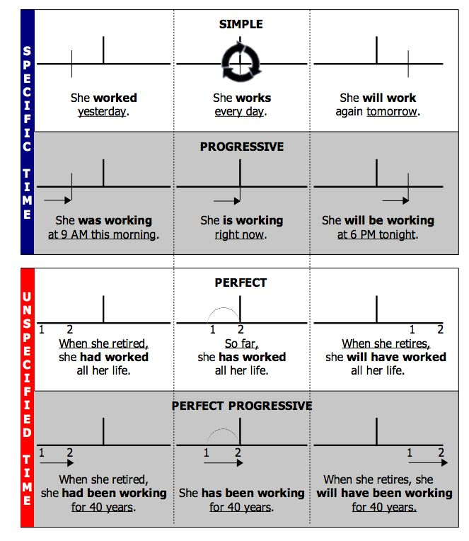

Slide 19
Additional nuances Rare usages Exceptions

Slide 20
1. Present Simple
Advanced Details:
Use with stative verbs: Verbs like know, believe, love, hate are rarely used in continuous forms.
Incorrect: I am knowing him for years.
Correct: I know him well.
Emphatic Present Simple: Adding "do/does" for emphasis:
I do enjoy reading this book!
In storytelling and informal speech: Sometimes used to narrate events:
So, he walks into the room, looks around, and says, "Where’s my coffee?"

Slide 21
2. Present Continuous
Advanced Details:
Temporary vs. Permanent Situations:
I am living in Sydney temporarily. (temporary)
I live in Sydney. (permanent)
Future Intentions:
We are meeting at 6 PM tomorrow.
Verbs rarely used in continuous forms: want, seem, belong:
Incorrect: I am wanting more coffee.
Correct: I want more coffee.

Slide 22
3. Present Perfect
Advanced Details:
Present Perfect vs. Simple Past:
I have seen that movie. (experience without time reference)
I saw that movie last night. (specific time reference)
Time expressions compatibility:
I have already finished my homework. (correct with "already")
I have finished my homework yesterday. (incorrect; "yesterday" is for Simple Past)
Different meanings with "for" and "since":
I have lived here for 5 years. (duration)
I have lived here since 2018. (starting point)

Slide 23
Present Perfect Continuous
Advanced Details:
Focus on duration: Often highlights the process, not just the result.
I have been reading this book for two hours. (emphasizes the activity of reading)
When not to use it: With stative verbs:
Incorrect: I have been knowing her since childhood.
Correct: I have known her since childhood.
Combination of tenses:
I have been waiting for two hours, but he hasn’t arrived yet. (Present Perfect Continuous + Present Perfect)

Slide 24
Additional Tips:
Time Expressions: Use of words like just, yet, already, so far, lately, recently, for, since.
Regional Differences: American English and British English differ in some usages, especially with Present Perfect:
American: Did you eat lunch yet?
British: Have you eaten lunch yet?
Common Mistakes:
Overusing continuous forms:
Incorrect: I am feeling sick now.
Correct: I feel sick now.
Negative and Question Form Emphasis:
Haven’t you finished yet? (surprised tone)
Don’t you like chocolate? (seeking confirmation)

