Slide 1
MapReduce vs Spark
Big Data Analytics Technologies
M.M.M.Ramsan
239348B

Slide 2
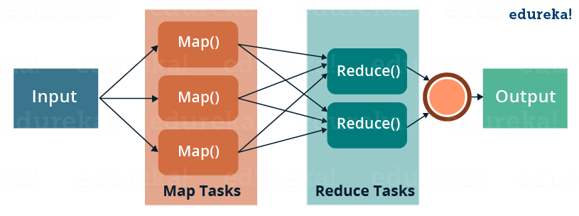
MapReduce
MapReduce is a programming model for processing large data sets.
The model consists of two phases:
The Map: processes data and outputs key-value pairs.
The Reduce: processes the output of the Map and produces a final result.

Slide 3
Apache Spark
Apache Spark is an open-source distributed computing system that is designed for processing large data sets.
It is designed to be faster than MapReduce, another popular distributed computing system, by providing in-memory processing and optimized scheduling.
Spark supports a wide range of data processing operations, including batch processing, stream processing, machine learning, and graph processing.
Spark has helped to accelerate the development of big data technologies and has made it easier for developers to work with large-scale data sets.

Slide 4
Loading and processing Delayed Flights Data
Hadoop
Iteration | 1 | 2 | 3 | 4 | 5 | AVG
Carrier delay query | 13.942 | 10.46 | 5.714 | 5.099 | 4.97 | 8.037
NAS delay query | 4.59 | 4.572 | 5.098 | 5.384 | 5.086 | 4.946
Weather delay query | 4.718 | 5.383 | 5.404 | 5.235 | 0.556 | 4.2592
Late aircraft delay query | 5.217 | 5.146 | 4.907 | 5.36 | 0.938 | 4.3136
Security delay query | 4.331 | 4.65 | 5.471 | 5.452 | 4.743 | 4.9294
Spark
Iteration | 1 | 2 | 3 | 4 | 5 | AVG
Carrier delay query | 3.068 | 0.508 | 0.504 | 0.421 | 0.559 | 1.012
NAS delay query | 0.396 | 0.396 | 0.372 | 0.388 | 0.342 | 0.3788
Weather delay query | 0.361 | 0.308 | 0.558 | 0.268 | 0.261 | 0.3512
Late aircraft delay query | 0.349 | 0.383 | 0.315 | 0.322 | 0.289 | 0.3316
Security delay query | 0.362 | 0.323 | 0.314 | 0.293 | 0.269 | 0.3122

Slide 5
Carrier Delay
 | Hadoop | Spark
Iteration1 | 13.942 | 3.068
Iteration2 | 10.46 | 0.508
Iteration3 | 5.714 | 0.504
Iteration4 | 5.099 | 0.421
Iteration5 | 4.97 | 0.559

Slide 6
NAS Delay
 | Hadoop | Spark
Iteration1 | 4.59 | 0.396
Iteration2 | 4.572 | 0.396
Iteration3 | 5.098 | 0.372
Iteration4 | 5.384 | 0.388
Iteration5 | 5.086 | 0.342

Slide 7
Weather Delay
 | Hadoop | Spark
Iteration1 | 4.718 | 0.361
Iteration2 | 5.383 | 0.308
Iteration3 | 5.404 | 0.558
Iteration4 | 5.235 | 0.268
Iteration5 | 0.556 | 0.261

Slide 8
Late aircraft Delay
 | Hadoop | Spark
Iteration1 | 5.217 | 0.349
Iteration2 | 5.146 | 0.383
Iteration3 | 4.907 | 0.315
Iteration4 | 5.36 | 0.322
Iteration5 | 0.938 | 0.289

Slide 9
Security Delay
 | Hadoop | Spark
Iteration1 | 4.331 | 0.362
Iteration2 | 4.65 | 0.323
Iteration3 | 5.471 | 0.314
Iteration4 | 5.452 | 0.293
Iteration5 | 4.743 | 0.269

Slide 10
Average
 | HiveQL | Spark-SQL
Carrier delay query | 8.037 | 1.012
NAS delay query | 4.946 | 0.3788
Weather delay query | 4.2592 | 0.3512
Late aircraft delay query | 4.3136 | 0.3316
Security delay query | 4.9294 | 0.3122

Slide 11
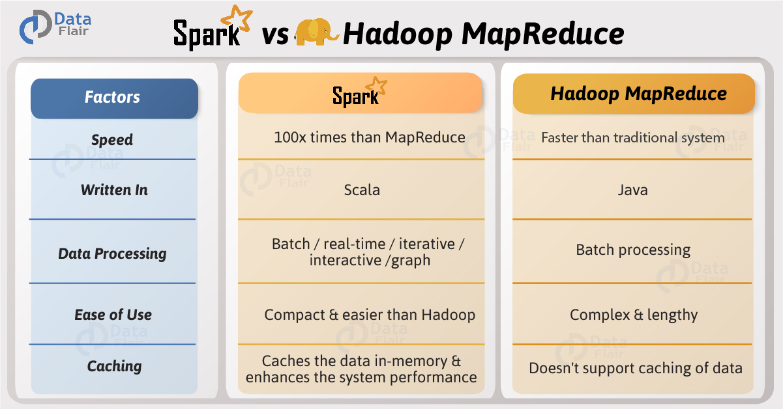
MapReduce vs Spark

Slide 12
Conclusion
MapReduce and Apache Spark are both distributed computing frameworks used for processing large-scale data.
MapReduce has a steep learning curve and is optimized for disk I/O, while Apache Spark is user-friendly, with APIs available in multiple languages, and is optimized for both disk I/O and memory.
Apache Spark is generally faster than MapReduce due to its in-memory processing capabilities.
Apache Spark can handle both small and large datasets and scale horizontally, while MapReduce is better suited for handling large datasets but does not scale well with small datasets.
The choice of framework depends on the specific requirements of the project, the skill set of the team, and the resources available.

Slide 13
Thank You

