Slide 1
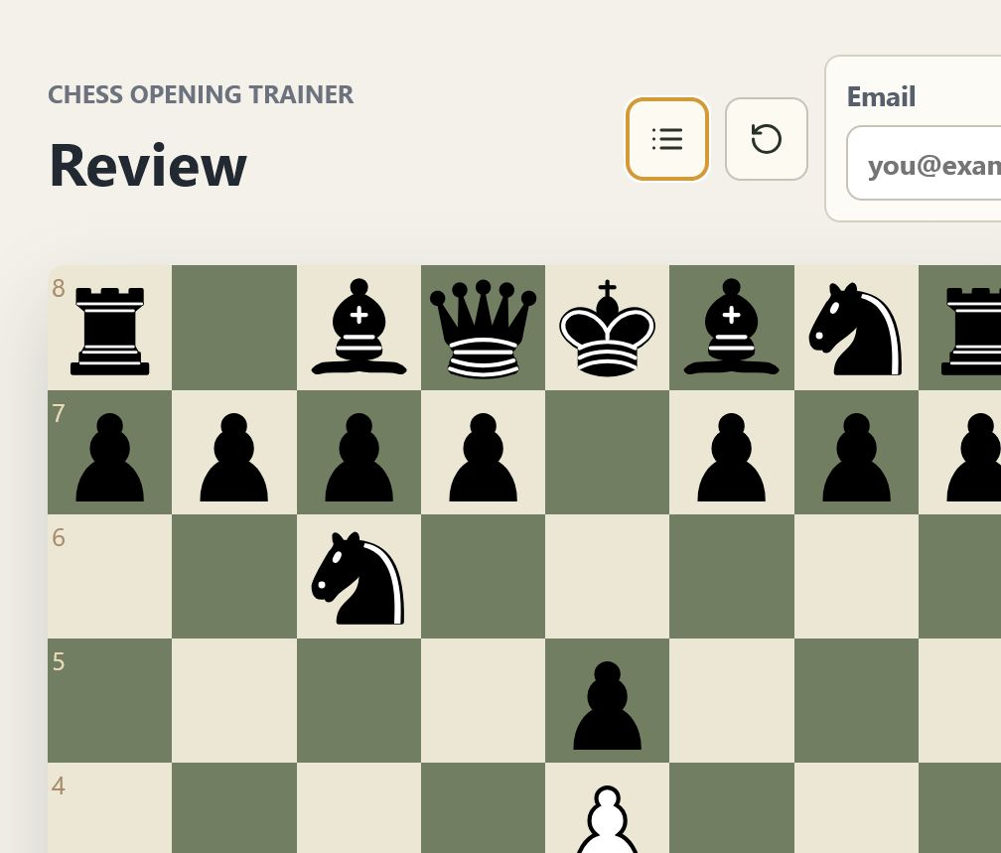
CHESS OPENING TRAINER
Chess is a practice loop,
not a move list.
A design set for the existing product and its next learning layer.
Current build → future feature direction
A board, a plan, a reason to come back.
CHESS OPENING TRAINER / FEATURE DESIGN SET
01

Slide 2
01 / PRODUCT THESIS
The app already connects four moments of improvement.
Each mode answers a different learner question, but they share one board and one progress loop.
01
02
03
04
Openings
Study
Review
Play
→
→
→
What should I play here?
What idea am I trying to learn?
Where did my game leave the plan?
Can I use it against resistance?
The strongest product idea is not the mode selector. It is the handoff between modes.
CHESS OPENING TRAINER / FEATURE DESIGN SET
02

Slide 3
02 / EXISTING EXPERIENCE
A learner can go from first move to feedback in one session.
The product already has the ingredients for a tight practice rhythm.
01
Choose a line
Select White or Black, then start with a focused repertoire.
02
Play the sequence
Get immediate correctness feedback as the position develops.
03
Name the idea
Use explanations, themes, and lesson cards to connect move to plan.
04
Keep the loop going
Review mistakes, inspect a PGN, or test the idea against Stockfish.
The board is the product surface.
CHESS OPENING TRAINER / FEATURE DESIGN SET
03

Slide 4
03 / CURRENT BUILD
The current build is a full training surface.
The foundation is broader than an opening database: it already supports practice, reflection, and persistence.
4
2
1
∞
learner-facing modes
sides of the board
shared game manager
room to layer plans
TRAIN
Opening lines, themes, explanations, common mistakes, move history
STUDY
Curriculum modules for development, pawn chains, open files, imbalances, endgames
REVIEW
PGN loading, replay positions, opening detection, review items from mistakes
ENGINE + SYNC
Stockfish-backed play and analysis, plus Supabase progress persistence when configured
CHESS OPENING TRAINER / FEATURE DESIGN SET
04

Slide 5
04 / DESIGN PRINCIPLES
The product should make plans more memorable than variations.
That means the next layer must deepen the position without turning the app into a theory browser.
FOUNDATION
STRUCTURE
AGENCY
Learn one clear line.
→
Recognize the shape.
→
Choose a plan.
Beginner content stays prominent and playable.
Model positions mark where memorization should become planning.
The learner names a plan before asking the engine for confirmation.
The rule for every future feature: make the next decision clearer.
CHESS OPENING TRAINER / FEATURE DESIGN SET
05

Slide 6
05 / FUTURE DIRECTION
Next, the repertoire becomes a ladder.
A beginner line is the base. Middlegame plans create the bridge. Theory branches become an optional upper layer.
03
Extension
Theory branches
with a reason to exist
02
Middlegame
Plans, warnings,
model positions
01
Foundation
Principled lines
for first sessions
Beginner-first by default. Sharper by invitation.
CHESS OPENING TRAINER / FEATURE DESIGN SET
06

Slide 7
06 / FUTURE FEATURE SET
The next features deepen learning without making the UI feel heavier.
Keep the board central. Let new intelligence appear as small, timely decisions around it.
Middlegame plans
Adaptive journey
Deeper review
After a model position, show one to three plans with themes, move ideas, and a warning when the plan is mistimed.
Use progress, mistakes, and due review items to recommend the next activity instead of sending learners back to a menu.
Turn PGN deviations and engine comparisons into concrete prompts: what changed, what matters, what to try next.
learn the why
know what next
make review actionable
This is a product of gentle escalation: more depth, not more friction.
CHESS OPENING TRAINER / FEATURE DESIGN SET
07

Slide 8
07 / North star
Play with a plan.
4
The strongest version of this product helps a learner move through the same loop again and again:
modes already
share the same board
see the position → name the idea → test the move → review the consequence
Now give them a
shared learning arc.
Recommended next build slice
Ship the middlegame plan layer first.
It is the smallest feature set that makes the whole product feel more like a coach.
CHESS OPENING TRAINER / FEATURE DESIGN SET
08

