Slide 1
Model Assessment
Vanessa and Matt

Slide 2
GOAL
STEPS
CONCLUSION
The assessment function provides numerical and visual results for easy model comparison. It makes strengths and weaknesses of different models evident to facilitate better model selection.
Develop a function to assess the performance of models
Identify important metrics
Create visualizations
Test function on results from different models

Slide 3
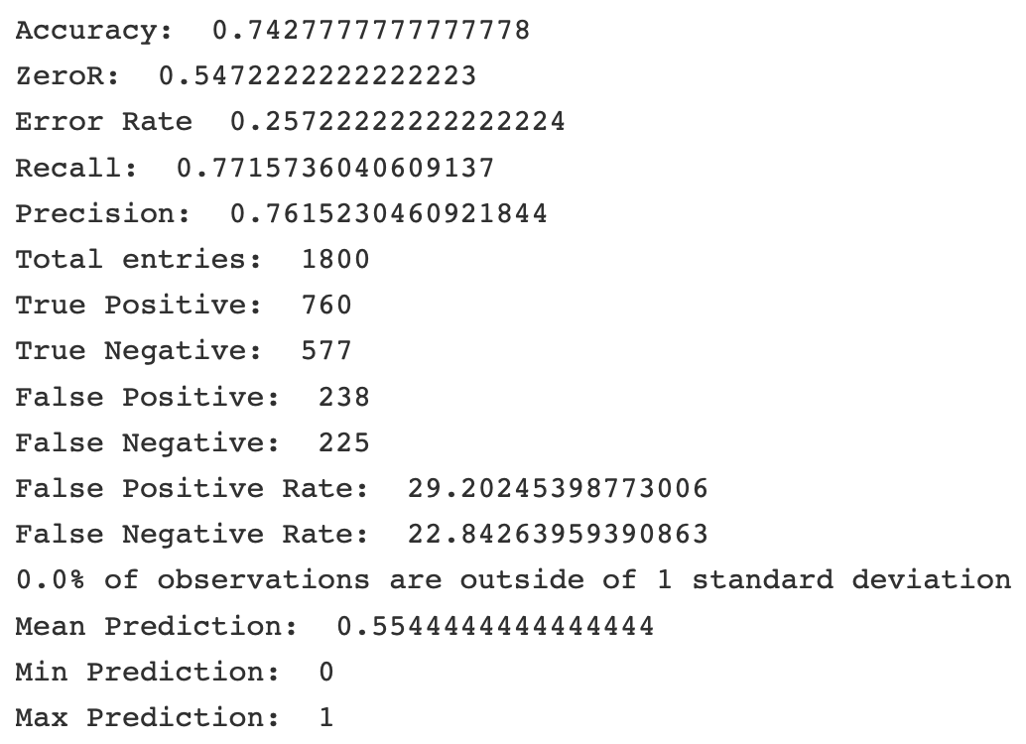
Identify Important Metrics
Accuracy
False positive and false negative rates
Confusion matrix
Prediction Distribution

Slide 4
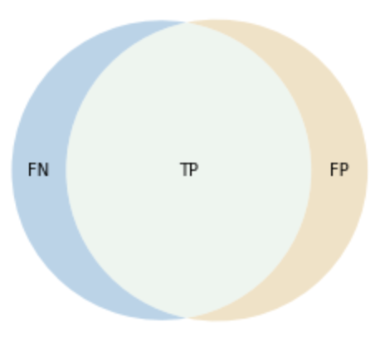
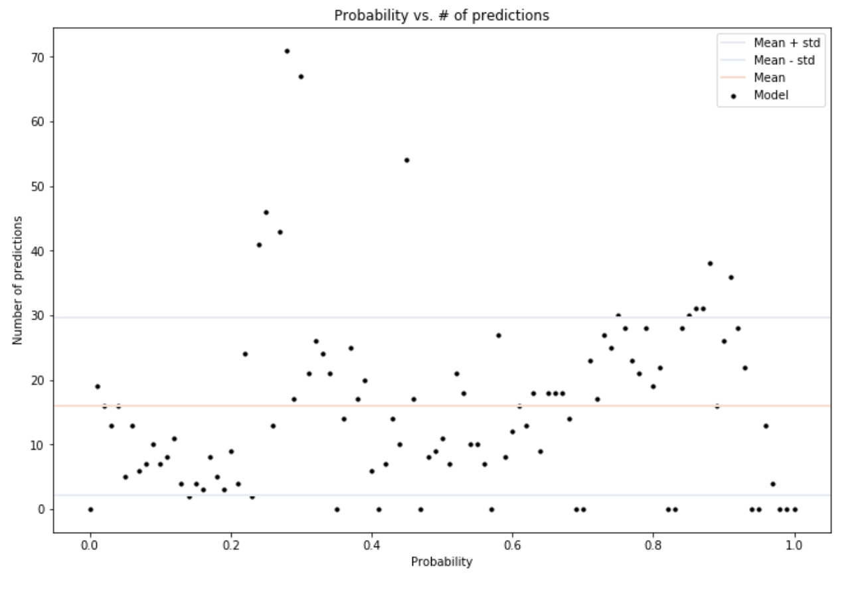
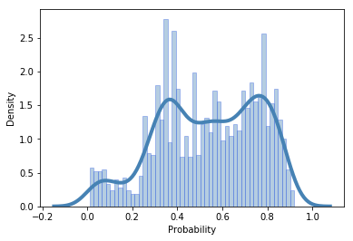
Create Visualizations
Confusion Matrix Visualization: TP, FP, TN, FN represented as areas
Probability Distribution Visualization: Shows the number of predictions at each probability
Confusion Matrix
Probability Distribution
Probability Density Histogram
Probability Density Visualization: Shows the probability density of predictions at each probability

Slide 5
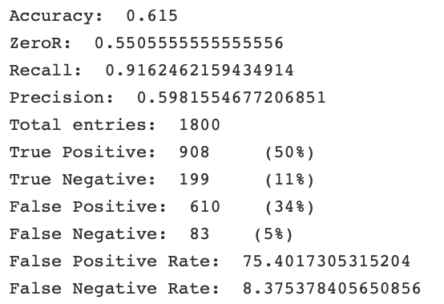
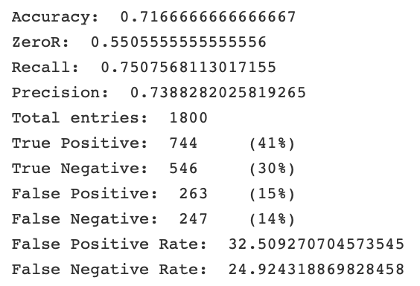
Logistic Regression vs. XGBoost on SHI data
analysis.performance(estimated, actual, visualize=False, verbose=True):
Logistic Regression
XGBoost

Slide 6
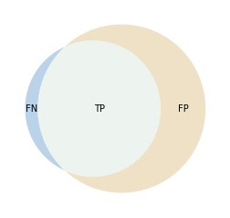
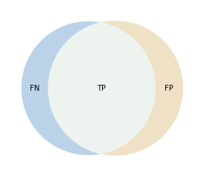
Logistic Regression vs. XGBoost on SHI data
analysis.performance(estimated, actual, visualize=True, verbose=False):
Logistic Regression
XGBoost

Slide 7
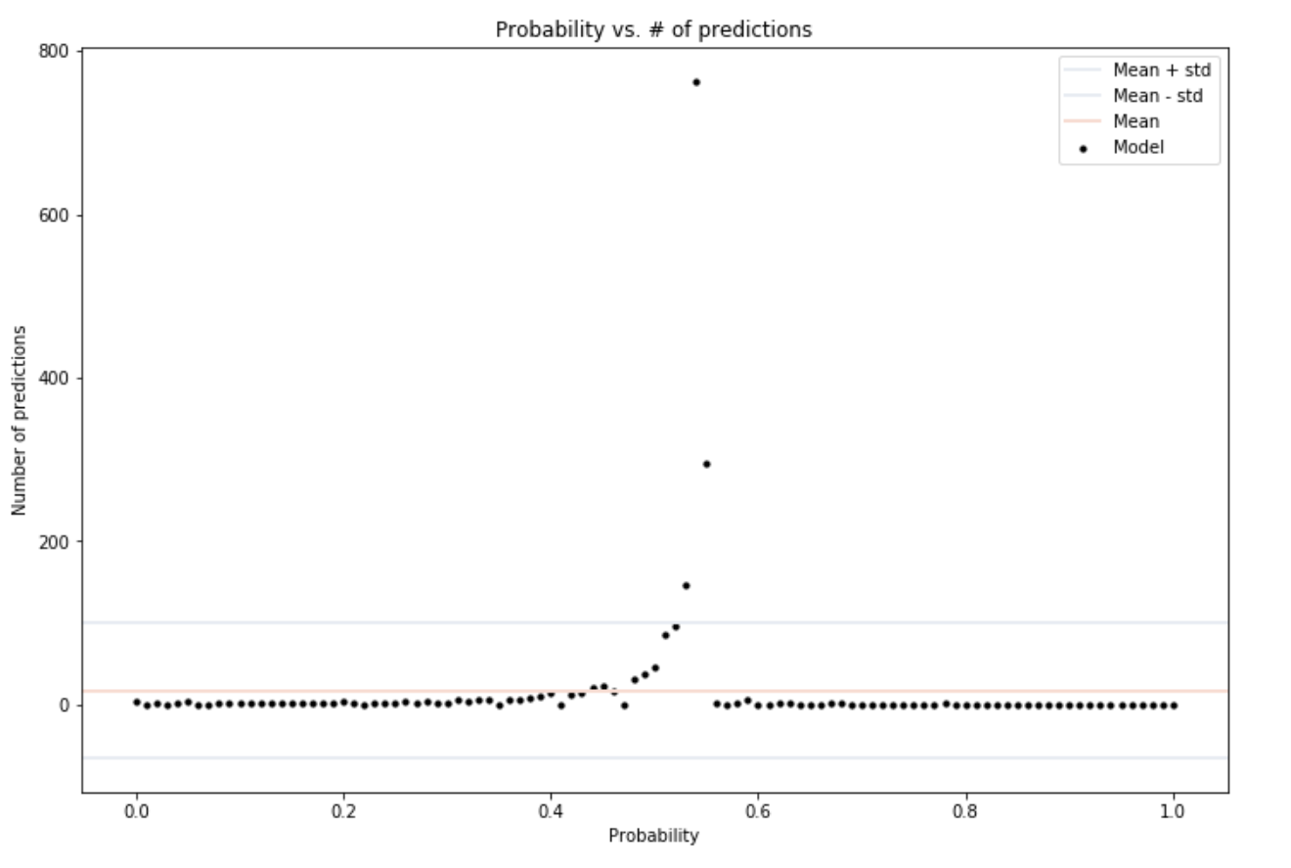
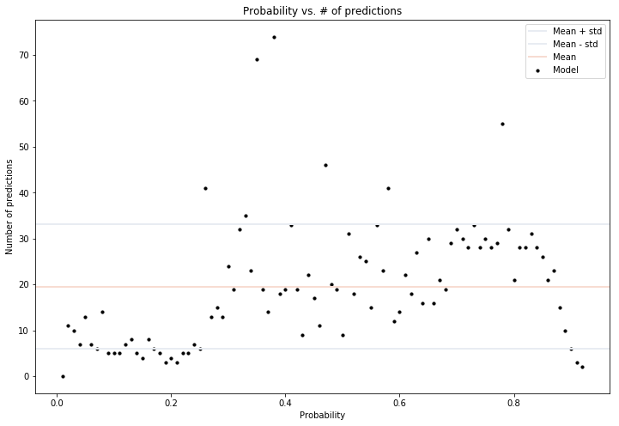
Logistic Regression vs. XGBoost on SHI data
analysis.distribution_metric(predicted, actual, precision=2, visualize=True, verbose=False):
Logistic Regression
XGBoost

Slide 8
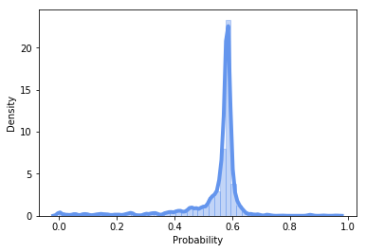
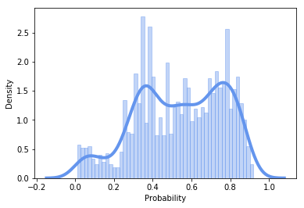
Logistic Regression vs. XGBoost on SHI data
Logistic Regression
XGBoost
Probability Density
Probability Density

Slide 9
Using the functions (Python 3): distribution_metric
import analysis
analysis.distribution_metric(estimated, actual, precision=2, visualize=True, verbose=True):
Arguments: estimated: array of estimated output probabilities, actual: array of actual output classifications
Optional: precision (int), visualize (Bool), verbose (Bool)
Returns: prints the calculated percentage of predictions outside of 1 standard deviation from the mean number of predictions at each probability, optionally draws a visualization

Slide 10
Using the functions (Python 3): performance
import analysis
analysis.performance(estimated, actual, visualize=True, verbose=True):
Arguments: estimated: array of estimated output probabilities, actual: array of actual output classifications
Optional: visualize (Bool), verbose (Bool)
Returns: returns accuracy, optionally prints other metrics and a performance visualization

Slide 11
Compiles important metrics in both numerical and visual formats
Easier Model Assessment
Visualize confusion matrix
Show distribution of probabilities
Results of Function
Compare results from different models
Show strengths and weaknesses of different models
Conclusions
Select model that favors a certain metric
Recommendations

Slide 12
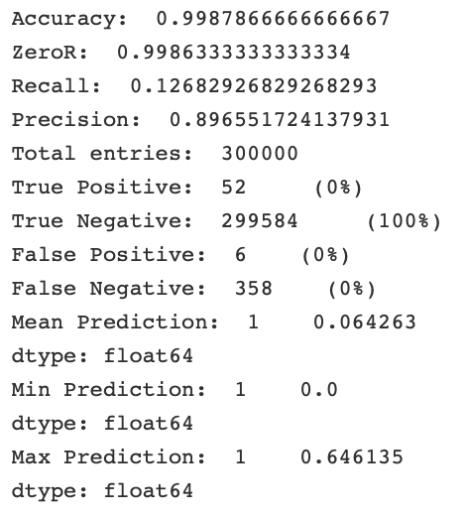
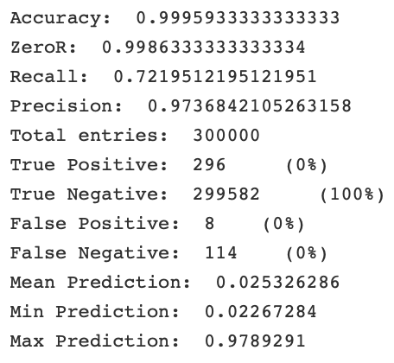
Imbalanced Data: Fraud Detection
Logistic Regression
XGBoost
Notes:
https://www.kaggle.com/ntnu-testimon/paysim1/home

Slide 13
Imbalanced Data
ZeroR = 0.999
(6362620, 8)
Undersampling
ZeroR = 0.51
(16426, 8)
Oversampling
ZeroR = 0.50
(2000000, 8)
Advantages
Can significantly help reduce run time
Disadvantages
Information loss
Random sample of majority class may be biased
Advantages
Less information loss
Generally outperforms undersampling
Disadvantages
Increases the likelihood of overfitting

Slide 14
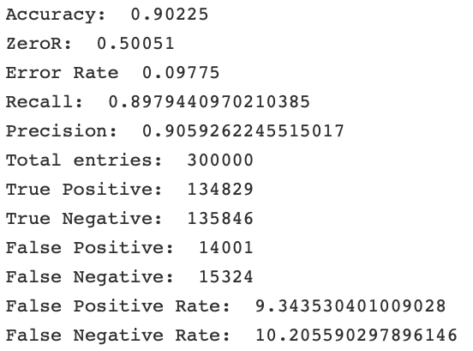
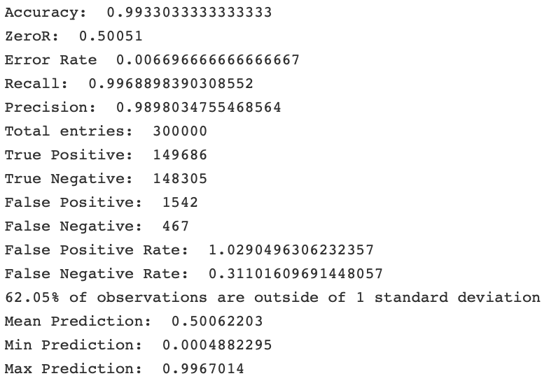
Randomly Oversampled Fraud Data
Logistic Regression
XGBoost

Slide 15
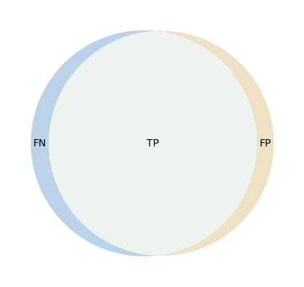
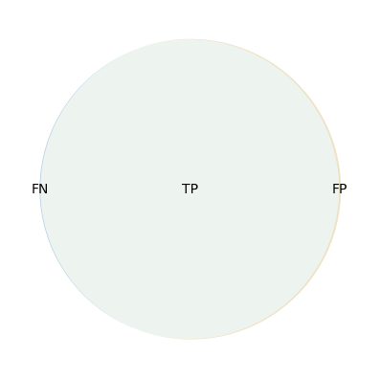
Randomly Oversampled Fraud Data
Logistic Regression
XGBoost

Slide 16
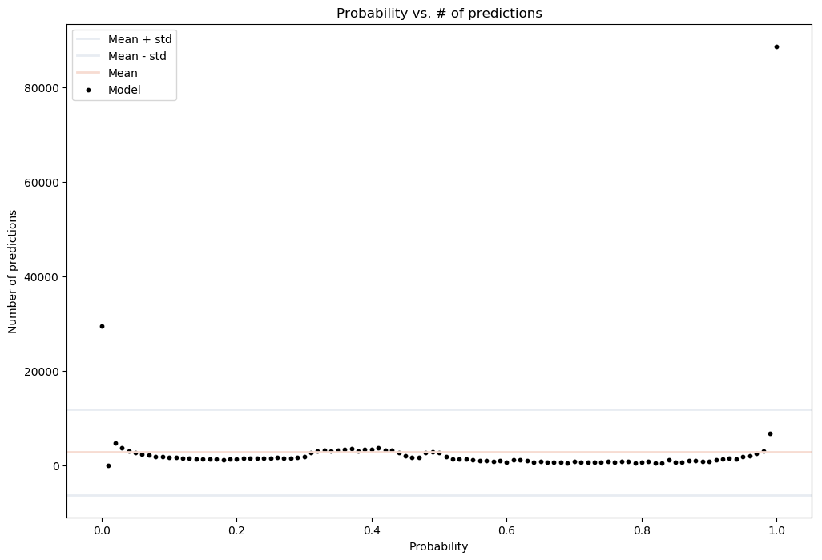
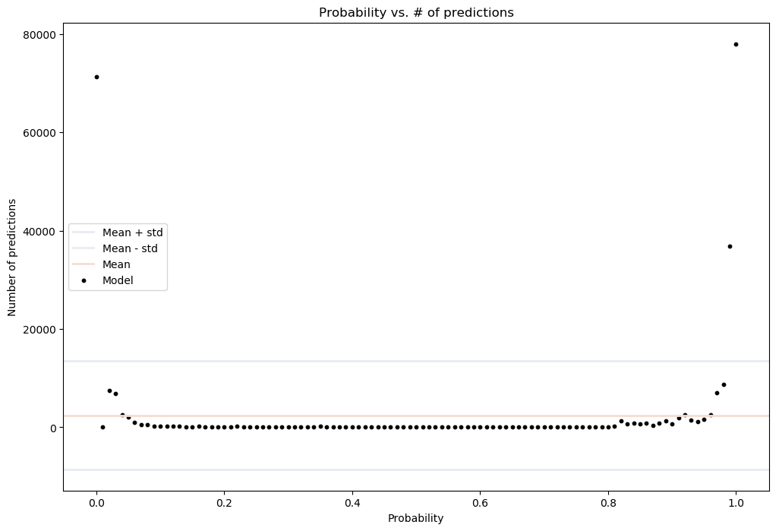
Randomly Oversampled Fraud Data
Logistic Regression
XGBoost
39.42% of observations are outside 1 std
62.05% of observations are outside 1 std

Slide 17
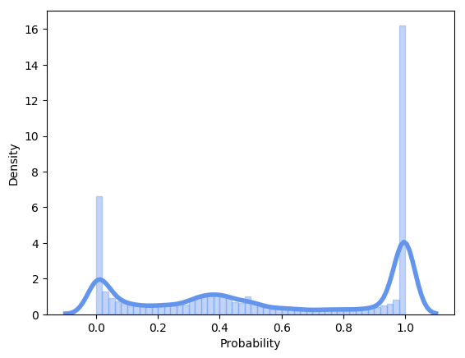
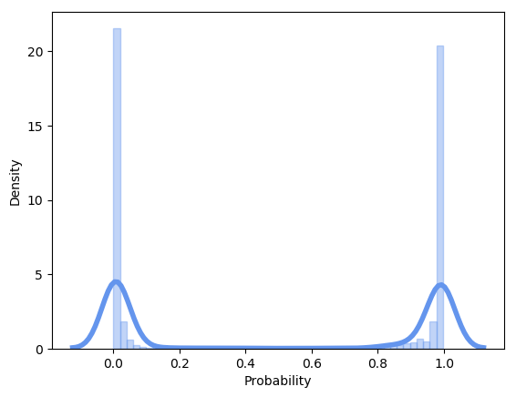
Randomly Oversampled Fraud Data
Logistic Regression
XGBoost
Probability Density
Probability Density

Slide 18
Imbalanced Data
ZeroR = 0.001
(6362620, 8)
Random Undersampling
ZeroR = 0.51
(16426, 8)
Random Oversampling
ZeroR = 0.50
(2000000, 8)
Logistic Regression
XGBoost
Logistic Regression
XGBoost
Accuracy | 0.899 | 0.991 | 0.902 | 0.993
FPR | 10.27% (83) | 1.24% (10) | 9.34% (14001) | 1.03% (1542)
FNR | 9.94% (83) | 0.48% (4) | 10.21% (15324) | 0.31% (467)

