Slide 1

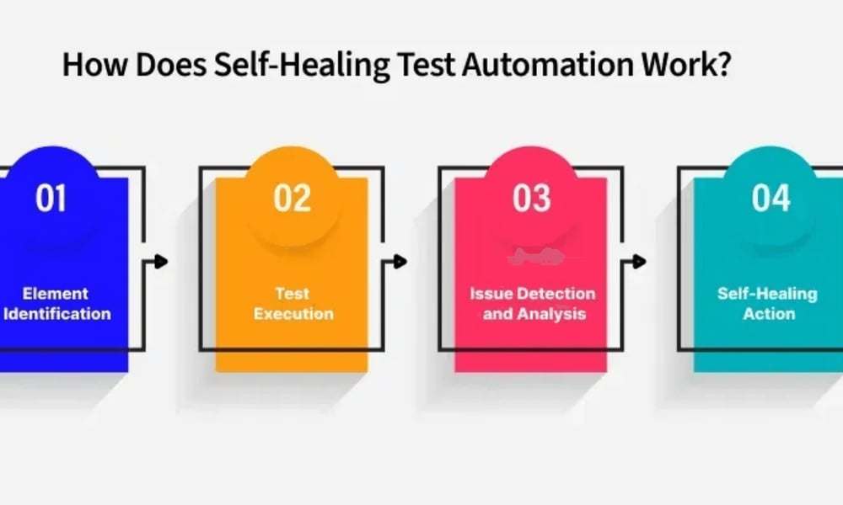
#TheFutureWorksHere
REAL-TIME
TESTING DASHBOARD
Live QA observability for CI execution, trends, and Playwright reports

Slide 2
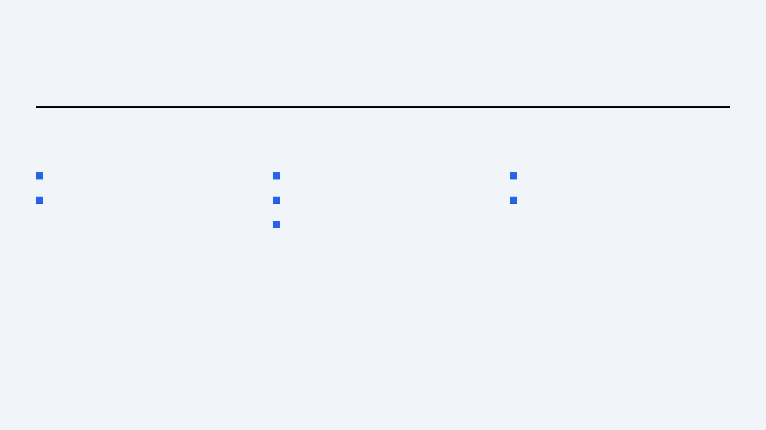
AGENDA AGENDA
#TheFutureWorksHere
STRATEGIC AGENDA
01
02
03
Executive overview & business value
Dashboard KPIs & live feed
CI pipeline control & deployment
Architecture & data flow
GitHub Actions ingest
Governance & roadmap
Embedded HTML reports

Slide 3
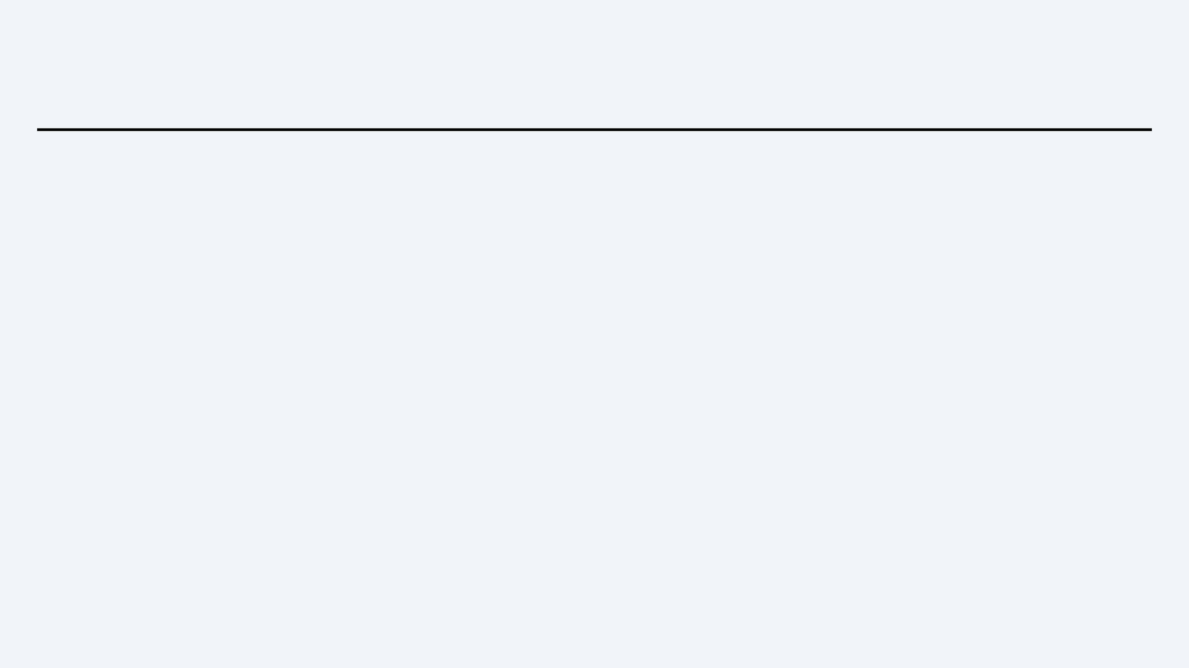
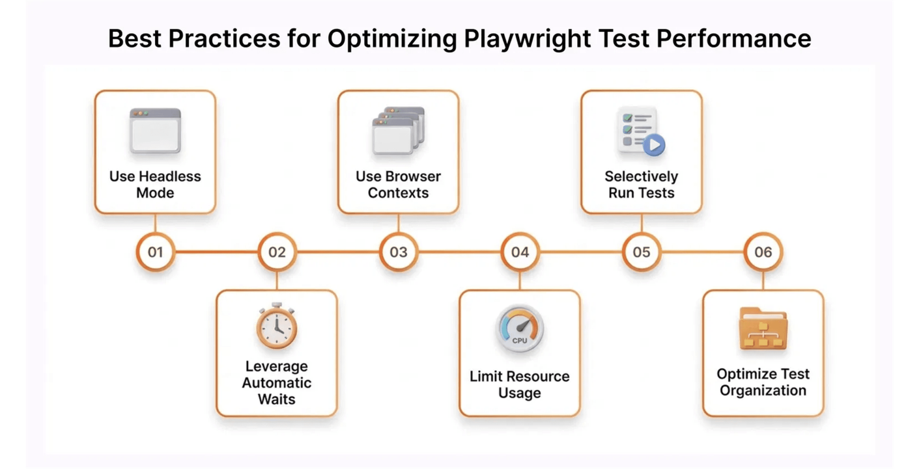
TECH STACK TECH STACK
MODERN ECOSYSTEM
PLATFORM COMPONENTS
Backend
FastAPI, SQLAlchemy, Alembic, Uvicorn
Frontend
React, TypeScript, Vite
Data
PostgreSQL (Render), SQLite (local)
Hosting
Vercel (UI) + Render (API + DB)

Slide 4
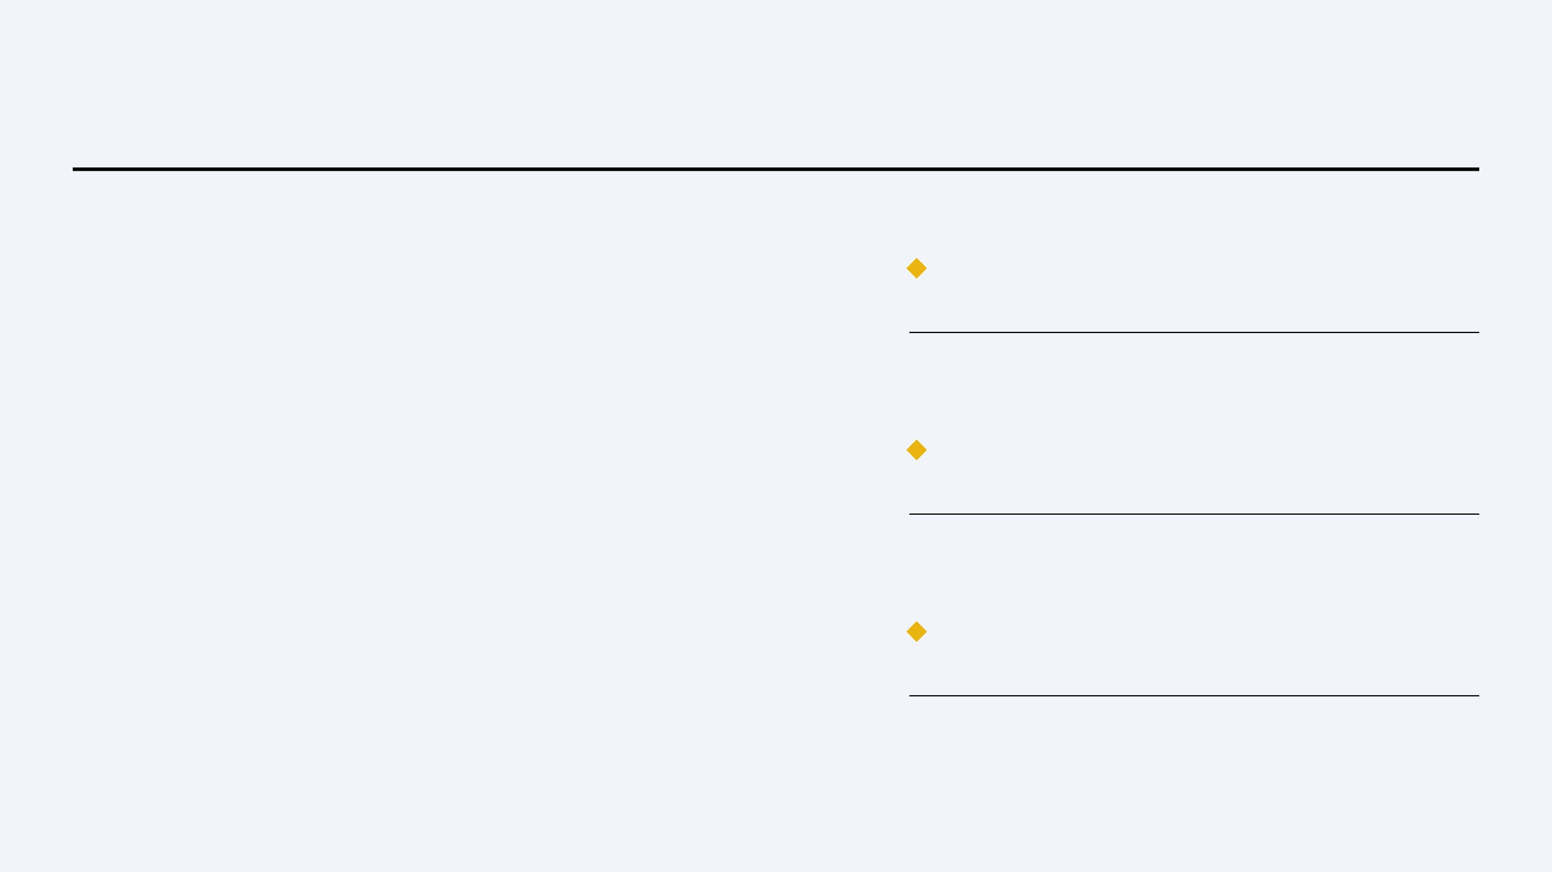
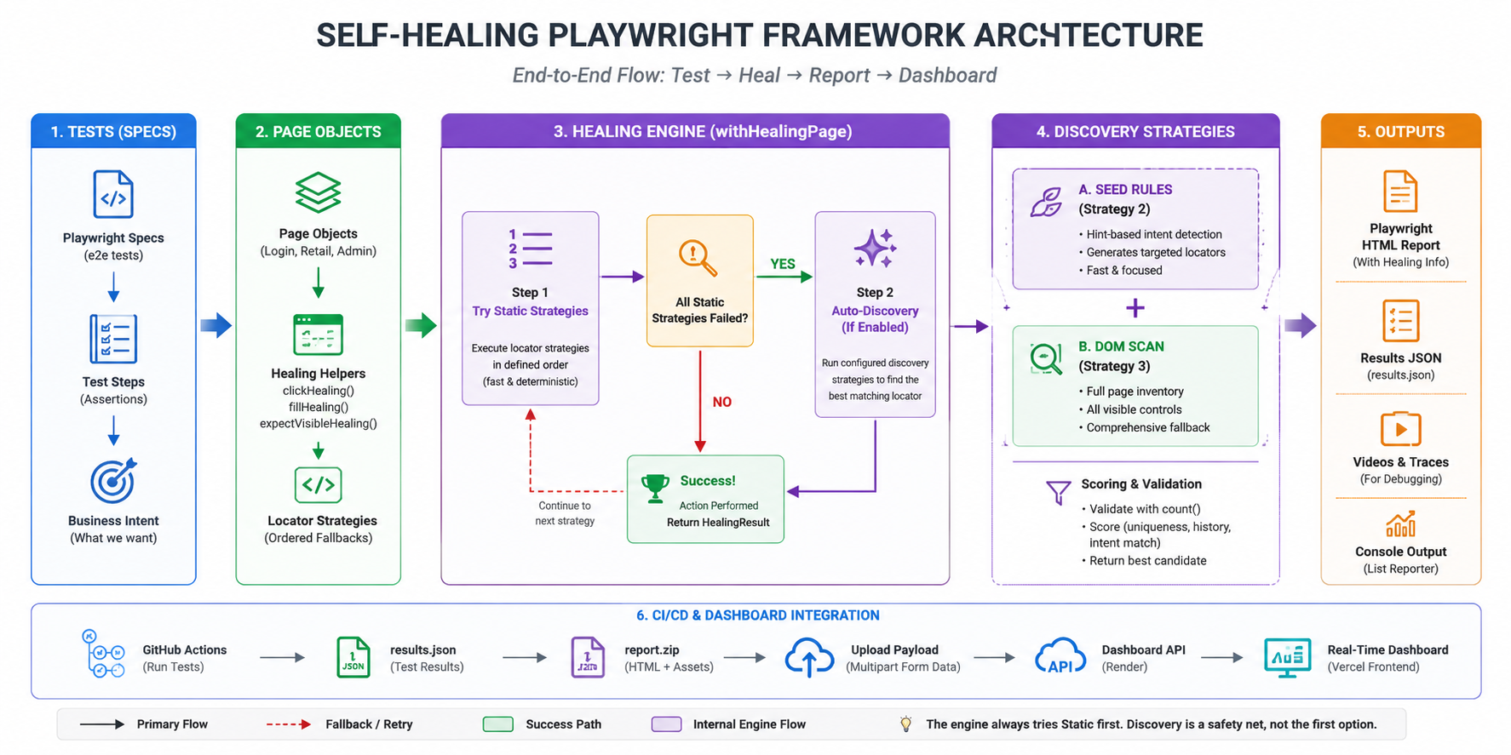
ARCHITECTURE ARCHITECTURE
#TheFutureWorksHere
SYSTEM DESIGN
LAYERED COMPONENTS
UI presents KPIs, trends, live feed, and embedded
HTML reports.
API LAYER
REST ingest, summary, reports, optional WebSocket,
and GitHub CI trigger.
PERSISTENCE
Postgres stores runs, cases, and optional Playwright
report ZIPs.

Slide 5

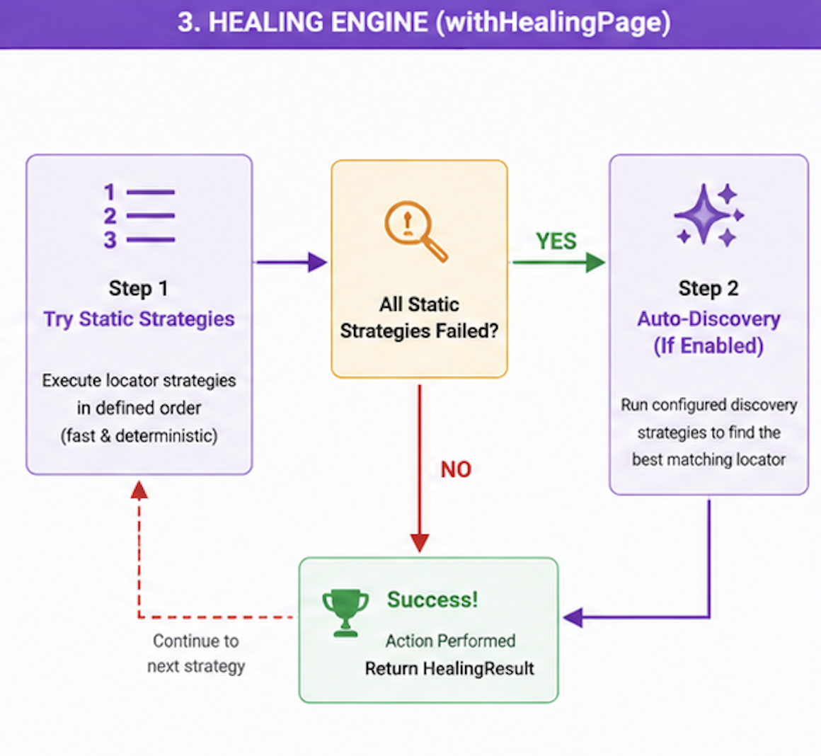
PROCESS FLOW PROCESS
#TheFutureWorksHere
END-TO-END PIPELINE
01
TRIGGER
Start from dashboard (workflow_dispatch) or
push to GitHub.
02
CI EXECUTION
Playwright suite runs on GitHub Actions; jobs
and steps visible in UI.
03
INGEST
Workflow POSTs JSON results and optional
report_zip to the API.
04
OBSERVE
Dashboard updates KPIs, trends, feed, and
embedded HTML viewer.

Slide 6
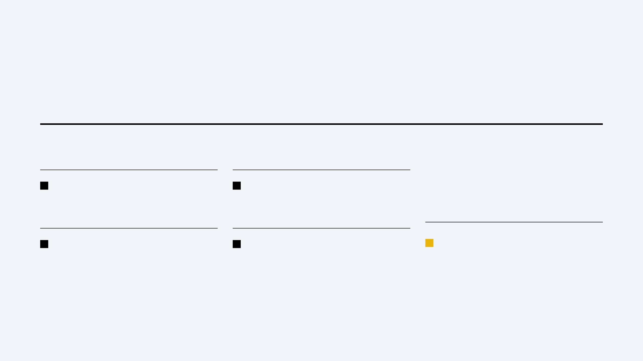
DASHBOARD DASHBOARD DASHBOARD
#TheFutureWorksHere
LIVE KPI SURFACE
EXECUTIVE VISIBILITY
SINGLE PANE OF GLASS
CI tabs and storage buckets.
KPI EXAMPLES
Totals for runs, cases, pass rate, and open
ALWAYS CURRENT
Total Runs · Pass Rate · Module quality
defects in one view.
Latest CI runs surface first when
Trends refresh as new CI runs are ingested.
DATA_SOURCE=github.
Portfolio roll-ups without opening GitHub Actions.
DEMO READY
Example:
NO LOG ARCHAEOLOGY
Synthetic runs available in demo mode for
https://realtime-testing-dashboard-ooka.vercel.app
Leadership and QA stop chasing artifacts across
stakeholder walkthroughs.

Slide 7
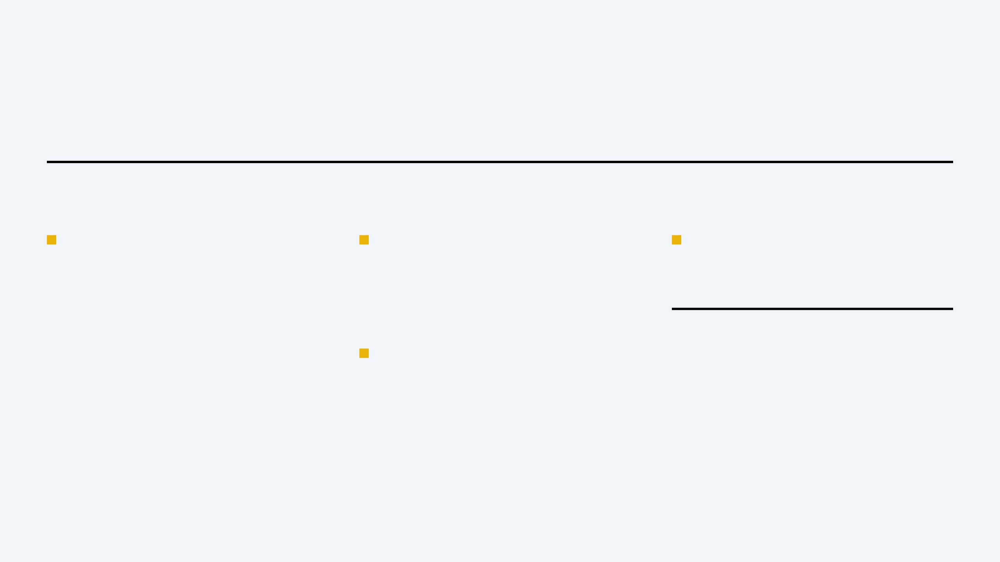
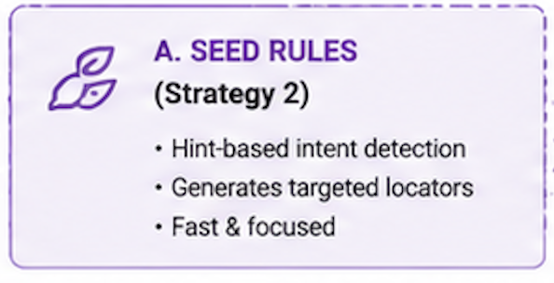
INGEST INGEST
#TheFutureWorksHere
GITHUB ACTIONS PUBLISH
SECURE CI PATH (PURPLE)
STRUCTURED PAYLOAD
Zip playwright-report/ and POST multipart
POST /api/ingest/github-actions/run
suite_name, environment, build_version,
run-with-report.
POST /api/ingest/github-actions/run-with-report
test_cases[] from Playwright JSON.
SERVER-ONLY SECRET
Triggers: After every CI run for the dashboard.
HTML REPORT ZIP
GITHUB_ACTIONS_INGEST_TOKEN never exposed to
Efficiency: Non-blocking POST from workflow.
the browser.
Accuracy: Same JSON schema as Playwright output.
Repo: mmohansqaai/SelfHealingPlaywrightFramework
Pair with examples/github-actions-publish-step.yml
AUTOMATIC REFRESH
Summary and live feed update after
successful ingest.
ENDPOINTS

Slide 8
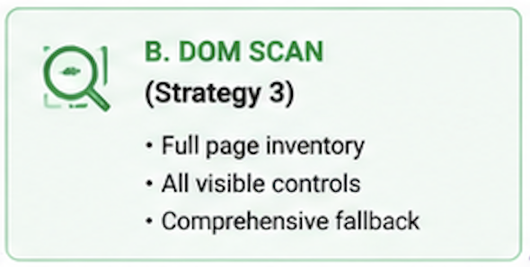
HTML REPORT HTML REPORT
#TheFutureWorksHere
EMBEDDED VIEWER
IN-DASHBOARD PLAYWRIGHT REPORTS
ZIP Storage
API stores report ZIP and serves /api/runs/{id}/report/... so teams browse without a public artifact URL.
Inline View
Managers and leads open the dashboard; engineers can still open full Playwright HTML for forensics.
Theme Alignment
Report shell styled to match dashboard dark theme when served from the API.

Slide 9
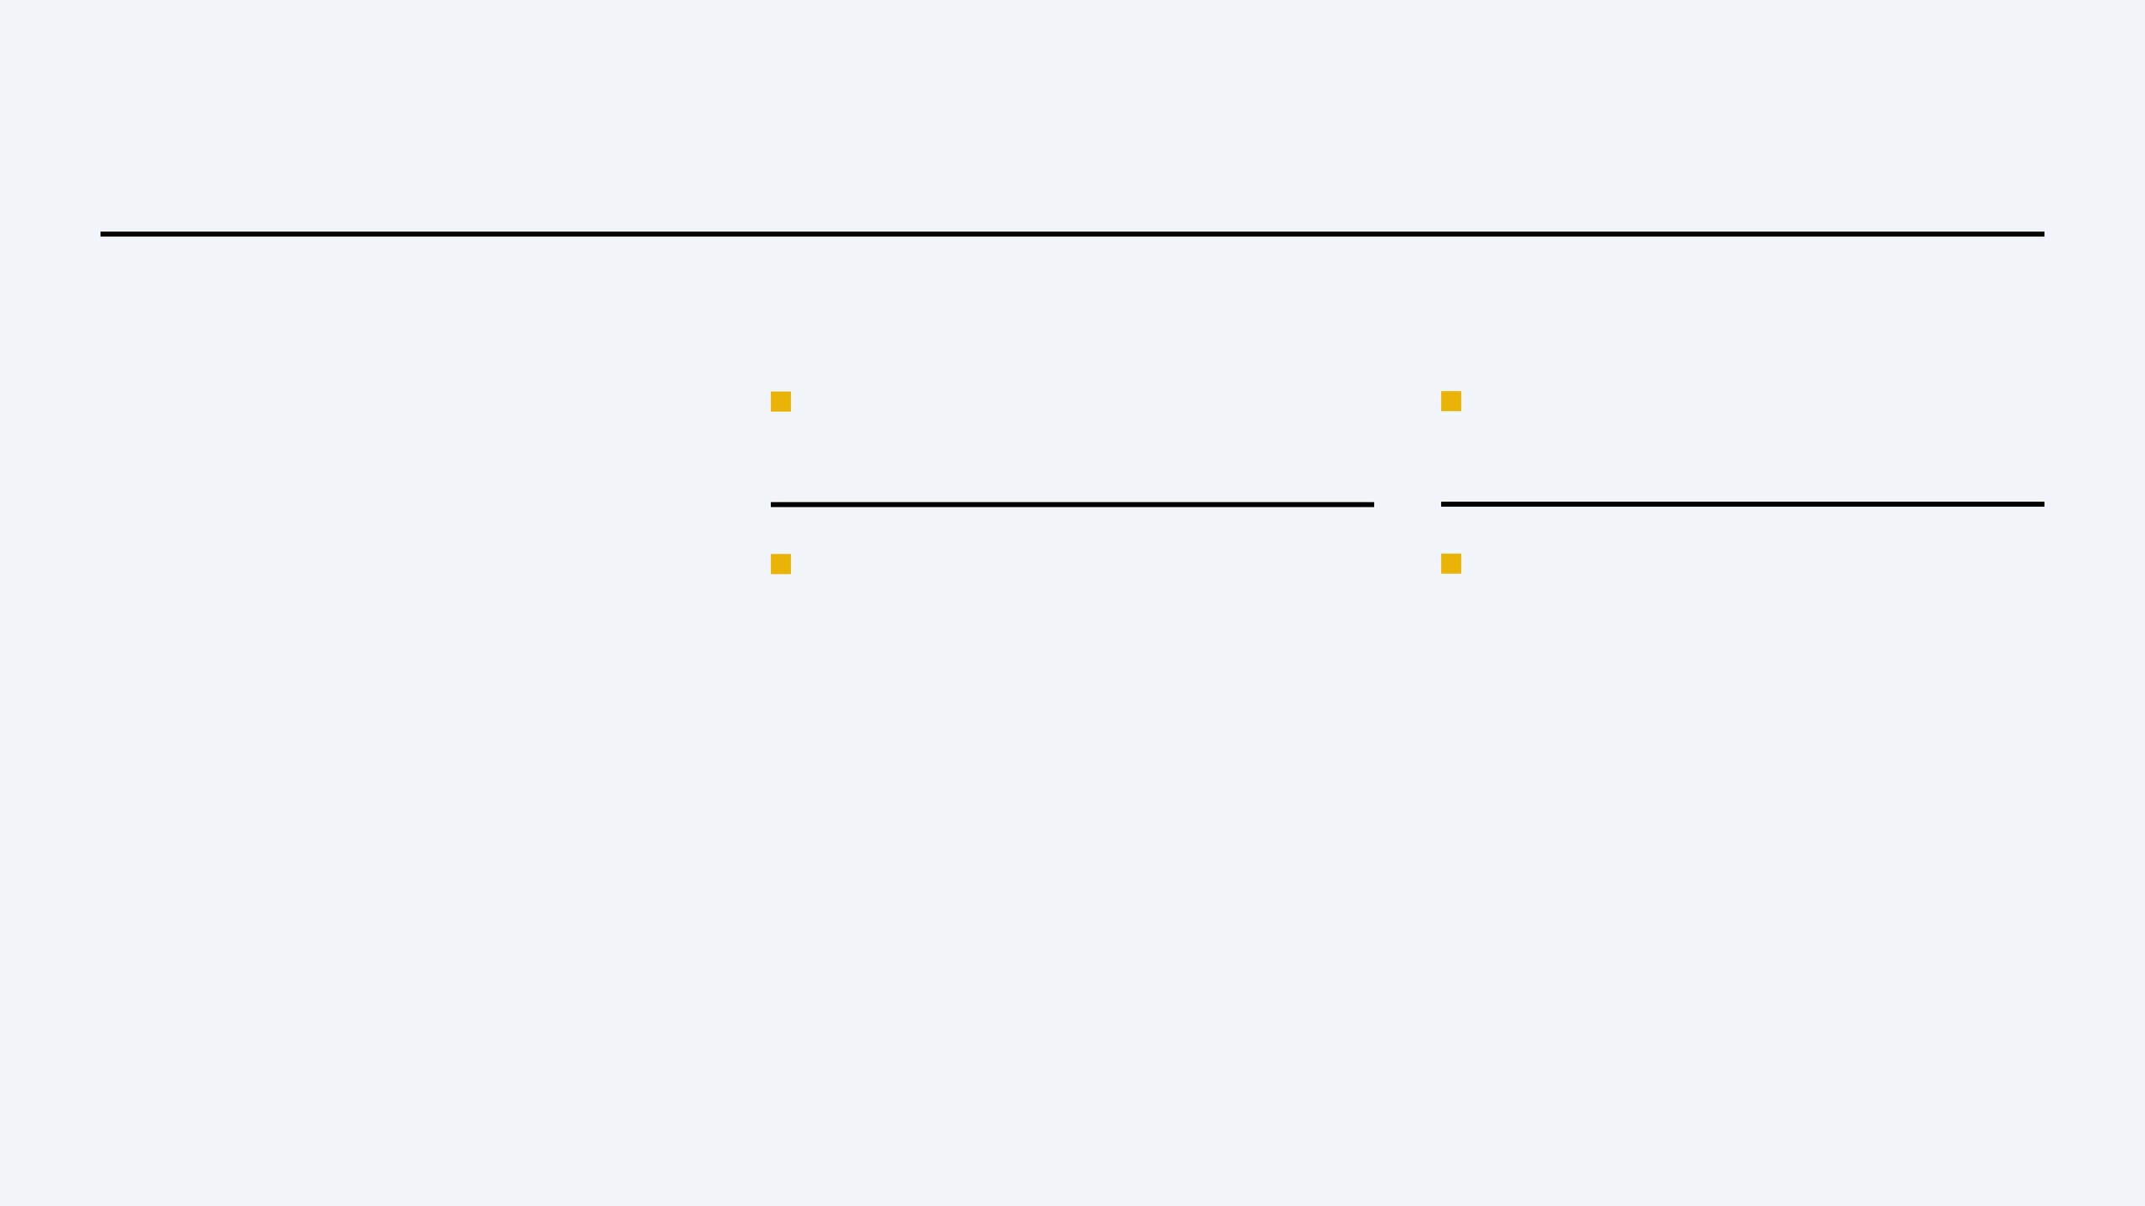
CONFIGURATION CONFIGURATION
#TheFutureWorksHere
OPERATING MODES
RUNTIME ORDER
ENVIRONMENT
Keep GITHUB_ACTIONS_INGEST_TOKEN server-side only.
demo
Global:
Set
DATA_SOURCE
DEDUPLICATION
Scoring:
env variable (demo vs github).
GITHUB_CI_TOKEN enables workflow_dispatch
↓
github
Per-Deploy:
Override DATABASE_URL and CORS_ORIGINS on
from the dashboard.
Uniqueness:
Render for each Vercel origin and API host.
Vercel rewrites /api to Render so the
browser stays same-origin.
↓
INGEST

Slide 10
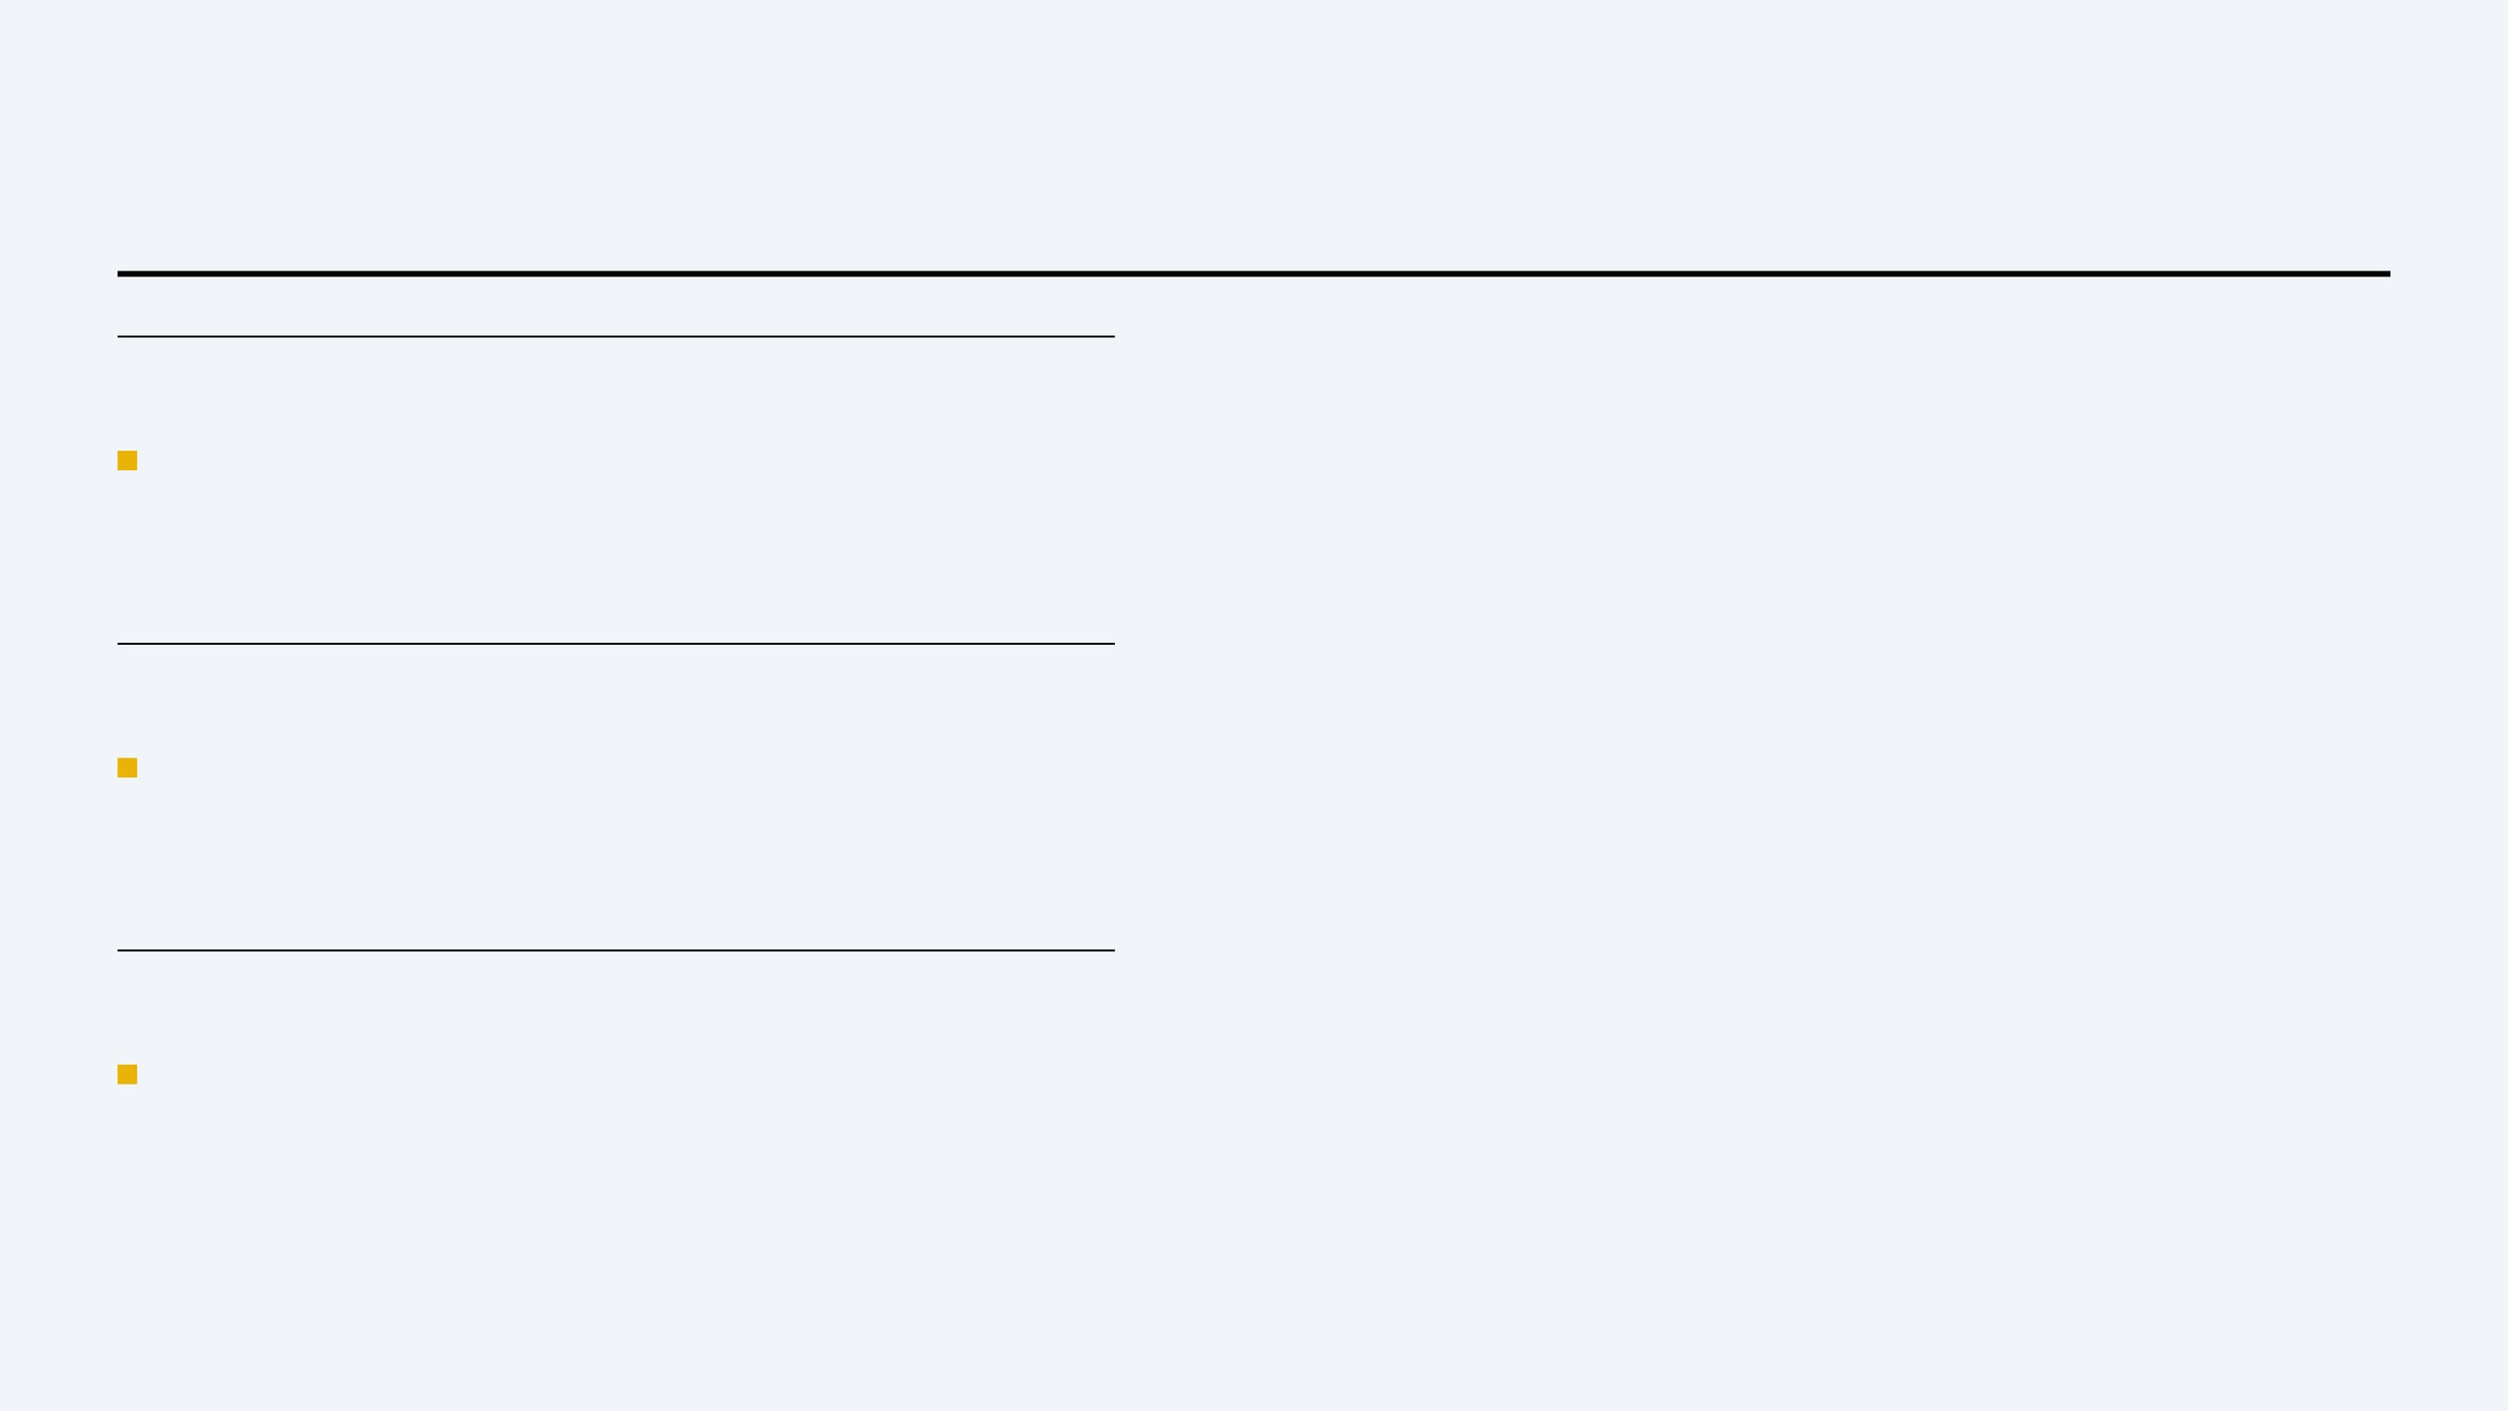
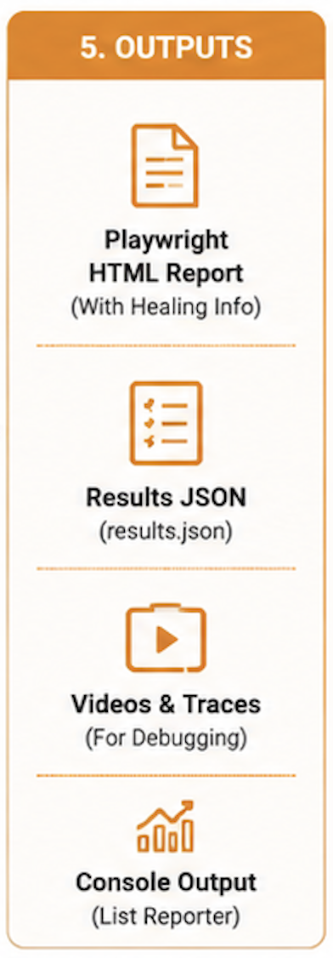
PIPELINE PIPELINE
#TheFutureWorksHere
CI/CD & DASHBOARD
AUTOMATED LOOP
Dashboard triggers GitHub Actions; Playwright runs on
every workflow_dispatch or push.
EXECUTION VISIBILITY
Poll GitHub for job/step status (queued, in_progress,
completed) in the CI panel.
DASHBOARD PUBLISH
Workflow posts JSON (+ optional ZIP) to Render API;
UI refreshes summary and live feed.

Slide 11

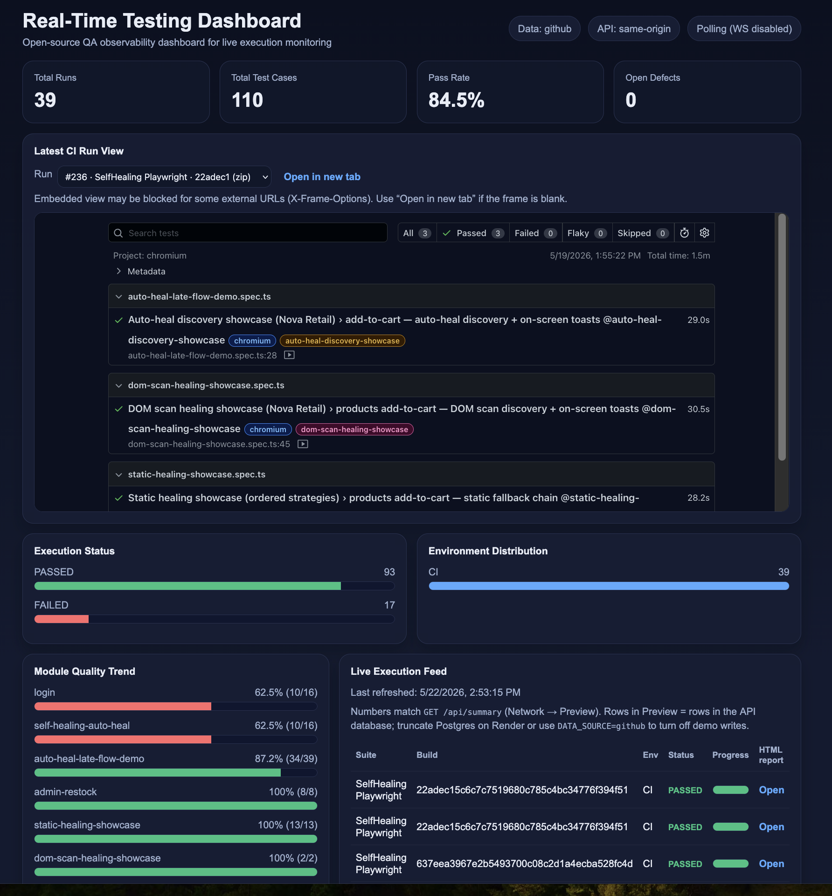
OBSERVABILITY OBSERVABILITY
#TheFutureWorksHere
DASHBOARD VS. FORENSIC REPORTS
FEATURE
REAL-TIME DASHBOARD
PLAYWRIGHT HTML REPORT
Audience
Leadership / QA Managers
Engineers / SDETs
Focus
Trends, Pass/Fail, Build History, CI control
Traces, Videos, Screenshots
Report Detail
Run list, KPIs, embedded HTML when uploaded
All attempts, step timings, attachments
Actionable Info
Portfolio health & pipeline status
Forensic debugging of individual failures

Slide 12
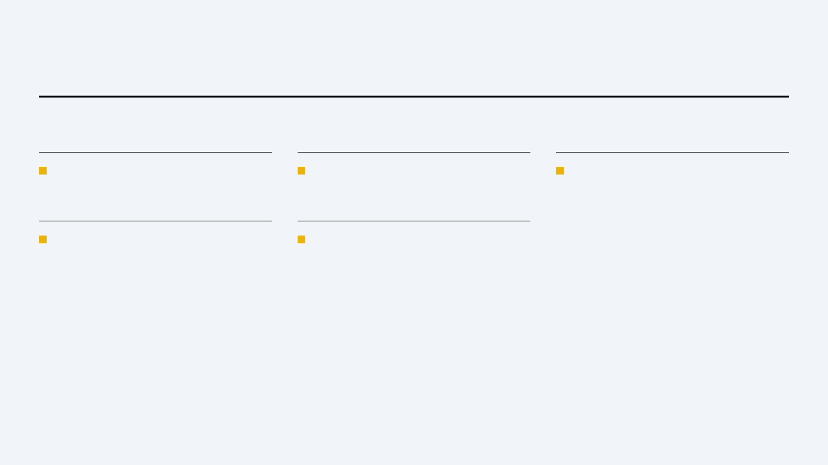
GOVERNANCE ROADMAP
#TheFutureWorksHere
GOVERNANCE & ROADMAP
CORE GOVERNANCE
FUTURE ROADMAP
STRATEGIC VISION
Secrets on server:
Alerting:
Single quality cockpit for Playwright CI
Ingest token, GitHub PAT, and database URL never ship to the browser.
Slack/email when pass rate drops below thresholds.
across the portfolio.
CORS allowlist:
Multi-repo:
Each Vercel origin must be listed on Render for production.
Support several GitHub repos and RBAC per team.

Slide 13

#TheFutureWorksHere
THANK
YOU
QUESTIONS?

