Slide 1



MAPpoly training section
Marcelo Mollinari
mmollin@ncsu.edu
CGDG Seminar Series – November 10, 2020

Slide 2
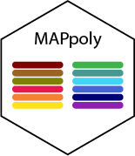
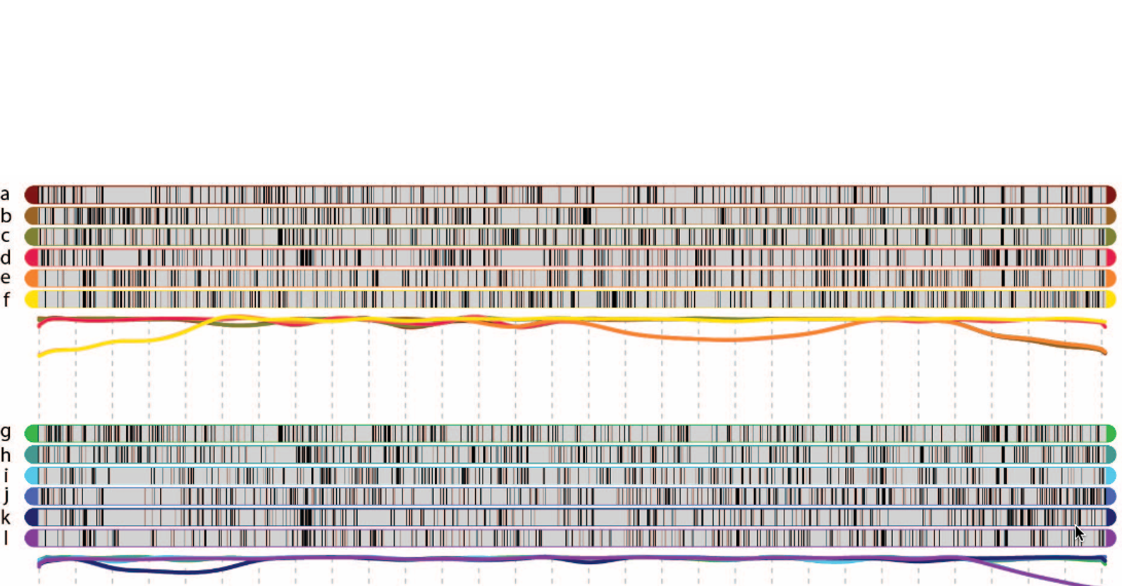
Outline
Installation
Reading/import datasets
Filtering
Two-point analysis
Grouping
Ordering
Phasing
Modeling errors/genotype probabilities
Final checking
Map summary/results
Genotype probabilities
Preferential pairing/haplotype probabilities
Appendix: meiotic analysis

Slide 3

Installation
From CRAN (stable version)
install.packages("mappoly")
From GitHub (development version)
install.packages("devtools")
devtools::install_github("mmollina/mappoly", dependencies=TRUE)

Slide 4
Reading/importing datasets
Supported datasets
MAPpoly files
Discrete dosage
Dosage Probability
CSV files
fitPoly files
VCF files
Supported R objects
updog objects
polyRAD objects
polymapR
datasets
maps

Slide 5
Reading/importing datasets
MAPpoly data reading functions
1. MAPpoly
dat.mappoly <- read_geno(file.in = 'path_to_input_file')
2. MAPpoly with genotype probabilities
dat.mappoly.prob <- read_geno_prob(file.in = 'path_to_input_file’
3. CSV
dat.csv <- read_geno_csv(file.in = 'path_to_input_file', ploidy = 6)
4. fitPoly, supports genotype probabilities
dat.fitpoly <- read_fitpoly(file.in = 'path_to_input_file', ploidy = 6,
parent1 = 'P1', parent1 = 'P2')
5. VCF files, supports genotype probabilities (PL field)
dat.vcf <- read_vcf(file.in = 'path_to_input_file', ploidy = 6,
parent1 = 'P1', parent1 = 'P2',
min.gt.depth = 0, min.av.depth = 0)

Slide 6
Reading/importing datasets
MAPpoly data importing functions
1. updog
dat.updog <- import_from_updog(object = input_multidog_object)
2. polyRAD
dat.polyRAD <- polyRAD::Export_MAPpoly(object = 'polyrad_object')
3. polymapR
Importing data
dat.polymapr <- import_data_from_polymapR(input.data = polymapR_screened_data,
ploidy = 6, parent1 = 'P1',
parent1 = 'P2')
Importing maps
map.polymapr <- import_phased_maplist_from_polymapR(maplist = phased_maplist,
mappoly.data = mappoly.data)

Slide 7

Reading/importing datasets
Example: reading CSV files
require(mappoly)
address <- "https://github.com/mmollina/B2721_map/raw/master/cluster_call/B2721_CC.csv"
tempfl <- tempfile(pattern = "B2721_CC_", fileext = ".csv")
download.file(url = address, destfile = tempfl)
B2721 <- read_geno_csv(file.in = tempfl, ploidy = 4, elim.redundant = FALSE)
plot(B2721)
print(B2721, detailed = TRUE)

Slide 8
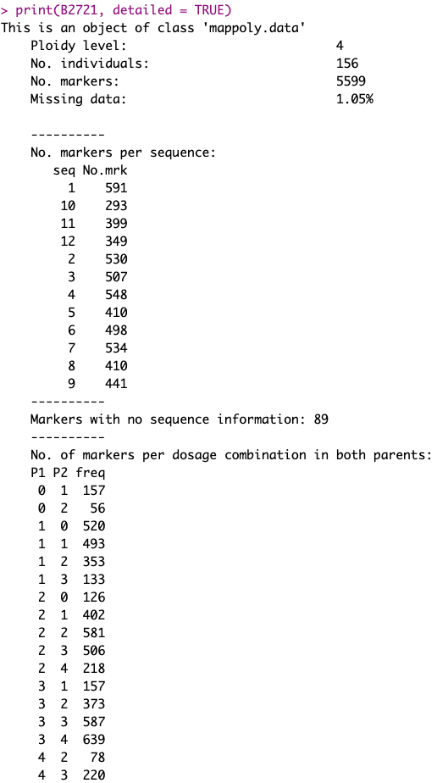
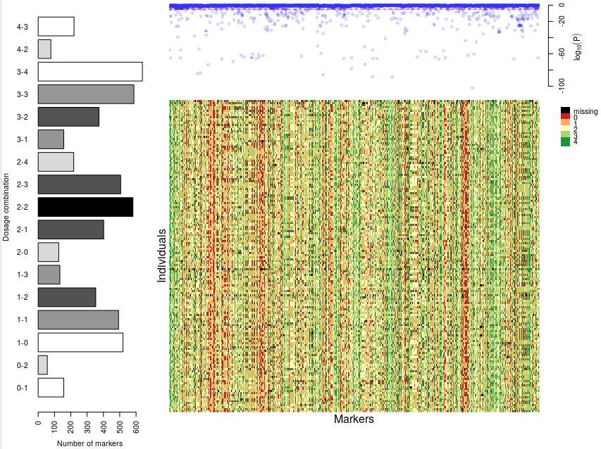
Reading/importing datasets
Example: reading CSV files

Slide 9


Reading/importing datasets
Example: reading VCF files
dat <- NULL
for(i in c(3,9,12)){
cat("Loading chromosome", i, "...")
tempfl <- tempfile(pattern = paste0("ch", i), fileext = ".vcf.gz")
x <- "https://github.com/mmollina/MAPpoly_vignettes/raw/master/data/BT/sweetpotato_chr"
address <- paste0(x, i, ".vcf.gz")
download.file(url = address, destfile = tempfl, quiet = TRUE)
dattemp <- read_vcf(file = tempfl, parent.1 = "PARENT1", parent.2 = "PARENT2",
ploidy = 6, verbose = FALSE)
dat <- merge_datasets(dat, dattemp)
cat("\n")
}
unlink(tempfl)
plot(dat)
print(dat, detailed = TRUE)

Slide 10
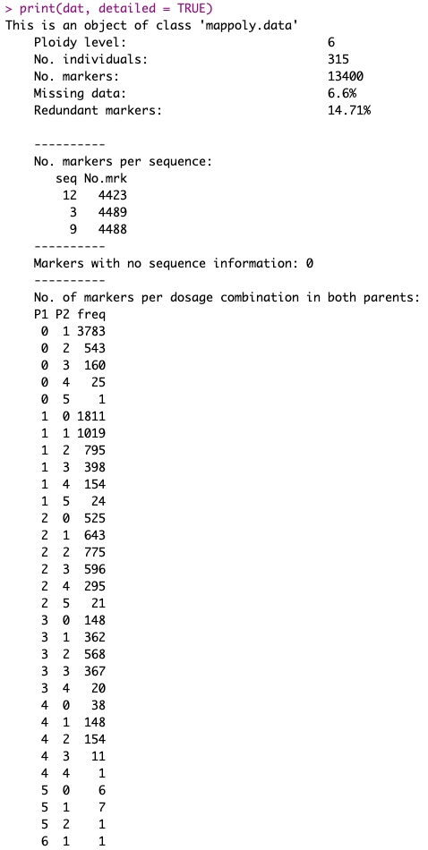
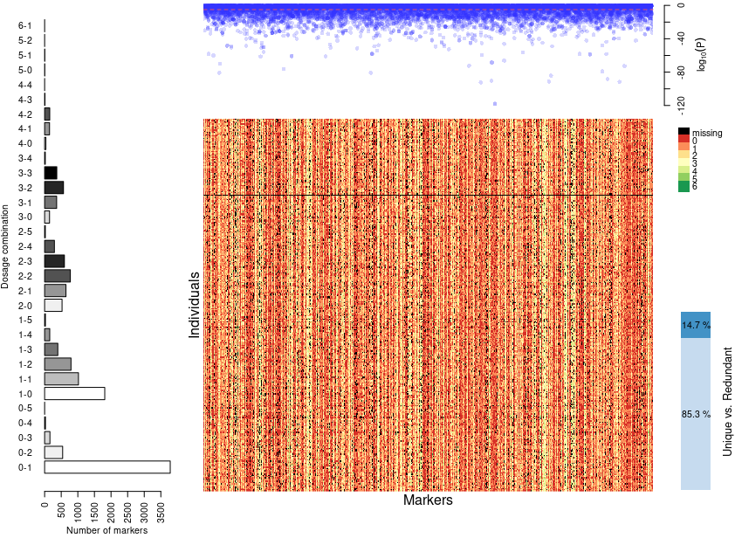
Reading/importing datasets
Example: reading VCF files

