Slide 1


Seamless BGP Migration with Router Grafting
Eric Keller, Jennifer Rexford
Princeton University
Kobus van der Merwe
AT&T Research
NSDI 2010

Slide 2
Dealing with Change
Networks need to be highly reliable
To avoid service disruptions
Operators need to deal with change
Install, maintain, upgrade, or decommission equipment
Deploy new services
Manage resource usage (CPU, bandwidth)
But… change causes disruption
Forcing a tradeoff

Slide 3
Why is Change so Hard?
Root cause is the monolithic view of a router (Hardware, software, and links as one entity)

Slide 4
Why is Change so Hard?
Root cause is the monolithic view of a router (Hardware, software, and links as one entity)
Revisit the design to make dealing with change easier

Slide 5
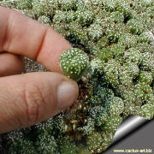

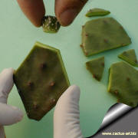
Our Approach: Grafting
In nature: take from one, merge into another
Plants, skin, tissue
Router Grafting
To break the monolithic view
Focus on moving link (and corresponding BGP session)

Slide 6

Why Move Links?

Slide 7
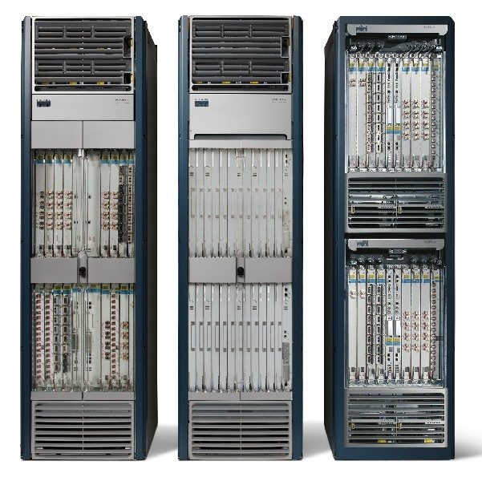
Planned Maintenance
Shut down router to…
Replace power supply
Upgrade to new model
Contract network
Add router to…
Expand network

Slide 8
Planned Maintenance
Could migrate links to other routers
Away from router being shutdown, or
To router being added (or brought back up)

Slide 9
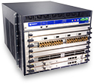

Customer Requests a Feature
Network has mixture of routers from different vendors
* Rehome customer to router with needed feature

Slide 10
Traffic Management
Typical traffic engineering:
* adjust routing protocol parameters based on traffic
Congested link

Slide 11
Traffic Management
Instead…
* Rehome customer to change traffic matrix

Slide 12
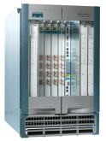
Understanding the Disruption (today)
Reconfigure old router, remove old link
Add new link link, configure new router
Establish new BGP session (exchange routes)
updates
BGP updates
delete neighbor 1.2.3.4
Add neighbor 1.2.3.4

Slide 13
Understanding the Disruption (today)
Reconfigure old router, remove old link
Add new link link, configure new router
Establish new BGP session (exchange routes)
Downtime (Minutes)

Slide 14
Router Grafting: Breaking up the router
Send state
Move link

Slide 15
Router Grafting: Breaking up the router
Router Grafting enables this breaking apart a router (splitting/merging).

Slide 16
Not Just State Transfer
Migrate session
AS300
AS100
AS200
AS400

Slide 17
Not Just State Transfer
Migrate session
AS300
AS100
The topology changes
(Need to re-run decision processes)
AS200
AS400

Slide 18
Goals
Routing and forwarding should not be disrupted
Data packets are not dropped
Routing protocol adjacencies do not go down
All route announcements are received
Change should be transparent
Neighboring routers/operators should not be involved
Redesign the routers not the protocols

Slide 19
Challenge: Protocol Layers
A
B
BGP
Exchange routes
BGP
TCP
Deliver reliable stream
TCP
IP
Send packets
IP
Physical Link
Migrate
State
C
Migrate
Link

Slide 20
Physical Link
A
B
BGP
Exchange routes
BGP
TCP
Deliver reliable stream
TCP
IP
Send packets
IP
Physical Link
Migrate
State
C
Migrate
Link

Slide 21
Physical Link
Unplugging cable would be disruptive
Migrate-from
Remote
end-point
Migrate-to

Slide 22
Physical Link
Unplugging cable would be disruptive
Links are not physical wires
Switchover in nanoseconds
mi
Migrate-from
Remote
end-point
Migrate-to

Slide 23
IP
A
B
BGP
Exchange routes
BGP
TCP
Deliver reliable stream
TCP
IP
Send packets
IP
Physical Link
Migrate
State
C
Migrate
Link

Slide 24
Changing IP Address
IP address is an identifier in BGP
Changing it would require neighbor to reconfigure
Not transparent
Also has impact on TCP (later)
mi
1.1.1.2
Migrate-from
Remote
end-point
1.1.1.1
Migrate-to

Slide 25
Re-assign IP Address
IP address not used for global reachability
Can move with BGP session
Neighbor doesn’t have to reconfigure
mi
Migrate-from
Remote
end-point
1.1.1.1
1.1.1.2
Migrate-to

Slide 26
TCP
A
B
BGP
Exchange routes
BGP
TCP
Deliver reliable stream
TCP
IP
Send packets
IP
Physical Link
Migrate
State
C
Migrate
Link

Slide 27
Dealing with TCP
TCP sessions are long running in BGP
Killing it implicitly signals the router is down
BGP and TCP extensions as a workaround (not supported on all routers)

Slide 28
Migrating TCP Transparently
Capitalize on IP address not changing
To keep it completely transparent
Transfer the TCP session state
Sequence numbers
Packet input/output queue (packets not read/ack’d)
app
recv()
send()
TCP(data, seq, …)
ack
OS
TCP(data’, seq’)

Slide 29
BGP
A
B
BGP
Exchange routes
BGP
TCP
Deliver reliable stream
TCP
IP
Send packets
IP
Physical Link
Migrate
State
C
Migrate
Link

Slide 30
BGP: What (not) to Migrate
Requirements
Want data packets to be delivered
Want routing adjacencies to remain up
Need
Configuration
Routing information
Do not need (but can have)
State machine
Statistics
Timers
Keeps code modifications to a minimum

Slide 31
Routing Information
Could involve remote end-point
Similar exchange as with a new BGP session
Migrate-to router sends entire state to remote end-point
Ask remote-end point to re-send all routes it advertised
Disruptive
Makes remote end-point do significant work
mi
Migrate-from
Remote
end-point
Exchange Routes
Migrate-to

Slide 32
Routing Information (optimization)
Migrate-from router send the migrate-to router:
The routes it learned
Instead of making remote end-point re-announce
The routes it advertised
So able to send just an incremental update
mi
Migrate-from
Remote
end-point
Send routes
advertised/learned
Incremental
Update
Migrate-to

Slide 33
Migration in The Background
Migration takes a while
A lot of routing state to transfer
A lot of processing is needed
Routing changes can happen at any time
Disruptive if not done in the background
Migrate-from
Remote
End-point
Migrate-to

Slide 34
While exporting routing state
BGP is incremental, append update
In-memory:
p1, p2, p3, p4
Dump:
p1, p2
Migrate-from
Remote
End-point
Migrate-to

Slide 35
While moving TCP session and link
TCP will retransmit
Migrate-from
Remote
End-point
Migrate-to

Slide 36
While importing routing state
BGP is incremental, ignore dump file
In-memory:
p1, p2
Dump:
p1, p2, p3, p4
Migrate-from
Remote
End-point
Migrate-to

Slide 37
Special Case: Cluster Router
Don’t need to re-run decision processes
Links ‘migrated’ internally
Blade
Blade
A
B
C
D
Line card
Switching
Fabric
Line card
Line card
Line card
A
C
B
D

Slide 38
Prototype
Added grafting into Quagga
Import/export routes, new ‘inactive’ state
Routing data and decision process well separated
Graft daemon to control process
SockMi for TCP migration
Graftable Router
Emulated
link migration
Unmod.
Router
Modified
Quagga
graft
daemon
Handler
Comm
Quagga
SockMi.ko
click.ko
Linux kernel 2.6.19.7
Linux kernel 2.6.19.7-click
Linux kernel 2.6.19.7

Slide 39
Evaluation
Impact on migrating routers
Disruption to network operation
Overhead on rest of the network

Slide 40
Evaluation
Impact on migrating routers
Disruption to network operation
Overhead on rest of the network

Slide 41
Impact on Migrating Routers
How long migration takes
Includes export, transmit, import, lookup, decision
CPU Utilization roughly 25%
Between Routers
0.9s (20k)
6.9s (200k)
Between Blades
0.3s (20k)
3.1s (200k)

Slide 42
Disruption to Network Operation
Data traffic affected by not having a link
nanoseconds
Routing protocols affected by unresponsiveness
Set old router to “inactive”, migrate link, migrate TCP, set new router to “active”
milliseconds

Slide 43
Conclusions and Future Work
Enables moving a single link/session with…
Minimal code change
No impact on data traffic
No visible impact on routing protocol adjacencies
Minimal overhead on rest of network
Future work
Explore applications
Generalize grafting (multiple sessions, different protocols, other resources)

Slide 44
Questions?
Contact info:
ekeller@princeton.edu
http://www.princeton.edu/~ekeller

