Slide 1

The “Platform as a Service” Model for Networking
Eric Keller, Jennifer Rexford
Princeton University
INM/WREN 2010

Slide 2






Hosted Infrastructures
Shift towards hosted and shared infrastructures
Cloud computing
Benefits:
Dynamically scale up/down
Cost benefits

Slide 3
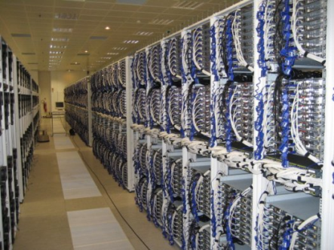
Hosted Network Infrastructure
Poised to happen for networking
Similar benefits
Additional driver: in-network inaccessibility
?

Slide 4
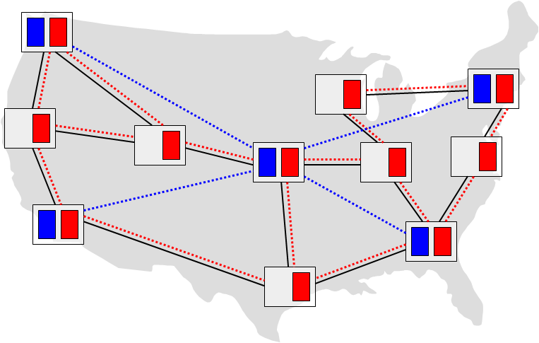
Old News
I’m not the first to believe this
Large body of research in Network Virtualization
Run multiple virtual networks concurrently on a shared infrastructure

Slide 5
That’s the Wrong Approach
Instead… abstraction should be a platform
Customers can focus on their application/service
“Single Router Platform”

Slide 6
What’s the problem with network virtualization?

Slide 7
Undesirable Business Model (for infrastructure provider)
End Users
Applications
Builds application which uses in-network functionality
(e.g., Virtual Worlds provider using a multi-cast service)
Service
Providers
Leases slices of virtualized routers to create network
Runs custom software/protocols/configurations
(e.g., a multi-cast or reliable connectivity)
Infrastructure
Providers
Owns and maintains physical routers/links

Slide 8
Undesirable Business Model (for infrastructure provider)
End Users
Applications
Builds application which uses in-network functionality
(e.g., Virtual Worlds provider using a multi-cast service)
Commodity Service
(unappealing to traditional ISPs)
Service
Providers
Leases slices of virtualized routers to create network
Runs custom software/protocols/configurations
(e.g., a multi-cast or reliable connectivity)
Infrastructure
Providers
Owns and maintains physical routers/links

Slide 9
Difficult to Manage (for application providers)
Same as managing physical network
Traffic engineering
Configuring a distributed collection of routers
Deal with failure
Managing resources to meet demand
Yes, but won’t service providers deal with that?

Slide 10
Limited Market Opportunity (for service providers)
Applications just want some control
Either service provider provides it or develop themselves
Services must be general to have a large market
Are there really that many generic services?
Don’t count on infrastructure providers
That’s today’s model

Slide 11
If not network virtualization, then what?

Slide 12
Cloud Computing Landscape
Infrastructure as a Service (IaaS)
e.g., Amazon EC2, Rackspace Cloud
Abstraction is managing set of virtual machines
Freedom: run any software you want
Effort: manage redundancy, all software
Platform as a Service (PaaS)
e.g., Google App Engine, Heroku
Write application using libraries and without worrying about actual servers
Freedom: tied to specific platform capabilities
Effort: apps scale automatically, build on the platform
(And everything in between)

Slide 13
Key Differences (why IaaS makes sense for computing)
Compute:
Legacy applications
Workflow used to writing applications on servers
Network:
Limited developer community
Not the end application
Goal
Platform enabling in-network functionality, without having to manage a network

Slide 14
The Router Platform (PaaS)
Present customers (application developers) with platform
Decoupled from physical infrastructure
Customers can focus on their application/service
Infrastructure owner has freedom in managing the infrastructure

Slide 15
The Single Router Abstraction
Router abstraction covers functionality, doesn’t bother with physical infrastructure
Router more than just routing
Note: this is preliminary thinking
Customer Program
API
Routing
Software
General purpose
functions
Data Plane

Slide 16
Interactive Program
Customer provides executable script (rather than static configuration file)
Initialization routine
Dynamic modification to configuration
Driven by events (control message, event notification)
Customer Program
API
Routing
Software
General purpose
functions
Data Plane

Slide 17
Routing
Specify sessions with neighboring routers
Customer’s routers or infrastructure provider’s neighbors
Know what links are available
Interface to query, metrics, callback when change
Customer Program
API
Routing
Software
General purpose
functions
Data Plane

Slide 18
Data Plane
Direct configuration of data plane functions
Setting up multi-cast groups, access control lists, etc.
Customer Program
API
Routing
Software
General purpose
functions
Data Plane

Slide 19
General-Purpose Processing
As name suggest, can be anything
Can be written by customer as well
Customer Program
API
Routing
Software
General purpose
functions
Data Plane

Slide 20
Customer Controlled Routing
ISP chooses one route, no choice to customers
Customer: Configure Router in ISP
Low cost route
C1
ISP
X
Dest.
C2
Y
Low latency route

Slide 21
Cloud Computing
IaaS offerings give you servers and connectivity
Customer: configure middlebox (firewall, load balancer), VPN, route selection
…

Slide 22
Gaming/Live Video Streaming
Limited ability to setup multi-cast, perform update aggregation
Customer: configure router to manage multi-cast group, add custom software
update

Slide 23
Gaming/Live Video Streaming
Limited ability to setup multi-cast, perform update aggregation
Customer: configure router to manage multi-cast group, add custom software
update

Slide 24
Challenge: The Physical Reality

Slide 25
Challenge: The Physical Reality
Physical Infrastructure is Distributed

Slide 26
Challenge: The Physical Reality
Physical Infrastructure is Distributed
Physical Infrastructure is Shared
Customer 1
Customer 2
Customer 3

Slide 27
Distributed Router Workload
Network virtualization – specify exact topology
Single router platform – specify work to be done
Leeway to distribute this workload
Some tied to physical router (e.g., BGP session)
Some can be replicated (for latency or to handle work)
Configure “inter-processor communication”

Slide 28
Dynamically Adjust Distribution
Estimates are used to choose how to distribute
Monitor the routers
CPU, update freq., traffic
Re-distribute workload as necessary
e.g., migrate BGP session
e.g., add replicated instances
Comes at cost

Slide 29
Shared Infrastructure
Virtualization is part of solution
Routing sessions can be shared
Tag message, process it, send out based on tag
C1
Inf
Prov
C2

Slide 30
Conclusion
Shift towards hosted and shared infrastructure
Can help management of private infrastructures
Worth exploring an alternate to the IaaS model
Some challenges in the single router platform

Slide 31
Questions?
Contact info:
ekeller@princeton.edu
http://www.princeton.edu/~ekeller

