Slide 1
Live Migration of an Entire Network (and its Hosts)
Eric Keller, Soudeh Ghorbani, Matthew Caesar, Jennifer Rexford
HotNets 2012

Slide 2


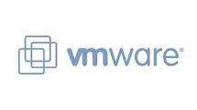
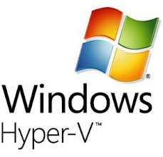

Virtual Machine Migration
Widely supported to help:
Consolidate to save energy
Re-locate to improve performance
Apps
Apps
Apps
Apps
Apps
Apps
OS
OS
OS
OS
OS
OS
Hypervisor
Hypervisor

Slide 3

But Applications Look Like This
Many VMs working together

Slide 4


And Rely on the Network
Networks have increasing amounts of state
Learned
Configuration
Software-Defined

Slide 5
Ensemble Migration
Joint (virtual) host and (virtual) network migration
No re-learning,
No re-configuring,
No re-calculating
Capitalize on redundancy

Slide 6
Some Use Cases

Slide 7


1. Moving between cloud providers
Customer driven – for cost, performance, etc.
Provider driven – offload when too full

Slide 8
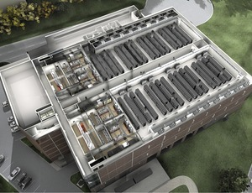
2. Moving to smaller set of servers
Reduce energy consumption (turn off servers, reduce cooling)

Slide 9
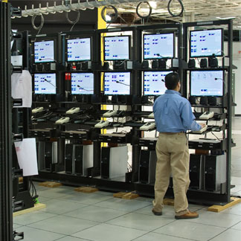
3. Troubleshooting
Migrate ensemble to infrastructure dedicated to testing (special equipment)

Slide 10


Goal: General Management Tool
Automated migration according to some objective and easy manual migration
Objective
manual
Ensemble Migration Automation
Migration
Monitoring

Slide 11
LIve Migration of Ensembles
Tenant Control
Tenant Control
virtual topology
Migration is transparent
API to operator/ automation
Migration Orchestration
Migration Primitives
LIME
Network Virtualization
Software-defined network
Virtualized servers

Slide 12
Why Transparent?

Slide 13
Separate Out Functionality
Tenant Control
Tenant Control
virtual topology
Network Virtualization

Slide 14
Separate Out Functionality
Tenant Control
Tenant Control
virtual topology
Migration Orchestration
Migration Primitives
Network Virtualization

Slide 15
Multi-tenancy
Tenant Control
Tenant Control
Tenants
virtual topology
Migration Orchestration
Migration Primitives
Infrastructure Operator
Network Virtualization

Slide 16
How to Live Migrate an Ensemble
Can we base it off of VM migration?
Iteratively copy state
Freeze VM
Copy last delta of state
Un-freeze VM on new server

Slide 17
Applying to Ensemble
Iterative copy

Slide 18
Applying to Ensemble
Freeze and copy

Slide 19
Applying to Ensemble
Resume

Slide 20
Applying to Ensemble
Resume
Complex to implement
Downtime potentially large

Slide 21
Applying to Whole Network
Iterative copy

Slide 22
Applying to Whole Network
Freeze and copy

Slide 23
Applying to Whole Network
Resume

Slide 24
Applying to Whole Network
Resume
Lots of packet loss
Lots of “backhaul” traffic

Slide 25
Applying to Each Switch
Iterative copy

Slide 26
Applying to Each Switch
Freeze and copy

Slide 27
Applying to Each Switch
Resume

Slide 28
Applying to Each Switch
Resume
Bursts of packet loss
Even more “backhaul” traffic
Long total time

Slide 29
A Better Approach
Clone the network
Migrate the VMs individually (or in groups)

Slide 30
Clone the Network
Copy state

Slide 31
Clone the Network
Cloned Operation

Slide 32
Clone the Network
Migrate
VMs

Slide 33
Clone the Network
Migrate
VMs

Slide 34
Clone the Network
Minimizes backhaul traffic
No packet loss associated with the network (network is always operational)

Slide 35
Consistent View of a Switch
Switch_A
Same guarantees as migration-free
Preserve application semantics
Application view
Migration Orchestration
Migration Primitives
Network Virtualization
Physical reality
Switch_A_0
Switch_A_1

Slide 36
Sources of Inconsistency
Apps
VM (end host)
Migration-free: packet 0 and packet 1 traverse same physical switch
OS
Packet 0
Packet 1
Switch_A_0
Switch_A_1
R1 R2
R1 R2

Slide 37
1. Local Changes on Switch
(e.g. delete rule after idle timeout)
Apps
VM (end host)
OS
Packet 0
Packet 1
Switch_A_0
Switch_A_1
R1 R2
R1 R2

Slide 38

2. Update from Controller
(e.g. rule installed at different times)
Apps
VM (end host)
OS
Install(R_new)
Packet 0
Packet 1
Switch_A_0
Switch_A_1
R_new
R1 R2
R1 R2

Slide 39
3. Events to Controller
(e.g. forward and send to controller)
Packet-in(pkt 1)
(received at controller first)
Apps
VM (end host)
OS
Packet 0
Packet 1
Packet-in(pkt 0)
Switch_A_0
Switch_A_1
R1 R2
R1 R2

Slide 40
Consistency in LIME
Switch_A
* Emulate HW functions
* Combine information
Migration Orchestration
Migration Primitives
Network Virtualization
*Restrict use of some features
* Use a commit protocol
Switch_A_0
Switch_A_1

Slide 41
Conclusions and Future work
LIME is a general and efficient migration layer
Hope is future SDN is made migration friendly
Develop models and prove correctness
end-hosts and network
“Observational equivalence”
Develop general migration framework
Control over grouping, order, and approach

Slide 42
Thanks
Eric Keller: eric.keller@colorado.edu
Soudeh Ghorbani: ghorban2@illinois.edu

