Slide 1

NATIONAL RESEARCH
NUCLEAR UNIVERSITY MEPHI
Moscow Engineering Physics Institute
Department of : “English"
Boeing vs Airbus: How The Market Stands Today
Student: Monastyrskiy M.O.
Group: C21-703

Slide 2
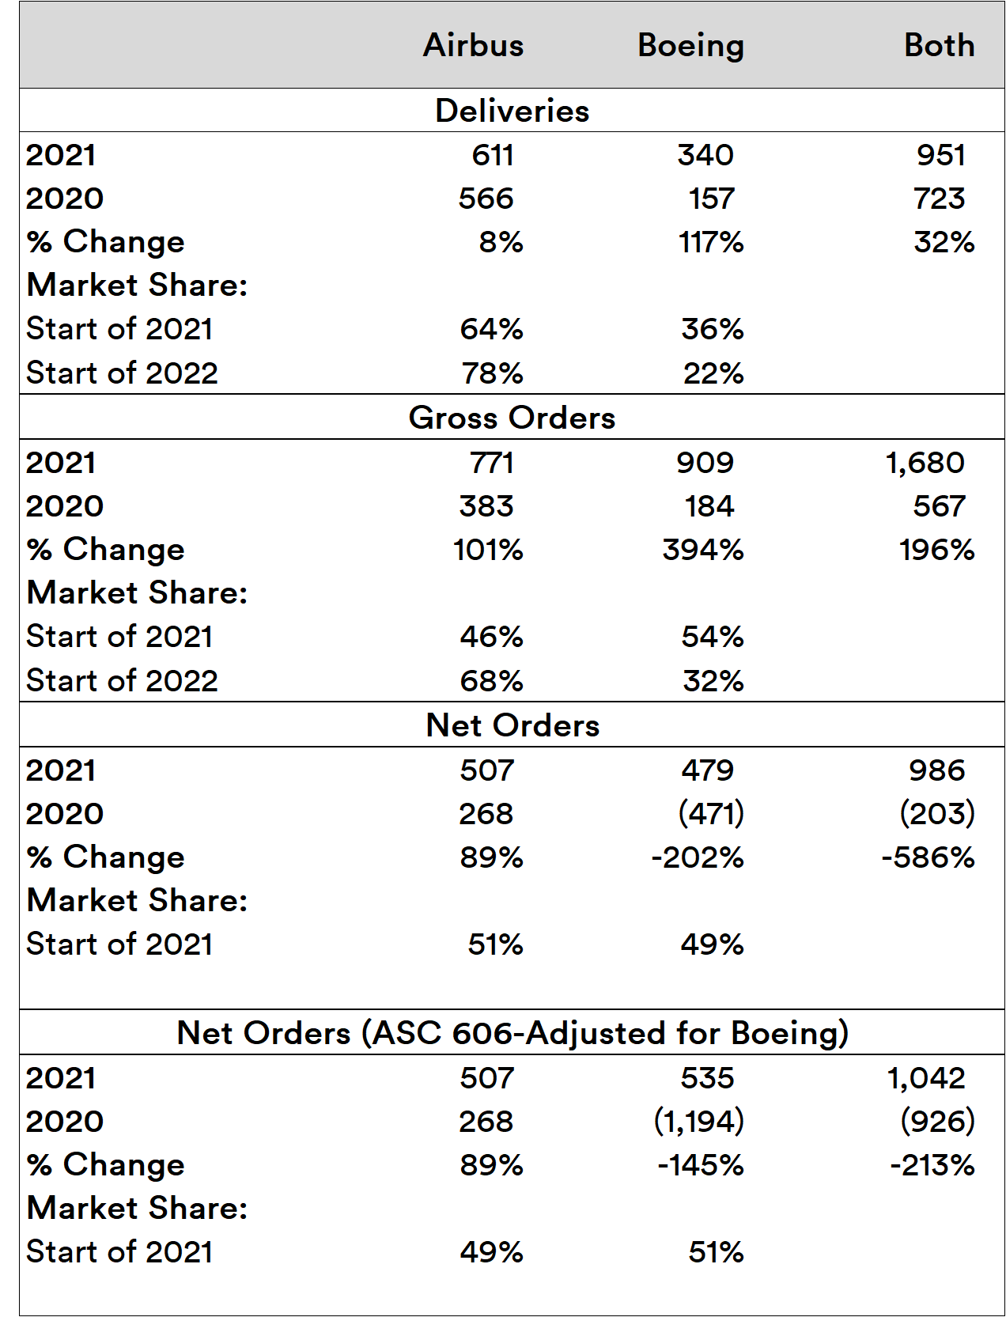

Slide 3
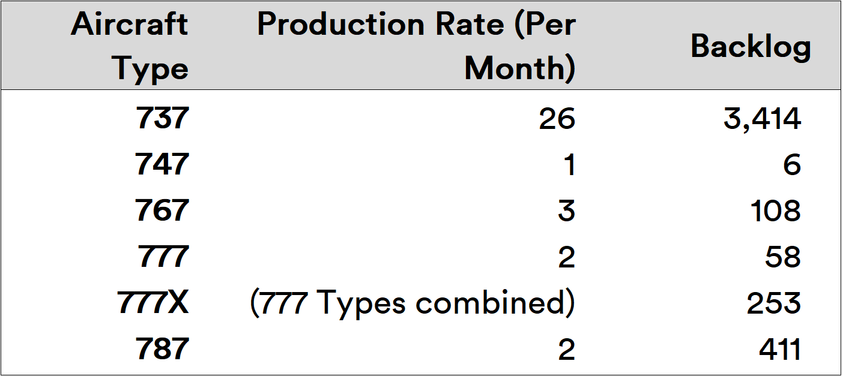
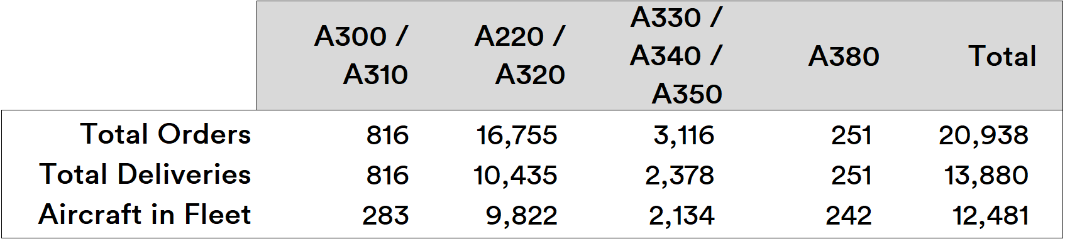

Slide 4
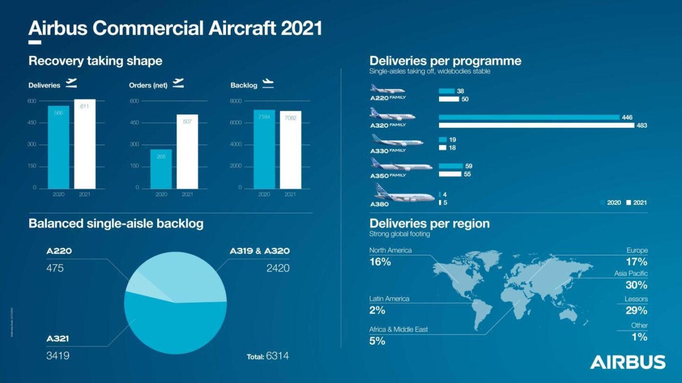

Slide 5
