Slide 1
Cypress Tutorial
By: Mohammad Monfared

Slide 2
What is Cypress?
Cypress is a testing framework based on JavaScript that can test anything runs on a web browser. We can use JavaScript or TypeScript in Cypress.

Slide 3
Why Cypress?
Open Source and Free with big community
Faster than Selenium – Interact with browser session directly
Can be used by QAs and Developers (Unit/Integration/E2E tests)
Time Travel – Getting Snap shot of all actions
Debuggability
Automatic wait for assertions
Intercept / Spy
Real time reloads
Cypress dashboard
Screenshots and Video Records
Robust documentation

Slide 4
Limits
Doesn't support XPath
Doesn't support Safari / (Supported Browsers: Chrome, Firefox, Edge, Electron )
IDE Debug is not supported. Pause and debug on checkpoints is not possible
Doesn't keep user Auth state and Login Info by default
Async/Await approach
Problem with CI/CD integration on third-party hosted agents.
You have to add a lot of dependencies and plugins to support all your test scenarios.

Slide 5
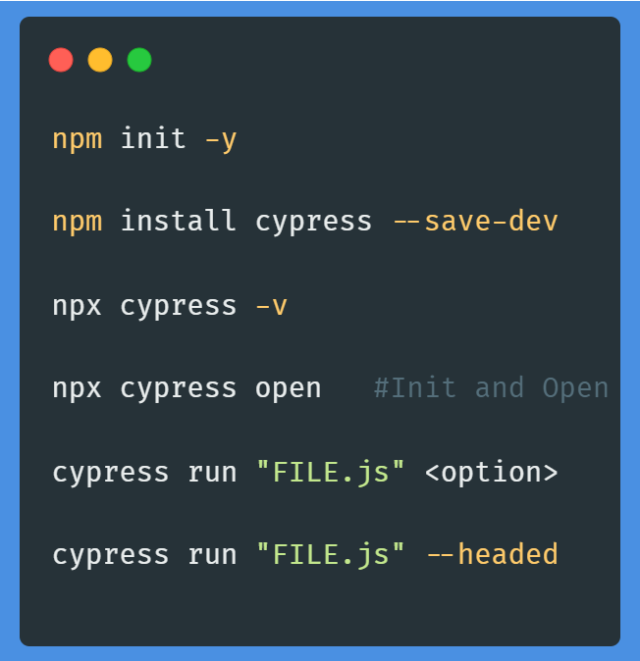
Commands
Project Initialize
Install Cypress in project
Check version of installed Cypress
Open Cypress GUI (and Initialize on first time)
Run Cypress test in Command Line (headless by default)
Run Cypress test in Command Line with showing browser

Slide 6
Cypress Tutorial S02: Locate Elements

Slide 7
S02 – Basic Syntax
cy.get(CSS SELECTOR) // Element
cy.contains(Text)
cy.contains(selector, Text)
cy.get(selector).contains(Text)

Slide 8
Relatives:
1- children()
cy.get(selector).children()
cy.get(selector).children(selector)
2- parent()
cy.get(selector).parent()
cy.get(selector).parent(selector)

Slide 9
Relatives:
3- siblings()
cy.get(selector).siblings()
cy.get(selector).siblings(selector)

Slide 10
Ancestors:
1- parents()
cy.get(selector).parents()
cy.get(selector).parents(selector)
2- parentsUntil()
cy.get(selector).parentsUntil(selector)

Slide 11
Descendant:
1- find()
cy.get(selector).find(selector)
2- within()
cy.get(selector).within(() => { <code> } )

Slide 12
Index:
cy.get(selector).eq(index)
cy.get(selector).first()
cy.get(selector).last()

Slide 13
Filter:
cy.get(selector).filter(selector)
cy.get(selector).not(selector)

Slide 14
Traversal:
1- .closest(selector)
2- .next(selector)
3- .nextAll(selector)
4- .nextUntill(selector)
5- .prev(selector)
6- .prevAll(selector)
7- .prevUntill(selector)

Slide 15
Cypress Tutorial S03: Mouse & Keyboard Actions

Slide 16
Keyboard Actions:
Basic Syntax:
cy.get(selector).type(“TEXT”)

Slide 17
Keyboard Actions:
Sequences:
cy.get(selector).type(“TEXT{enter}”)
cy.get(selector).type(“{shift}TEXT”)
cy.get(selector).type(“{backspace}{home}{del}”)
cy.get(selector).realPress(“[‘Control’, ‘A’, ‘Del’]”)

Slide 18
Keyboard Actions:
Clear Input:
cy.get(selector).clear()
cy.get(selector).type(“{selectall}{del}”)
cy.get(selector).type(“{selectall}{backspace}”)
cy.get(selector).realPress(“[‘Control’, ‘A’, ‘Del’]”)

Slide 19
Keyboard Actions:
Delay:
cy.get(selector).type(“TEXT”, {delay: 100})
Repeat:
cy.get(selector).type(“TEXT”, {repeat(4)})

Slide 20
Mouse Actions:
1- Click
2- Double Click
3- Right Click
4- Hover
5- Long Press (Click and Hold)
6- Drag & Drop
7- Drag & Drop by offset
8- Scroll

