Slide 1


Predicting Happiness Project Presentation
Matt Moravec, Thomas Florian, Rajib Alam

Slide 2
Outline
Dataset
Classification: K-nearest neighbors
Metrics
Improving the model
Revisiting Metrics
Visualization and Analysis
Regression Analysis
Coefficient Comparison
Neural Network Analysis
Interpretation
Conclusion

Slide 3
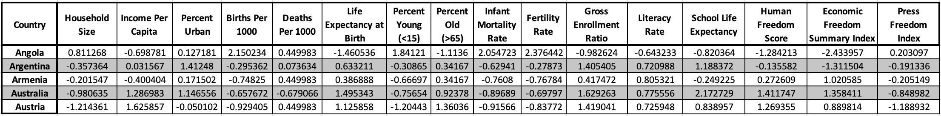
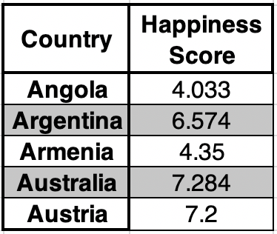
Dataset
125 countries and 16 features
Limitations of our dataset
Train and Test data

Slide 4
K-nearest neighbors
What is KNN?
The process
Happiness Score Range | Label
x<5 | Low range (2)
5>=x<6 | Mid range (1)
X>=6 | High range (0)

Slide 5
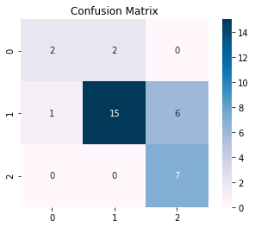
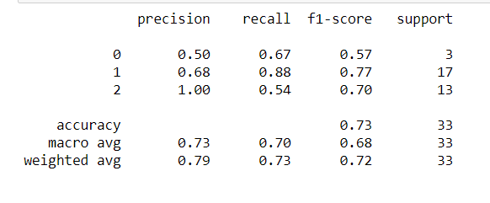
Metrics
No. of neighbors = 5

Slide 6
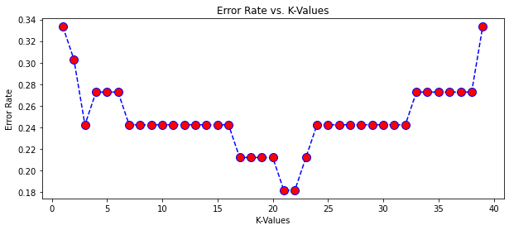
Improving Model

Slide 7
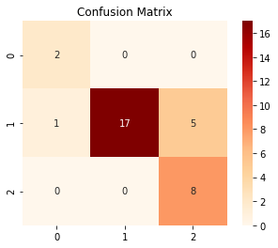
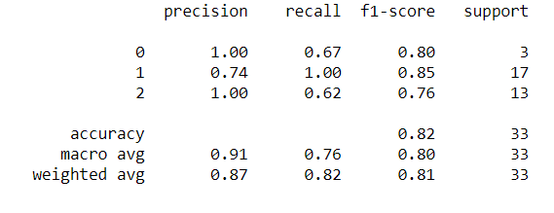
Revisiting Metrics
No. of neighbors = 21

Slide 8
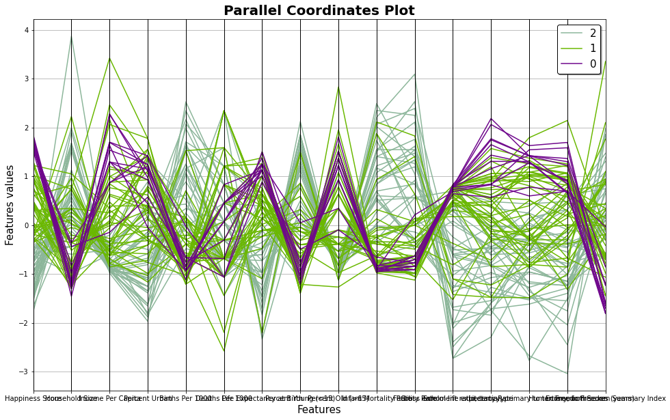
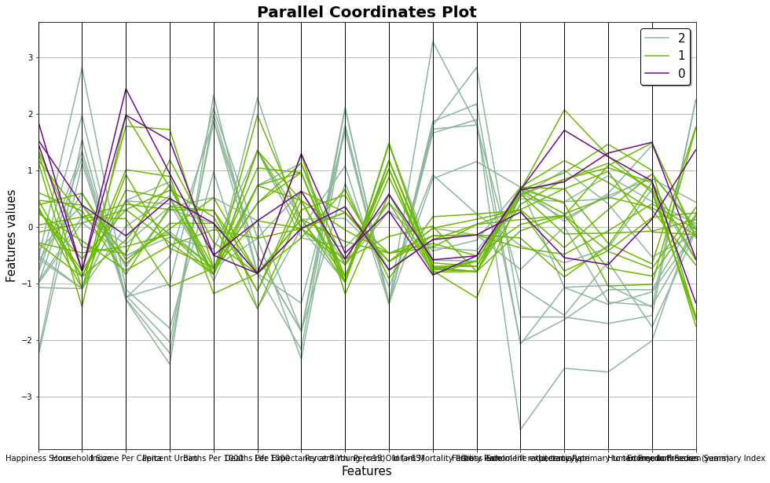
Visualization and Analysis

Slide 9
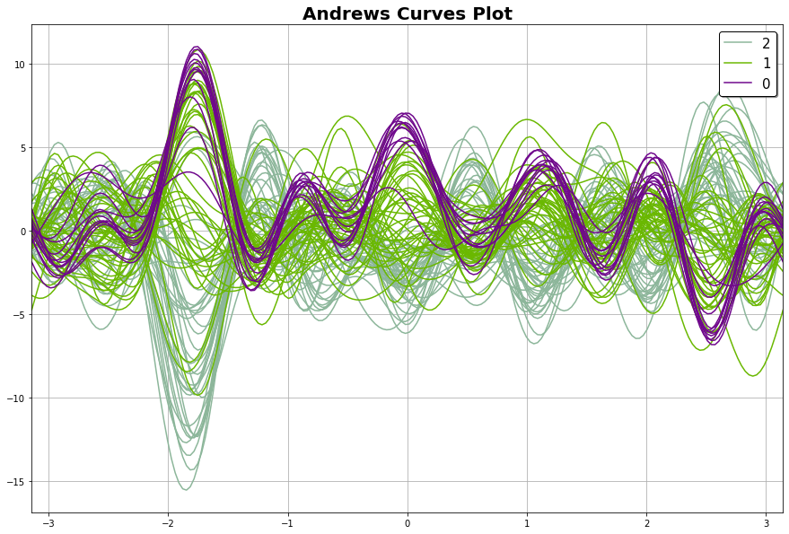
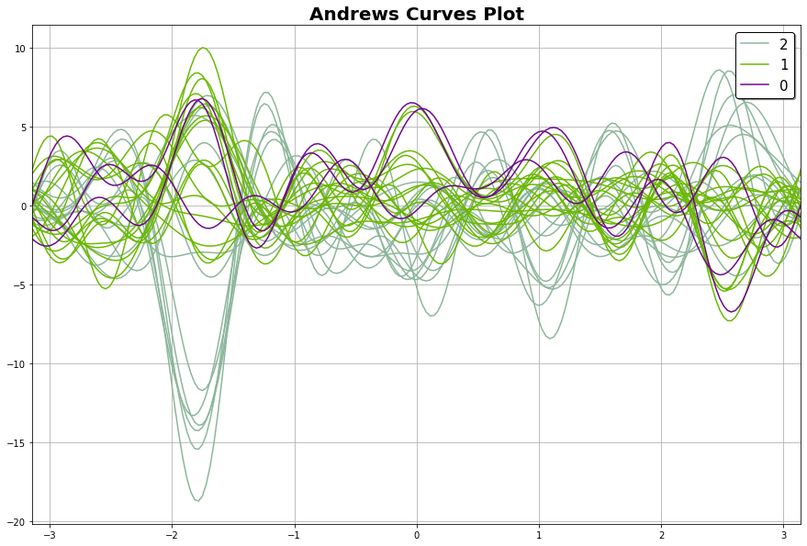
Visualization and Analysis

Slide 10
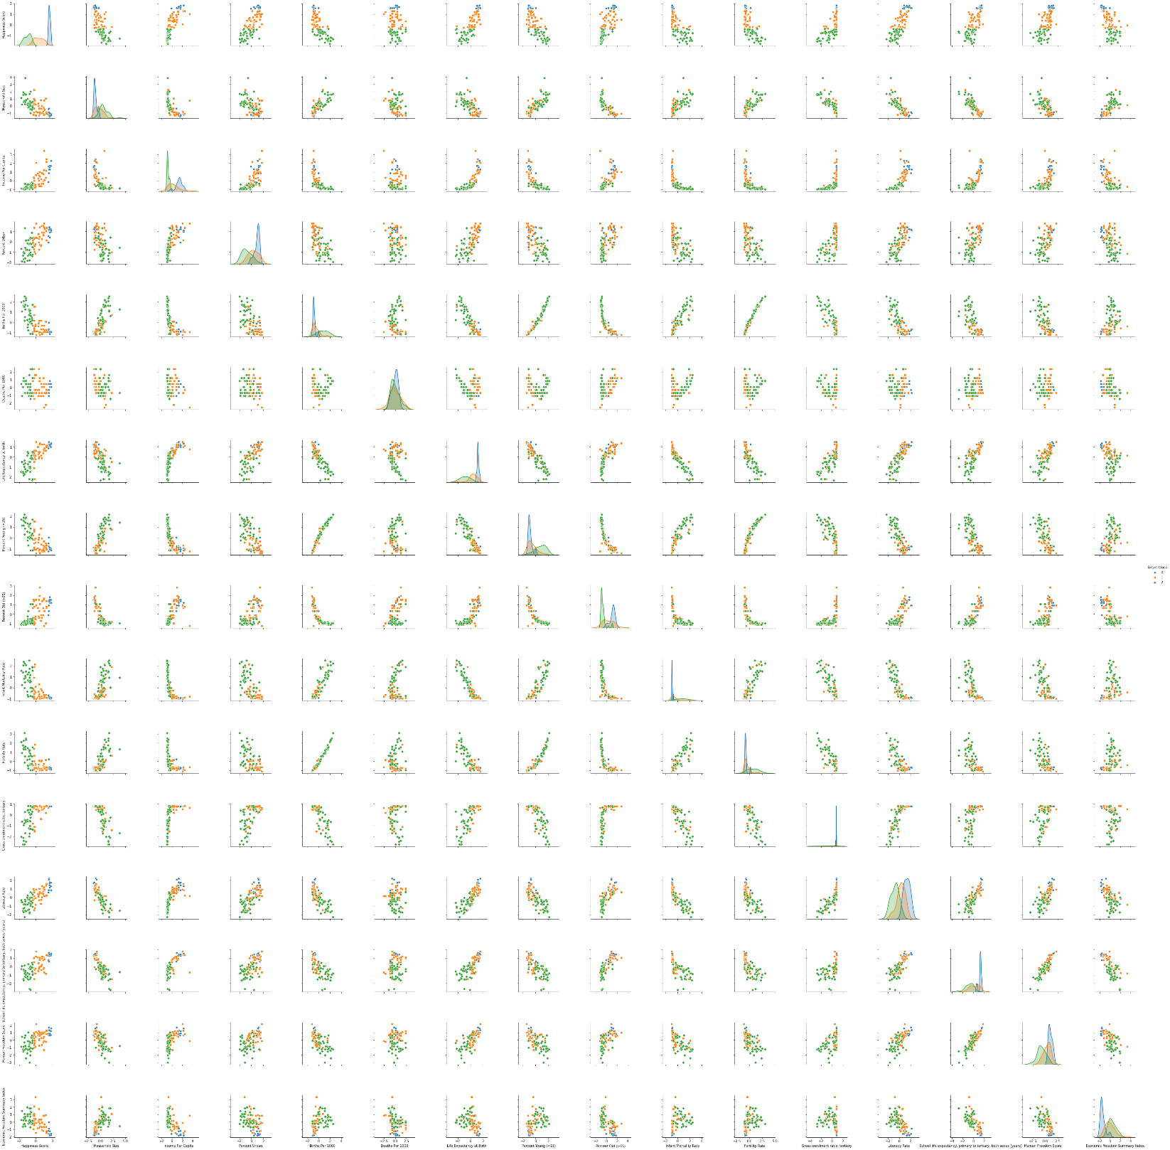
Visualization
and
Analysis

Slide 11
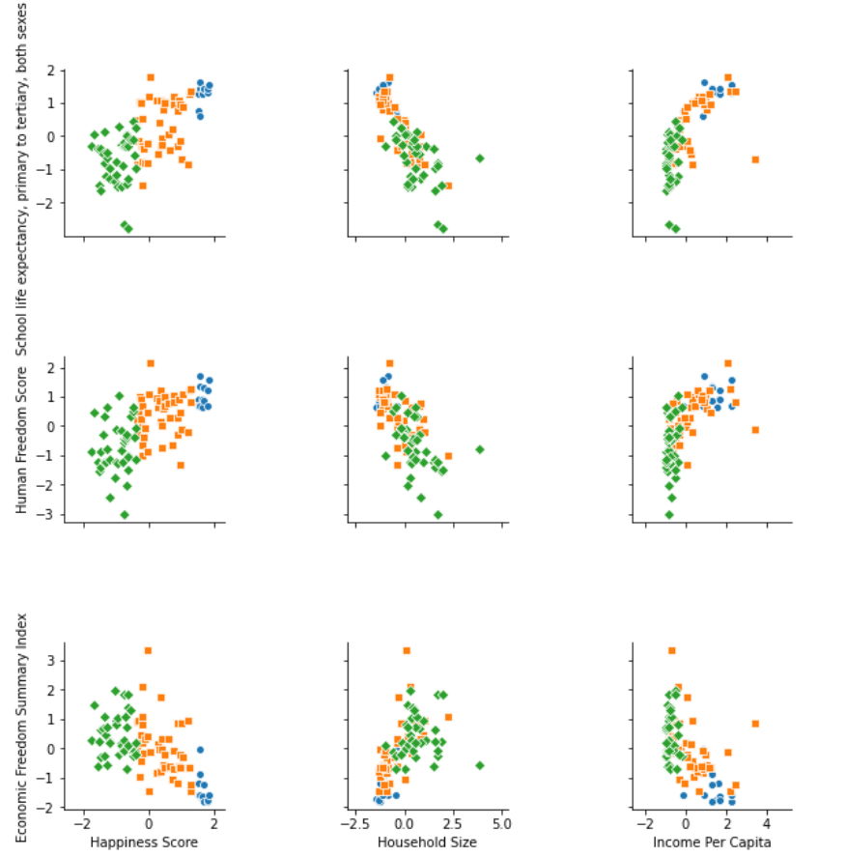
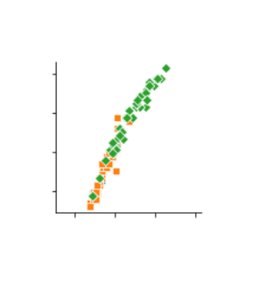
Visualization and Analysis
Percent Young (<15) vs Fertility Rate

Slide 12
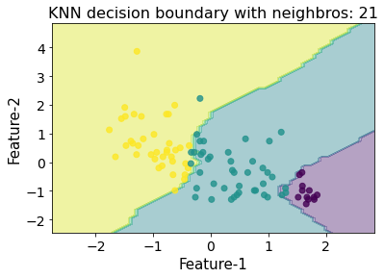
Visualization and Analysis

Slide 13
Interpretation of KNN
Classifies the countries, but cannot evaluate the features

Slide 14
Regression Analysis
(Least Squares, Lasso, Ridge)

Slide 15
Regression R² Scores
 | Train | Test | Cross Validation Train | Cross Validation Train
Linear Regression | .777 | .459 | .777 | .461
Lasso Regression | .760 | .501 | .769 | .495
Ridge Regression | .728 | .482 | .763 | .502

Slide 16
Regression P - Values
 | Not Cross Validation | Cross Validation
Linear Regression | Income Per Capita: .002 Deaths Per 1000: .018 Infant Mortality Rate: .019 Gross Enrollment Ratio: .047 Press Freedom Index: .010 | Income Per Capita: .002 Deaths Per 1000: .019 Infant Mortality Rate: .018 Gross Enrollment Ratio: .044 Press Freedom Index: .010
Lasso Regression | Income Per Capita: .002 Press Freedom Index: .031 | Income Per Capita: .001 Press Freedom Index: .030
Ridge Regression | Income Per Capita: .029 | Income Per Capita: .011 Press Freedom Index: .042

Slide 17
Coefficient Comparison
 | Non - Loo | Loo
Linear Regression | Income Per Capita: 0.345 Deaths Per 1000: -0.325 Infant Mortality Rate: 0.490 Gross Enrollment Ratio: 0.304 Press Freedom Index: -0.251 | Income Per Capita: 0.342 Deaths Per 1000: -0.320 Infant Mortality Rate: 0.493 Gross Enrollment Ratio: 0.308 Press Freedom Index: -0.252
Lasso Regression | Income Per Capita: 0.358 Press Freedom Index: -0.214 | Income Per Capita: 0.358 Press Freedom Index: -0.213
Ridge Regression | Income Per Capita: 0.257 | Income Per Capita: 0.293 Press Freedom Index: -0.203

Slide 18
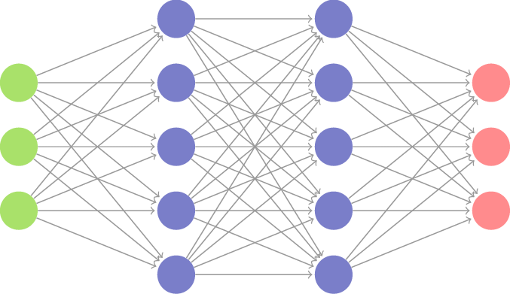
Neural Network
Why Neural Networks?
Limitations of Neural Network?

Slide 19
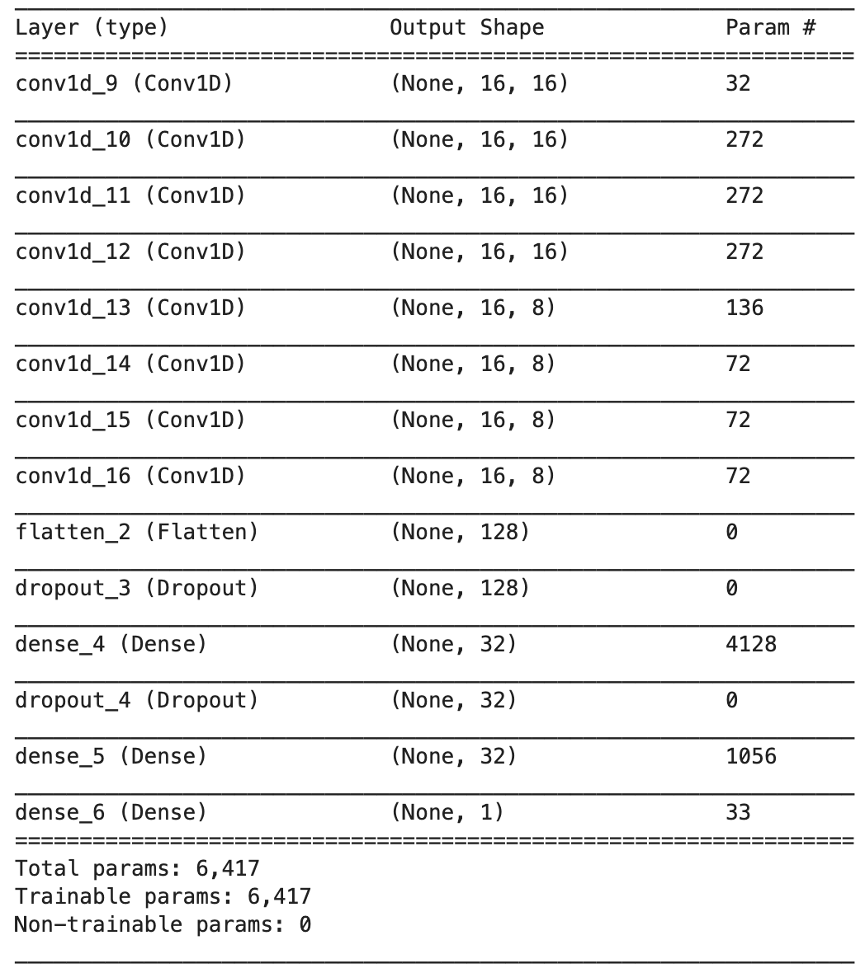
Architecture and Hyperparameter Optimization
Learning rate: 0.005
Epochs: 200
Batch Size: 32

Slide 20
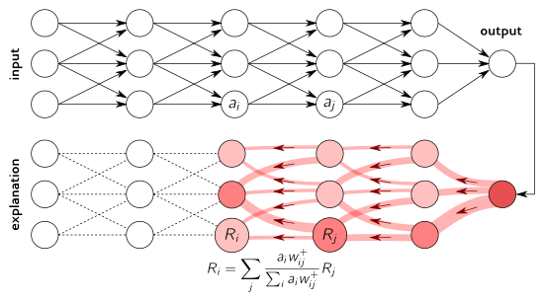
Layer-wise Relevance Propagation
LRP ranks features based on their relevance to the model’s predications by performing a backwards pass through the neural network. This provides interpretability to the model.

Slide 21
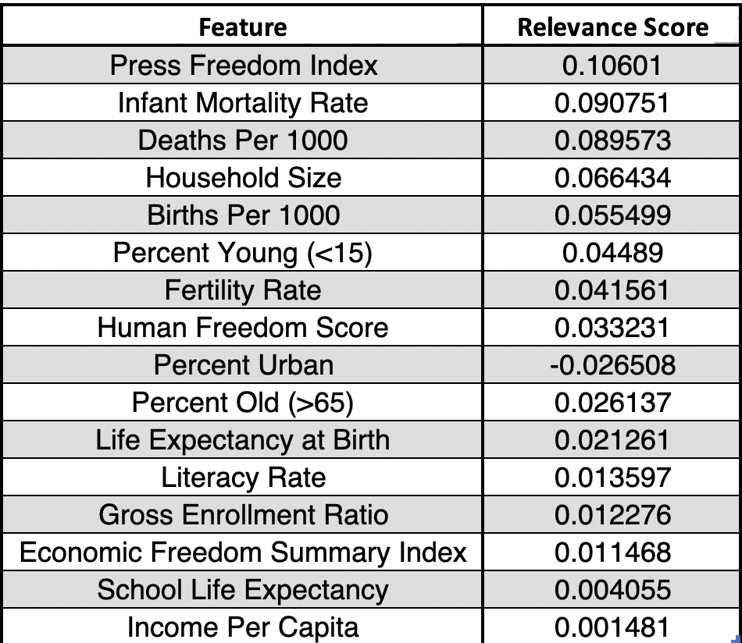
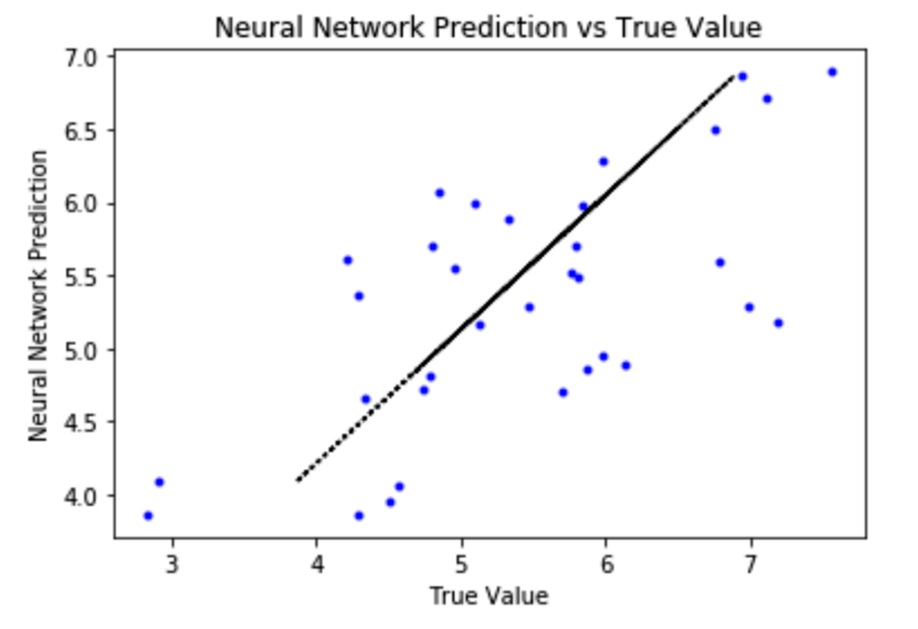
Neural Network Results
R2 = 0.436

Slide 22
Conclusion
Comparing the models
Goals vs Accomplishments
Future Prospect

