Slide 1

dittAudio
Matt Morais
Sakthi Vignesh Kanagarajan

Slide 2

Introduction
Music Recommendation Project
Utilize Spotify API to generate data set
Utilize User Input (playlists, liked songs, etc)
Recommend New Music (Popular, up and coming, low key jams)

Slide 3

Value
Content and (hopefully) collaborative RS
Suggest different types of recommended music by artist popularity
Create playlists for a user
Play a sample of a song on a registered device.

Slide 4
Access to Data
Step 1
Create Spotify App using developer website
Step 2
Use public and private API keys to query the data
Step 3
Utilize Python package “spotipy” to simplify access
Step 4
Query a huge sample set to develop with
Step 5
Polish the algorithm, investigate dynamic queries, unique to each request

Slide 5
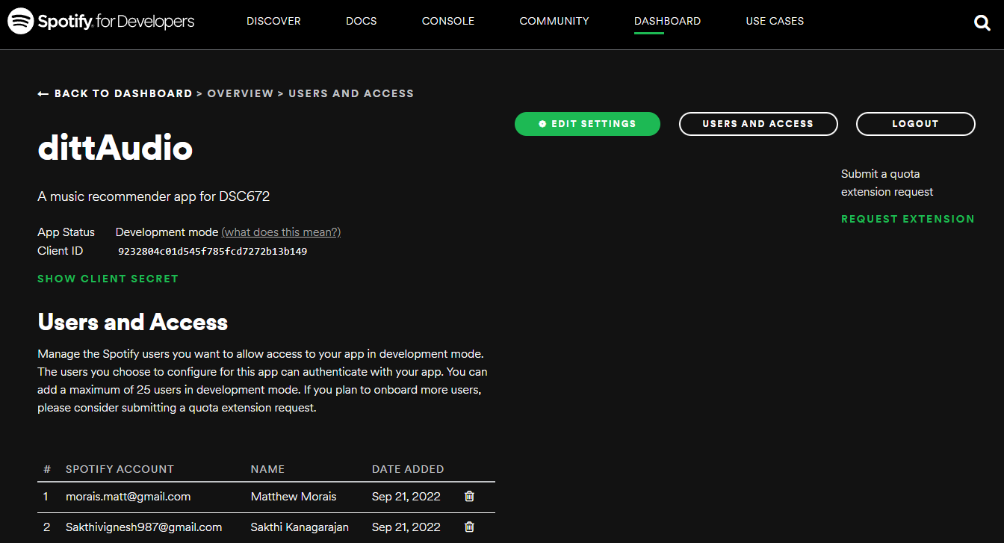

Slide 6
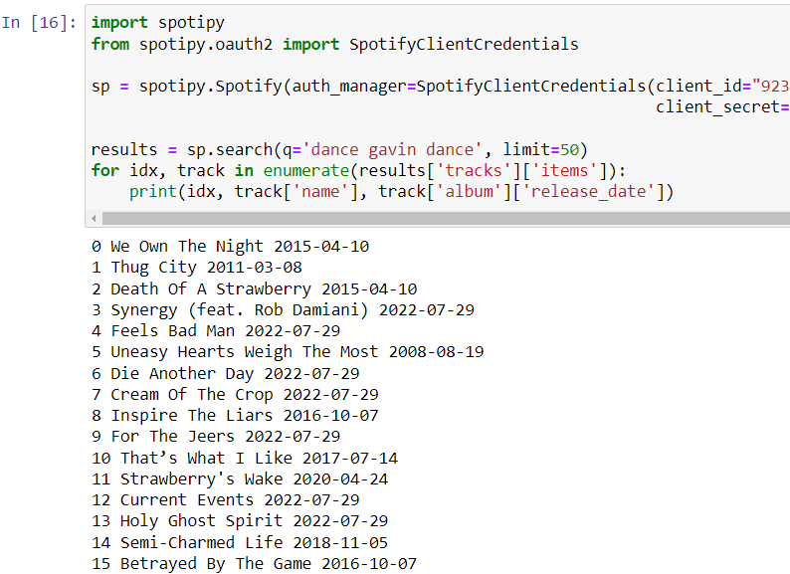
Sample of data

Slide 7
Techniques
Content Based
Collaborative
GUI
Recommendation algorithm
Based on user input of songs / artists / genres / etc.
Recommends music with similar attributes
Recommendation algorithm
Uses other user’s likes / dislikes
Could take the form of looking at popular playlists, if cannot access other account information
Leverage tkinter or other python package to create a UI
Hopefully, simplify usage for end user

Slide 8



Biggest Challenge
Speed and Processing capacity
If we save the training data with the application, the file could be huge, but if we cannot access the API and make fast queries, we will have no choice.
Speed on a mobile device

Slide 9
Research Topics
Efficient API querying
GUI design
Resource Management
Signal Processing – looking at tracks with similar waveforms as a way to predict likability for a user.

