Slide 1
Paper Presentation 1 Predicting a Hit Song with machine Learning
Matt Morais
9/26/2022

Slide 2


Overview
Agha Haider Raza
Published in the 2020 International Conference on Data Science, Artificial Intelligence, and Business Analytics on 9-12-2020
Utilized four machine learning techniques
Logistic Regression
Decision Trees
Naïve Bayes
Random Forests
Is there a magical formula for the prediction of hit songs before they are released?
Krishnadas Nanath

Slide 3
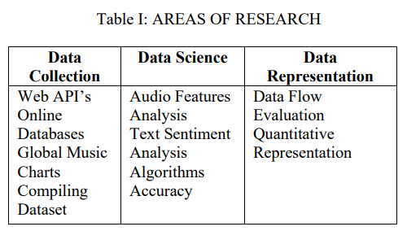
Data
Utilized Billboard top 100 to collect sample of “popular songs”
Hit (310): in the top 20 at the end of each month
Non-hit (337): appeared in the bottom 10 at the end of each month
Included song lyrics for Sentiment Analysis

Slide 4
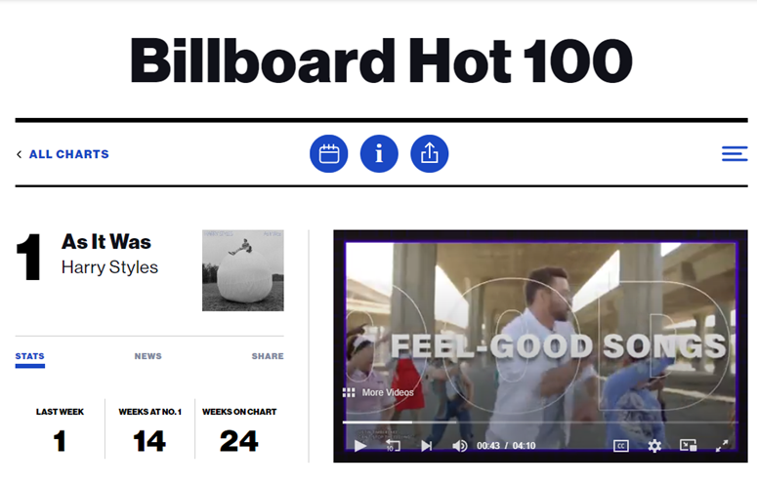
Models
Logistic Regression
Good for binary prediction (hit or not hit)
Decision Tree / Random Forest
Augments Logistic regression due to better non-linear data performance
Naïve bayes
Supervised algorithm that is effective with a small training set

Slide 5
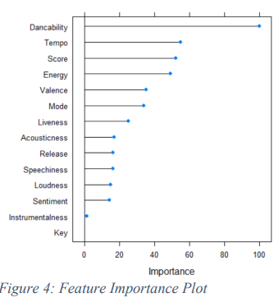
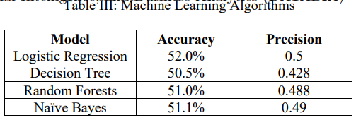
Results
Sentiment Analysis
No statistically significant difference between sentiments of hit songs vs non-hit songs
Machine Learning Models
550 training, 88 testing
Used k-fold validation, 48/52 split of hit/non hit in training set
Overall, no model had an accuracy above 52%
Feature importance showed the “danceability” of a song was important in determining if it became popular

Slide 6
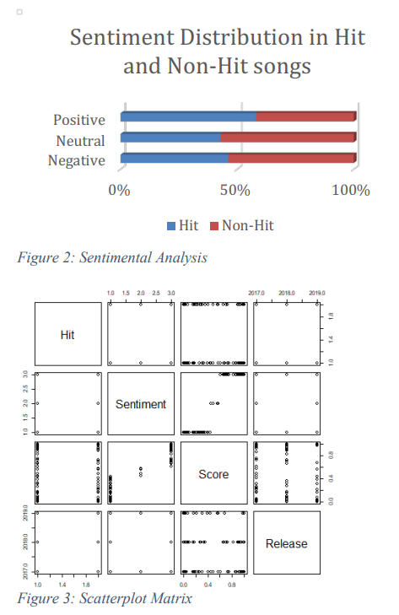
Findings
Based on this data, there is not a magic formula for the prediction of hit songs based on apriori
Sentiment analysis showed lyrics do not impact if a song will be popular

Slide 7
Criticism
Any song that makes it onto the billboard top 100, is already popular
Looking at number 90 from this month, the YouTube video alone has 40 million hits
Billboard top 100 is typically pop/hip hop genre, may want to diversify their sample of music
No inclusion of artist popularity prior to release
Drake releasing a new song is more likely to be a Billboard top 100 hit than Job for a Cowboy
Poor use of visualizations, did not help get point across

Slide 8
What did I learn? (Applicability)
Project Related
Fun Facts
Lyrics don’t impact popularity (for pop music)
Spotify API provides useful metadata for songs
I would expect the importance plot to shift for different genres of music
Ensure a large sample set of varying genres / artists / etc
Other studies that analyzed the popularity of a song after it became popular, showed the song itself had little impact on the likelihood of it becoming a hit. The dominant predictor was marketing strategy (social media, twitter comments, etc).

Slide 9




Thank you

