Slide 1
REST, CRUD, AND HTTP REQUESTS

Slide 2
WHAT IS AN API?

Slide 3
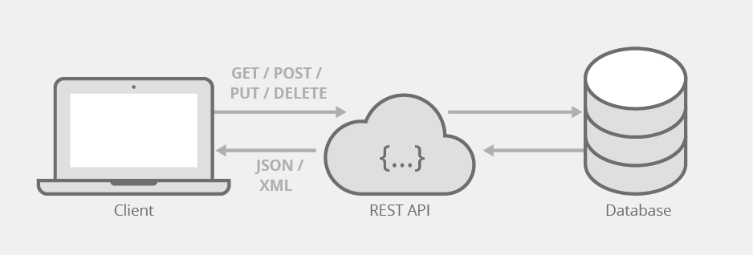
Stands for Application Programming Interface
Way for applications to communicate with a backend
The connector between back and frontend

Slide 4
HTTP REQUESTS

Slide 5
Way to communicate with API
Contains:
Destination
Method (GET,POST,PUT,DELETE…)
Headers (Extra information)
Returns a status code that indicates success
Grouped by hundreds (ex. 100-199, 200-299, …) To classify groups of status codes
Will learn more about specifics of HTTP throughout course

Slide 6
REST ARCHITECTURE

Slide 7
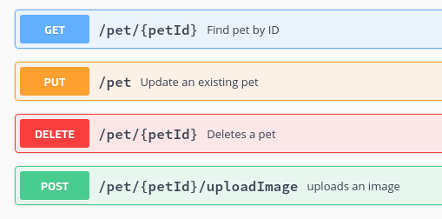
Stands for Representational State Transfer
Way of organizing an API; referred to as an “architecture”
Primarily uses GET, POST, PUT, and DELETE operation
Gets and returns data in some standard format, usually JSON

Slide 8
CRUD

Slide 9
Stands for Create, Read, Update, Delete
Operations used to interact with data in database
Primary operations of REST API; each associated with specific HTTP method
Create: POST
Read: GET
Update: PUT
Delete: DELETE

