Slide 1
Improved Morphological Feature Vector
convert the 3D point cloud into a “signature model” describing the cloud
Previous work is similar:
  Construct spin images for every point in the cloud
  Randomly sample subset from each cell
  Use clustering technique to find centroids
  Centroids become 'words' that describe cell
  For every point in cell, find nearest word and count

Slide 2
Improved Morphological Feature Vector
convert the 3D point cloud into a “signature model” describing the cloud
New work is similar:
  Construct spin images for every point in the cloud
  Randomly sample subset from each cell
  Use a Gaussian mixture model to find mean, covariences, and priors
  Using these parameters, for each cell's spin images, build Fisher Vector

Slide 3
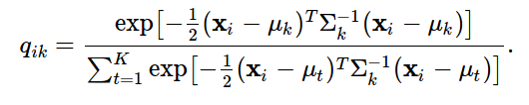
Fisher Vector
Let I = (x1,…,xN) be a set of D dimensional feature vectors (e.g. SIFT descriptors)
Let Θ = (μk, Σk, πk:k=1,…, K) be the parameters of a Gaussian Mixture Model fitting the distribution of descriptors.
The GMM associates each vector xi to a mode k in the mixture with a strength given by the posterior probability:

Slide 4
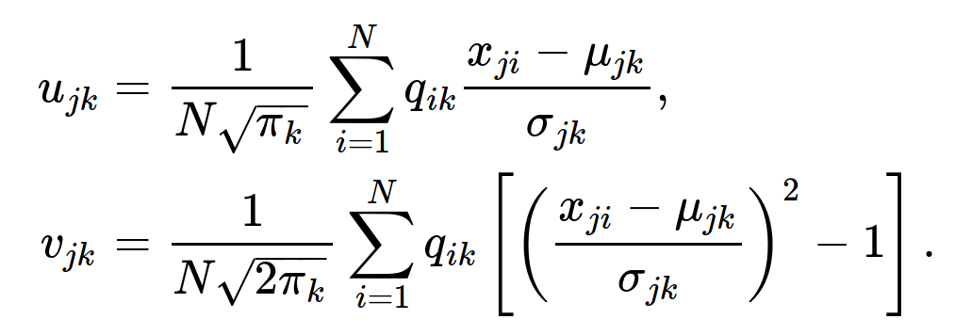
Fisher Vector
For each mode k, consider the mean and covariance deviation vectors:
where j = 1,2,…,D spans the vector dimensions.

Slide 5
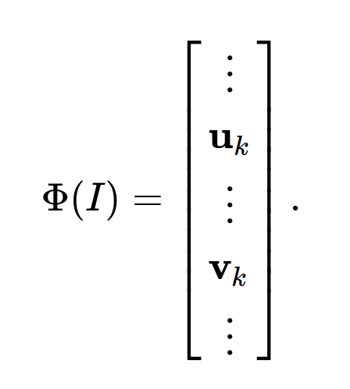
Fisher Vector
The FV of cell I is the stacking of the vectors uk and then of the vectors vk for each of the K modes in the Gaussian mixtures:

Slide 6
Current Results
SVM – classification
56 cells previously used for BoW experiment (2 failed)
Selected only 30 clusters for GMM
  Need to search for ideal parameter

