Slide 1

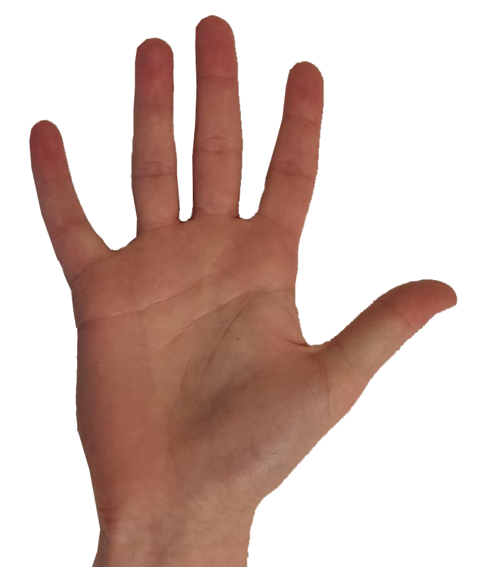
1
2

Slide 2

Tone
Image
Response

Slide 3
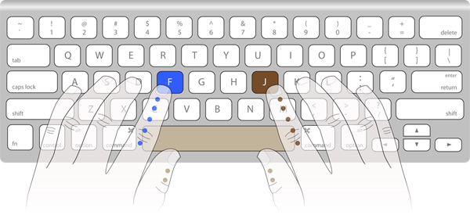

Slide 7
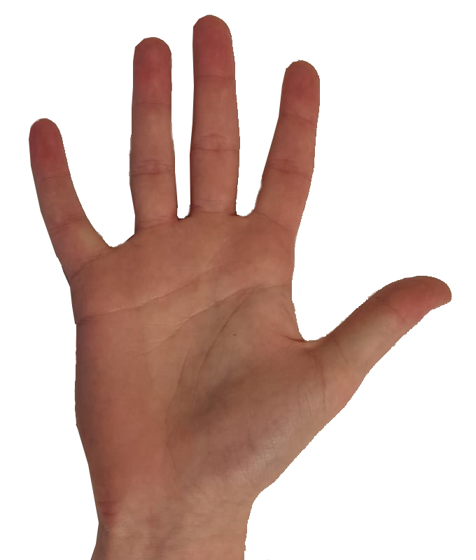
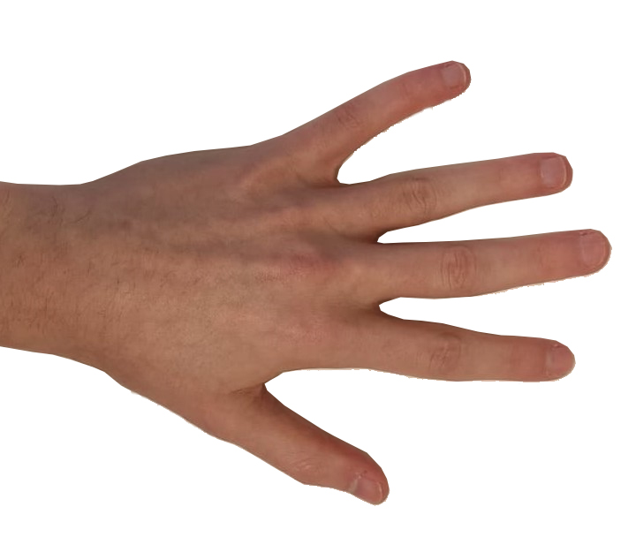

Slide 8
On time
Too early
Too late
No response

Slide 9
On time
Too early
Too late
No response

Slide 10
BOTH

Slide 12


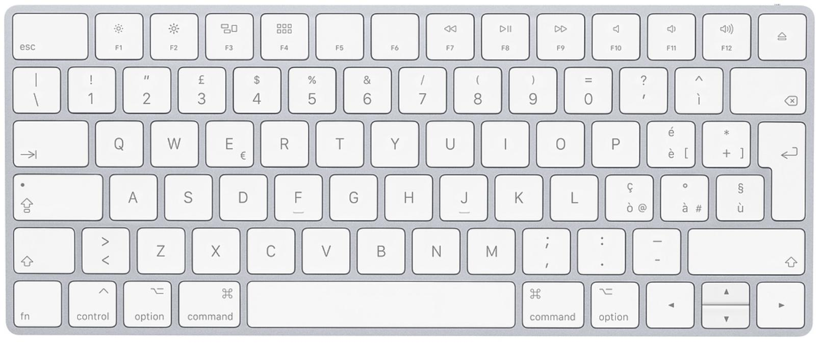
J
K

Slide 13
D
F

