Slide 1
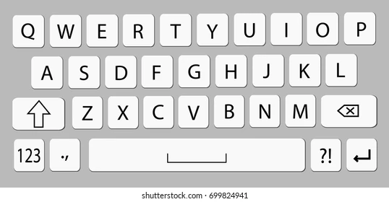

S
L
S
L

Slide 2


Slide 3


+

Slide 4



