Slide 1


Slide 2
What it is ?
Git (/ɡɪt/)[8] is a distributed version control system[9] that tracks changes in any set of computer files, usually used for coordinating work among programmers who are collaboratively developing source code during software development. Its goals include speed, data integrity, and support for distributed, non-linear workflows (thousands of parallel branches running on different computers).[

Slide 3
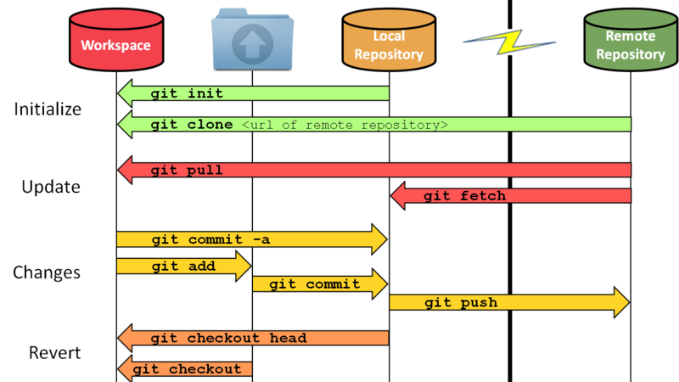

Slide 4
Sample Commands
git init ( to start repository )
git remote add origin https://github.com/mmoro75/TrainingPython.git ( add remote to your local repository )
git remote get-url origin ( chek remote repository )
git pull origin main ( pull from main branch)
git status ( check if there is any change on the repository )
git add . ( add the new file )
git commit -m "comment" ( commit the cnages )
git push origin master
git branch <branch name> create a new branch
git checkout < branch name> switch branch
git log ( see all commits for the repository)
git log --oneline ( see commits history semplified)
git merge <branch name you want to merge"
git revert HEAD ( revert previous )
git revert HEAD~x ( x number of steps back)

Slide 5
Download and Install GIT
https://github.com/git-guides/install-git
Install Git on Windows
Navigate to the latest Git for Windows installer and download the latest version.
Once the installer has started, follow the instructions as provided in the Git Setup wizard screen until the installation is complete.
Open the windows command prompt (or Git Bash if you selected not to use the standard Git Windows Command Prompt during the Git installation).
Type git version to verify Git was installed.
Note: git-scm is a popular and recommended resource for downloading Git for Windows. The advantage of downloading Git from git-scm is that your download automatically starts with the latest version of Git included with the recommended command prompt, Git Bash . The download source is the same Git for Windows installer as referenced in the steps above.

Slide 6

Jenkins is an open source automation server. It helps automate the parts of software development related to building, testing, and deploying, facilitating continuous integration, and continuous delivery.

Slide 7
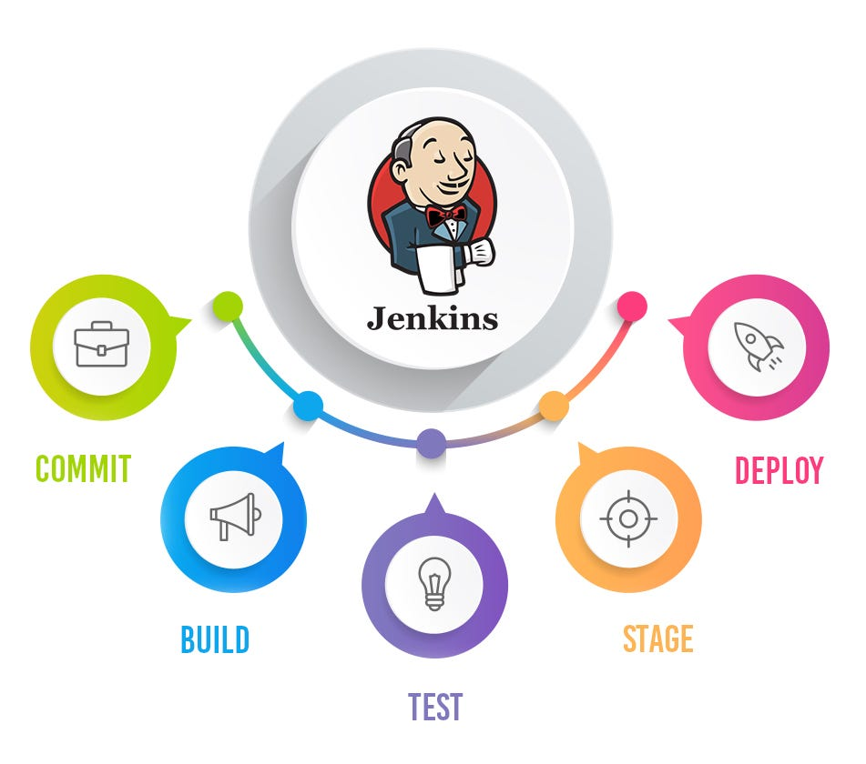

Slide 8
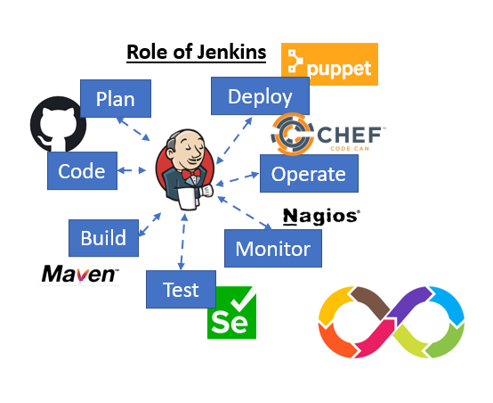

Slide 9
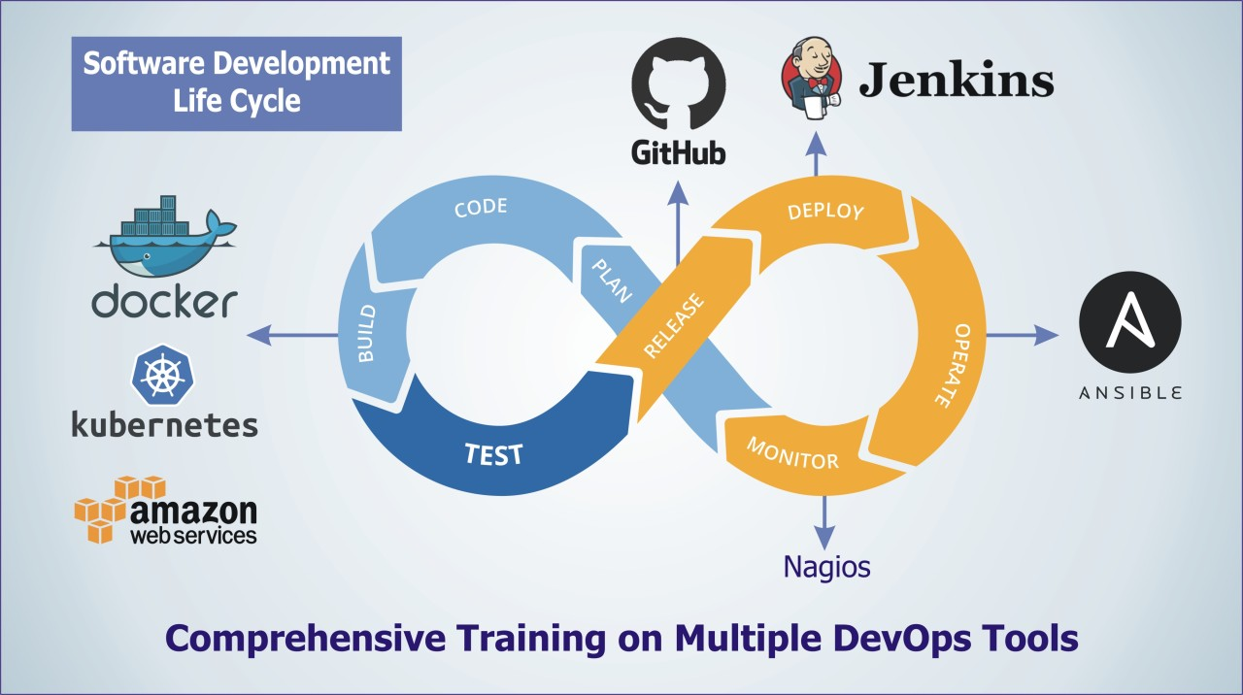

Slide 10
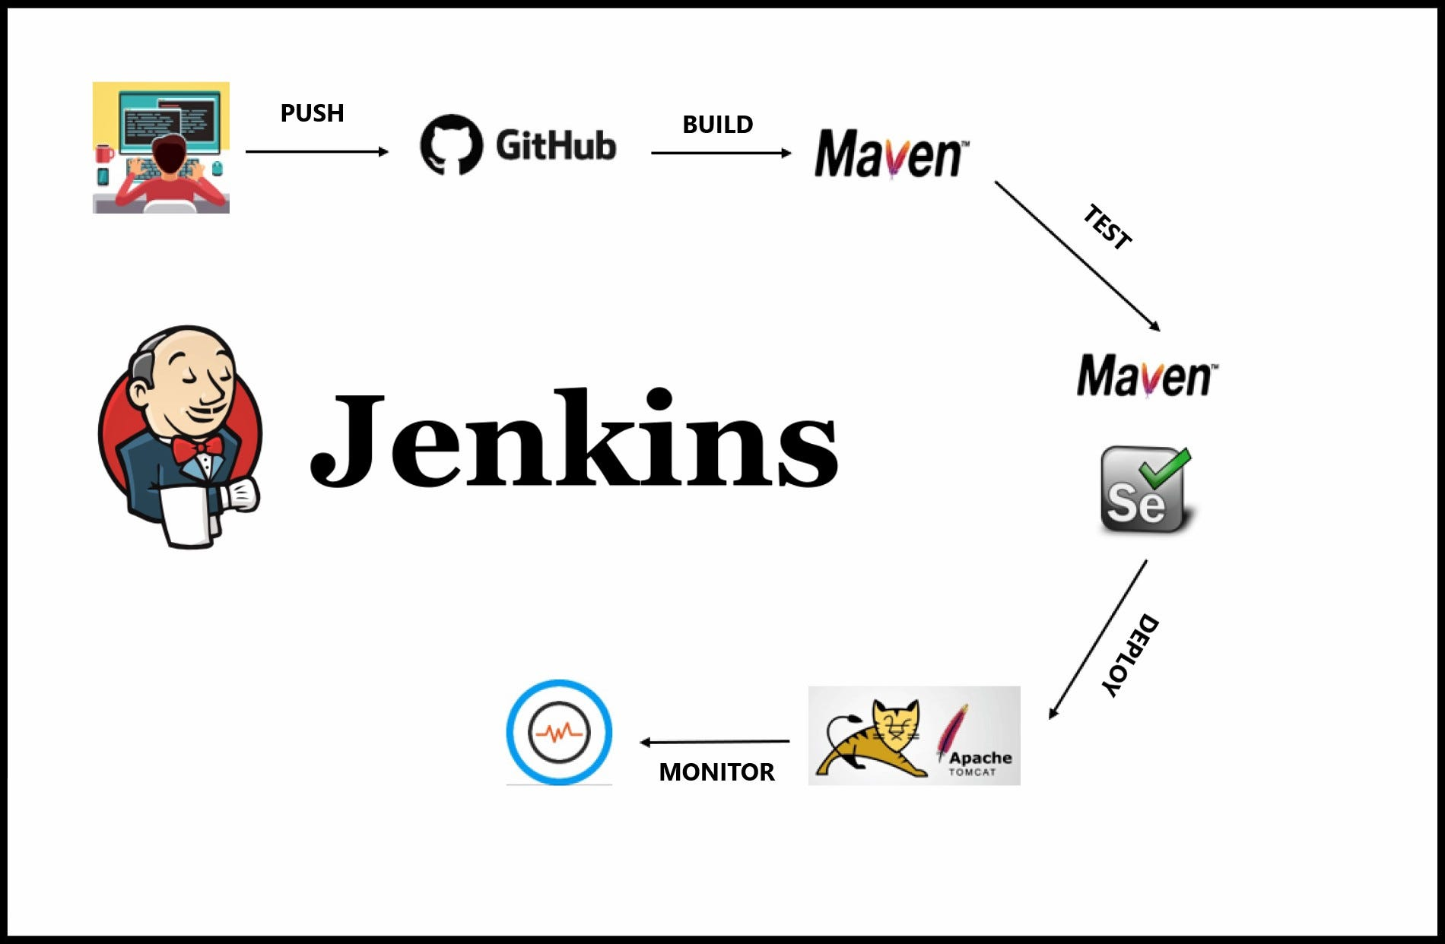

Slide 11
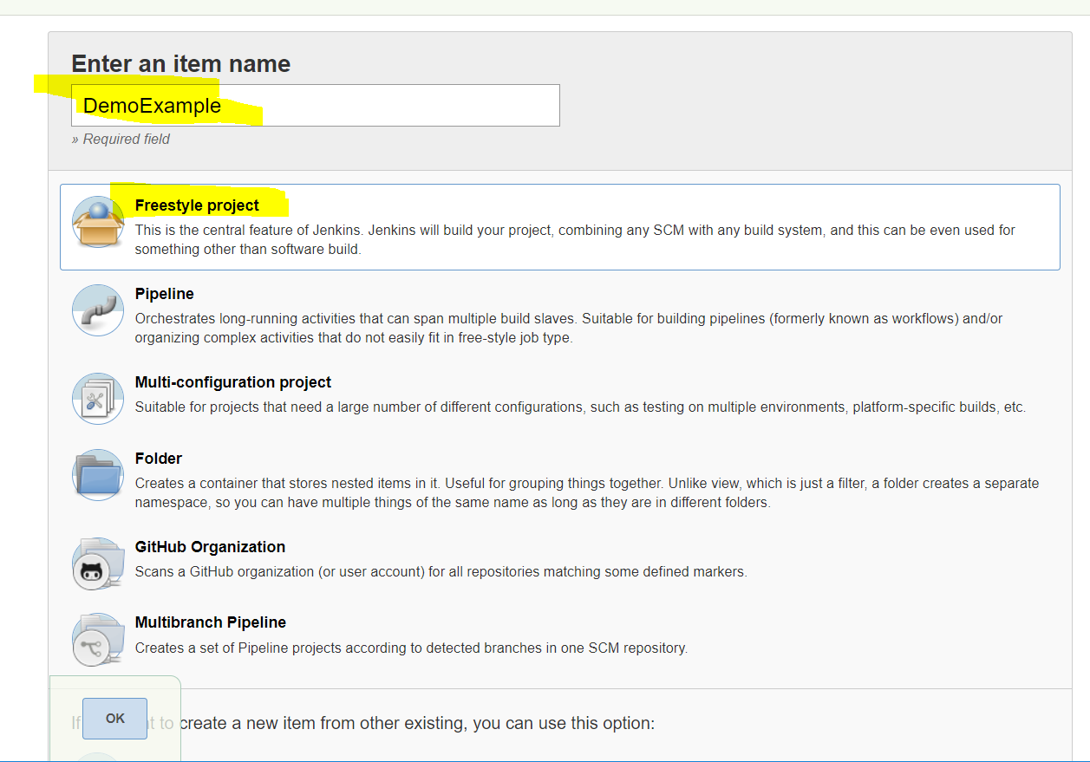
Jenkins Jobs Menu

Slide 12
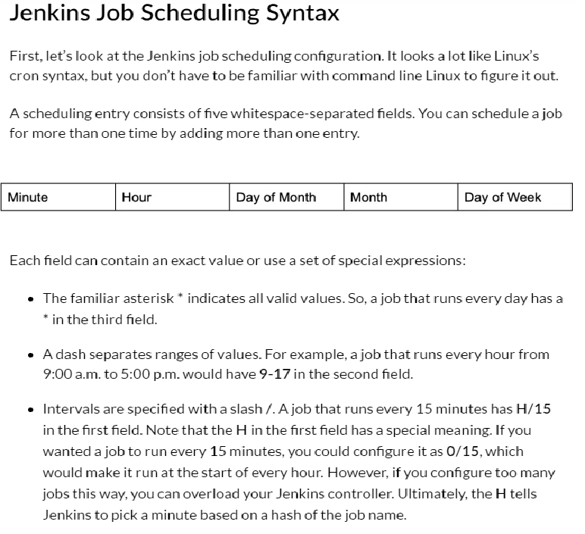
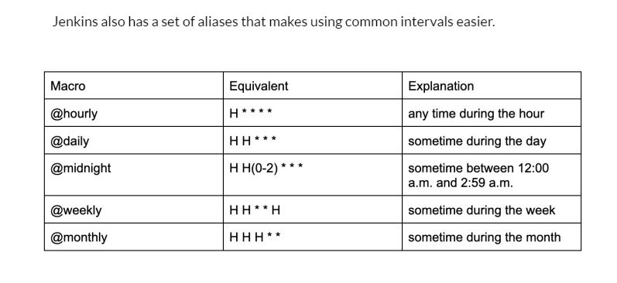
Jenkins Scheduling

