Slide 1
Python
Training

Slide 2
Literally nothing is impossible. When there is a will, there is always a way
Буквально немає нічого неможливого. Коли є бажання, завжди є спосіб

Slide 3
Download and Install Python – GIT and PyCharm
Download Software at:
https://lsegroup.sharepoint.com/teams/RefinitivSoftwareRepository/
Installation instructions as can be found at:
https://phoenixnap.com/kb/how-to-install-python-3-windows

Slide 4
Object Oriented Programming Languages
What is object-oriented programming?
Object-oriented programming (OOP) is a computer programming model that organizes software design around data, or objects, rather than functions and logic. An object can be defined as a data field that has unique attributes and behavior.
OOP focuses on the objects that developers want to manipulate rather than the logic required to manipulate them. This approach to programming is well-suited for programs that are large, complex and actively updated or maintained. This includes programs for manufacturing and design, as well as mobile applications; for example, OOP can be used for manufacturing system simulation software.
The organization of an object-oriented program also makes the method beneficial to collaborative development, where projects are divided into groups. Additional benefits of OOP include code reusability, scalability and efficiency.
The first step in OOP is to collect all of the objects a programmer wants to manipulate and identify how they relate to each other -- an exercise known as data modeling.
Examples of an object can range from physical entities, such as a human being who is described by properties like name and address, to small computer programs, such as widgets.
Once an object is known, it is labeled with a class of objects that defines the kind of data it contains and any logic sequences that can manipulate it. Each distinct logic sequence is known as a method. Objects can communicate with well-defined interfaces called messages.
What is the structure of object-oriented programming?
The structure, or building blocks, of object-oriented programming include the following:
Classes are user-defined data types that act as the blueprint for individual objects, attributes and methods.
Objects are instances of a class created with specifically defined data. Objects can correspond to real-world objects or an abstract entity. When class is defined initially, the description is the only object that is defined.
Methods are functions that are defined inside a class that describe the behaviors of an object. Each method contained in class definitions starts with a reference to an instance object. Additionally, the subroutines contained in an object are called instance methods. Programmers use methods for reusability or keeping functionality encapsulated inside one object at a time.
Attributes are defined in the class template and represent the state of an object. Objects will have data stored in the attributes field. Class attributes belong to the class itself.

Slide 5
GIT – Repository
Clone the existing repository
git clone https://github.com/mmoro75/TrainingPython.git
git remote get-url origin ( check remote repository )
git push origin main ( try sync your local to remote)
user name = ( your user name )
password = (token to be provided separately )

Slide 6
examples of object-oriented programming languages
popular pure OOP languages include:
Ruby
Java
Python
C++
Visual Basic .NET
PHP
JavaScript

Slide 7
The First program, Hello World!!
# This program prints Hello, world! in PYTHON
print('Hello, world!’)
// This program prints Hello, world! in Java
class HelloWorld {
public static void main(String[] args) {
System.out.println("Hello, World!");
}
}

Slide 8
Python Variables
There are different types of data types in Python. Some built-in Python data types are:
Numeric data types: int, float, complex
String data types: str
Sequence types: list, tuple, range
Binary types: bytes, bytearray, memoryview
Mapping data type: dict
Boolean type: bool
Set data types: set, frozenset

Slide 9
Numeric Data Type
Python numeric data type is used to hold numeric values like;
int - holds signed integers of non-limited length.
long- holds long integers(exists in Python 2.x, deprecated in Python 3.x).
float- holds floating precision numbers and it’s accurate up to 15 decimal places.
complex- holds complex numbers. (https://www.python-engineer.com/posts/complex-numbers-python/)
Documentation at:

Slide 10
String Data Type
The string is a sequence of characters. Python supports Unicode characters. Generally, strings are represented by either single or double-quotes.
name = "John Doe" # this is a string example
print(name)
name = "John " # String
age = 30 # Int
print(f"Hello, my name is {name} and I am {age} years old.")

Slide 11
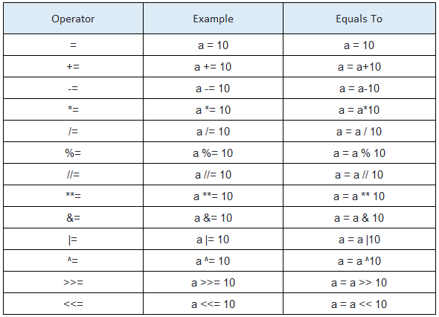
Assignment Operator Table

Slide 12
Conditional Statements
Conditional statements (if, else, and elif) are fundamental programming constructs that allow you to control the flow of your program based on conditions that you specify. They provide a way to make decisions in your program and execute different code based on those decisions.
Here's an example of how to use an if-else statement to check if a number is positive or negative:
num = -5
if num > 0:
print("The number is positive.")
else:
print("The number is negative.")

Slide 13
Loops in Python
There are two types of loops in python: for loop and while loop. For loops are used to iterate over a data structure or sequence of elements, such as a list, string, or dictionary, and execute a block of code for each element in the sequence.
While Loop in Python
In Python, a while loop is used to execute a block of statements repeatedly until a given condition is satisfied. When the condition becomes false, the line immediately after the loop in the program is executed.
While Loop Syntax:
while expression:
statement(s)
For Loops
For loops are used for sequential traversal. For example: traversing a list or string or array etc. In Python, there is “for in” loop which is similar to foreach loop in other languages. Let us learn how to use for loop in Python for sequential traversals with examples.
For Loop Syntax:
for iterator_var in sequence:
statements(s)

Slide 14
Modules in Python
module is a file containing python definitions and statements, that means a module contains python class, functions and variables.
a module can help to compile your code by reusing already defined logics for specific features you want to develop
the key word "import + module name " give you access to predefined classes, functions and variables defined in modules’
In python we already have pre-defined modules ( access them with “help(“modules”) they are called default modules
External modules are called third party modules and they can be dowloanded by using pip
Documentation @ https://docs.python.org/3/py-modindex.html

Slide 15
Import Modules with Python
import modulename (to import all the content from the module modulname into the script program )
modulname.modulevariable) ( to access the content type modulename."the name of what you want to access defined in module in this example modulevariable)
##### method - 1 direct import ########
from math import * ( from math module import all by using star)
print(pow(3,2)) (in this occasion you can access the functions pow directly without specifying module name first)
########## method 2 import only what is needed from module with “from” ########
from math import pow (with the from import we are only importing power function needed from maths)
from math import pi,pow (or we can import multiple functions together with single line)
####### method 3 import as alias ######################################
import math as m (you can create alias name and use the functions by using the alias names to simplify the code)
print(m.pow(3,2)) (now you are using m in your script to access maths functions)

