Slide 1
Tech Talk
Matt Morris
Data Scientist

Slide 2
Agenda
What is Data Science/NLP
Soft Power Project Background
Technical Approach
Techniques & Lessons Learned

Slide 3
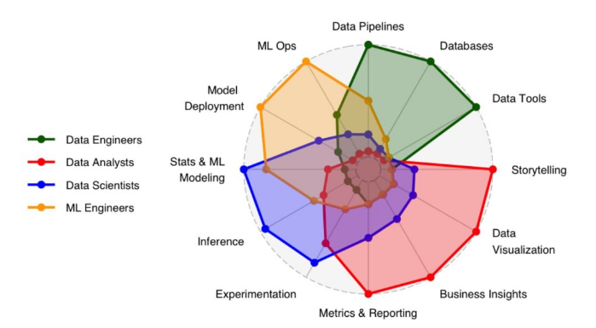
What is Data Science? The practice of using data through collection, processing, statistical analysis, and machine learning to generate knowledge, predictions, and data informed decisions.
Data Scientist
Focus: Models, algorithms, and inference
What they do:
Build predictive and prescriptive models (e.g., machine learning, NLP, forecasting).
Design experiments (A/B tests), validate hypotheses statistically.
Work heavily with Python/R, Jupyter, and ML frameworks (scikit-learn, PyTorch, etc.).
Transform business problems into mathematical ones and extract insights from complex, unstructured data.
Often deploy models via APIs or dashboards, sometimes partnering with data engineers for production.
Core tools: Python/R, SQL, Jupyter, TensorFlow/PyTorch, pandas, NumPy, scikit-learn, MLflow, Databricks.

Slide 4
Natural Language Processing (NLP)
The branch of data science and artificial intelligence focused on enabling computers to understand, interpret, and generate human language, both written and spoken.
The field has shifted from rule-based NLP → statistical NLP → neural NLP → large language models (LLMs).
Today, transformer-based models (BERT, GPT, T5, Llama, etc.) dominate, using massive corpora to learn contextual understanding rather than hand-crafted features.

Slide 5
Key NLP Terms
Named Entity Recognition (NER) | Identifying and classifying proper nouns in text (e.g., recognizing “France” as a country).
Text Classification | Categorizing text into predefined groups (e.g., news topics, spam detection).
Summarization | Generating a shorter version of text while keeping the main ideas intact.
Translation | Automatically converting text from one language to another.
Vectorization | The process of converting text into numbers that models can understand.
Embedding | A numerical representation of words or sentences that captures their meaning for computers to process.
Token | A small piece of text—often a word, part of a word, or punctuation mark—that a model processes.

Slide 6
Soft Power Project Background
Main Goal: Automate the categorization of soft-power articles according to a custom schema to replicate a customer built dashboard tracking soft power influence across their AOR.
Economy
Social
Diplomacy
Military
2. If possible:
Apply sub-category labels
Extract Acting and Recipient countries
Extract Project Names and descriptions
Extract funding references
Notes:
How much we can automate to make the process of keeping the soft power tracking database current as efficient as possible.

Slide 7
Approach
1. Assess the feasibility of using pretrained models:
zero-shot classification and standard entity extraction models
GAI models such as GPT-3.5, GPT-4, Llama2, and Llama3 models.
If these approaches proved insufficient, we would then utilize external labelers to enable the development of a custom classification model.
Notes:
Given the significant time and costs associated with annotating the necessary number of samples to train a custom extraction and classification model, we first explored approaches that utilized pretrained models. The rationale was that pretrained models, having been trained on large and diverse datasets, might already incorporate relevant concepts of soft power, thereby reducing the need for extensive custom annotation.
Zero-shot learning refers to the ability of a model to categorize or understand content it hasn't been explicitly trained on. This approach could potentially categorize articles into wide, overarching categories of soft power without needing detailed, topic-specific training.
The adaptive nature of GAI enhances both its efficiency and cost-effectiveness. By reducing the need for frequent retraining and updates, GAI minimizes operational costs and resource expenditure associated with model maintenance.

Slide 8
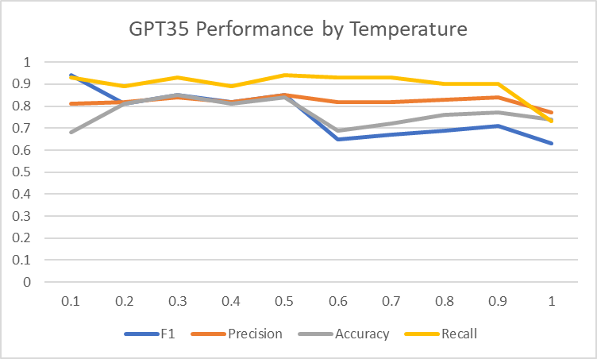
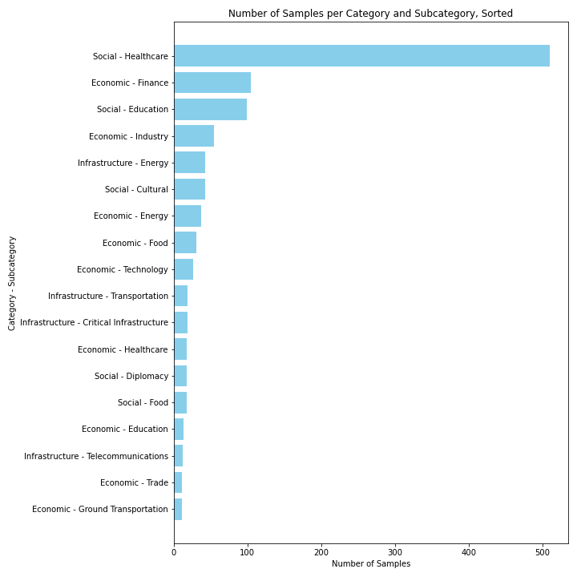
Prompt Experimentation
Conducted iterative prompt experiments using the GAI Workbench testing the effects of adjustments to language, output requirements, and hyperparameters on performance at a smaller scale.
Tested alternative GAI models (Llama2, Lama3)
Notes:
In collaboration with Kris’ team, I took the initial work they did and started to do iterative experiments with different prompt language for each of the soft power tasks.
Building off WEG work using GPT 3.5
Context. Verbose vs Concise
Temperature
Across main tasks on small individual documents in GAI Workbench

Slide 9
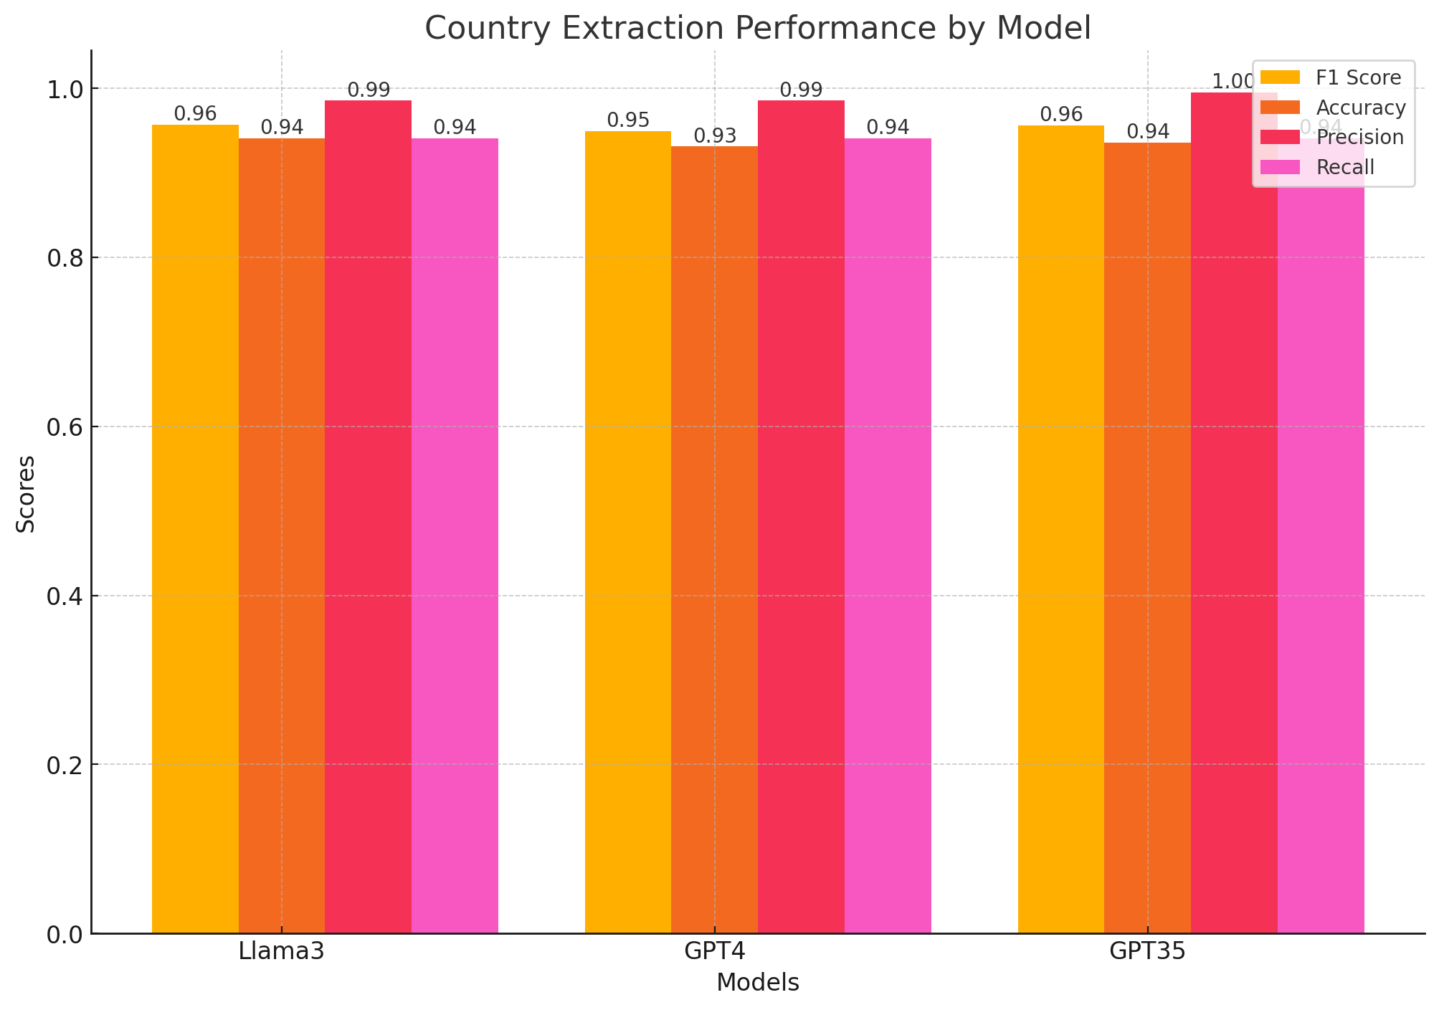
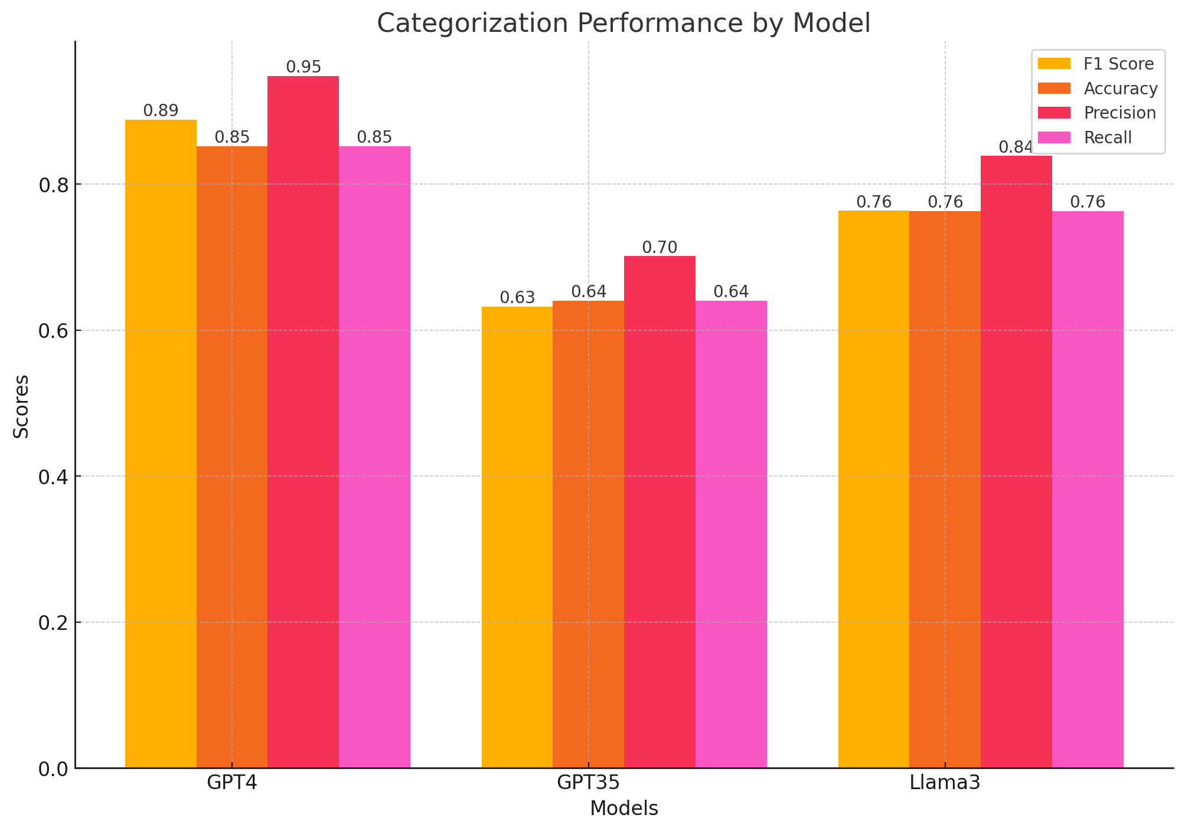
Categorization and Extraction (GCDF)
Using GCDF’s schema we tested the ability of the GAI model to interpreting a labelling schema in its prompt and apply it to a dataset without any prior training
Using the top 3 models, a prompt was designed to categorize a GCDP sample of 300 documents, broken into an even distribution of 20 documents per category, according to the W&M schema seen in the ‘Sector Name’ field.
GCDF Labels:
'EMERGENCY RESPONSE’,
'HEALTH', 'GOVERNMENT AND CIVIL SOCIETY’,
'TRANSPORT AND STORAGE’,
'ACTION RELATING TO DEBT’,
'AGRICULTURE, FORESTRY, FISHING’,
'BANKING AND FINANCIAL SERVICES’,
'INDUSTRY, MINING, CONSTRUCTION’,
'EDUCATION’,
'GENERAL BUDGET SUPPORT’,
'COMMUNICATIONS’,
'WATER SUPPLY AND SANITATION’,
'TRADE POLICIES AND REGULATIONS’,
'DEVELOPMENTAL FOOD AID
'ENERGY'
Notes:
For this sample, GPT-4 with a .95 F1 score was very effective in correctly identifying the relevant categories, balancing both false positives and false negatives with a .99 precision score. LLaMA-3 also reach the high-performance level of GPT-4, and presents a viable open-source alternative.

Slide 10



Why Generative AI (GAI) Matters
Domain-specific AI models have been around a long time. How is GAI different?
SUPERVISED/TRAINED
MACHINE LEARNING MODELS
PROMPT AGAINST GENERAL
LARGE LANGUAGE MODELS (GAI)
Build Time
6 MONTHS
1 HOUR
Build Cost
$10000s
$1s
Run Cost
$0
$100s (decreasing quickly)
Mod Agility
Delayed, rigid
Immediate, flexible
Performance
Pretty good for specific task
Really good for many tasks
Use Difficulty
Data engineer/scientist
Anyone who can type (and think)
User Rating
“Not thrilled with the output or having to pay more & wait months for you to make it a little better.”
“Pretty good output and love that I can improve it or add something new myself in less than 1 hour.”

Slide 11
Generative AI (GAI) Capability Spectrum
The risk of inaccurate output and adverse effects of model bias increases as you move to the right.*
Soft Power Project
GAI Prompts
Event
Tagging
Text
Summary
Sentiment
Tagging
Findings
Composition
Intent
Analysis
Prediction/
Forecasting
FACTUAL Less Creative, Lower Risk
ANALYTIC
More Creative,
Higher Risk
Salience
Tagging
Quote
Extraction
Thematic
Categorization
Rhetorical
Scoring
* The placement of tasks on the spectrum are approximations that assume
an optimized prompt with a moderate scope running against validated
data—not simply generated outputs from the model's training dataset.

Slide 12
GAI Workflow Lifecycle
Phase 1 – Exploration & Experimentation
Run small-scale PoCs with CompassAI/Workbench or sandbox environments.
Test prompt designs, evaluate output quality, and document caveats.
Establish early human-in-the-loop validation checkpoints.
Phase 2 – Implementation into Development Pipeline
Programmatic integration of GAI via API into dev workflows.
Refine model selection by task; optimize latency and cost.
Deploy supporting infrastructure (vector DBs, observability, monitoring).
Demonstrate value at scale (tens of thousands of samples).
Apply governance & risk management frameworks across the pipeline.
Phase 3 – Maintenance & Evaluation
Continuously update prompts and workflows as new requirements emerge.
Monitor for model drift, data quality issues, and compliance risks.
Introduce feedback loops from user edits or analyst corrections to improve models.
Periodically evaluate against benchmarks and update documentation.
Phase 4 – Distillation & Specialization
Fine-tune SLMs or student models on production-generated datasets.
Build lightweight, domain-specific models for efficiency and portability.
Retire or replace outdated models with updated baselines.
Continue human validation and governance oversight.

Slide 13
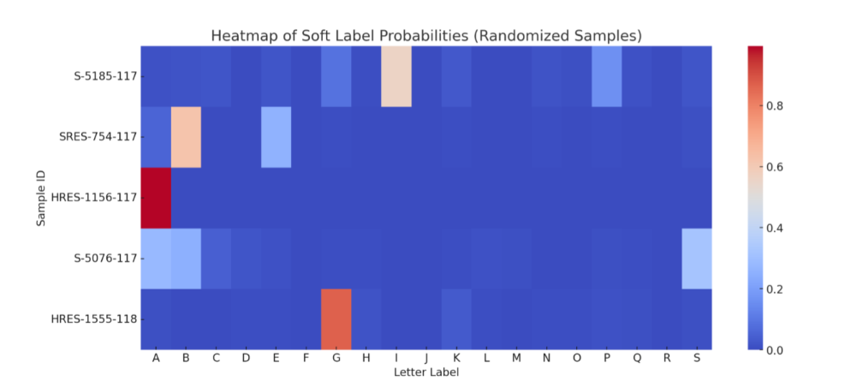
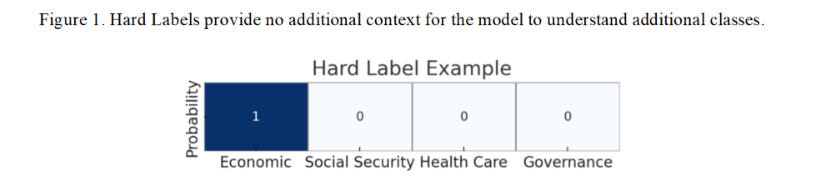
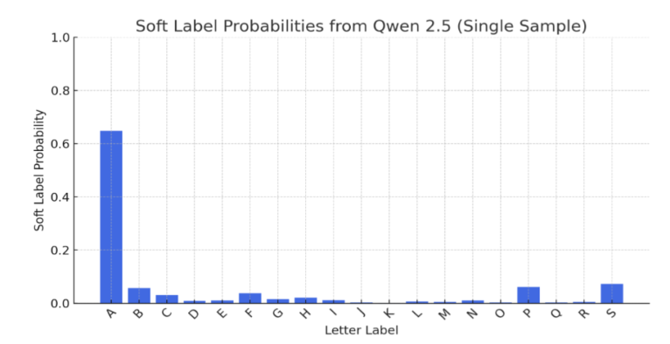
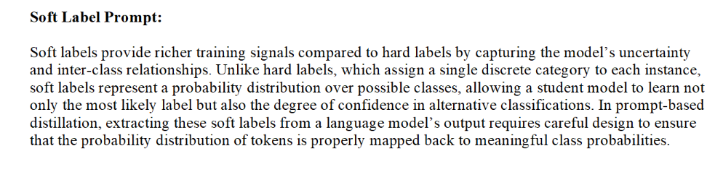
Knowledge Distillation (Classification)

Slide 14
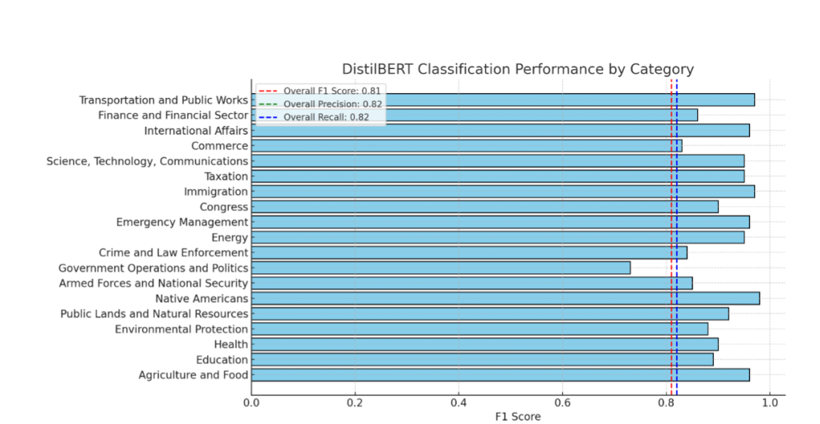
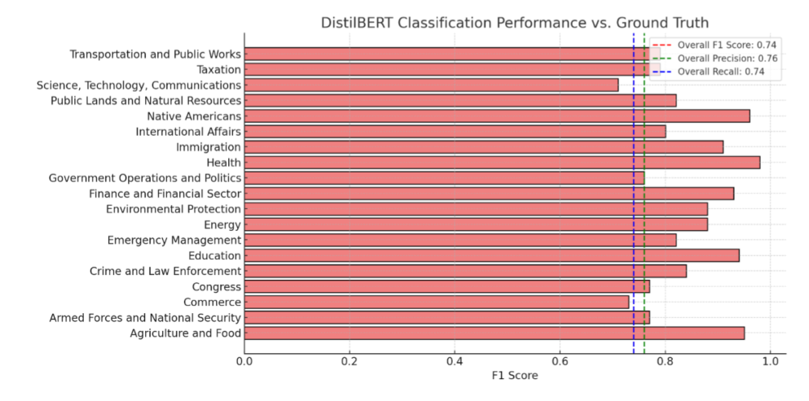
Knowledge Distillation (Cont’d)
When evaluated against GPT 4o’s synthetic labels, our DistilBERT student achieved an overall F1 score of 0.81—closely matching the teacher’s performance with both precision and recall at 0.82. Performance varied by topic, for example Transportation and Public Works led the pack (F1 ≈ 0.97), followed by International Affairs, Science & Technology, and Agriculture & Food (all > 0.95), while Government Operations & Politics was the most challenging category (F1 ≈ 0.71). Across 19 Congressional topics, the student model sustained high accuracy (15 categories > 0.80).

Slide 15
Inputs
backend
front end
Hard Target Project & Event Index
Status tracking of hard target SP projects and events of interest
Hosted
Dashboard
Deep dive on analytics, data quality, and sourcing
Collections
GAI
Salience & Extraction Runs
DS&R
Storage
Post-Processing
Softpower DB (pgvector)
Document Metadata
Monthly/Weekly Overview
Publication
Distributed to Community for SA
Activity Aggregation
GAI Extractions
Daily/Monthly/WeeklyAggregation
Unique Activity Abstracts
Daily/Weekly/Monthly Abstracts
Dynamic interactions with SP data via prompts
Distilled Text Embedding
GAI Extraction Data
Soft Power Agent UI
Event Embeddings
Project Embeddings
("all-MiniLM-L6-v2")
Document and GAI Extractions data are parsed
Distilled texts are grouped and summarized using GAI
Unique Event & Project identification
Project & Event Summary Updates using GAI
Unique Soft Power Event Index
Analytics dashboard (streamlit)
Summary Publications
Research and Insight development via Agentic UI

Slide 16
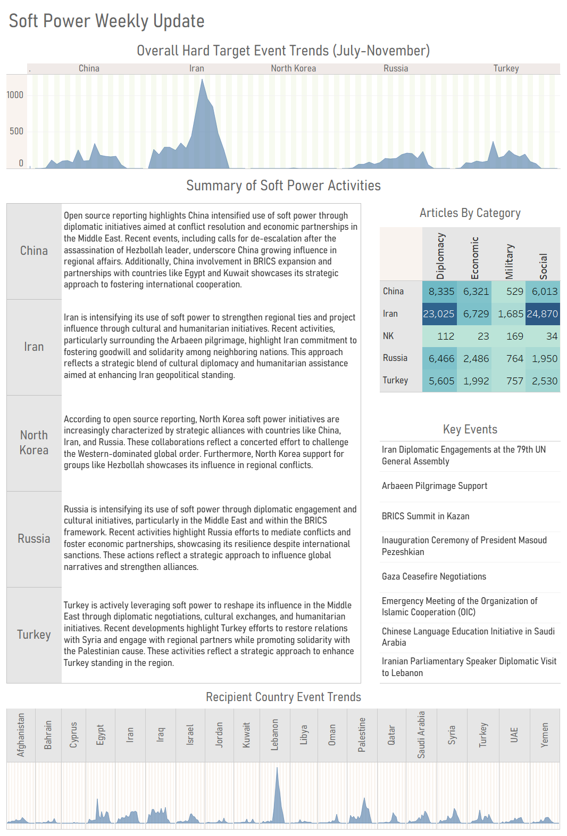

Slide 17
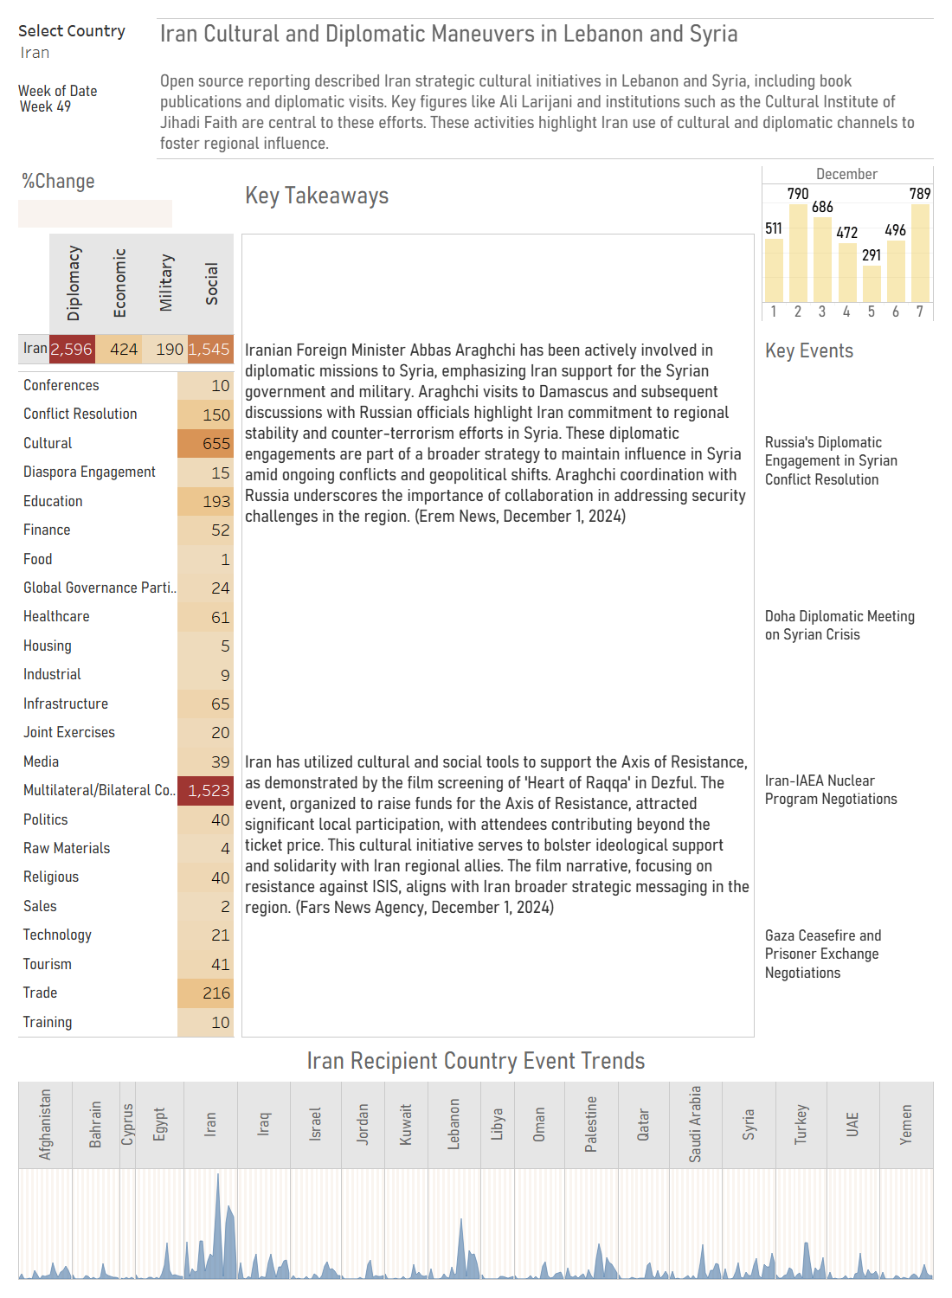
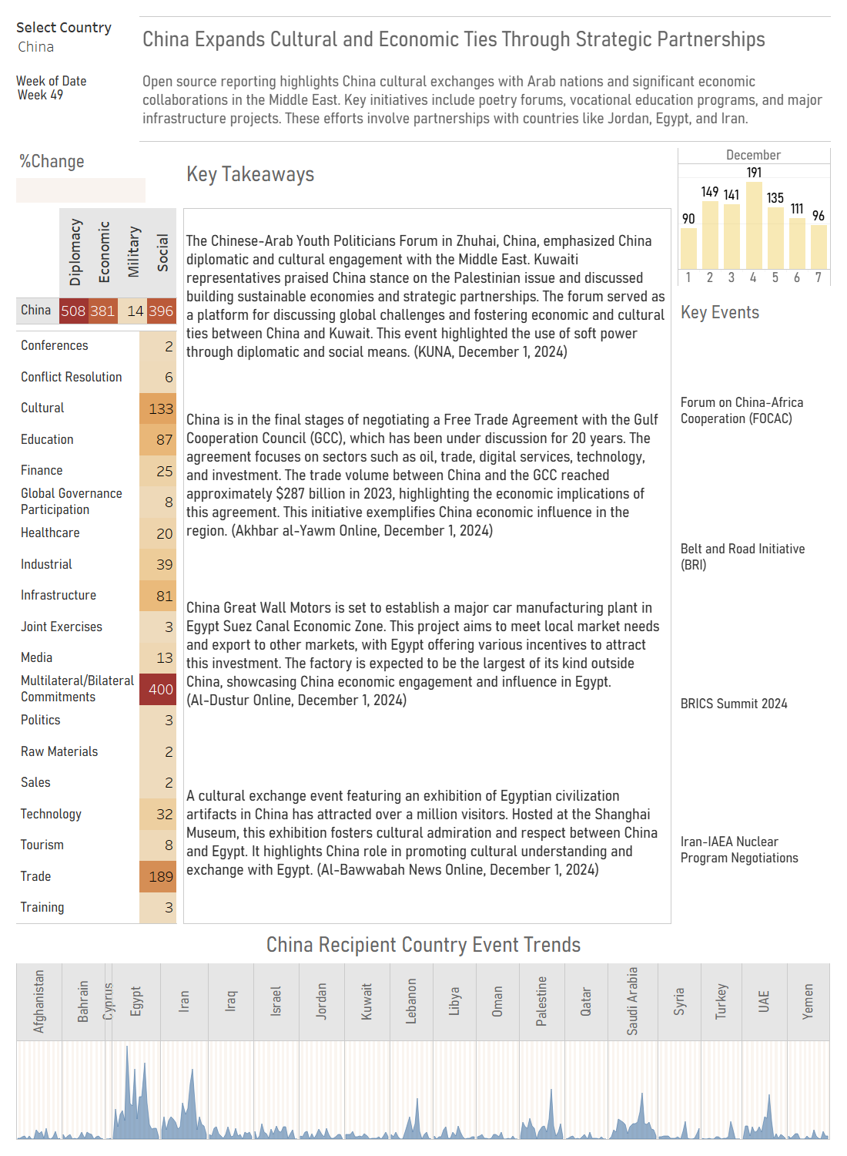

Slide 18
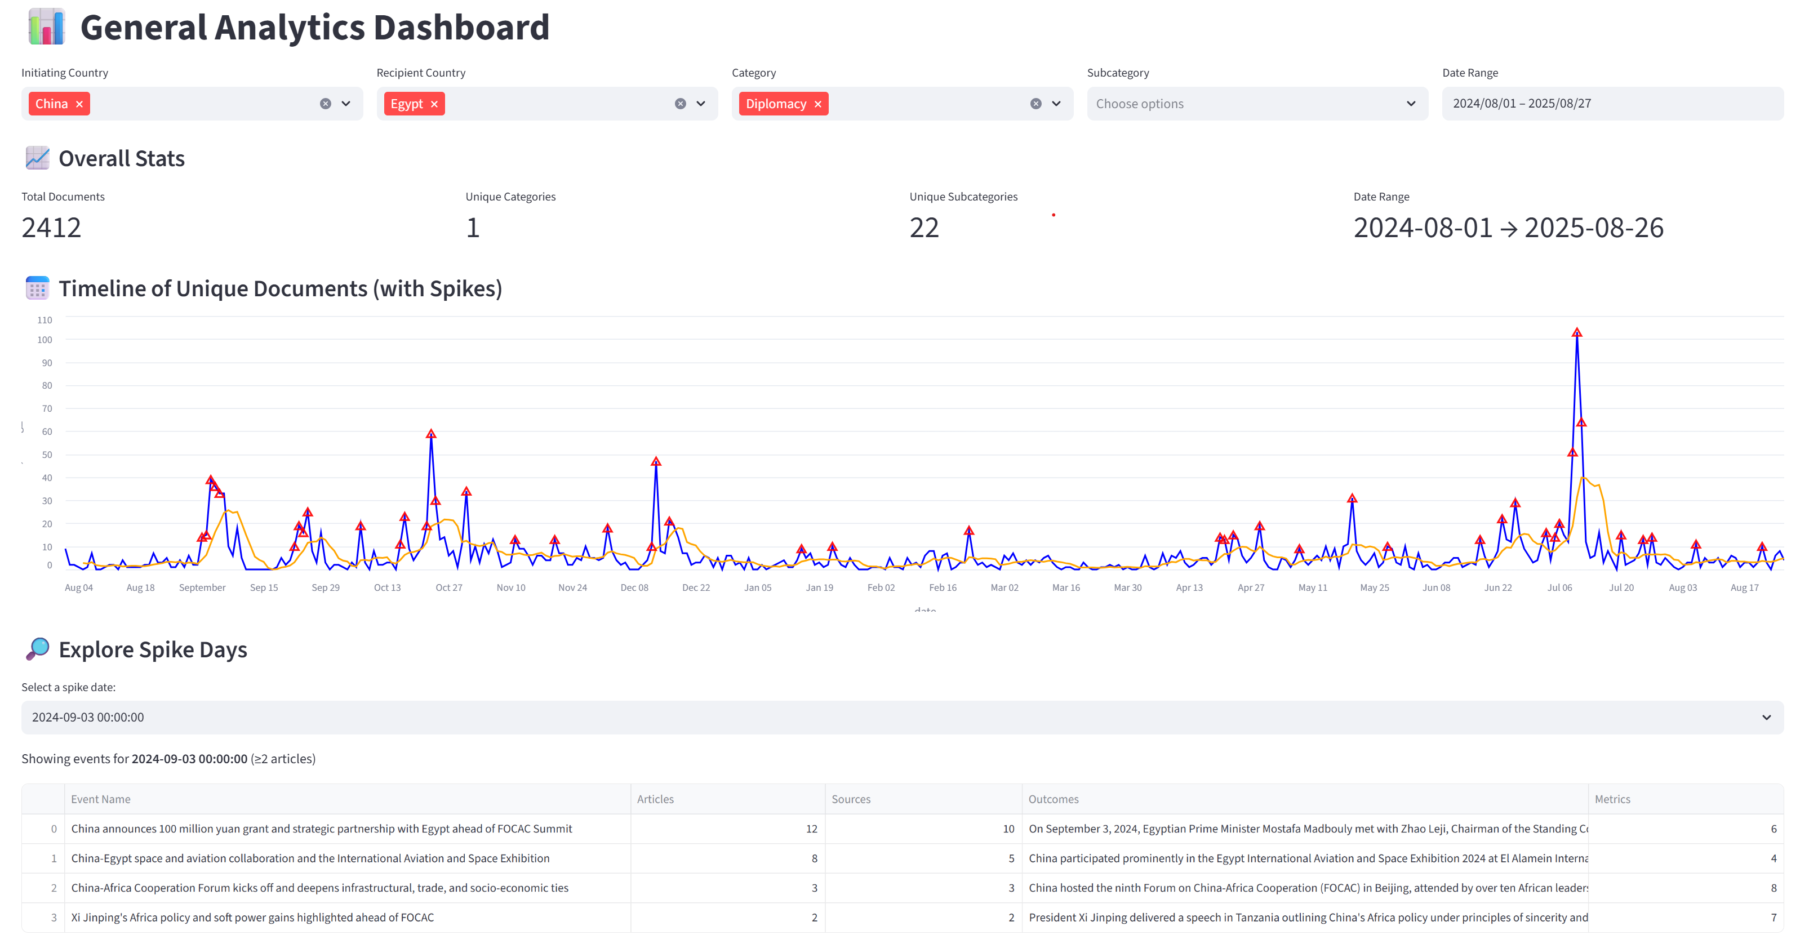

Slide 19
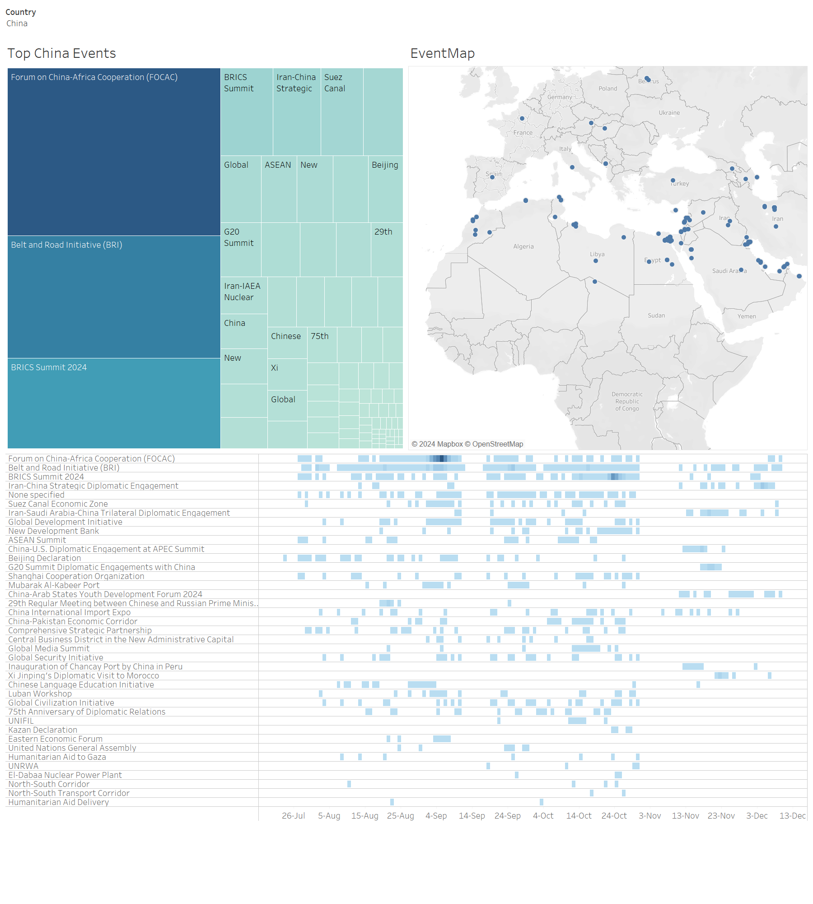

Slide 20
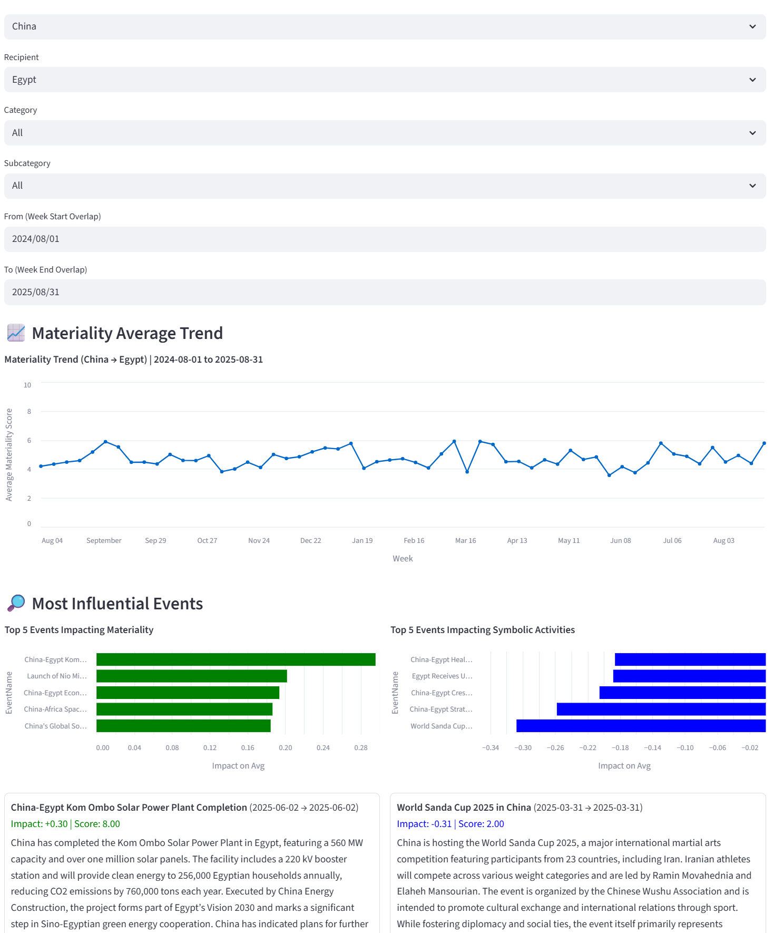

Slide 21



Slide 22
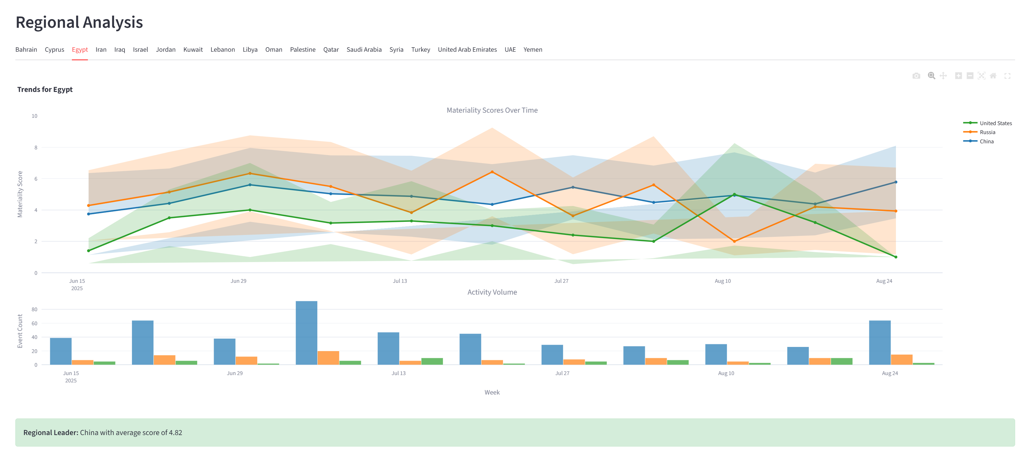

Slide 23
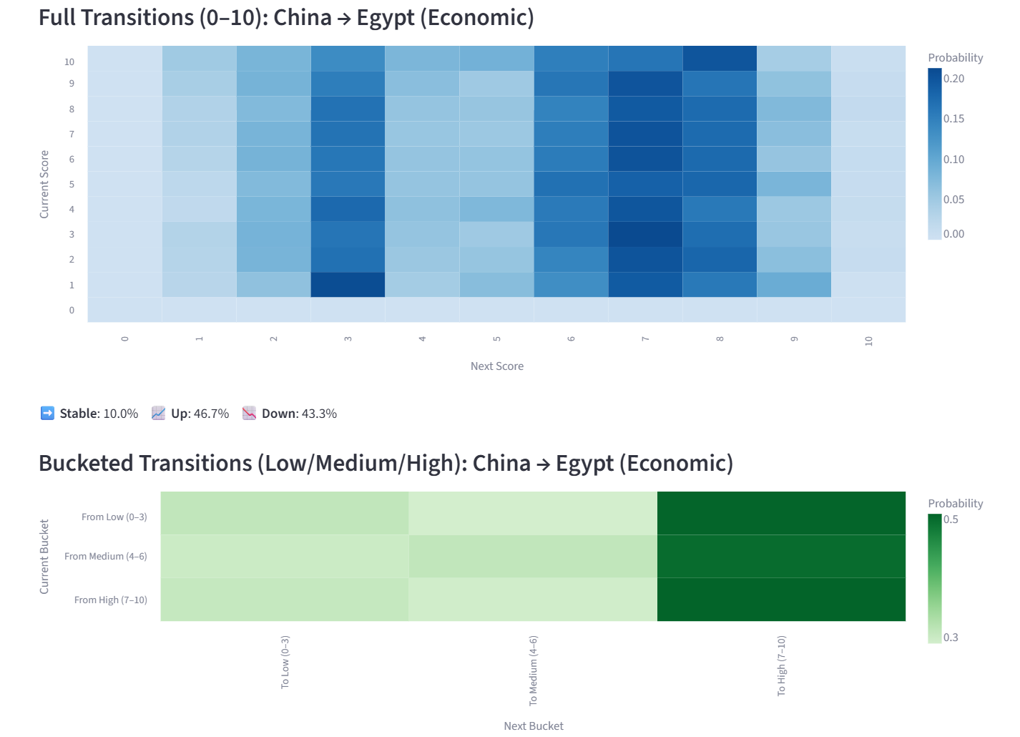

Slide 24
Challenges
Limited ability to provide consistent scoring metrics (material vs symbolic, sentiment) implementing agentic internal review steps
Understanding “quality” vs “relevant” source.
Temporal context of events (upcoming vs occurred)

Slide 25
Techniques & Lessons learned
Model Strategy & Cost Optimization
Matched model to task:
GPT-4o-mini → salience filtering
GPT-4o → full extraction
GPT-4.1 → deduplication, sourcing, clustering
Open-source embeddings (MiniLM-L6-v2) for chunking & retrieval reduced token costs.
Scalable High-Signal Artifacts
Distilled texts into signal-only summaries for model efficiency.
Daily → Weekly → Monthly roll-ups provided scalable and traceable insights.
Used proxy identifiers to avoid token overflow from long UUIDs.
Output Structuring & Formatting
Enforced JSON schemas for reliable machine-readable output.
Prompt precision mattered — quotation style, placeholder use (<initiating_country>).
Embedding markdown metrics/charts in prompts boosted ranking task accuracy.
Sourcing & Claim Verification
Split summarization from sourcing to improve citation fidelity.
Applied TF-IDF narrowing before model claim sourcing.
Deduplication consolidated events while preserving all underlying sources.
Context Window Managment
Preprocessing, chunking, clustering reduced raw reporting overload.
Deduplication avoided event inflation from redundant coverage.
Tiered summarization ensured detailed enrichment only for high-volume events.
Human-in-the-Loop & Governance
Analysts validated high-stakes events and anomalies.
Risk controls prevented unchecked propagation of hallucinated content.

