Slide 1
Content-based Music Retrieval System
Team B
Eduardo Hernandez Almanza
Richard Degenfellner
Jonas Peche

Slide 2
Dataset Music4All-Onion
Lyrics
Tf-idf , word counts
Word2vec, word representation in vector space
BERT, Bidirectional Encoder Representations from Transfromers
Audio
Mel Frequency Cepstral Coefficients (MFFCs)
Essentia: An audio Analysis Library for Music Information Retrieval
Block Level Features (BLFs)
Video
VGG19 Very Deep Convolutional Networks For Large Scale Image Recognition
Inception v3 Deep Convolutional Neural Network architecture codename Inception
Resnet 13. Deep Residual Networks for Image Recognition

Slide 3
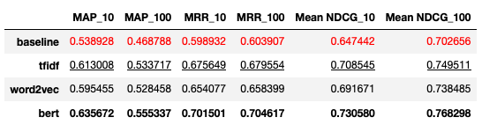
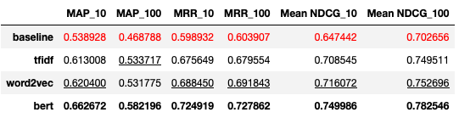
Individual Analysis of features - Lyrics
With Jaccard Similarity
With Cosine Similarity
LowerValue | SecondBestValue. | BestValue

Slide 4
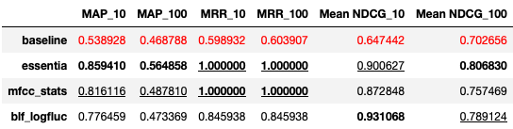
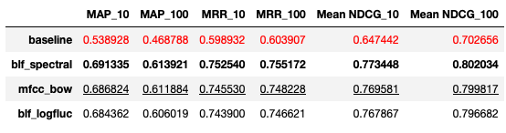
Individual Analysis of features - Audio
With Jaccard Similarity
With Cosine Similarity
LowerValue | SecondBestValue. | BestValue

Slide 5
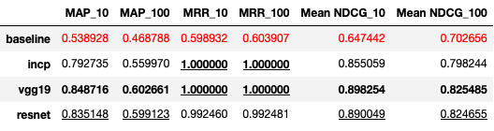
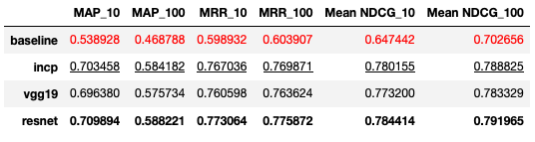
Individual Analysis of features - Video
With Jaccard Similarity
With Cosine Similarity
LowerValue | SecondBestValue. | BestValue

Slide 6
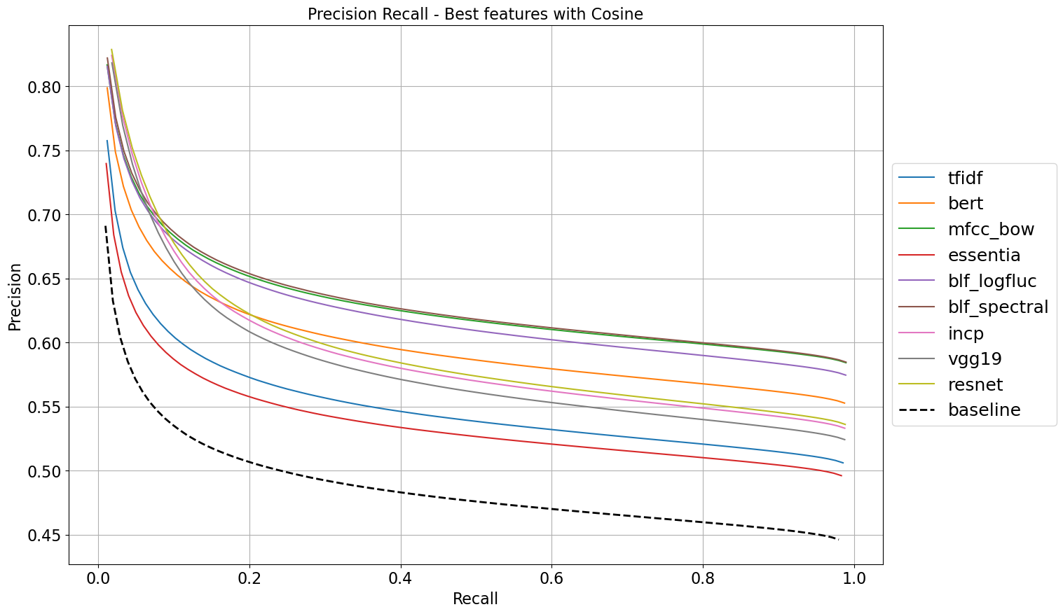
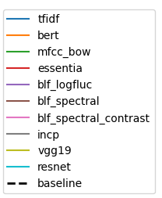

Slide 7
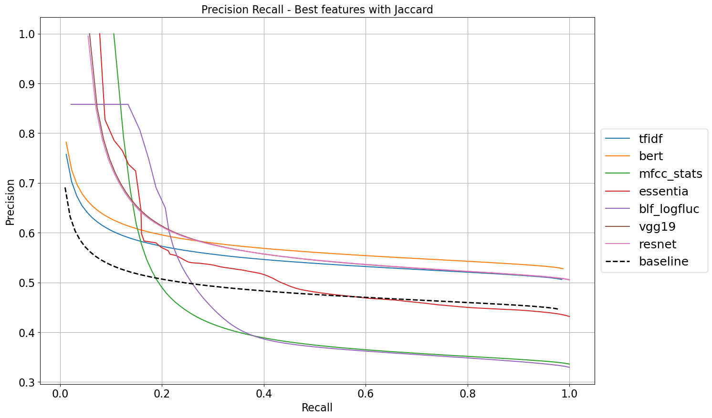

Slide 8
Selection of the best features
Cosine Similarity | Jaccard Similarity
Lyrics | Bert Tfidf
Audio | BLF spectral MFCC bow BLF loglfuc
Video | Resnet Incp
Jaccard Similarity | Jaccard Similarity
Lyrics | Bert Tfidf
Audio | Essentia BLF loglfuc MFCC stats
Video | Vgg19 Resnet

Slide 9
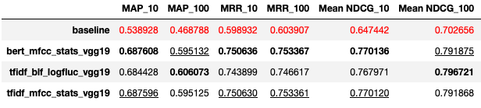
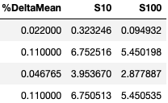
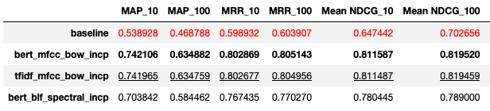
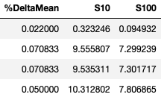
Early Fusion
With Jaccard Similarity
With Cosine Similarity
LowerValue | SecondBestValue. | BestValue

Slide 10
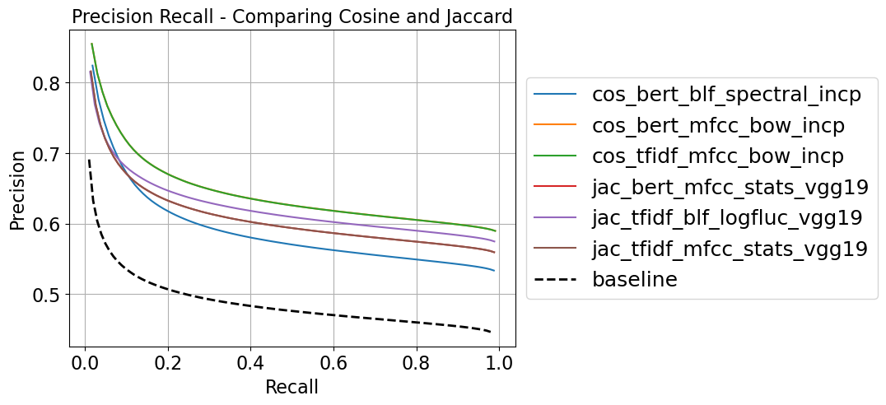

Slide 11
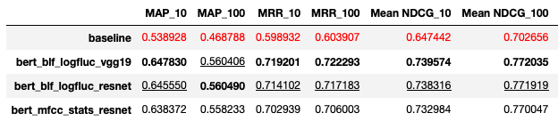
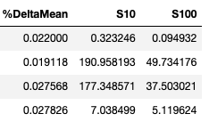
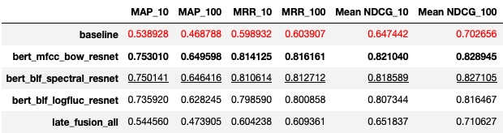
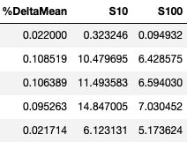
Late fusion
With Jaccard Similarity
With Cosine Similarity

Slide 12
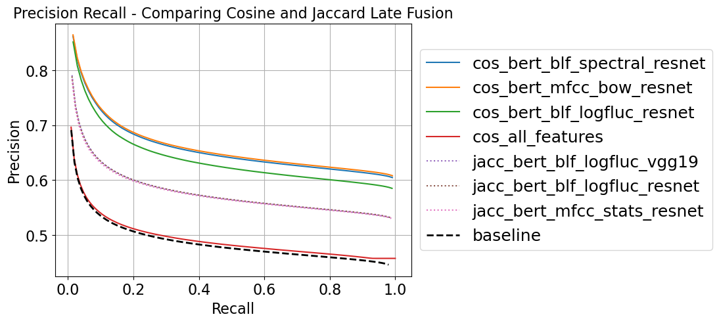
Slide of precision-recall comparing them

Slide 13
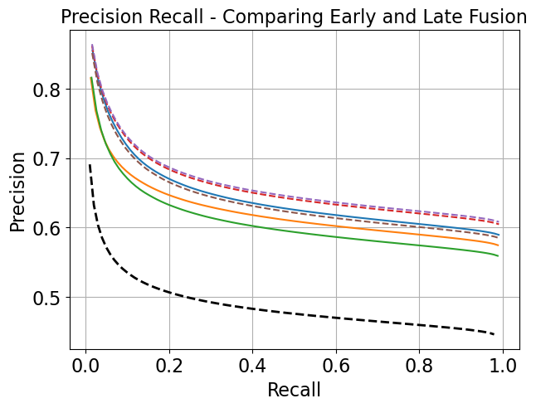
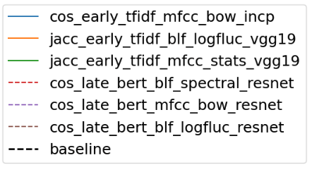

Slide 14
Demo
https://mmsr-app.vercel.app

